Slide 1
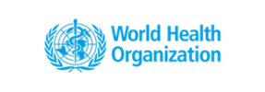
“The world can no longer afford to overlook the fundamentals*.”
Global Launch Webinar
December 2020
*Tedros Adhanom Ghebreyesus, Director-General, World Health Organization
Henrietta H. Fore, Executive Director, United Nations Children’s Fund
Notes:
Thank you Nurse Mary for that inspiring video. It really is a good introduction to this new global progress report on WASH in health care facililties, because it shows that water, sanitation, and hygiene, but also waste management and cleaning, are fundamental to delivering safe health services, and they can no longer be overlooked.
My name is Rick Johnston and I manage the WHO side of the WHO/UNICEF Joint Monitoring Programme for Water Supply, Sanitation and Hygiene, or JMP.

Slide 2
Outline of the session
PART 1
Latest data on access
PART 2
Country progress in implementing practical steps
Main recommendations
Notes:
Along with my colleague Maggie Montgomery, the lead author of this report, I’m going to introduce the report. I’ll start with an overview of the latest data on WASH in health care facilities, and then Maggie will talk about the actions that countries are taking to improve WASH in health care facilities, and what the main recommendations of the report are.

Slide 3
About the report
7 chapters
30 country case studies
1. About this report
New data from 165 countries
2. Putting fundamentals first
Data representing 794,000 health care facilities
3. Latest status of WASH services in health care facilities
4. Integration of WASH with energy and health programmes
4 recommendations & a renewed call to action
5. Country and regional progress
~100 contributing authors & reviewers
6. An investment opportunity
7. Where do we go from here?
Notes:
The report is divided into 7 main chapters, and there are also seven annexes with more detailed information. You can see the chapter topics here, and these represent contributions from around 100 authors and reviewers from both the WASH and the health sectors. I’ll be mainly talking about Chapter 3, with the data update on WASH services, and then Maggie will share some of the good examples from countries and regions in improving WASH in health care facilities. She’ll also describe an early financial analysis about how much it would cost to achieve universal basic WASH in health care facilities, and then share four recommendations that make part of a renewed call to action.

Slide 4
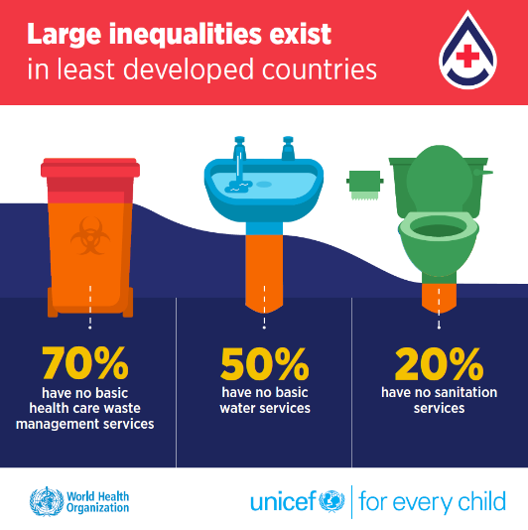
Part I
Latest data on access
Notes:
OK – part 1 on the data. These are produced and regularly updated by WHO and UNICEF through the Joint Monitoring Programme. We produced our first baseline report on WASH in health care facilities in 2019, and have now contributed a chapter to this 2020 update report. We will be updating the global database every two years, along with the databases on WASH in schools and WASH in households.
Here you can see some of the main messages about health care facilities in least developed countries, which have some of the most vulnerable health systems in the world. 70% lack basic health care waste management services, half lack basic water services, and 20% have no sanitation services at all.

Slide 5
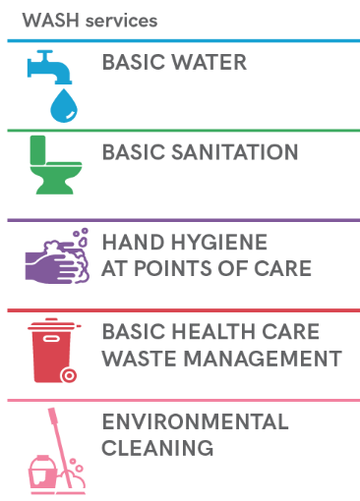
Basic WASH services
 | 2019 baseline | 2020 update
National data sources | 260 | 476
Countries with some data | 125 | 165
Health care facilities assessed | 560 000 | 794 000
Notes:
I want to start by explaining a bit where those numbers come from. When we speak of WASH in health care facilities, we’re talking about five distinct service areas: water, sanitation, hand hygiene, health care waste management, and environmental cleaning. For each of those service areas, we have defined what a basic service level means – and we’ll get into those terms and definitions shortly. But the point I want to make first is that for each of these services, we look for national sources of data. And that might be from a health facility assessment, or a routine data collection system like an MIS.
[CLICK]
The JMP published a first baseline report on WASH in health care facilities in 2019, and at that time we had 260 national data sources in the global database, representing assessments of 560,000 health care facilities from 125 countries.
Now the JMP has updated the global database, and just one year on we now have 476 national data sources, from 165 countries, drawing on data from 794 000 HCF.
[CLICK]
And you can see that from 2019 to 2020 we increased the number of countries that have estimates for basic WASH services, by about 50% depending on the service area. Basic water and basic health care waste management have relatively good data coverage, with over 50 countries having estimates. For sanitation and hand hygiene it’s more in the range of 20-30 countries, and there are only 12 countries with data on environmental cleaning.

Slide 6
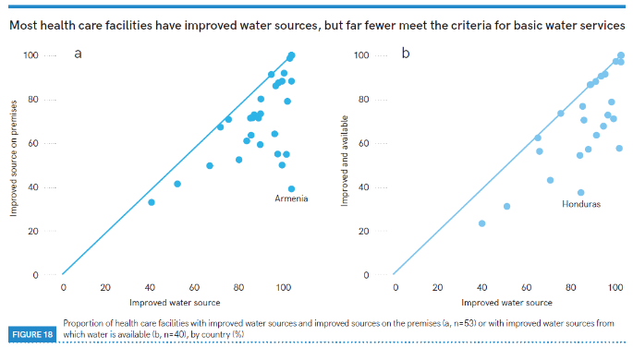
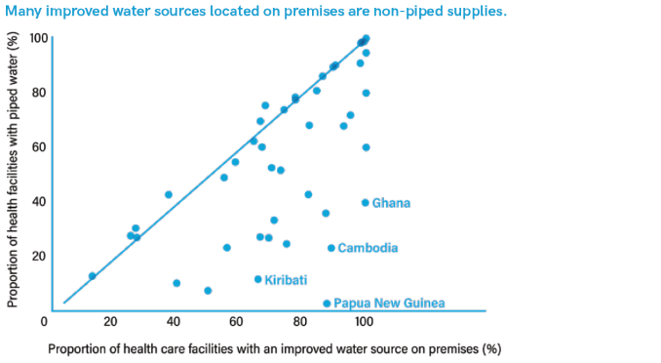
Water
Basic water service: Water is available from an improved source on the premises.
Notes:
So let’s look in more detail at the basic service levels and their definitions. For water, a basic service is defined as the HCF having water available from an improved source on the premises. It’s a pretty low bar. And here you see that about 76% of health care facilities globally meet this service level, that’s extrapolating from the 52 countries that had estimates of basic services. We also define lower levels of service: the yellow bar indicates what we call ‘limited services’ – health care facilities that meet some but not all of the requirements of the basic service. Maybe for example an improved water supply but one that is located off premises. Then in orange you see the health care facilities with ‘no services’, which means that they either used water from an unimproved source, or had no water source at all.
But you can take either a ‘glass three quarters full’ or ‘glass one quarter empty’ approach – it does mean that a quarter of the population, or 1.8 billion people lacked basic water services at their health care facilities. And that includes 1.1 billion who had a limited service and 712 million who had no water service at all.
[CLICK]
Now improved sources are fairly well established in the WASH world – this simply means water supplies that have some kind of sanitary protection, that includes piped water supplies, but also boreholes, and even protected wells, springs, and rainwater harvesting systems. But this graph shows that a lot of improved water sources are NOT located on premises, or do NOT have water that’s actually available when needed.
[CLICK]
And also it’s important to realize that a lot of improved water sources that ARE located on premises are not reticulated piped supplies. They might be boreholes, for example, or in Papua New Guinea most of the health care facilities have rainwater collection systems.

Slide 7
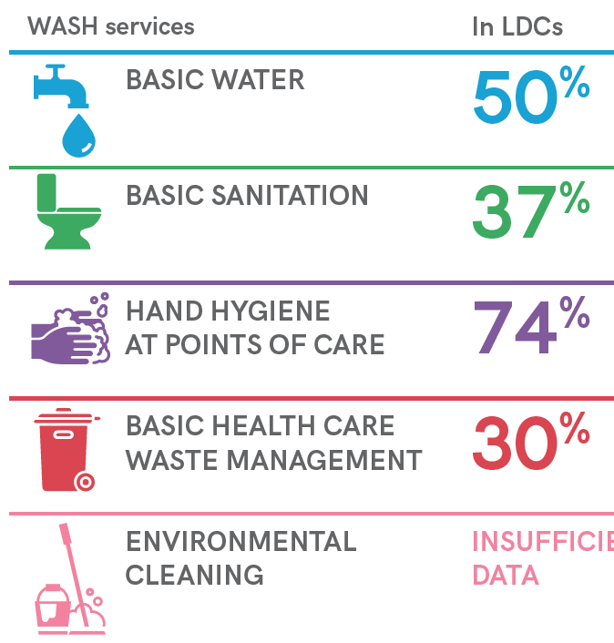
Sanitation
Basic sanitation: Improved sanitation facilities are usable, with at least one toilet dedicated for staff, at least one sex-separated toilet with menstrual hygiene facilities, and at least one toilet accessible for people with limited mobility.
Country | Facility | Improved | & Usable | & Dedicated for Staff | & Dedicated for Women | & Menstrual hygiene facilities | & Limited mobility | Basic
Kuwait | 100 | 100 | 100 | 100 | 100 | 100 | 100 | 100
North Macedonia | 100 | 100 | 100 | 100 | 100 | - | - | 100
Tokelau | 100 | 100 | 100 | 100 | - | 100 | - | 100
Montenegro | 100 | 100 | 100 | 100 | 100 | 100 | 85 | 85
Thailand | - | - | 96 | 92 | - | 81 | 97 | 61
Cook Islands | - | 80 | 80 | 60 | - | 80 | - | 60
Ethiopia | 96 | 76 | 76 | 71 | 59 | - | - | 59
Burundi | - | - | 76 | 72 | 48 | - | - | 48
Azerbaijan | 100 | 100 | 98 | 48 | 100 | 100 | - | 48
Brazil | 100 | 100 | 84 | 82 | - | - | 45 | 45
Mozambique | 99 | - | 72 | 43 | 62 | - | - | 43
Armenia | - | 81 | 62 | 87 | 42 | 42 | 41 | 41
Bangladesh | 96 | 94 | 36 | 98 | 84 | 31 | 38 | 31
Paraguay | 100 | 88 | 63 | 31 | 26 | - | - | 26
Nigeria | 97 | 49 | 49 | 80 | - | 50 | 17 | 17
Zimbabwe | 100 | 99 | 64 | 89 | 97 | 32 | 17 | 17
Guinea-Bissau | 100 | 100 | 48 | 68 | 32 | 17 | 24 | 17
Bhutan | 100 | 99 | 84 | 73 | 31 | 16 | 31 | 16
Lebanon | 96 | 83 | 83 | 70 | 59 | 31 | 16 | 16
Maldives | 100 | 100 | 99 | 80 | 15 | 30 | 57 | 15
Peru | 97 | 90 | 83 | 86 | 66 | - | 7 | 7
Serbia | 99 | 98 | 78 | 87 | 48 | 27 | 6 | 6
Rwanda | 100 | 99 | 91 | 16 | 31 | 6 | 6 | 6
Malawi | - | 93 | 77 | 20 | 40 | 3 | 44 | 3
Comoros | - | 51 | 38 | 43 | 9 | 2 | 7 | 2
Honduras | 100 | 96 | 84 | 78 | 70 | - | 1 | 1
Niger | - | 74 | 29 | 30 | 31 | 0 | 27 | 0
Notes:
The sanitation indicator is the most complicated one. A basic sanitation service is defined as the health care facility having improved sanitation facilities that are usable, but that also have toilets available for different types of users. There should be toilets dedicated for staff, and also sex-separated toilets with menstrual hygiene facilities, and at least one toilet accessible for people with limited mobility.
[CLICK]
Globally, only 27 countries had enough data to make an estimate for basic sanitation services, and that wasn’t enough to make a global estimate. More countries had enough data to report on the ‘no services’ level, which means that they either used unimproved sanitation facilities like pit latrines without a slab, or had no sanitation facilities at all. And we find that globally, in 2019, one in ten health care facilities had no sanitation service.
There were enough data from two SDG regions – Latin America and the Caribbean and sub-Saharan Africa – to make estimates for basic sanitation services. And also we could show that in least developed countries, only 37% of HCF in LDCs had a basic sanitation service in 2019.
[CLICK]
And here are those 27 countries, along with all of the elements of the basic sanitation indicator. The grey cells show that some data were unavailable, and for now we can still make a basic services estimate if one or two of the elements are missing. But what this table shows is that in different countries, different factors are the limiting factor for the basic services indicator. In Azerbaijan everything is near 100%, but less than half of health care facilities have toilets dedicated for staff. Frequently data on menstrual hygiene management show lower coverage than for other elements – see for example Bhutan with only 16% of health care facilities having menstrual hygiene facilities in women’s toilets. But even more frequently, health care facilities lack toilets that are accessible to people with limited mobility. Honduras is a good example of this – all of the other elements are 70, 80, 90%, but almost none of the toilets are accessible. And of all places, health care facilities are settings where people in wheelchairs, or people with difficulty moving due to other health problems, should be able to use the toilet.

Slide 8
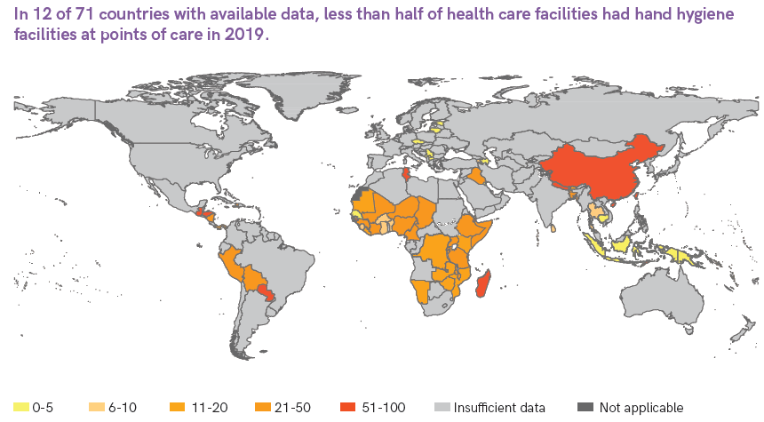
Hand hygiene
Basic hand hygiene: Functional hand hygiene facilities (with water and soap and/or alcohol-based hand rub) are available at points of care, and within 5 metres of toilets.
Notes:
Speaking of toilets, the basic hand hygiene indicator is a composite indicator – it calls for health care facilities to have functional hand hygiene facilities at points of care – where health care workers are interacting with patients – but also at or near toilets.
There currently isn’t a lot of data on water and soap in toilets, there were only 22 countries with national data on soap and water in toilets, so that means that we couldn’t produce a global estimate on basic hand hygiene services. But there is relatively high data coverage on availability of hand hygiene facilities at points of care, there were 71 countries that had data on this in 2019, and we could make a global estimate that 68%, or just over two thirds of health care facilities had hand hygiene facilities at points of care.
[CLICK]
This map shows the proportion of health care facilities that lack hand hygiene at points of care. The first thing to note is that most of the data we have is coming from low- and middle-income countries, especially in sub-Saharan Africa. That’s where a lot of the global survey programmes are focused. I said that globally two thirds of health care facilities had hand hygiene materials at points of care; of course that means that one in three did not have adequate facilities for cleaning hands where care is provided. This map shows that there are even 12 countries, shown in dark orange, where less than half of health care facilities had hand hygiene facilities at points of care. And this is a problem that doesn’t need heavy investments in infrastructure, it’s about management and ensuring that hand hygiene and more broadly infection prevention and control are adequately resourced.

Slide 9
Waste management
Basic waste management: waste is safely segregated into at least three bins, and sharps and infectious waste are treated and disposed of safely.
Notes:
The basic waste management services indicator comes in two parts: waste should be safely segregated at the point of generation, and then wastes including both sharps and infectious waste, should be treated and disposed of safely.
[CLICK]
Globally, there were data from enough countries to say that 69% of health care facilities had some kind of waste segregation system, and just over 30% didn’t – so nearly one in three health care facilities don’t have systems for safe segregation of waste. The situation is a bit better in hospitals, as you might expect, where 80% of hospitals had systems for waste segregation.

Slide 10
Waste management
Basic waste management: waste is safely segregated into at least three bins, and sharps and infectious waste are treated and disposed of safely.
Notes:
But there were fewer data available on treatment, and we couldn’t make a global estimate of treatment of sharps or infectious materials, and so there’s no global baseline yet for basic waste management services.
There were enough data from hospitals, though. Some data sources focus on hospitals exclusively. And there we could see very similar levels: around 80% of hospitals were treating sharps and infectious waste with some kind of basic treatment. The other 20% were either not treating wastes at all, or were using primitive methods like open burning. Now in some contexts that might be the best available solution at least in the short term, but it is far from a normative practice, and doesn’t count towards the basic service level. And when you combine the data on segregation and treatment, you find that 71% of hospitals globally had basic waste management services in 2019.

Slide 11
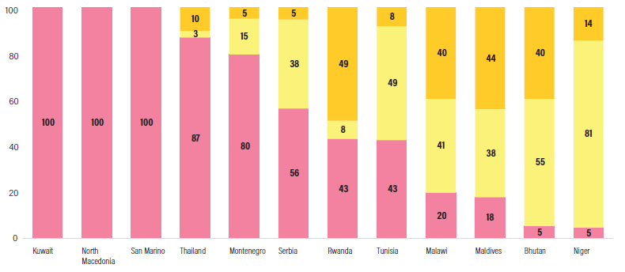
Environmental cleaning
Basic environmental cleaning: basic protocols for cleaning are available, and staff with cleaning responsibilities have all received training.
Notes:
Environmental cleaning – this indicator is a bit different. The other WASH services are based on physical things that can be checked and confirmed objectively. Are water, toilets, or hand hygiene facilities, or waste segregation and treatment facilities available? But it’s much harder to check and observe environmental cleaning, consistently and objectively. So instead this indicator focuses on processes: are there basic protocols for cleaning available – like SOPs – and have all the staff with cleaning responsibilities received training on cleaning? This is still a new indicator, and hasn’t traditionally been in the facility assessments and other data sources that we draw on, so we only have 12 countries with national estimates.
[CLICK]
But that is growing quickly – there were only 4 in the first report in 2019.
And you can see there’s a real range of coverage with this one – some of the countries in Europe and the Middle East already have universal coverage, but in others there is a range from high coverage, for example in Thailand, to very low coverage in places like Bhutan and Niger. Like hand hygiene, this is an indicator that in principle could be improved rapidly, with relatively small financial requirements. It’s more about strengthening the approach to cleanliness, and the focus on infection and prevention control, and these are things that a committed administration can change relatively quickly if they put their minds to it. And we certainly do see examples of countries focusing on improving cleanliness and IPC, and overall the quality of care, we will hear some examples of that in the second part of this presentation.

Slide 12
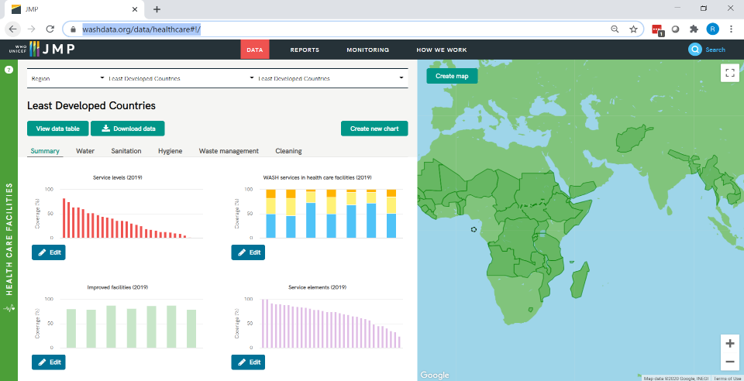
Interactive data are available at https://washdata.org/data/healthcare#!/
Notes:
Thanks – this was just a quick tour of the data highlights. Please do look at the report in more detail – and all of these data can already be explored online at washdata.org. Now let me pass over to my colleague Maggie Montgomery who will talk about the broader work on WASH in HCF.

Slide 13
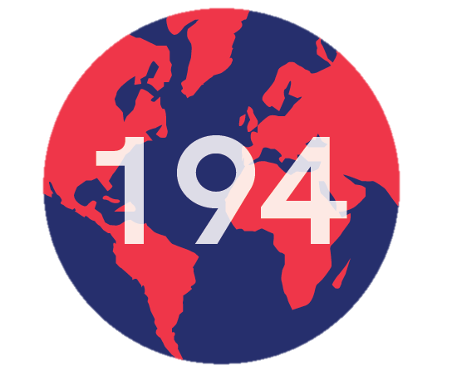
Part II
Country progress in implementing practical steps
Recommendations

Slide 14
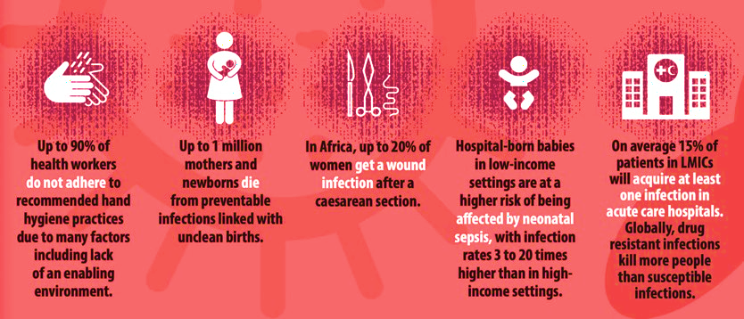
Impacts quality of care
5.0 million deaths
per year in 137 LMICs from poor quality care.
https://www.thelancet.com/pdfs/journals/langlo/PIIS2214-109X(17)30101-8.pdf

Slide 15
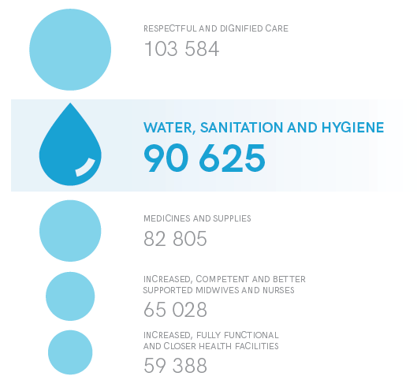
Women want WASH services
1.2 million women surveyed
“Women said they were fed up with giving birth in dirty conditions. They want clean health facilities, clean toilets, and health providers with sterile supplies and clean hands. They want soap and water to wash themselves and their babies after birth”.
What Women Want survey: Demands for quality healthcare for women and girls (2019) https://www.whatwomenwant.org/

Slide 16
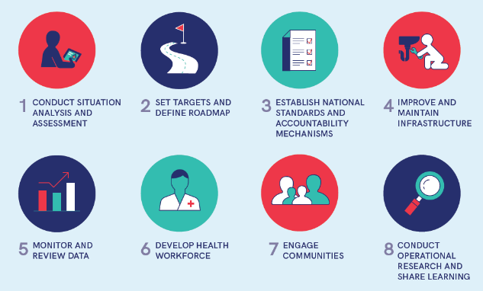
Resolution: a catalyst for action
At the 2019 World Health Assembly 194 countries committed to universal WASH access.
8 practical steps
A framework for national action and accountability and the basis for tracking.

Slide 17
Snapshot of progress from 47 early adopter countries

Slide 18
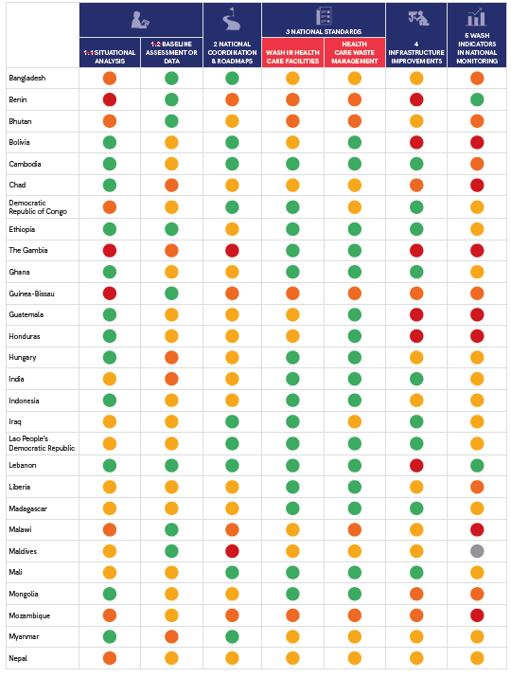
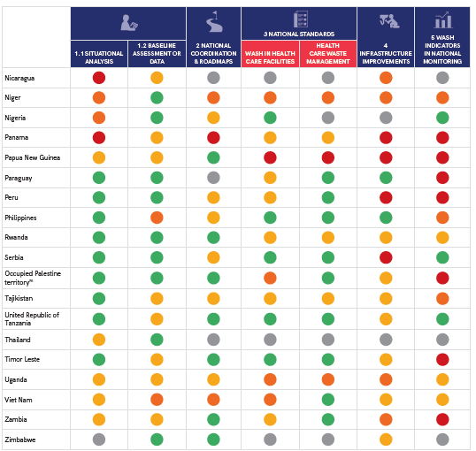
Tracking country progress
47 countries
Every WHO and UNICEF region
Notes:
Progress is rated using a four-point scale.
Ratings are based on published documents (e.g. standards, national strategies), availability of JMP data, meetings and training reports, information from regional initiatives (e.g. WHO South-East Asia Regional Office Quality Dashboards) and through interviews and email exchanges with governments and partners.
Data were validated by WHO and UNICEF country and regional focal points.

Slide 19
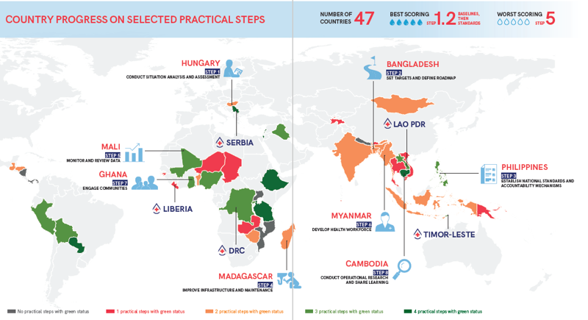
Country case studies
BHUTAN. An innovative, local handwashing + drinking-water treatment technology was rolled out in major hospitals to prevent infections, including COVID-19.
GHANA. Communities rate services and contribute to solutions which are tracked through the national health monitoring system.
PHILIPPINES. the green healthcare facilities initiative and WASH FIT are facilitating national efforts for climate resilient WASH.
COLOMBIA. The First Lady, started a regional coalition of political spokespersons and advocates.
CAMBODIA. WASH is regulated, monitored and incentivized through the national health equity and quality programme.
19

Slide 20
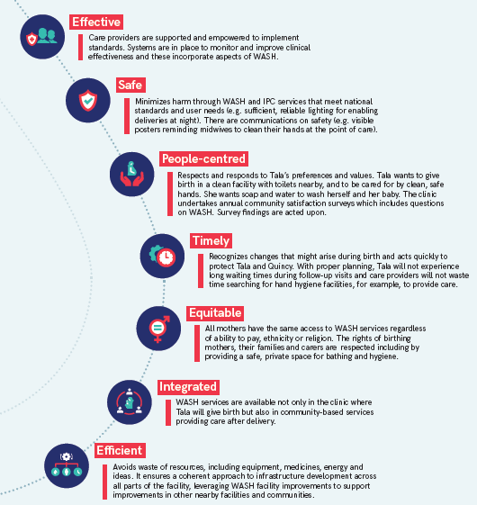
Integration with health incomplete
Care through the lens of the quality elements
Key programmes:
Infection prevention and control
Maternal and newborn health
Antimicrobial resistance
Outbreaks/cholera
Vaccines
Neglected tropical diseases

Slide 21
Price tag for achieving universal basic WASH
US$ 1.2 billion in capital investment, equal to US$ 1 per capita (0.10 USD/per capita/year)
US$ 2.4 billion more for operation and maintenance,
equal to US$ 2 per capita (0.20 USD/capita/year)
Achieving universal basic WASH by 2030 in all LDCs will cost US$ 3.6 billion

Slide 22


Costs are modest compared to WASH and health resource flows…
US$ 0.30
(Cap: US$ 0.10,
O&M: US$ 0.20)
Annual investment needed per capita for WASH in HCFs in LDCs (2021–2030)
US$ 2.64
ODA per capita for WASH in LDCs in 2018
US$ 3.09
Annual spending per capita on WASH by 22 LDC governments
US$ 10
Recurrent health spending per capita by LDC governments in 2018
Annual investment needed per capita for universal basic WASH in LDCs (2015–2029)
US$ 11.59
Annual costs for WASH in health care facilities in LDCs are 3% of annual recurrent government spending on health and 3% of the annual universal WASH pricetag.
Notes:
GLAAS data include expenditure reported for years between 2015 and 2019. Per capita calculations based on 2020 populations in the World Population Prospects.
No GHED recurrent data were available for Somalia, and the most recent data available for Yemen were for 2015.
GHED capital data are for the most recent year with values (back to 2015).

Slide 23
An investment opportunity
Every dollar invested in hand hygiene alone yields, on average a US $15 return.
Lack of financing undermines sustainable services
  Only 11% (out of 69) countries have sufficient resources to meet WASH in health care facility targets-(2019 GLAAS Report)
Sufficient budgets and financing requires:
  Disaggregating existing budget lines to ensure allocations and spending on WASH more visible
  Rigorous process to gather costs of defined WASH (and IPC) packages
  Investments in operation and maintenance (not just capital)
  Intersectoral dialogue and financial planning
Whole system planning and flexible use of funds
  District wide approaches
  Use of discretionary funds for minor WASH, energy, etc repairs
Notes:
Yet, the value of WASH services are manifold:
preventing health care associated infections;
saving health systems costs;
improving quality care;
protecting health workers, users and communities;
increasing health system resilience.

Slide 24
Commitments
194 countries committed to resolution and practical steps
Over 130 partners have committed resources
34 made financial commitments in 2019 (totaling US$ 125 million)
Others allocated human resources, technical and advocacy support.

Slide 25
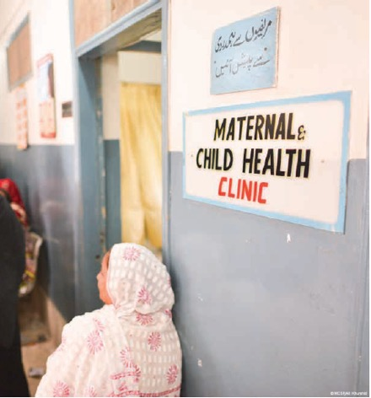
Recommendations

Slide 26
Recommendations
Implement costed national roadmaps with appropriate financing
1.
Acts as a basis by which government and partners engage, track progress and target resources
Requires a multi-year, multi-sectoral process and leadership from a national taskforce or coordination body

Slide 27
Recommendations
Monitor and regularly review progress in improving WASH services, practices and the enabling environment
2.
Data on environmental cleaning and sanitation are especially lacking. Higher levels of service need to be defined and tracked in many countries.
WASH indicators should be incorporated into facility surveys, health systems monitoring, quality of care improvement cycles; and regularly reviewed and assessed.
Efforts to track implementation of the practical steps and WHA resolution should be continued and strengthened.

Slide 28
Recommendations
Develop capacities of health workforce to sustain WASH services and promote and practice good hygiene
3.
Sustaining WASH services (especially cleaning and health care waste) requires trained and supported staff.
All staff should be supported to practice and serve as models for good hand hygiene.
WASH FIT provides a mechanism to empower staff to incrementally improve and sustain WASH services.

Slide 29
Recommendations
Integrate WASH into regular health sector planning, budgeting,
4.
and programming,
including COVID-19
response and recovery efforts to deliver quality services.
WASH and waste services are “common goods for health” that must be financed.
All COVID-19 response, vaccine and more broadly, economic recovery plans should monitor and budget for WASH in health care facilities.
Build back better should address climate resilience of WASH and energy; key prescription in WHO’s Manifesto for a Healthy Recovery

Slide 30

Time to step up efforts
Vision
Every health care facility has the necessary, functional and sustainable WASH services and practices in order to provide quality essential health services for everyone, everywhere.

Slide 31
Join the movement
Learn
Visit www.washinhcf.org for practical tools, case studies, news and stories.
Connect
Join the conversation and share your questions & comments @WASH_for_health
Commit
Make and reaffirm your commitment and encourage others to commit at www.washinhcf.org/commitments

