Slide 1
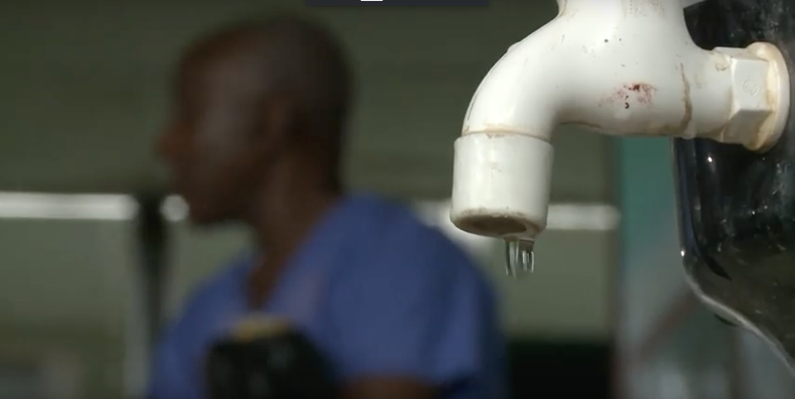
WASH in health care facilities for preventing COVID-19
Technical guidance and adaptation of the water, sanitation and hygiene for health facility improvement (WASH FIT) process
@WASH_for_health

Slide 2
Today’s agenda
Introduction & overview of webinar series (Ruth Stringer, HCWH)
Basic Health Care Waste Management and latest guidance on HCWM during the COVID-19 outbreak (Dr. Ute Pieper, WHO)
Disposal options in emergency situations and management considerations (Dr. Emilia Raila, UNICEF)
Country reflections (Malala Ranarison, WHO Madagascar)
Questions and answers
Closing remarks (Maggie Montgomery, WHO)

Slide 3
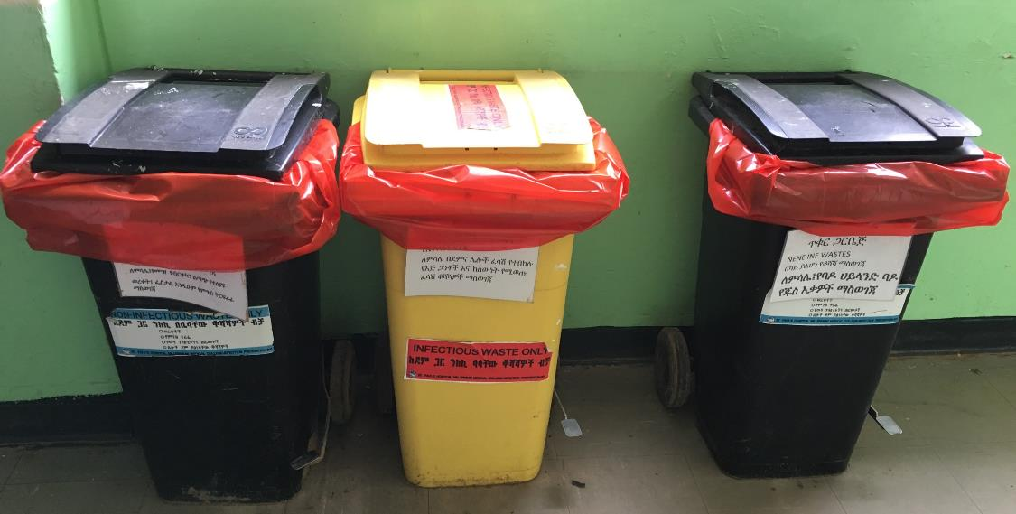
WASH in health care facilities for preventing COVID-19
Session 2 (14 April 2020):
Health Care Waste Management

Slide 4
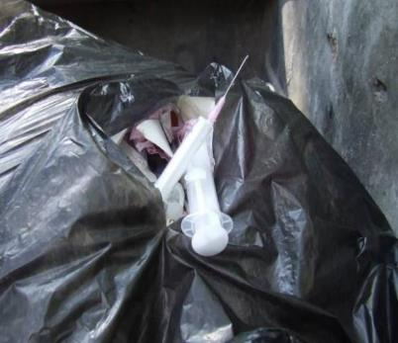
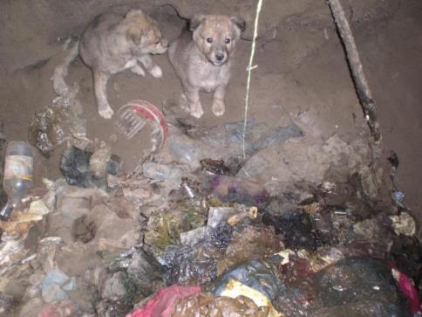
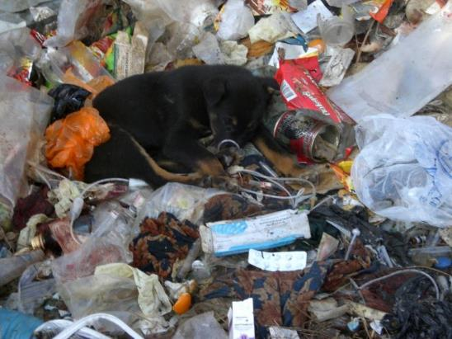
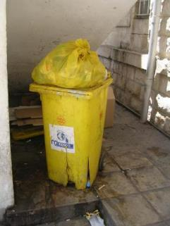
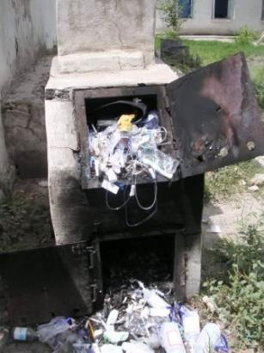
Notes:
Top left: broken black bag with sharp waste (needle is pricking through – usage of a black bag instead of a yellow)
Top right pic: dog puppies in a placenta pit (unprotected pit – dogs can spread infections)
Bottom left: dog puppy sleeps in an open dump with hazardous and non-hazardous waste mixed
Bottom middle: overfilled and broken bin for infectious waste – unprotected and accessible to the public.
Bottom right: overfilled small-scale incinerator (risk for the operator – incinerator should be heated up before starting to be filled)

Slide 5
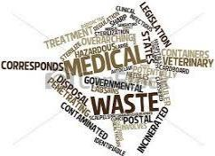
Waste management process
Start: Waste minimization
Transport
Storage
Treatment
Final disposal
Segregation
Collection
Notes:
The logistic chain starts with MINIMSATION – not to produce waste or to produce less waste is lowering the risk for humans and environment in general – and costs!
Segregation is the key of the waste management system: all other logistic steps (collection, transport, storage, treatment and disposal) are based on this step!

Slide 6
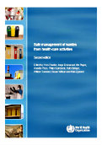
What is the typical composition of waste generated in a health care facility?
Between XX% and XX% of the waste produced is similar to domestic waste and usually called ‘non-hazardous’ or ‘general health care waste’
XX - XX% of health care waste is regarded as ‘hazardous’ and may pose a variety of environmental and health risks
Safe management of waste from health-care activities, WHO, 2014
https://www.who.int/water_sanitation_health/publications/safe-management-of-wastes-from-healthcare-activities/en/
Notes:
Quiz – ask participants to guess their answers.

Slide 7
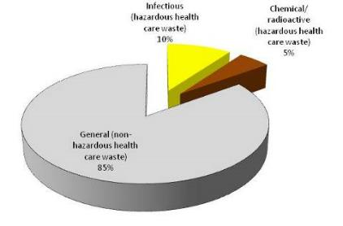
What is the typical composition of waste generated in a health care facility?
Between 75% and 90% of the waste produced is similar to domestic waste and usually called ‘non-hazardous’ or ‘general health care waste’
10-25% of health care waste is regarded as ‘hazardous’ and may pose a variety of environmental and health risks
Non-hazardous waste is usually similar in characteristics to municipal solid waste. More than half of non-hazardous waste from hospitals is paper, cardboard and plastics, whilst the rest comprises discarded food, metal, glass, textiles, plastics and wood.
Safe management of waste from health-care activities, WHO, 2014
https://www.who.int/water_sanitation_health/publications/safe-management-of-wastes-from-healthcare-activities/en/
Notes:
The 10% of infectious waste includes also sharp waste and pathologic / anatomical waste (biohazardous waste)

Slide 8
Which categories of hazardous waste do you know?
Category | Examples
Sharps waste | Used or unused sharps (i.e. hypodermic, intravenous or other needles; auto-disable syringes; syringes with attached needles; infusion sets; scalpels; pipettes; knives; blades; broken glass
Infectious waste | Waste suspected to contain pathogens and pose a risk of disease transmission (i.e. waste contaminated with blood and other body fluids; laboratory cultures and microbiological stocks
Pathological waste | Human tissues, organs or fluids; body parts; foetuses; unused blood products
Pharmaceutical waste, cytotoxic waste | Pharmaceuticals that are expired or no longer needed; items contaminated by or containing pharmaceuticals Cytotoxic waste containing substances with genotoxic properties, e.g. waste containing cytostatic drugs (used in cancer therapy); genotoxic chemicals
Chemical waste | Waste containing chemical substances (i.e. laboratory reagents; film developer; disinfectants that are expired or no longer needed; solvents; waste with high content of heavy metals, e.g. batteries; broken thermometers and blood pressure gauges)
Radioactive waste | Waste containing radioactive substances (i.e. unused liquids from radiotherapy or laboratory research; contaminated glassware, packages, or absorbent paper; urine and excreta from patients treated or tested with unsealed radionuclides; sealed sources)
Notes:
Pathological waste might also include anatomical waste (amputated .
Chemical waste includes also portable pressurized cylinders, cartridges and aerosol cans – depending on the content these can also be considered as general waste.
Note: Waste from X-ray departments are NOT radioactive. It is categorized as chemical (fixer, developer, x-ray films).

Slide 9
Segregation
Different types of waste require different handling, treatment and disposal
Segregation must start at the source, i.e. where waste is generated
In most wards three waste categories are generated and should be segregated accordingly:
  General waste
  Infectious waste
  Sharp waste
Health care Waste
General waste
Sharp waste
Infectious
3-bin Standard System
Black container (lined)
Yellow container (lined)
Sharps box
Notes:
Basic (all patient care areas) = 3 bins
Bin for general waste (black bag in a bin)
Bin for infectious waste (yellow bag in a labeled pedal bin)
Sharp container or needle cutter

Slide 10
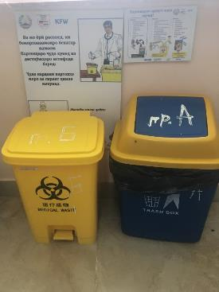
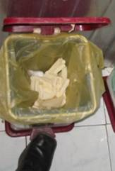
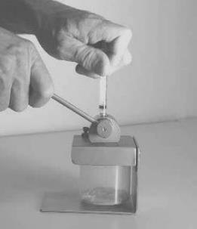
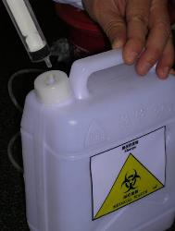
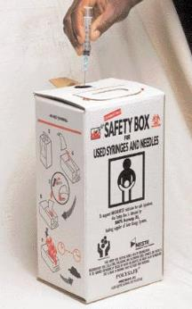
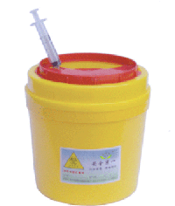
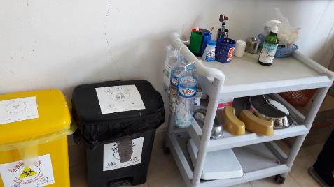
Notes:
Top
1. Two bins with correct label and colored bag – poster support segregation
The use of pedal bins is recommended in order not to touch the lid of the bin
In case there is a lack of sharp container, self-made ones are an option (labels are produced locally)
The use of a needle cutter (needle is cut from the syringe body):
Bottom:
5-liter cardboard sharp container (UN / WHO standard)
Needle strip sharp box: the needle is striped off the syringe body (sharp box can be used for a longer time)
Setting in a ward: labeled and lined black and yellow bin plus a sharp containers at the trolley

Slide 11
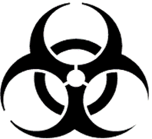


Guidance for bins and containers
Waste categories | Colour and markings | Type of container | Collection frequency
Infectious waste |  | Leak-proof strong plastic bag placed in a container (bags for highly infectious waste should be capable of being autoclaved). | When three-quarters filled or at least once a day.
Sharp waste |  | Puncture-proof container. | When filled to the line or three-quarters filled.
Pathological waste |  | Leak-proof strong plastic bag placed in a container. | When three-quarters filled or at least once a day.
Chemical and pharmaceutical waste |  | Plastic bag or rigid container. | On demand.
Radioactive waste |  | Lead box. | On demand.
General health-care waste | Black or grey coloured bag | Plastic bag inside a container or container which is disinfected after use. | When three-quarters filled or at least once a day.

Slide 12
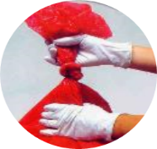
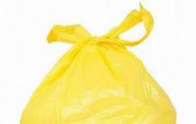
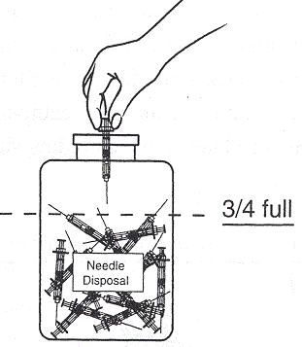
Safe appropriate collection
A schedule should be available for reference: e.g. collection of waste after each shift.
PPE use and hand hygiene action should be followed
Waste bags should be collected when 3/4 full or at least daily
Sharp waste should be collected when the container is 3/4 full
Hazardous and non-hazardous waste should never be collected at the same time as then all waste has to be considered hazardous
Tie bags securely
After removing the waste bag, replace with a new one

Slide 13
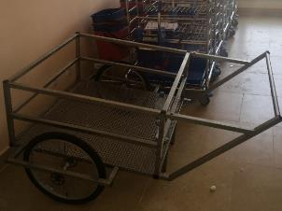
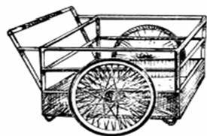
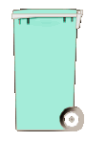
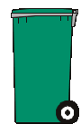

Safe and appropriate transport
Waste handlers should wear appropriate PPE and perform hand hygiene after handling waste
Transport waste with covered trolley, wheel barrow, wheeled bin or cart
Separate transport of hazardous and non-hazardous waste (yellow - black)
Transport equipment should be dedicated for waste transportation only
The equipment must be cleaned and disinfected at the end of each working day.
Notes:
Disinfection of bins: e.g. chlorine (0.2%) solution
Washing / disinfection areas should be available also for the waste handlers – like the persons transporting the waste!

Slide 14

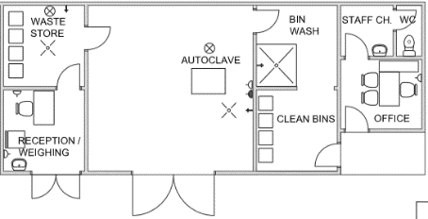
Waste storage: infectious & sharp waste
Only infectious and sharp waste should be stored here – no mixture with other waste.
Inaccessible to unauthorized persons, animals, insects and birds
Marked with biohazard symbol
Floor and walls are sealed or tiled to allow easy disinfection
Keep well ventilated & protected from rain
Temperate climate: 72 hours in winter 48 hours in summer | Warm climate: 48 hours during the cool season 24 hours during the hot season
Notes:
Note: waste can be stored for more than a week when stored below 8° C (e.g. in a fridge or in winter with temperatures below 8 °C)

Slide 15
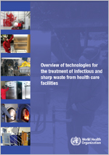
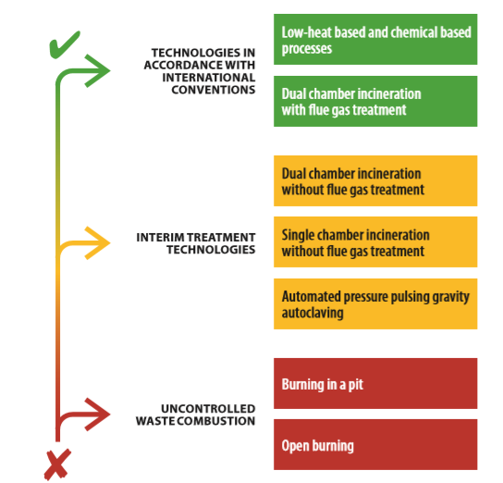
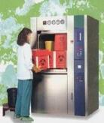
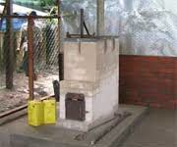
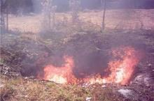
Heirarchy of waste treatment options
https://www.who.int/water_sanitation_health/publications/technologies-for-the-treatment-of-infectious-and-sharp-waste/en/
Notes:
The green highlighted waste treatment options should be preferred as these are limiting the emissions to the environment (autoclave does not emit emissions, emissions from incineration can be cleaned by a flue gas cleaning system).
The yellow highlighted which can be used as interim solutions.
The red ones are considered as the last resort options and are not recommended but sometimes the only feasible option for emergency or as an interim solution. These process should be minimized and eliminated as soon as possible and wherever feasible.

Slide 16
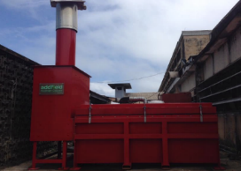
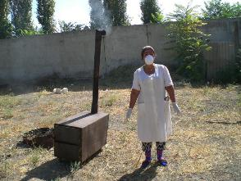
Incineration
Incineration should comply with Stockholm Convention (BAT):
  2 burning chambers (1st: 850 °C and 2nd: 1,100°C),
auxiliary burners
sufficient resident time of air in the 2nd chamber
sufficient oxygen content and high turbulence of exhaust gases
As well as flue gas treatment
Small Scale incinerators:
  Commonly used technology in low recourse settings
  Low cost, easy to install….
  Generation of hazardous emissions like dioxin and furans
Stockholm Convention: treaty to protect human health and environment from POPs. Parties are required to use the BAT and BEP limit the levels of dioxins and furans in air emissions to 0.1 ng I-TEQ/Nm3.
Notes:
Disadvantage: release of combustion by-products into atmosphere and generation of residual ash, which are considered as hazardous for health and environment.
Combustion by-products are dioxin and furans (POPs).
Dioxin and furans causes negative effects on the environment and health of humans including:
skin toxicity,
immunotoxicity, neurotoxicity,
negative effects on reproduction,
teratogenicity,
endocrine disruption, and a predisposition to cancer

Slide 17
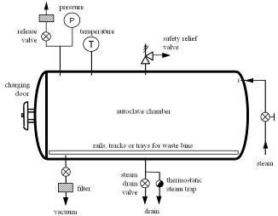
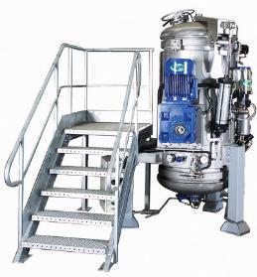
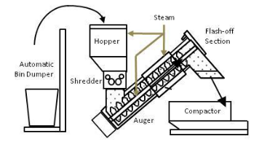
Examples of treatment technologies that Do Not generate Dioxins/Furans
Non-Burn Thermal Technologies (in accordance with Stockholm Convention) like
  Autoclaves
  Hybrid Steam Systems
  Microwave Units

Slide 18
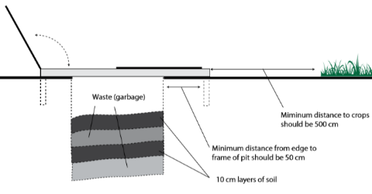
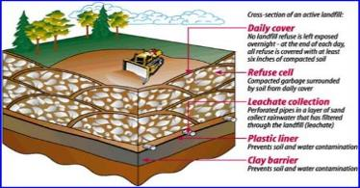
Waste disposal options
Interim Solution)
General Waste
Source: Safe management of waste from health-care activities, WHO, 2014
Municipality: Lined landfill (preferable)
Protected Pits for ash and placenta waste
Source: Technical Specifications, Healthcare Without Harm / MSF
Notes:
Not accessible to unauthorized persons (fenced, locked)
If possible, located on a higher-level area - bottom should be 1.5 meter away from the water table.
Ash pit should be lined with watertight bricks or concrete lining to prevent contamination to the soil and water (ash is considered as hazardous waste)
Placenta pit does not need to be entirely lined, with concrete, as it is biodegradable and will sooner or later be transferred to soil.

Slide 19


Waste from COVID-19 patients
Best practices for safely managing health care waste should be followed, including assigning responsibility and sufficient human and material resources to dispose of waste safely.
There is no evidence that direct, unprotected human contact during the handling of health care waste has resulted in the transmission of the COVID-19 virus.
All health care waste produced during the care of confirmed COVID-19 patients is considered as infectious (infectious, sharps and pathological waste) and should be collected safely in clearly marked lined containers and sharp boxes.
This waste should be treated, preferably on-site, and then safely disposed.
If waste is moved off-site, it is critical to understand where and how it will be treated and disposed.

Slide 20
Prepare for extra waste generation
Waste handlers:
-wear appropriate PPE (boots, long-sleeved gown, heavy-duty gloves, mask, and goggles or a face shield) and
- perform hand hygiene after removing it.
Waste generated in waiting areas of health care facilities or at home during home based quarantine can be classified as non-hazardous and should be packed in strong black bags and closed properly before disposal by municipal waste services.
It is important to asses the existing waste treatment capacity as the volume of waste during an outbreak will increase (mainly PPE) and additional treatment capacity might be needed.
Note: .
A surgical or even a cloth mask can protect
against splashes and also help prevent workers touching their faces (N95, FFP2 or 3 masks are not essential).
For more information refer to the WHO guidance, Safe management of wastes from health-care activities (32).

Slide 21
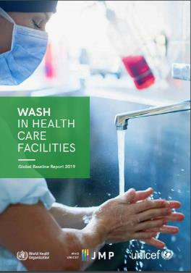
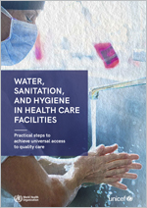
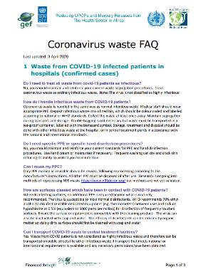
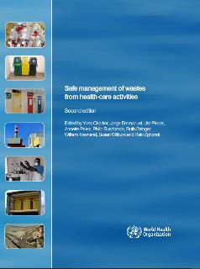
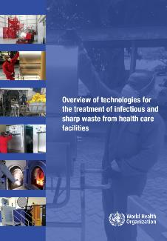
Key documents on waste in HCF
COVID-19 technical note and FAQs
Baseline reports and practical actions

Slide 22
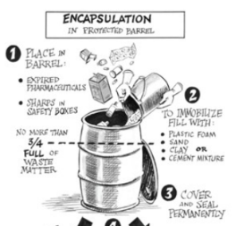
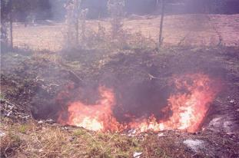
Disposal options in emergency situations
Encapsulation (disposal of expired vaccines & medications)
  Add immobilizing materials (i.e. cement) and seal the container
Burning pit
  Disposal of waste only during emergency in the absence of incinerators/autoclaves.
  It causes higher smoke pollution and other health risks
Notes:
Expired pharmacies can also be inerted. Inertization is a variant of encapsulation and involves removing the packaging materials, paper, cardboard and plastic, from the pharmaceuticals. Pills need to be removed from their blister packs. The pharmaceuticals are then ground, and a mix of water, cement and lime added to form a homogenous paste. More information:
https://www.who.int/water_sanitation_health/publications/unwanted-pharmaceuticals/en/
Burning in a pit should be undertaken in a confined area – away from public and the health facility. The waste should be burned within a dugout pit, followed by covering with a layer of soil

Slide 23
Healthcare waste staff
A responsible person for the management of healthcare waste should be appointed and trained (Healthcare Waste Officer – HWO)
This person is often from the Infection Control Committee
The HWO should be trained on HCWM
Introduction of supervision
of safe handling methods
Data recording
Regular training of
medical and logistic staff
Development and revision
of a waste management plan
Supervision of safe waste treatment and disposal
Observing
legal regulations
Notes:
In a lot of countries the HWO is the Infection Control Nurse or the Head Nurse.
The duties of the HWO should be included in the description of the person taking this position.

Slide 24


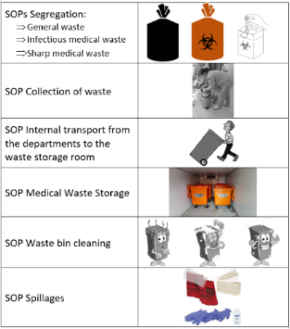
Documentation
The following documentation should be available:
  Standard Operation Procedures (SOPs) / Protocols (e.g. for segregation, collection, transport, storage, treatment, disposal, spillages):
    Possible Hazards,
    Responsible Person, Emergency Contact,
    Step for step procedure, dos and don’ts.
  Incident Reports (sharp incidents etc.)
  Weighing records of the generated infectious and sharp waste
Notes:
Do you have a reporting system on needle stick incidents in your facility or/ and on national level?
How is the standardized procedure for a needle stick incident (who need to be informed, medical care, filling out forms)?
Why is it recommended to weigh the infectious waste?
- To observe changes in the amount generated and to invest on mitigation measures.
To proof that the implemented activities to improve segregation and minimization are working.
To plan for sizes and capacities of storage, treatment and disposal of this waste.

Slide 25
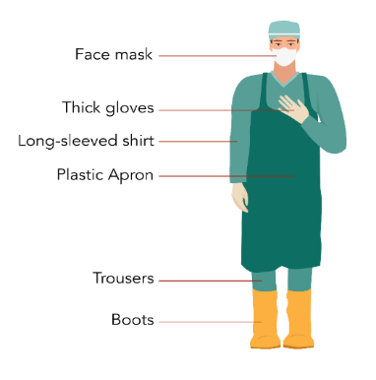
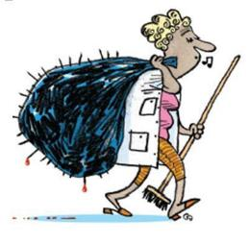
Safe handling of waste for health care workers
When handling hazardous or infectious waste, always wear personal protective equipment (PPE). PPE should include:
RISK!!
Remember to remove PPE and perform hand hygiene after handling waste!
Notes:
Wear appropriate personal protective equipment (PPE)
Handle waste with care
Practice hand hygiene before and after handling waste
Do not re-sort waste
Never carry waste bags/containers against body
Avoid heavy loads (use transport tools)

Slide 26
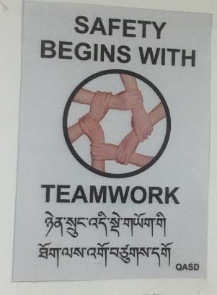
How to increase sustainability?
Stakeholders are convinced that proper HCWM is important for health and environment!
Legal framework, rules and guidance is available, standardized, known and available for all
Training on HCWM need to be part of the country / district / facility organization / culture (institutionalization)
Adequate budget for HCWM is available
Equipment and infrastructure is
maintenance and repaired
Continues monitoring and mentoring…
Notes:
What could you do to increase sustainability in your facility?

Slide 27
Key takeaways
Segregate hazardous and non-hazardous waste at the point of generation
Use sharp boxes – never recap or reuse needles
Keep infectious and sharp waste away from patients and public
Treat infectious and sharp waste before disposal
Plan for incremental improvement of your waste management system

Slide 28
Questions?
Today’s slides available at www.washinhcf.org/resource/covid-19-webinar-series-hcwm/
Visit www.washinhcf.org/resources and search “COVID-19” for related resources & slides

Slide 29
References
UNEP (2003). Technical guidelines on the environmentally sound management of biomedical and healthcare waste. http://archive.basel.int/pub/techguid/tech-biomedical.pdf
UNEP (2007). Guidelines on best available techniques and provisional guidance on best environmental practices relevant to Article 5 and Annex C of the Stockholm Convention on Persistent Organic Pollutant. http://chm.pops.int/Implementation/BATandBEP/BATBEPGuidelinesArticle5/tabid/187/Default.aspx
WHO (1999). Guidelines for safe disposal of unwanted pharmaceuticals in and after emergencies. http://apps.who.int/medicinedocs/en/d/Jwhozip51e/
WHO (2003a). Aide-memoire for a strategy to protect health workers from infection with bloodborne viruses. http://www.who.int/occupational_health/activities/1am_hcw.pdf
WHO (2014). Safe management of wastes from health-care activities. http://www.who.int/water_sanitation_health/publications/wastemanag/en/
WHO (2017). Safe management of wastes from health‑care activities - A summary;” https://www.who.int/water_sanitation_health/publications/safe-management-of-waste-summary/en/
WHO (2019). Overview of technologies for the treatment of infectious and sharp waste from health care facilities”; https://www.who.int/water_sanitation_health/publications/technologies-for-the-treatment-of-infectious-and-sharp-waste/en/index.html

