Slide 1
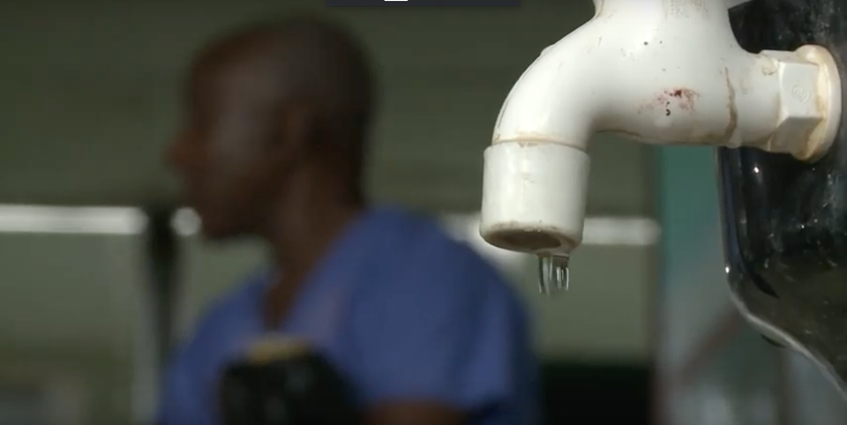
WASH in health care facilities for preventing COVID-19
@WASH_for_health
Technical guidance: focus on SANITATION
30th April 2020
Slides available at www.washinhcf.org/resources, “search COVID-19”

Slide 2
Overview of session
Introduction Lindsay Denny, Global Water 2020
Sanitation & COVID-19 Maggie Montgomery and Kate Medlicott, WHO
Country reflections:
Ghana Abdul-Nashiru Mohammed, WaterAid Ghana
Liberia Jefferson Dahnlo, MoH
Viet Nam Dr. Nguyen Thi Lien Huong, VIHEMA
Q and A Lindsay Denny
Closing remarks Tsedey Tamir, UNICEF
Slides available at www.washinhcf.org/resources search “COVID-19”

Slide 3
Sanitation quiz
According to latest global estimates, what proportion of health care facilities do not have a toilet?
In a health care facility, toilets should be separated for _____ & _____ and for _____ & ______.
Toilets should have a hand washing station within _____ metres.
Toilets should be cleaned every _________.
Notes:
Spend 5 minutes discussing with the person next to you.

Slide 4
Answers
Globally, 2 in 5 health care facilities do not have a toilet
In a facility, toilets should be separated for male & female and for patients & staff.
Toilets should have a hand washing station within 5 metres.
Toilets should be cleaned every day.
Notes:
Spend 5 minutes discussing with the person next to you.

Slide 5
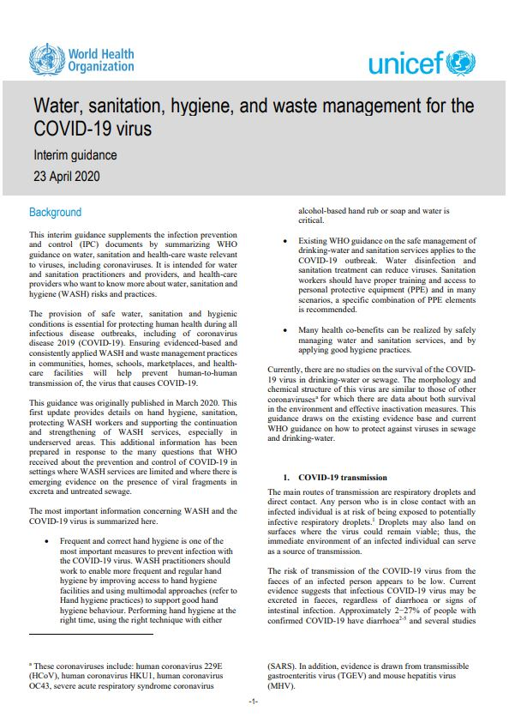
Technical guidance takeaways
Guidance updated 23 April
Hand hygiene: Frequent and effective hand hygiene - one of the most important prevention measures. Hand hygiene at the right time.
1.
Environmental hygiene: Effective inactivation on surfaces can be achieved within 1 minute using common disinfectants
2.
Water and sanitation: Existing WHO guidance on the safe management of drinking-water and sanitation services applies to the COVID-19 outbreak.
3.
4.
WASH investments: Should be fundamental to all country preparedness and response plans.
Co-benefits: Many will be realized through good WASH, including preventing millions of deaths each year caused by other infectious diseases.
5.

Slide 6
Survival of human coronaviruses in faces and wastewater
Media | Temp (^{O}C) | Time | Removal | Reference
Dechlorinated tap water | 20 | 2 days | None surviving | Wang et al, J Virol Methods, 2005
Dechlorinated tap water | 23 | 8-12 days | 99.9% | Gundy et al Food Environ Virol, 2009
Hospital wastewater | 20 | 2 days | None surviving | Wang et al, J Virol Methods, 2005
Settled sewage | 25 | 14 days | 99.9% | Casanova, et al, Water Research, 2009
Wastewater | 23 | 2-4 days | 99.9 % | Gundy et al Food Environ Virol, 2009
Baby faeces | 20 | 3 hours* | None surviving | Lai, et al., Clinical Infectious Disease, 2005
Adult faeces | 20 | 1 day | None surviving | Lai, et al., Clinical Infectious Disease, 2005
Cotton gown | 20 | 5 min- 24 hours** | None surviving | Lai, et al., Clinical Infectious Disease, 2005
Various surfaces (review of 22 studies + one study on SARS-CoV-2) | Average 20 | 2 hours-9 days | None surviving | Kampf, et al., Journal of Hospital Infection, 2020; Dorelman, et al., NEJM, 2020
*Quicker die off attributed to lower pH in baby feces (pH 6-7).
**Quicker die off when there is a lower initial concentration of the virus.

Slide 7
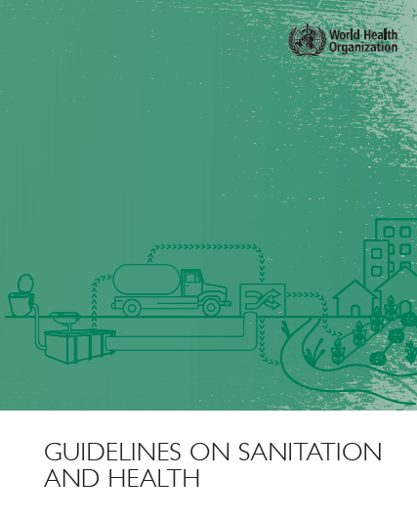
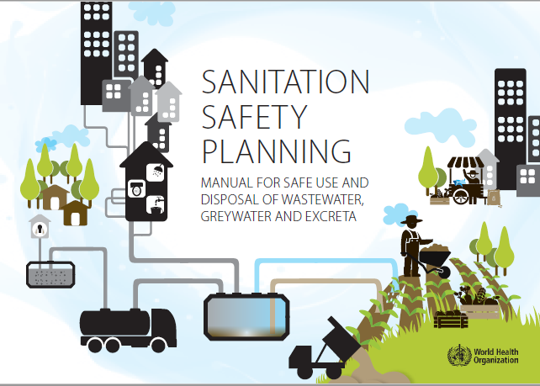
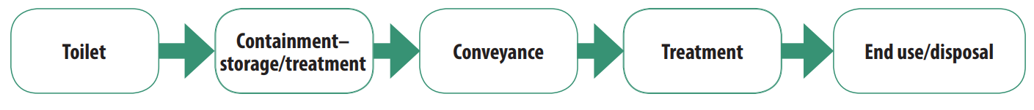
Safely managed sanitation in the context of COVID-19
Safe management at every point of the sanitation chain; system should be able to meet an increase in demand
Important to check safety plumbing (e.g. sealed bathroom drains, backflow valves on bathroom sprayers and faucets)
Staff and patients should have separate toilets; where possible COVID-19 patients should have their own toilets
Regular cleaning and disinfection of bathrooms and anyone with risk of exposure to excreta should wear PPE
Practical, simple wastewater treatment technologies exist (e.g. septic tank + leach field; waste stabilization pond, burying and covering sludge)
WHO (2018) Guidelines on Sanitation and Health
https://www.who.int/water_sanitation_health/publications/guidelines-on-sanitation-and-health/en/
Notes:
Safe sanitation systems must meet these requirements in a manner consistent with human rights, while also addressing co-disposal of greywater, associated hygiene practices and essential services required for the functioning of technologies.

Slide 8
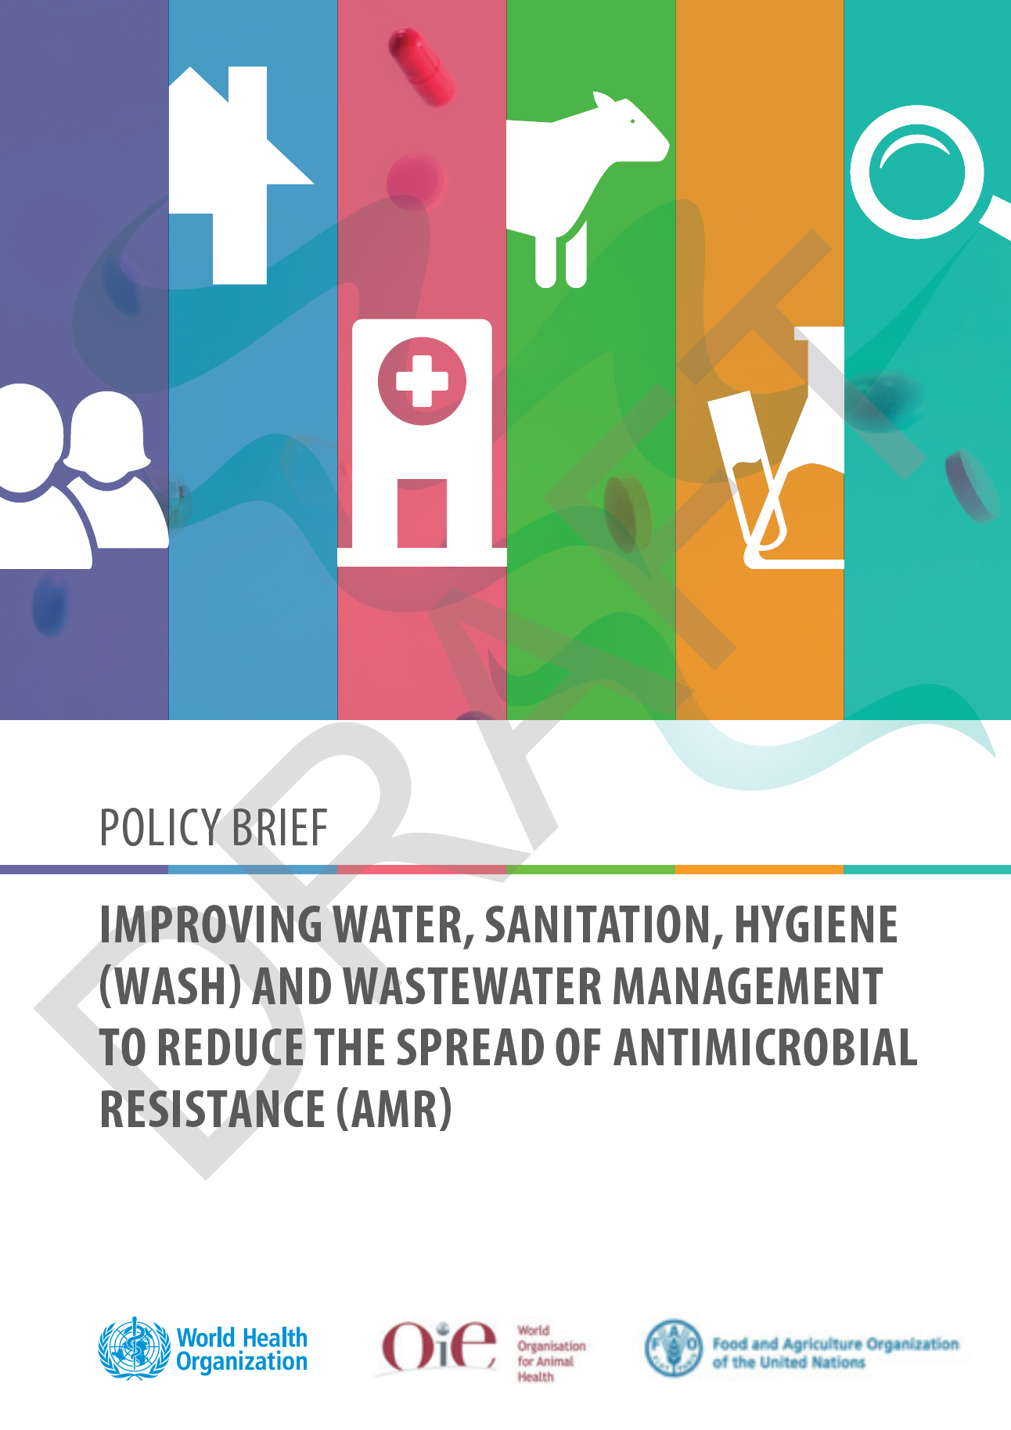
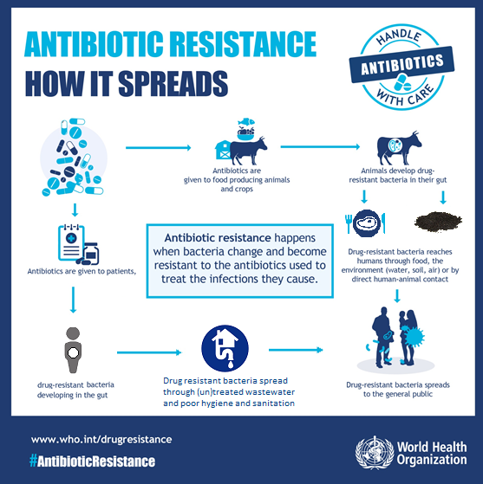
Sanitation & AMR:
The role of health care facilities
Good manufacturing practices including wastewater treatment
Universal access to WASH (SDG 6.1 &6.2) in households to prevent avoidable use
Universal access to WASH in health facilities
Safe disposal of unused medicines
Improve wastewater treatment for all sewage (SDG6.3)

Slide 9
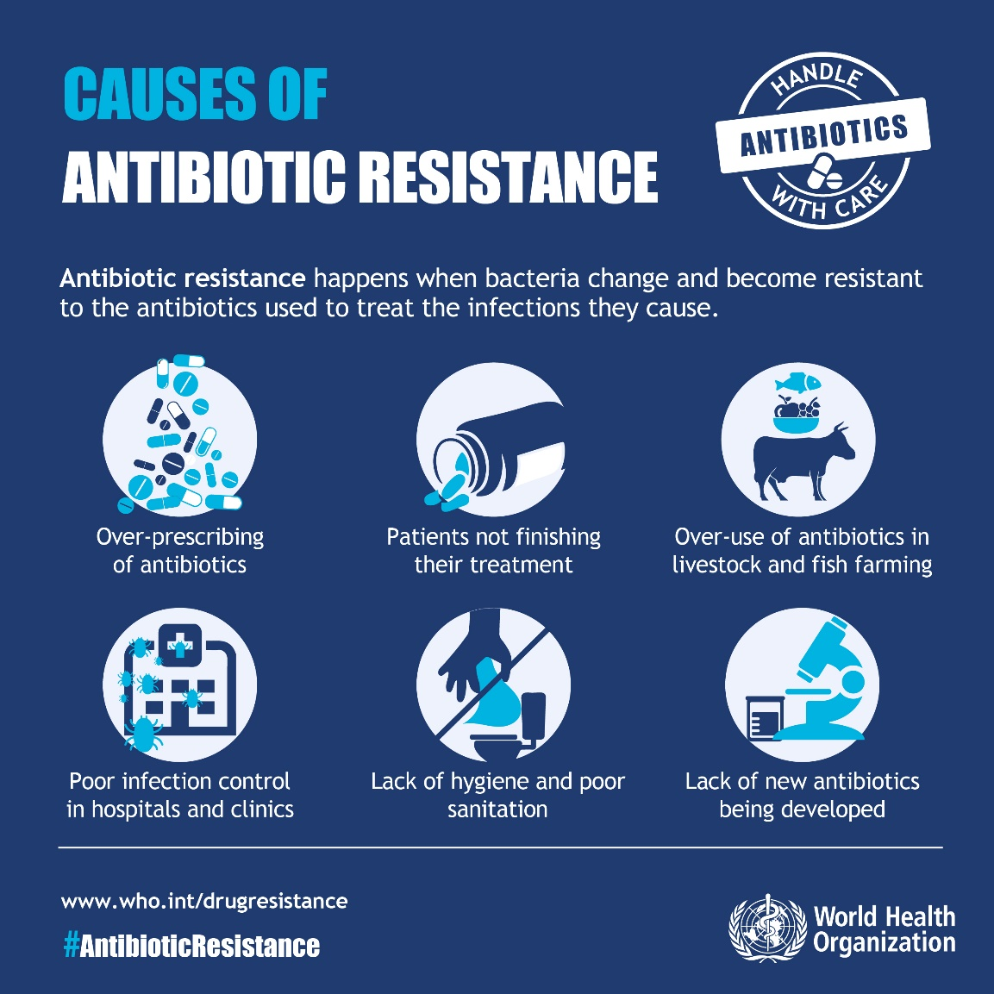
What can be done?
Watsewater form HCF carries higher proportions of resistant bacteria and residues from last line of defense antimicrobials
Current evidence suggests that AMR-resistant bacteria is removed at the similar rates as other bacteria in sanitation treatment systems.
Safe collection, storage, and minimally secondary treatment of fecal waste (on or off site) should be prioritized to control spread of AMR. Higher level of treatment may provide additional protection.
For more on hygiene-related aspects of AMR, refer to the Hand Hygiene module

Slide 10
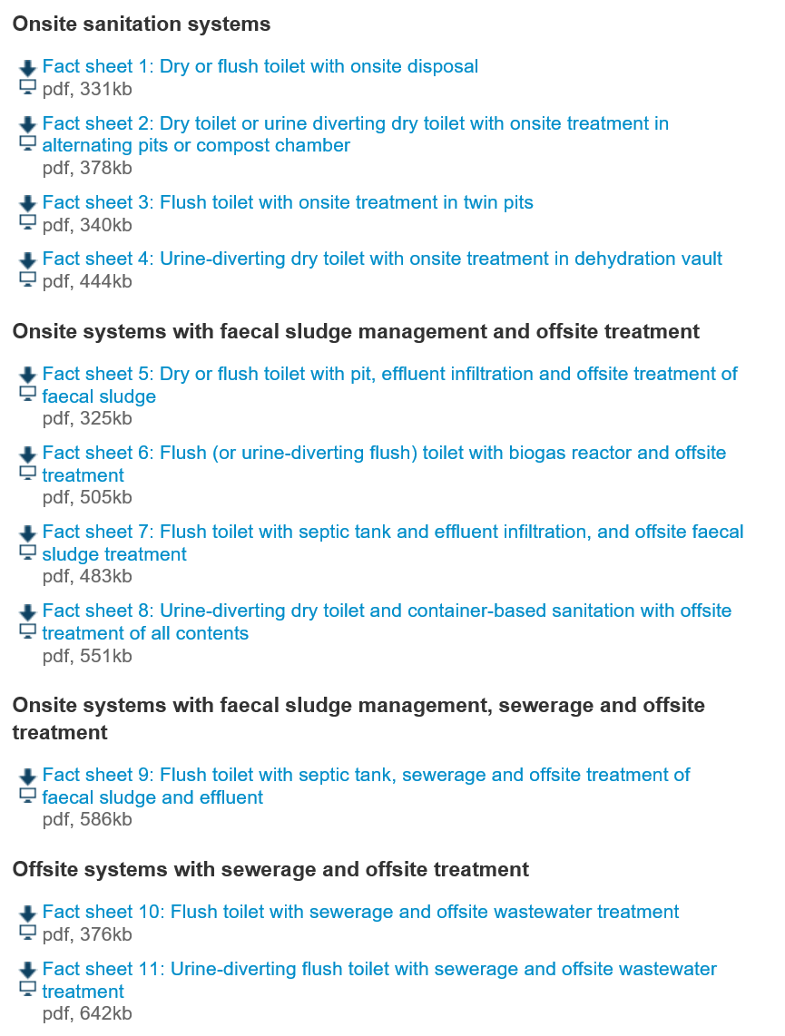
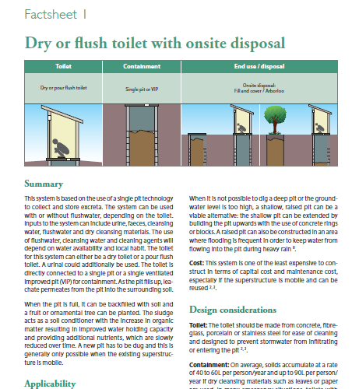
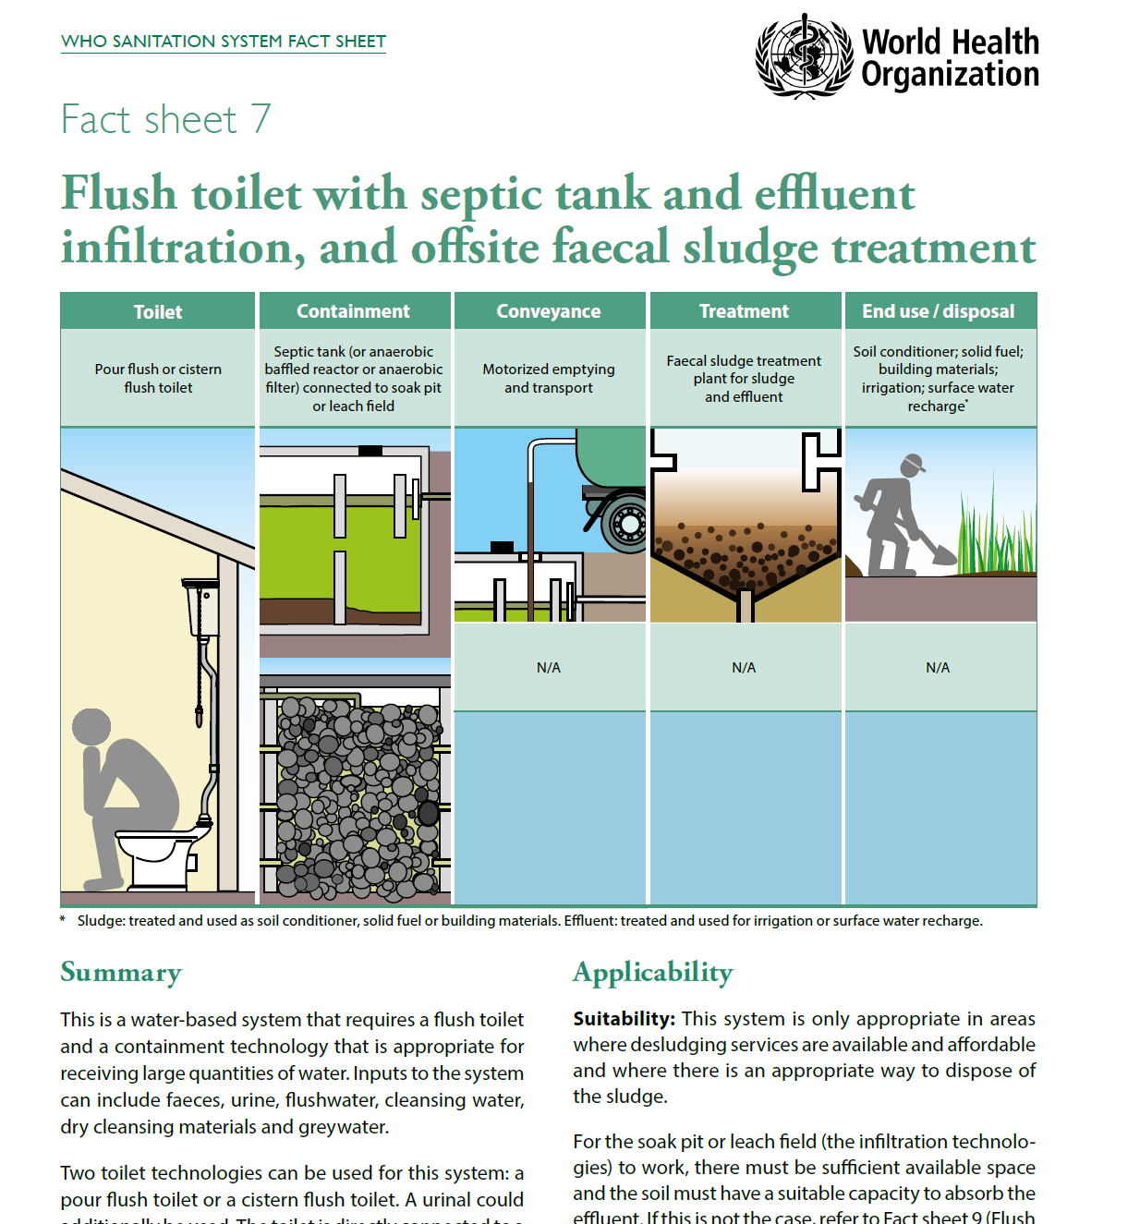
Sanitation options for health care facilities
11 system fact sheets covering:
Applicability
Design considerations
Operation and maintenance
Measures to protect public health
Accompanying sanitary inspection forms
www.who.int/water_sanitation_health/sanitation-waste/sanitation/sanitation-guidelines/en/

Slide 11
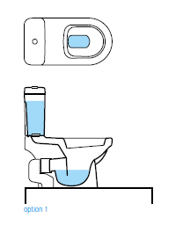
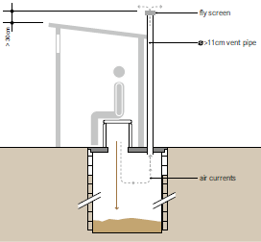
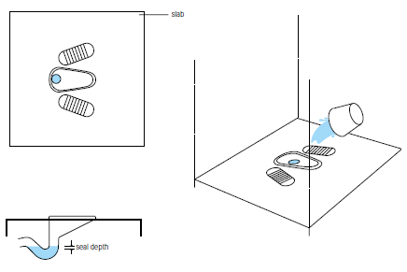
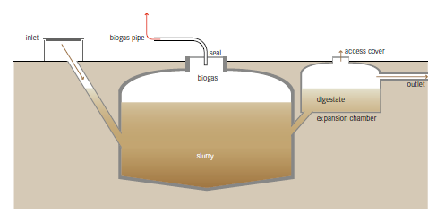
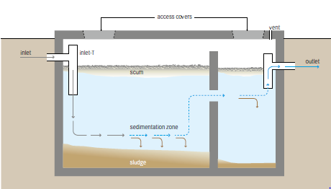
Sanitation options for health care facilities – on site treatment examples
Pour flush or cistern toilets and bio-gas reactor or septic tank
Single, ventilated pit latrine
Source: Compendium of Sanitation Technologies. Eawag, Switzerland. 2018.
More information available at: https://www.who.int/water_sanitation_health/sanitation-waste/sanitation/sanitation-system-fact-sheets/en/
Notes:
Refer to Sanitation System fact sheets, Annex 1 of the WHO Sanitation Guidelines, also available at
https://www.who.int/water_sanitation_health/sanitation-waste/sanitation/sanitation-system-factsheets/en/

Slide 12
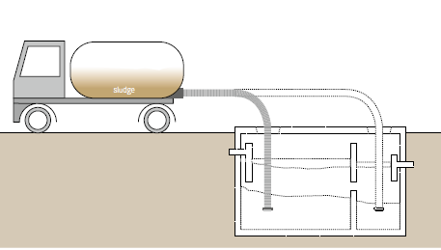
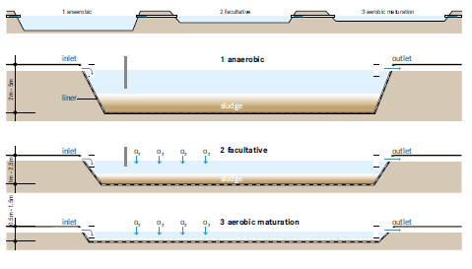
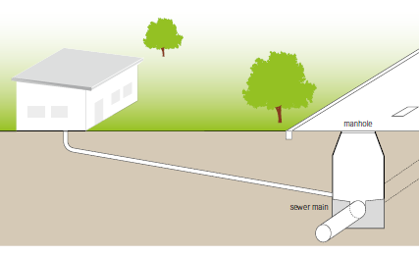
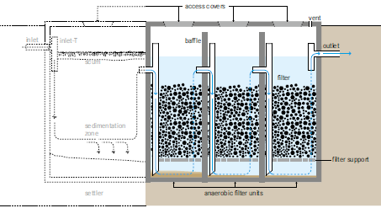
Sanitation options for health care facilities – examples of off site transport or on-site treatment for larger volumes
Motorized collection
Waste stabilization pond
Gravity sewer
Anaerobic filter
Source: Compendium of Sanitation Technologies. Eawag, Switzerland. 2018.

Slide 13
Performance of sanitation treatment options
Type | Pathogen reduction level | Treatment products and pathogen level | Best suited for/conditions required:
Containment technologies
Dry toilet with single pit | High (except Asacaris eggs) | Sludge stabilized into humus with low pathogens | Few users Medium soil permeability
Dry toilet with twin pits | High (except Asacaris eggs) | Sludge stabilized into humus with low pathogens | Few users Medium soil permeability
Flush toilet with open bottomed tank | Low | Liquid leachate high in pathogens is adsorbed aerobically into soil; removal dependent on soil conditions | Few users Water available Medium soil permeability
Flush toilet with septic tank connected to soak pit | Low | Liquid sludge has high pathogens, but these are absorbed aerobically in the soak pit | Average number of users Water available
Wastewater treatment technologies
Waste stabilization pond | High | Liquid sludge with low pathogens Effluent with low pathogens | Many users Water available Land available Personnel to maintain
Constructed wetlands | Medium | Plants-no pathogens Effluent with medium pathogens | Many users Water available Land available Personnel to maintain
Anaerobic upflow sludge blanket reactors | Low | Liquid sludge with high pathogens Biogas | Many users Water available Land available Personnel to maintain
Source: Adapted from WHO Guidelines on Sanitation and Health. 2018.

Slide 14
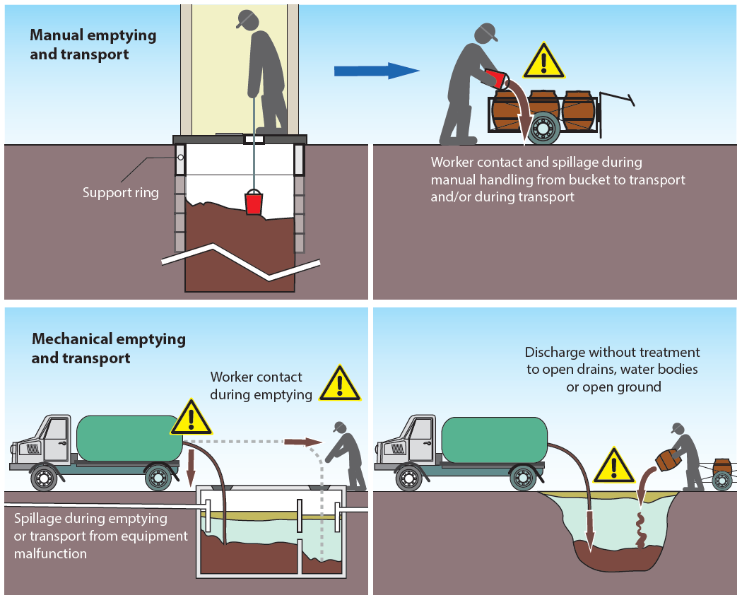
Emptying and conveyance – minimizing risk to waste handlers
Be aware of risks associated with handling wastewater and/or faecal sludge
Equip workers to follow SOPs.
All workers to consistently & correctly wear PPE – gloves, masks, hats, full overalls and enclosed footwear – particularly where manual sewer work or emptying is required.

Slide 15
Examples of climate impacts on sanitation
Climate change effect | Example impact on sanitation | Examples of associated health effects
More intense precipitation or inundation caused by sea-level rise | Flooding of on-site systems causing destruction of facilities, spillage, overflow and environmental contamination | Increased stress and potential exposure to violence and anxiety from lack of access to toilet facilities and reliance on open defecation Increased risks of water- and vector-borne diseases Increased exposure to faecal contamination
Long-term declines in rainfall and run‑off (leading to e.g. long-term drought etc.) | Declining water supply impeding function of water-reliant sanitation systems (e.g. flush toilets, sewerage); Increased demand for use of wastewater – especially in agriculture; shifting ground due to drying soils cracks or damages infrastructure | Increased risks of water- and vector-borne diseases (e.g. due to lack of water for flushing and cleaning resulting in poor sanitary conditions and poor hygiene, and changes in mosquito breeding) Increased open defecation and associated health risks Increase risk of water- and vector- borne diseases linked to untreated wastewater reuse
Higher temperatures (leading to e.g. warmer surface water and soil temperatures, heatwaves) | Malfunction, breakdown or inaccessibility of sanitation systems deterring safe sanitation behaviours (e.g. strong odours during heatwaves deterring use of latrines) | Health impacts resulting from unsafe use or non-use of sanitation systems (e.g. physical or mental health conditions)
Source: WHO, 2019. Discussion paper on sanitation, climate change and health. https://www.who.int/water_sanitation_health/sanitation-waste/sanitation/sanitation-and-climate-change20190813.pdf?ua=1

Slide 16
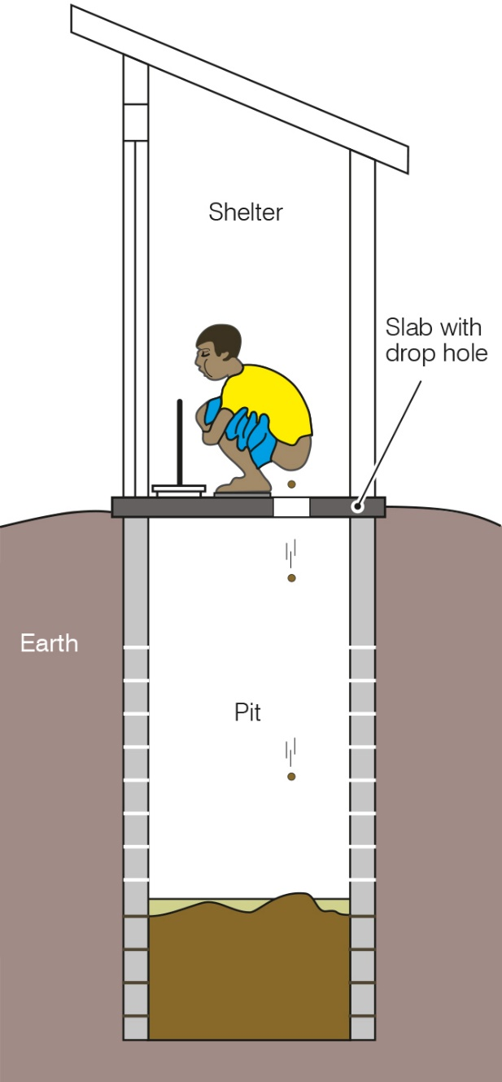
Consider climate resilience of sanitation technologies
Resilience | Sanitation types
More resilient | Pit toilets Low flush on-site systems
Less resilient | High volume onsite systems Conventional sewerage Modified sewerage
Diagram of pit latrine
Source: WHO, 2019. Discussion paper on sanitation, climate change and health. https://www.who.int/water_sanitation_health/sanitation-waste/sanitation/sanitation-and-climate-change20190813.pdf?ua=1

Slide 17
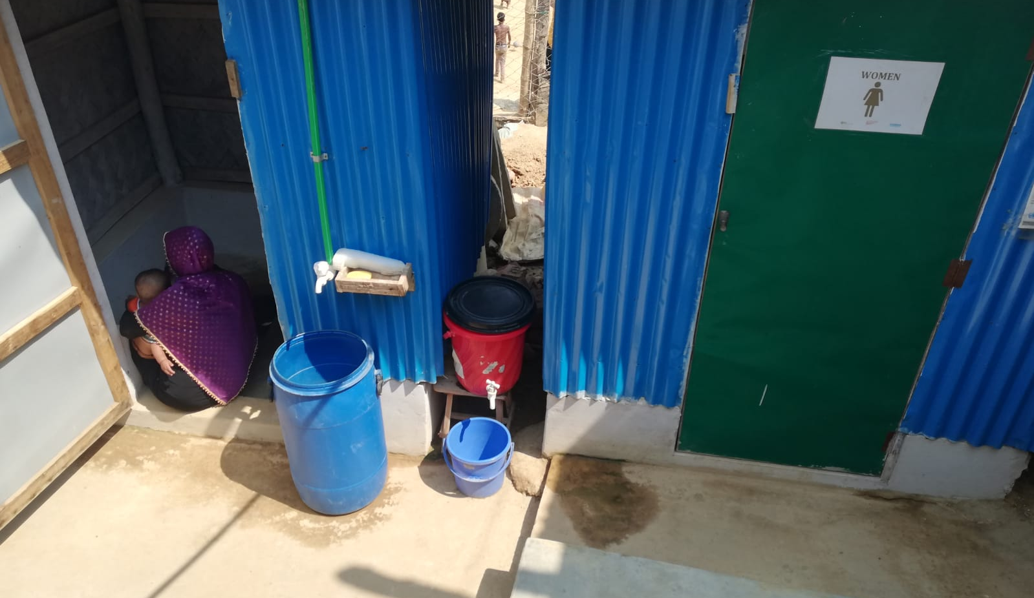
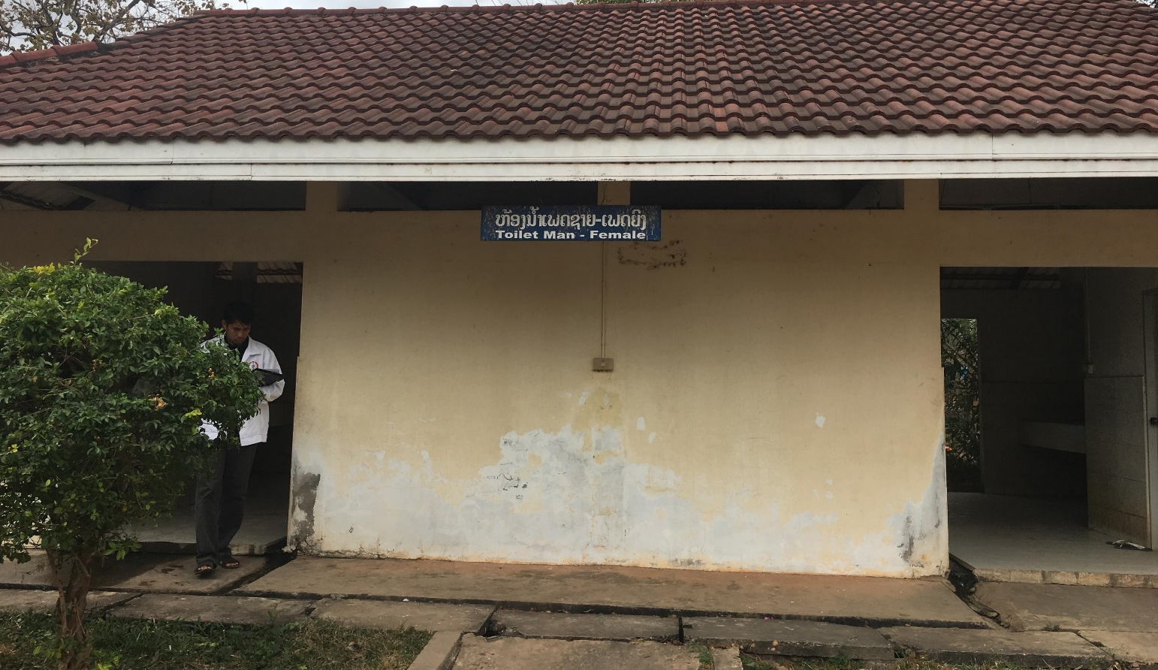
Global monitoring indicators
* ALL ARE APPLICABLE FOR COVID-19 *
Toilets/latrines should be onsite, usable (offers privacy, clean) and accessible.
Toilets are clearly separated for male and female or provide privacy (i.e. single stall/room) if gender neutral
At least one toilet should meet the needs of people with limited mobility and menstrual hygiene management needs.
Toilets should have a functioning hand hygiene station within 5m.
Notes:
A toilet/latrine should have a door which is unlocked when not in use (or for which a key is available) and can be locked from the inside during use, there should be no major holes in the structure, the hole or pit should not be blocked, water should be available for flush/pour flush toilets, and there should be no cracks, or leaks in the toilet structure. It should be within the grounds of the facility and it should be clean as noted by absence of waste, visible dirt and excreta and insects).

Slide 18
Additional WASH FIT indicators – safely managed sanitation
Faecal sludge is fully contained for later emptying and treatment offsite or fully contained and treated in-situ.
Toilets are connected without leaks to a public sewer system. The sewer conveys excreta and wastewater with minimal leaks/overflows to treatment.
The treatment plant is designed to provide at least secondary treatment and performs to performance standards.
A stormwater (i.e. rainwater) and greywater drainage system is in place that diverts water away from the facility into a safe drainage or leachfield area
Greywater and/or stormwater is captured and reused for washing, cleaning, watering plants and toilet flushing

Slide 19
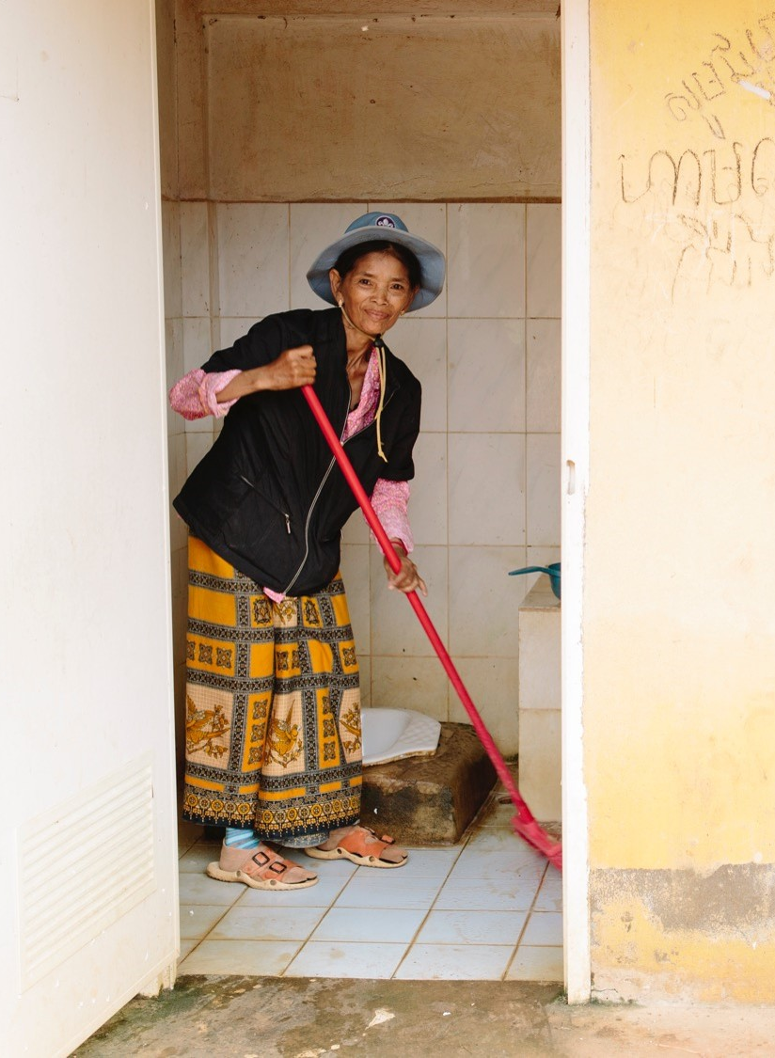
Managing and maintaining sanitation facilities
Toilets should be cleaned every day, and have a signed record of cleaning clearly visible.
Ensure a process is in place for rapidly addressing dirty or broken toilets, including through user feedback
Technical staff trained, and able to conduct regular operation and maintenance of plumbing, toilet and storage/treatment facilities.
© WaterAid, Tom Greenwood
Notes:
Chapter 3: Operation and maintenance
• Cleanliness: the toilet and all surfaces of the room that it is in (e.g. bathroom, washroom, rest room, cubicle etc.) should be kept clean and free of excreta.
• Cleaning arrangements: Locally-available cleaning materials should be safely stored and used, and all people carrying out cleaning should observe safe working practices. Where the toilet is public or shared, a regular cleaning schedule should be in place, with provision made for supply of cleaning materials and personal protective equipment (PPE).
• Where dry toilets are used, a ready supply of ash, soil, lime or sawdust should be available within the facility, with which users can cover faeces after defecating. This helps to prevent flies and minimize
odours.

Slide 20
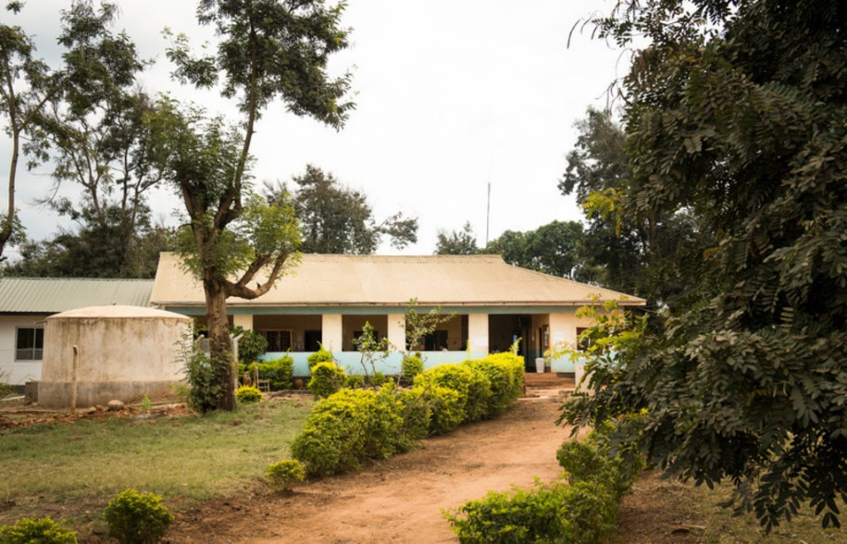
Quiz
What type of sanitation system would you recommend?
How many toilets?
A primary care facility assists with 10 births a month.
Of these, on average, two women spend the night and the rest return home after a few hours.
In addition the staff treat, on average, 40 outpatients a week.
In addition there is a vaccination clinic once a month that serves 100 children.
It is a rural facility and not connected to a sewer.
. https://www.who.int/water_sanitation_health/publications/ehs_hc/en/
© WaterAid

Slide 21
Answer
Facilities may not get a huge amount of use, apart from during vaccination clinics
Ventilated pit latrine or pour flush standing toilets and septic tank + leach field.
Once latrine is full cover and dig a new pit or have someone come empty the pit.
At a minimum: 3-4 toilets (1 or 2 for staff, 1 for male, 1 for female patients)
. https://www.who.int/water_sanitation_health/publications/ehs_hc/en/

Slide 22
Key takeaways
Existing WHO guidance on the safe management of drinking-water and sanitation services applies to the COVID-19 outbreak.
Staff and COVID-19 patients should have separate toilets to protect against spread of infections.
A toilet is not enough – it should be accessible to ALL + fecal waste should be safely collected, transported, treated and disposed.
Regular cleaning and maintenance of toilet facilities is a low-cost, high impact measure to manage risks from fecal waste.
Spread of AMR can be controlled through safely managed sanitation systems; integrating sanitation actions and investments into national AMR plans is a way to leverage political and financial resources.

Slide 23
References
WHO UNICEF (2020) Water, sanitation, hygiene, and waste management for the COVID-19 virus. Interim technical guidance. 23 April 2020.
WHO (2008). Essential environmental health standards in health care. https://www.who.int/water_sanitation_health/publications/ehs_hc/en/
WHO (2018) Guidelines on Sanitation and Health https://www.who.int/water_sanitation_health/publications/guidelines-on-sanitation-and-health/en/
Compendium of Sanitation Systems and Technologies. 2nd Revised Edition https://www.eawag.ch/en/department/sandec/publications/compendium/
WHO (2015). Sanitation safety planning: manual for safe use and disposal of wastewater, greywater and excreta. http://www.who.int/water_sanitation_health/publications/ssp-manual/en/
WHO (2008). Essential environmental health standards in health care. http://www.who.int/water_sanitation_health/hygiene/settings/ehs_hc/en/
WHO (2011). Technical notes on drinking water, sanitation and hygiene in emergencies. Available at http://www.who.int/water_sanitation_health/publications/2011/tn9_how_much_water_en.pdf
WHO/UNICEF (2015). Water, sanitation and hygiene in healthcare facilities: Status in low-and middle-income countries and way forward. http://www.who.int/water_sanitation_health/publications/wash-health-care-facilities/en/
Swedish Red Cross (Ed.) (2008): Slide show of Swedish Red Cross water and sanitation module 4O ERU deployed in Philippines. Stockholm: Swedish Red Cross. URL: http://www.ifrc.org/Global/sw-watsan-eru-philippines0808.pdf [Accessed: 20.03.2015].

Slide 24
SANITATION MANAGEMENT
IN THE CONTEXT OF COVID-19 PREVENTION
IN VIET NAM
Health Environment Management Agency,
Ministry of Health of Viet Nam

Slide 25

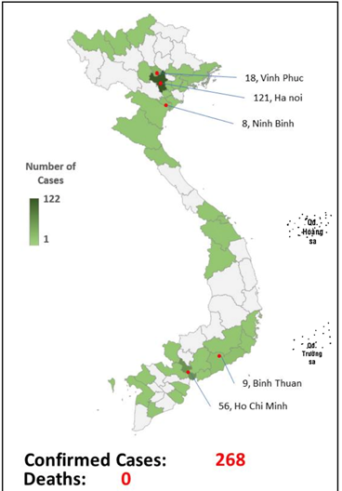
COVID-19 IN VIET NAM
Last update: 18/4/2020

Slide 26
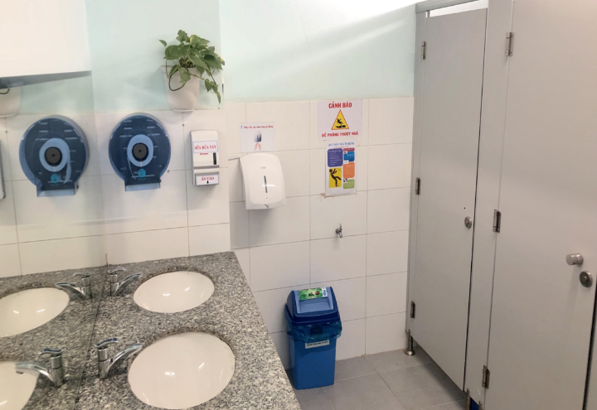
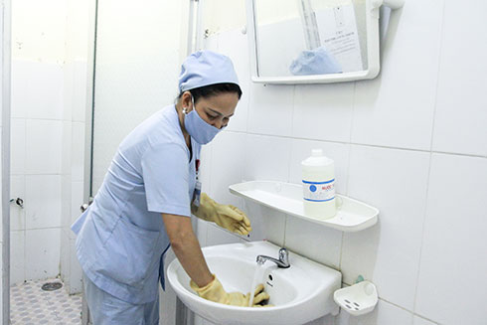
SANITATION
IN THE CONTEXT OF COVID-19 PREVENTION
Availability of sanitation facilities in:
Health care facilities
Quarantine/isolation room
Quarantine/isolation facilities: Fixed or mobile toilets
Sanitation quality:
Easy to access
Privately for male and female
Having soap, clean water and toilet paper
Instructions on hand washing steps
Cleaned and monitored at least twice times daily:
  Using 0.05% active chlorine-containing disinfectant solution
  Focusing on floor, water flush button, water tap, door knobs

Slide 27
SANITATION
IN THE CONTEXT OF COVID-19 PREVENTION
Sanitation management for COVID-19 patient and suspected person
  One toilet for one isolation room
  Having water and soap
  Cleaned at least 2 times a day with disinfectant solution (0.05% active chlorine)
  Waste generated from the toilet is managed as infectious waste
  Toilet cleaner should wear PPE when cleaning
  Training is required for cleaning staff

Slide 28
WASH in health care facilities for preventing COVID-19
@WASH_for_health
Technical guidance: focus on SANITATION
30th April 2020
Slides available at www.washinhcf.org/resources, “search COVID-19”

