Slide 2
This Community of Practice is an action-oriented learning platform that brings together the WASH and health communities to focus on policy, evidence, and practice in WASH in HCF.
CONNECT partners
SHARE experiences
Encourage groups to ACT
Notes:
This webinar is a part of the WASH in HCF initiative.
Our goal is to expand the conversation, connecting the expertise and experience of our partners and colleagues to the members of the WASH and health community who have expressed interest in “moving to action” in WASH in HCF. We welcome all to participate these webinars, whether you’re a seasoned expert on WASH in HCF, or someone for whom this topic is brand new.

Slide 3
WASH in HCF Community of Practice Basic Principles
WASH is a fundamental prerequisite for quality care within a healthcare facility and there cannot be effective infection prevention and control without adequate WASH.
WASH in healthcare facilities is a solvable issue and will require multiple systems, sectors, and stakeholders to work together to see sustainable improvements.
The Community of Practice is open to all who seek to learn and share about WASH in healthcare facilities. We welcome all and respect the diversity of perspectives who participate.

Slide 4
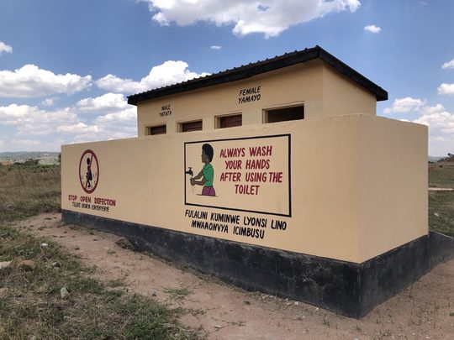
Success Corner
Between 2020-21, World Vision Zambia :
Installed a water system at a health post that had been without access.
Through the Citizen Voice Action group, community members took on an initiative to construct a maternity to expand space to meet the growing demand for services.
World Vision then connected the water system to the new maternity annex and constructed a septic tank and soak away.
Now the health post is able to provide safe delivery services which meet the needs of the community

Slide 5
New Publication Alert
The Ministry of Health and Medical Services in Fiji has published guidelines for WASH in HCF, with a specific focus on climate resilience – the first guidelines to do so.
Find it on WASHinHCF.org/resources

Slide 6
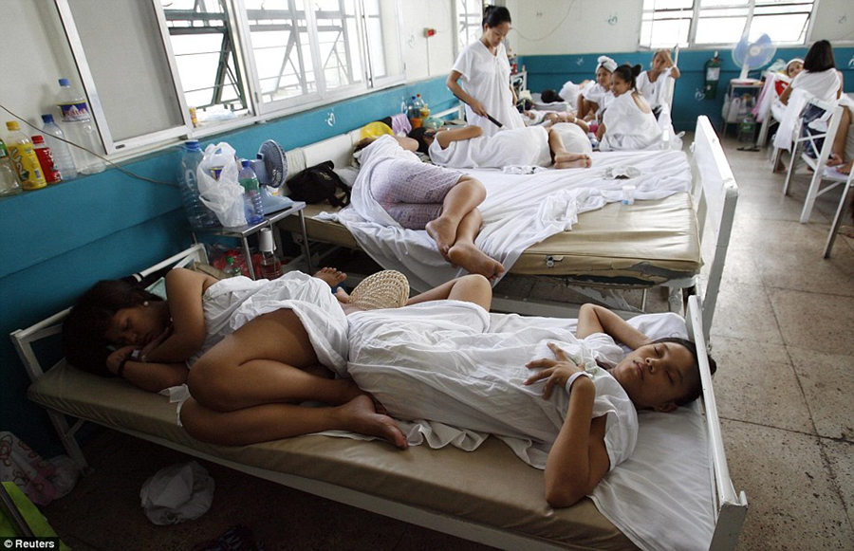
Gender-Responsive WASH in Healthcare Facilities

Slide 7
Why do we need to consider gender?
Poor WASH service provision disproportionately affects women and girls.
Inadequate WASH services in HCF lead to negative health impacts (i.e. maternal mortality rates and reproductive health)
WASH facilities in HCF in LMIC fail to provide user friendly and gender sensitive services. Common challenges include:
Women feel unsafe in the toilets or bathrooms (i.e. lack of gender separated facilities, bathroom doors that cannot be locked, toilets without light)
Soap and/or water is not available for handwashing
The hospital environment is unclean (i.e. open defecation)
Lack of area to bathe after giving birth
Lack of menstrual hygiene management

Slide 8
Gender-Responsive WASH in HCF
Gender-responsive WASH examines the gender inequities and opportunities within WASH programming, engaging female stakeholders throughout the process and addressing needs specific to women.
In the healthcare facility setting, there are multiple perspectives to be considered:
Female patients (including mothers)
Female healthcare workers
Female leadership

Slide 9
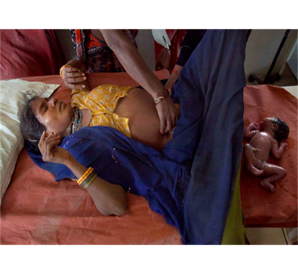
Perspective 1: Female Patients
Female patients are particularly vulnerable in HCF without adequate WASH services, both as more frequent visitors to the HCF and due to the nature of childbirth. Major WASH concerns impacting women include:
Dirty, contaminated deliver setting
Inability to wash themselves or the newborn after birth
Lack of private, safe bathing and sanitation facilities
Specific health realities and concerns:
Menstrual Hygiene Management
Postpartum bleeding
Incontinence (also can be an issue for men)
Fibroids and Endometriosis
Source: Jennifer Foster

Slide 10
Patient Satisfaction & Care-seeking Behaviors
Inadequate WASH in HCF is not just dangerous for women, girls and newborns, but it leads to patient dissatisfaction and prevents women from using HCF.
Interviews from recently delivered women in Uttar Pradesh, India found that the cleanliness of toilets was reported as a concern in the majority of HCF.
Some women refrained from using the toilet due to the irregular supply of water and lack of proper cleaning.
With specific regard to maternal health services, poor WASH provision in HCF was the reason women choose home delivery.
A 2018 review suggests that improving WASH conditions in HCF will decrease patient dissatisfaction, increase care seeking behavior and improve health outcomes.

Slide 11
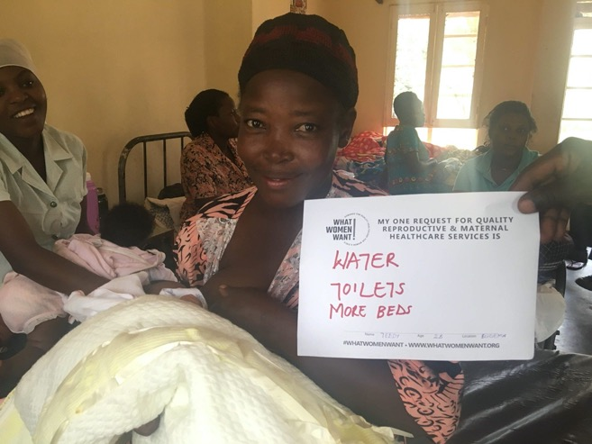
The What Women Want Campaign
Led by the White Ribbon Alliance, the What Women Want campaign surveyed 1.2 million women across 114 countries in 2018 about their demands for quality reproductive and maternal healthcare.
WASH was #2 on the list of demands, behind compassionate care.
Source: White Ribbon Alliance What Women Want Campaign
Notes:
What Women Want campaign—

Slide 12
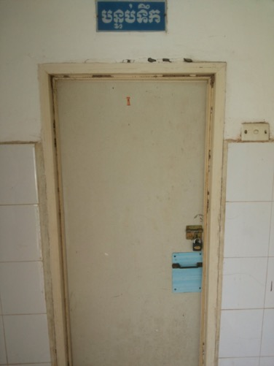
Perspective 2: Female Healthcare Workers
The lack of adequate WASH in HCF puts female staff at increased risk of healthcare-associated infections and undermines their safety, motivation and ability to do their job in a clean and safe environment (WaterAid, 2019).
Lack of gender separated toilets dedicated to staff increases risk of UTI from health workers holding-in their urine during long shifts.
Not having a safe, private location for changing used menstrual materials can lead to anxiety and stress and reduce concentration and productivity.
Some women miss hours or entire days of work to avoid managing their menstruation in difficult environments (Sommer, 2016).
Source: Lindsay Denny

Slide 13
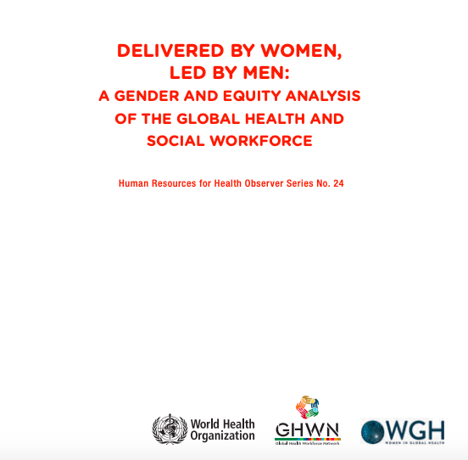
Perspective 3: Female Leadership
According to WHO, approximately 75% of the healthcare workforce is female, yet the majority of leadership positions, both at the facility-level and within the Ministry of Health, are held by men.
Power dynamics between female frontline healthcare workers and male health leaders further prevent women from decision-making and resource allocation processes.
This can affect everyone’s ability to address gender-specific WASH needs at the facility.
The gendered leadership gap is a barrier to reaching SDGs and universal health care
Source: WHO (2019)

Slide 14
Example Strategies for Gender-Responsive WASH in HCF
Ensure women are part of the WASH in HCF strategy, design, planning and monitoring process – as leaders, health workers, and community members
Review gender-disaggregated data for WASH in HCF.
Include gender-specific indicators for WASH services in HCF
Support the government in setting minimum standards for gender-responsive WASH services in HCF.
Consider women-centered design principles
Support training for healthcare providers, cleaners and other HCF staff
Ask women what they want!

Slide 15
Key Takeaways
Female patients (in particular mothers) and female healthcare workers face specific challenges in HCF that lack appropriate WASH services.
Inadequate WASH in HCF can increase the health risks of women and their babies and be a deterrent to women utilizing health services.
Female healthcare workers make up three-quarters of the global health workforce, but power dynamics prevent women from decision-making and resource allocation roles.
Integrating the female perspective in the design, planning and implementation of WASH in HCF programs is essential to addressing these challenges.

Slide 16
Ways to Get Involved
Subscribe to the listserv to receive updates on events and resources (link in chat). Join live sessions and connect with others in the space.
Send us topic recommendations. We want to know what you want to learn about and discussion.
Nominate a success story. Every live session + newsletters will highlight successes, big and small, in WASH in HCF.

