Slide 2
WASH FIT KoBoToolbox Tutorial
February 2022
Notes:
This module accompanies the 2022 WASH FIT training package.

Slide 3
A recording of this training module is available on the WASH in health care faciltiies YouTube channel, visit https://www.youtube.com/channel/UCmERJPGZTfolALXCDcpbkug

Slide 4
Learning objectives
Understand how to use KoBoToolbox to conduct assessments with the WASH FIT tool.
Understand how to modify the WASH FIT assessment in KoboToolbox.
Understand the scoring for different domains and generate a WASH FIT facility score.
Understand how to download the data.
Note: This is NOT a tutorial on the full WASH FIT tool
Notes:
Note: to access the full WASH FIT training package, visit www.washinhcf.org/wash-fit.

Slide 5
Tool Formats and Links
WASH FIT
Spreadsheet version:
https://washinhcf.org/resource/wash-fit-assessment-form-excel/
KoBoToolbox version:
https://washinhcf.org/resource/wash-fit-assessment-form-kobo/
Which format is for you?
Notes:
Excel is intended essentially as a paper copy format
KoboToolbox is intended as an electronic data collection tool. Less manual entry, can be collected on a handheld device etc.
FH assisted in the implementation of this tool in Kobotoolbox format to assist in electronic data collection.

Slide 6
Open Source and Customizable
Both spreadsheet and KoBoToolbox versions can be easily customized to culture, context and language.
Indicator definitions can be modified based on:
National regulations
Best practice
Add specifics to terms, e.g. “reliable” “available” “regular time period”
For example “Water quality routinely and regularly tested according to standards” could become “Water quality tested daily according to Country X’s Ministry of Health regulations”
Situation on the ground
Number of indicators changed (add or remove)

Slide 7
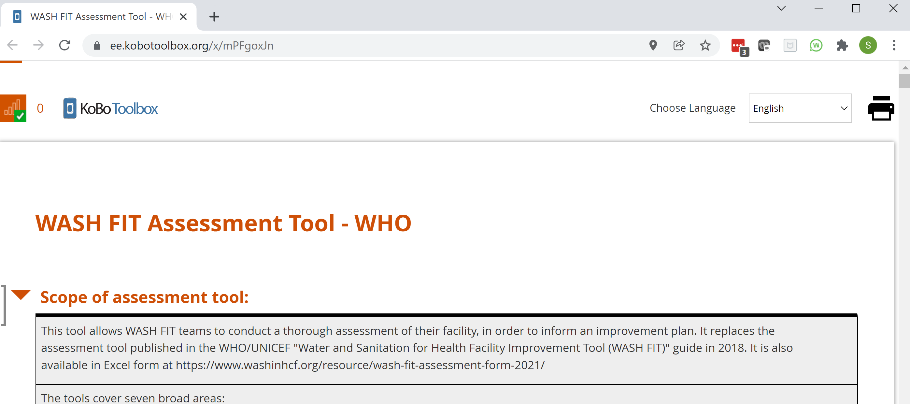
Introduction to KoBoToolbox
Click your link: https://ee.kobotoolbox.org/x/mPFgoxJn
No need to have an App or specific software
Start working!
Notes:
Note: If someone has made a change to the form it should say will indicate that a new version of this form is available and you will need to refresh your browser.

Slide 8
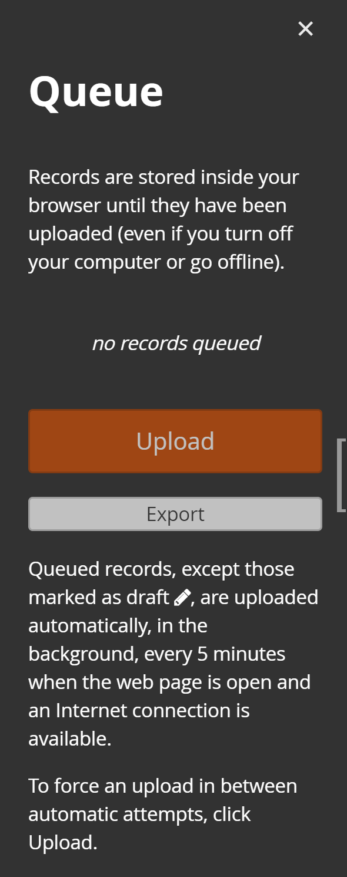
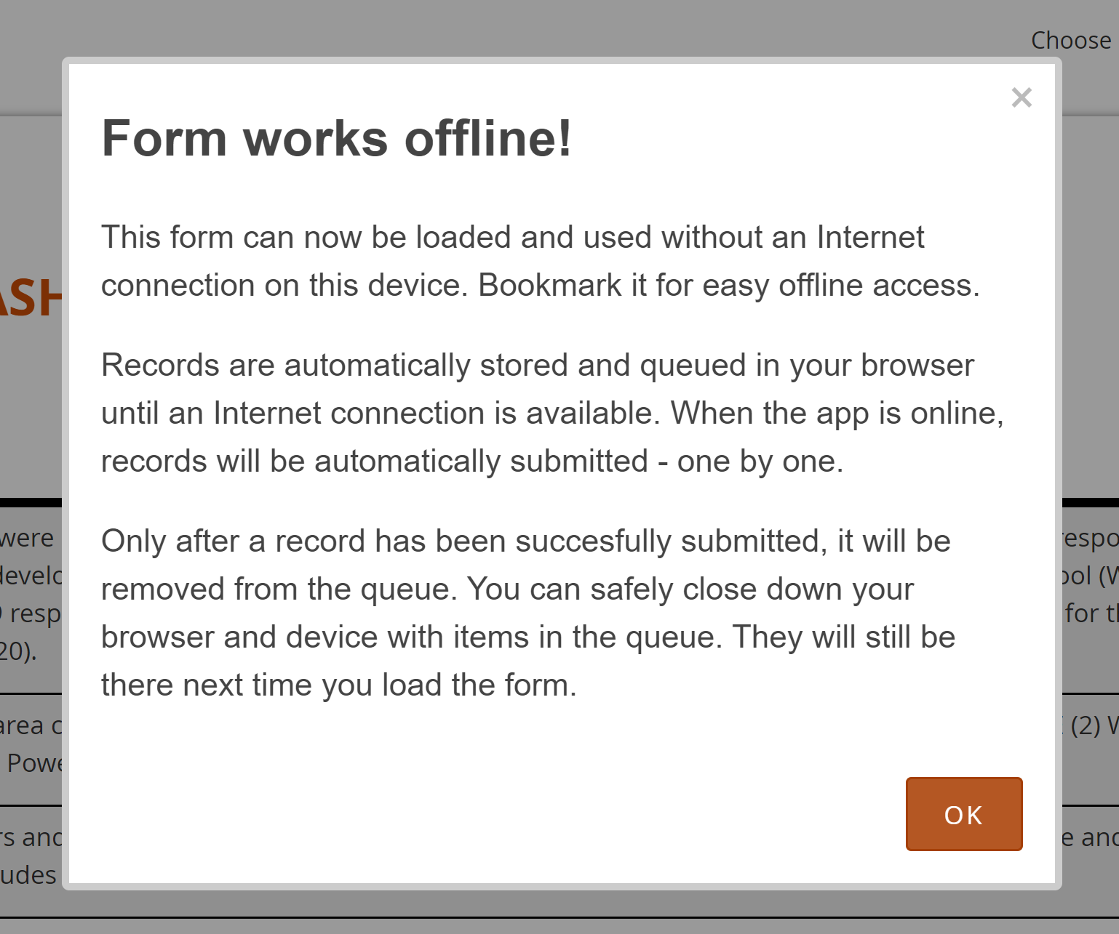
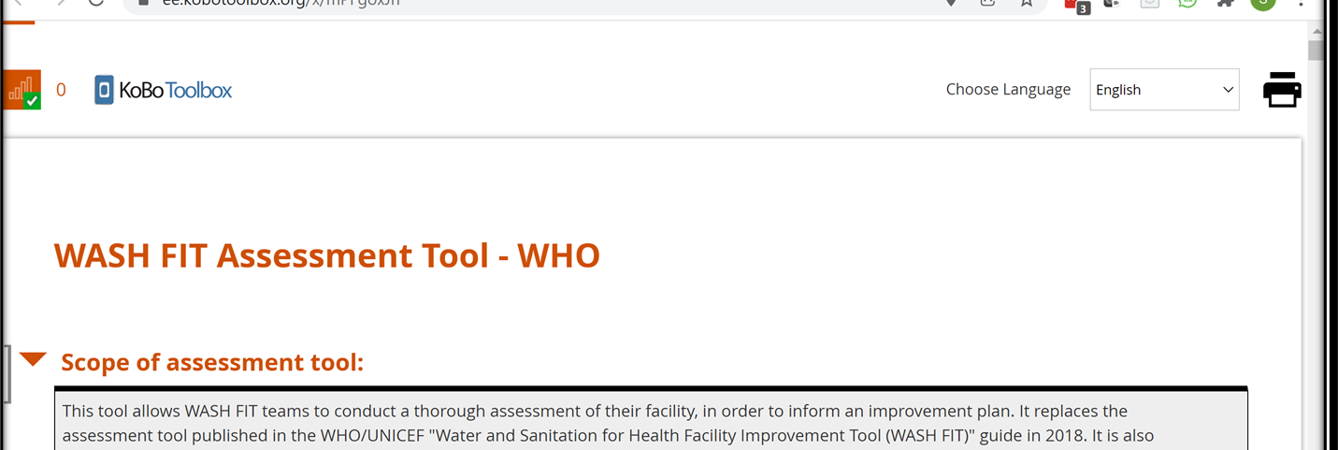
Data Collection/Submission
Notes:
The form works even if you don’t have a Wi-Fi or data connection to the internet. As long as you load it prior to departing for the facility (facilities)/moving out of network, you will be able to access it. The number shown will be the records stored on your device. Once downloaded this number will return to 0.
If you click the Queue button you can see the records that you have stored. These are automatically updated as soon as you have an internet connection.

Slide 9
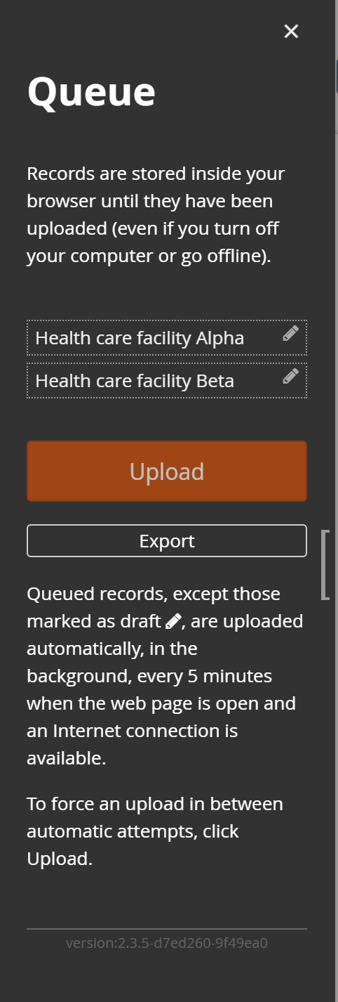
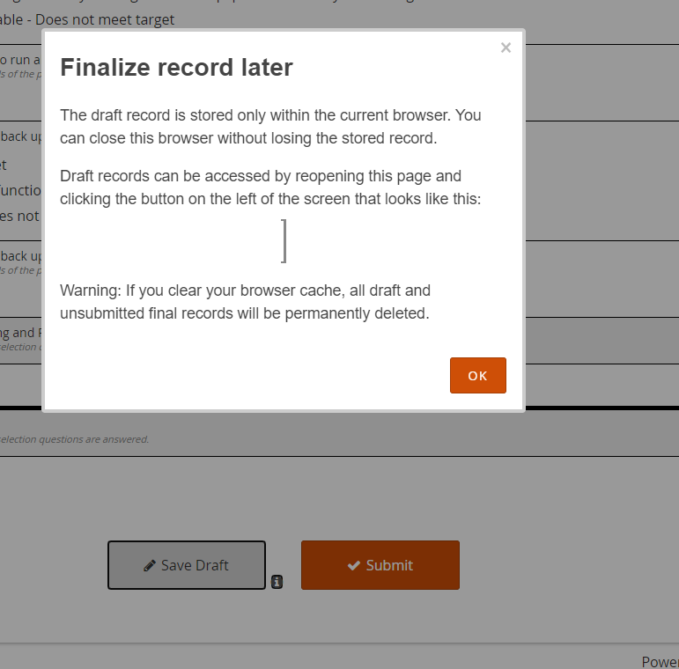
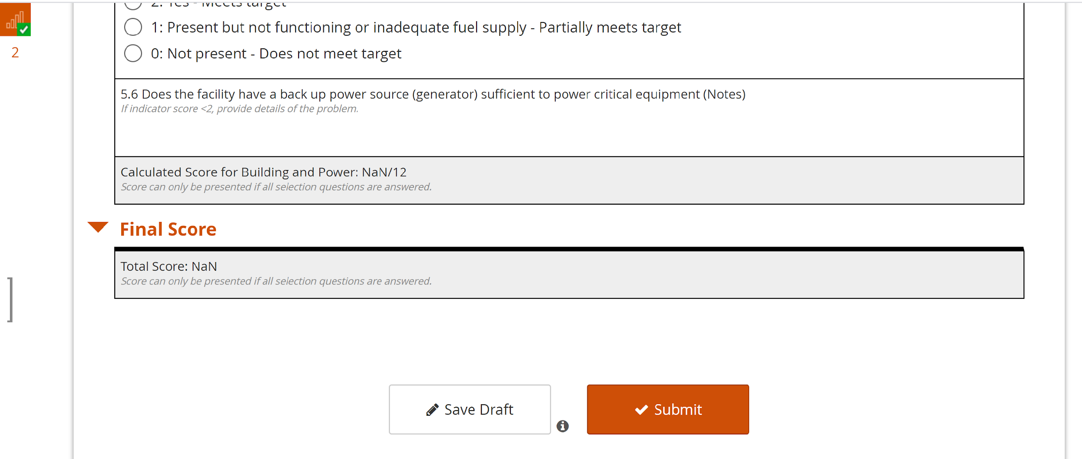
Drafts
Notes:
You can go back and edit a form before it is submitted. For example, perhaps you visit HCF Alpha and fill your form and then go to HCF Beta and realize you’ve interpreted a question differently. You can go back and edit the answers later.
Reminder: remember to submit the form or they will not be uploaded. If you submit them, they will automatically be uploaded when you have an internet connection.

Slide 10
Filling Out the Form: Comparison of KoBoToolbox and Excel
Indicator
Category
Explanatory Notes
Score
Comments
Notes:
In general, the layout is similar to the Excel version and should be straightforward to fill out. Click the score for the indicator and type in any explanatory comments.

Slide 11
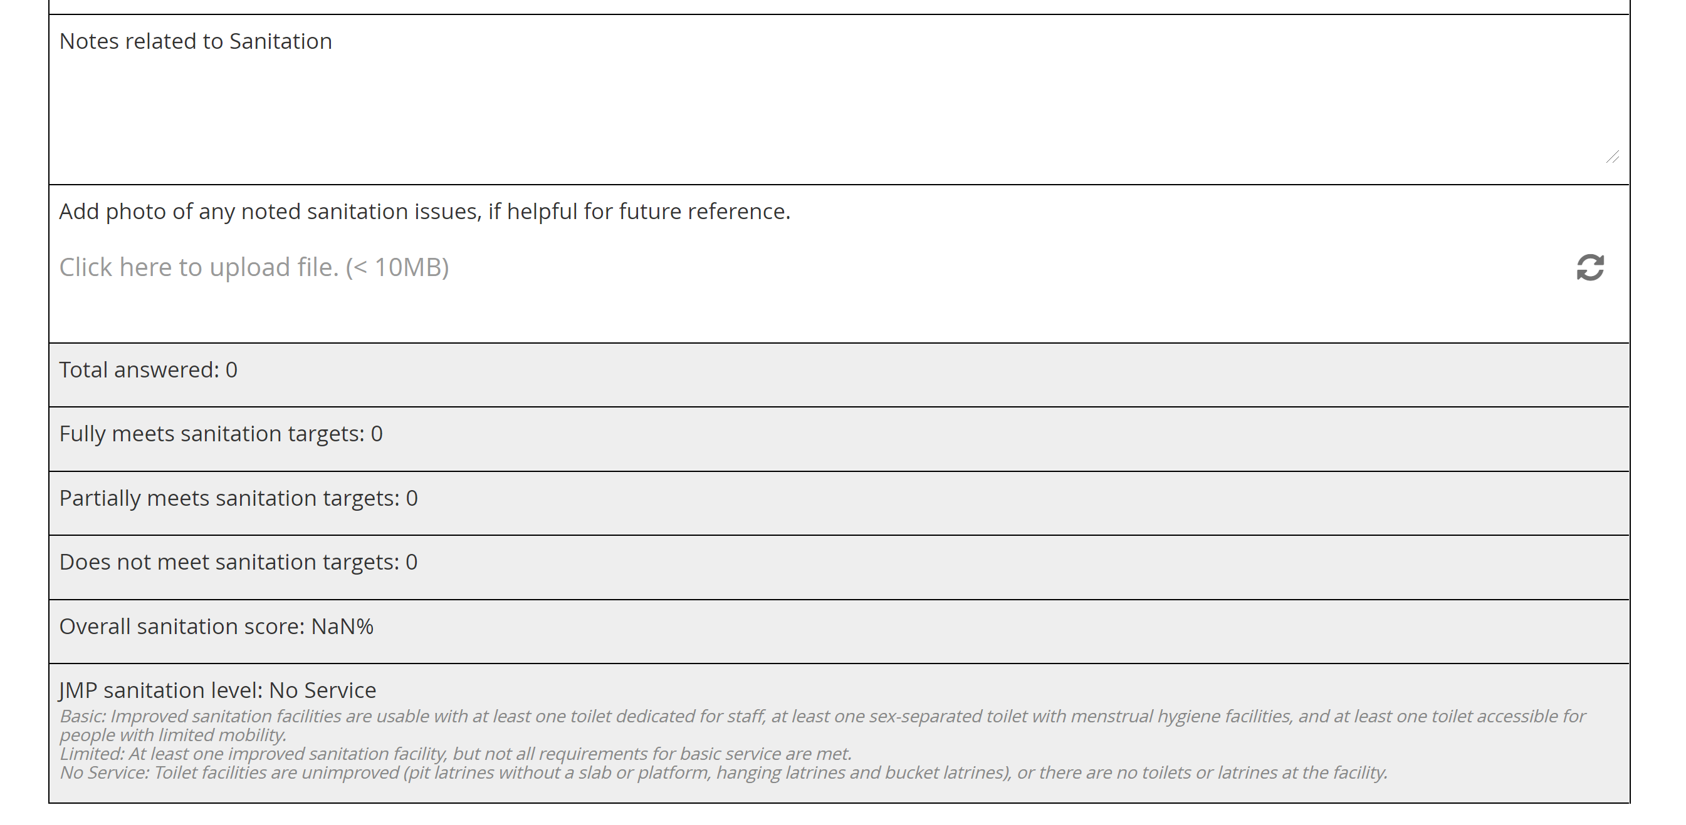
Filling Out the Form
General notes for the section - major issues
Photo can be uploaded or taken directly in form
Scoring auto-populates
Notes:
At the end of each domain is a section for:
Notes specifically related to the domain that would clarify the response for any indicators or suggest an improvement, etc.
Photographs can be uploaded directly into the file.
The scoring will display automatically.

Slide 12
Scoring in KoboToolbox
Questions can be skipped and calculations will be based on the questions answered
Overall facility score % is based on weighting: met (2), partially met (1) and not met (0). So the calculation is:
$Facility score \left(\%\right)=\frac{2∗sum of met+1∗sum of partially+0∗sum of not met }{2∗total indicators }X 100$
JMP scoring based only on the questions addressed in JMP
Notes:
If you do not answer some of the questions, the overall score will be based ONLY on the questions answered.
Note that there is some “skip logic” in the form. Make sure if you change your answer in the skip logic to go back and unclick former answers otherwise it will be calculated within the total score. For example: In the sanitation section it asks, “Is the system connected to a municipal sewer?” Depending on your answer different questions are displayed. If you answer the questions under “yes” and then realize you should have answered “no” please unclick your answers to the appropriate indicators and then go back and switch your answer from “yes” to “no”.

Slide 13
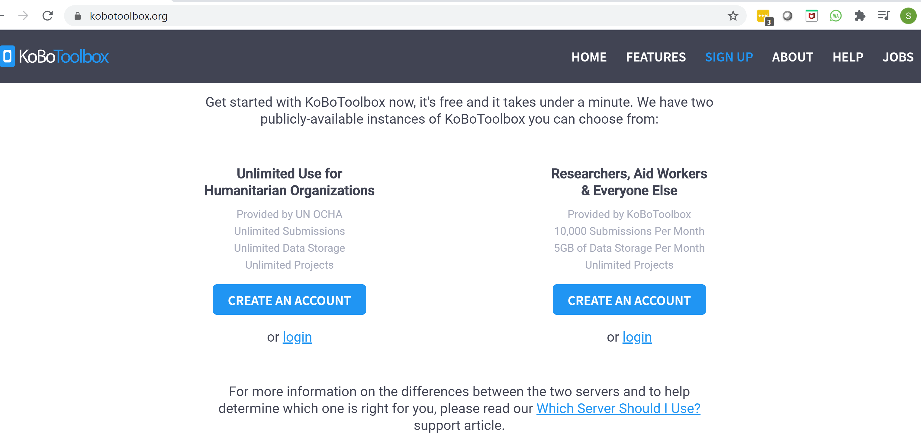
How do you set up the form for your organization/country/facility?
Designate an administrator
Sign up for a KoBoToolbox account (www.kobotoolbox.org)
Download the Excel version of the survey at the www.washinhcf.org/resources/wash-fit-assessment-kobo-toolbox-version
(optional) Modify the Excel version with any changes
Upload to KoBoToolbox
(optional) Modify within the KoBoToolbox form for your use
Notes:
You can find these tools in two locations: www.washinhcf.org under the Resources section and also on the WASH FIT specific page: www.washinhcf.org/wash-fit
Note: There will be more information on editing in the next slides; however, note that you can edit the form either directly in the excel file or from the form builder in KoBoToolbox. Personally, as a novice, I’ve found that whether I do edits in excel or in KoBoToolbox depends on the types of edits. For example, adding translations is most straightforward in Excel, but skip logic is easier in the form builder.

Slide 14
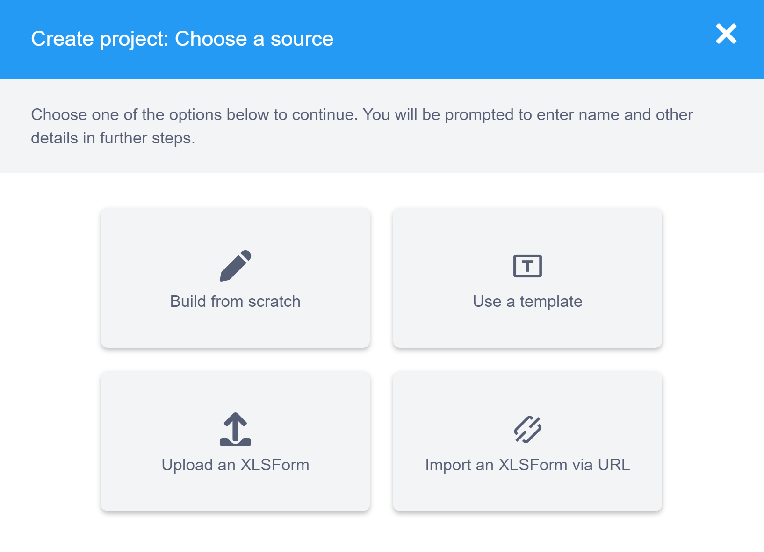
How to Upload the Form
Hit the “NEW” button
Hit the “Upload an XLSForm” button
Notes:
Uploading is pretty straightforward, click the “New” button and then “Upload an XLSForm”
Browse to the file. You can add a specific name and some details to the file.
It should then show up in your list of projects.

Slide 15
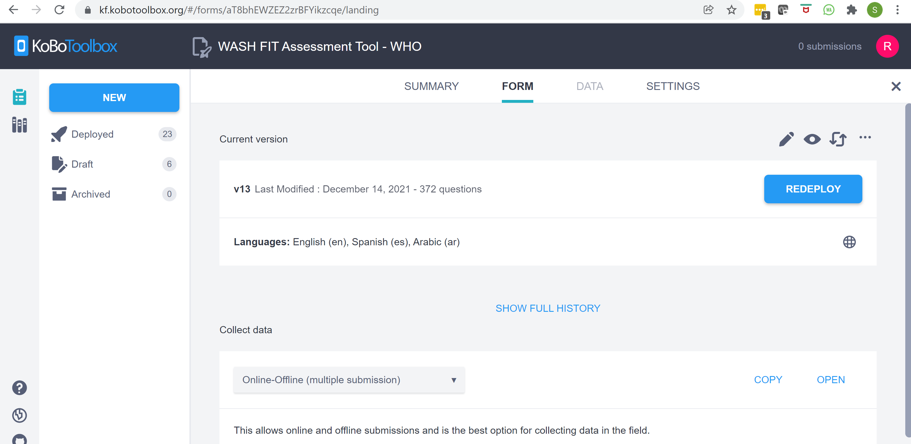
Use with No Modifications
1. You must always DEPLOY (or redeploy) the survey after EVERY change.
2. Click OPEN to start collecting data.
3. You can share this link with anyone collecting data. They do not require a log-in to collect and submit data. The data they collect will display in your dashboard.
Notes:
If you want to use the form without any modifications simply hit “deploy” after you upload the form and you are ready to collect data.
Note: If you have redeployed the form while colleagues are using the form. If they are online, they will get a message to refresh their browser. If they are offline, they will not get the updated form until they connect to the internet again.
KoboToolbox will keep data from multiple versions, but it may be more difficult to sort and process the data on the tail end, so if at all possible, I would suggest testing your form with your surveyors and making any needed modifications prior to real data collection.

Slide 16
Simple Modifications within KoBoToolbox
Simple modifications are easier to do within the form.
Click the pencil icon to modify the survey
Note: You may also modify the Excel file and replace the version; however, you will need to understand the coding at a deeper level.
Notes:
As noted above, you may wish to do some edits both ways. As a novice, I’ve found this the most effective way to complete it without getting too detailed with the coding.

Slide 17
Simple Text Modifications
Click any of the text areas to modify
Notes:
Note: KoBoToolbox is not wonderful at displaying text, so you have to scroll to view any text that is not displayed. Also, inserting hard returns in the form editor is challenging, if this is critical for you to change, you might wish to do that within excel (CTRL Enter will put a hard return in excel).

Slide 18
Reordering or Removing Questions
The order of question may be changed simply by dragging the box to where you want it.
Click trash can to delete a question
Notes:
Reordering questions can be done with “drag and drop”. Just note, that you’ll need to move the comment question as well.
Deleting a question is simple; however, note that it will cause issues with scoring. More on that later in the presentation.

Slide 19
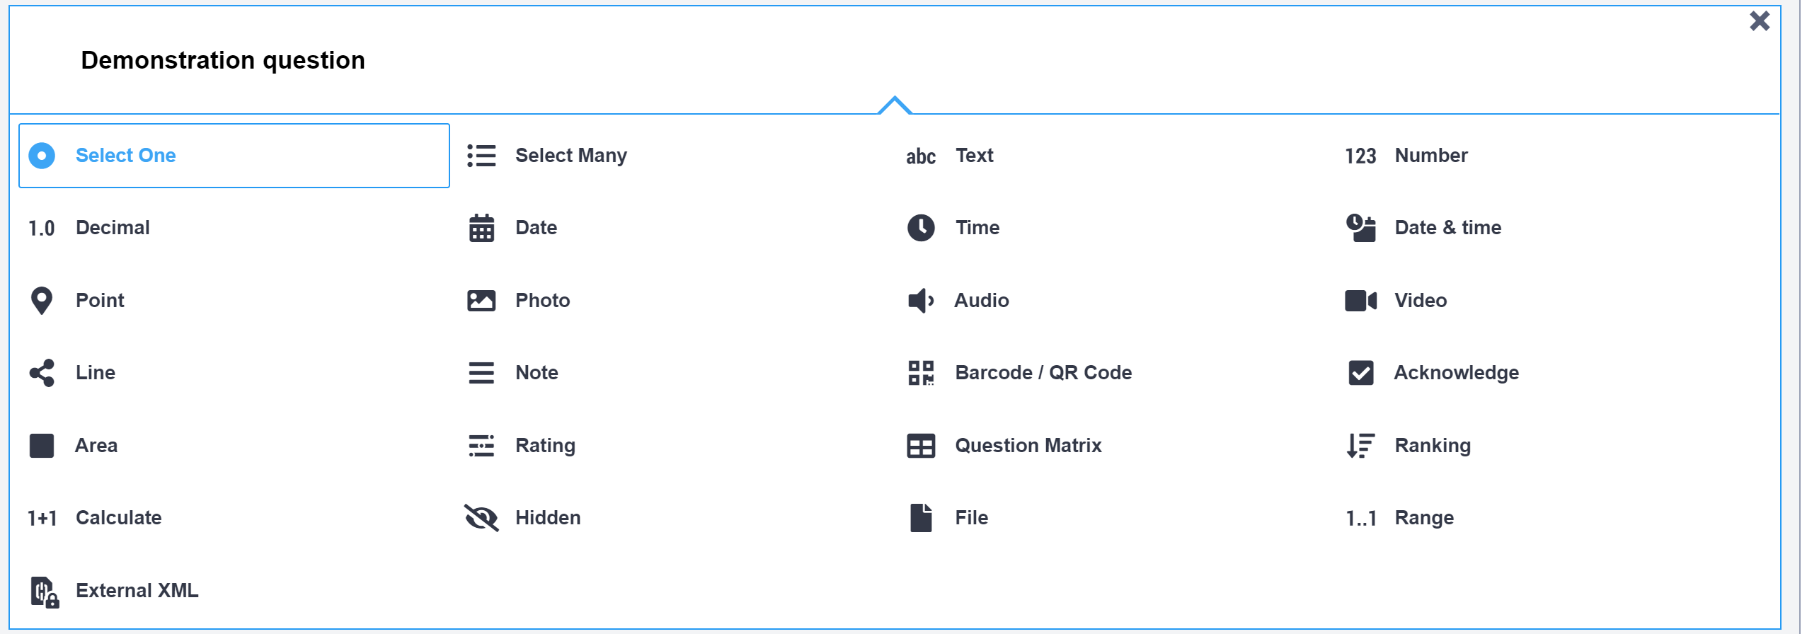
Adding Questions
1. If you hover at the upper lefthand corner of any question a + sign will show up. Click the + to add a question.
2. Type your indicator
3. Click “Select One”
Notes:
Note: To add the comment, you follow the same procedure, but instead click “text”

Slide 20
Adding Questions
1. Add the options
2. Add the category and any explanatory notes
3. Make sure to change the XML value for each option. I.e., 2, 1 or 0
Notes:
Add the criteria for met (2), partially met (1) and not met (0) – you will need to click the empty row at the bottom that reads “+Click to add another response…”
Add category and explanatory notes (again, hard returns are funny in the form builder, you may wish to do these in Excel)
Add the XML to the scoring value – this is how KoBoToolbox knows the value for calculating scores.

Slide 21
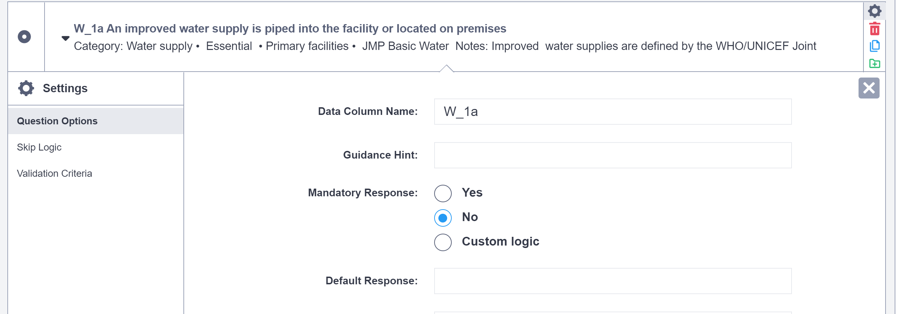
Simple Right? Not Entirely…
Click the gear to see the settings
Side note: This duplicates the question. Theoretically you could duplicate a question and then modify it for a new question…don’t do this – It causes issues!
Not a big deal if you reorder but keep all the questions. BUT if you delete or add any, then the scoring WILL NOT WORK. In fact, KoBoToolbox will not allow you to launch the form if you have deleted a question that is included in the scoring.
Each data column name has been assigned to match the question number
Notes:
Note:

Slide 22
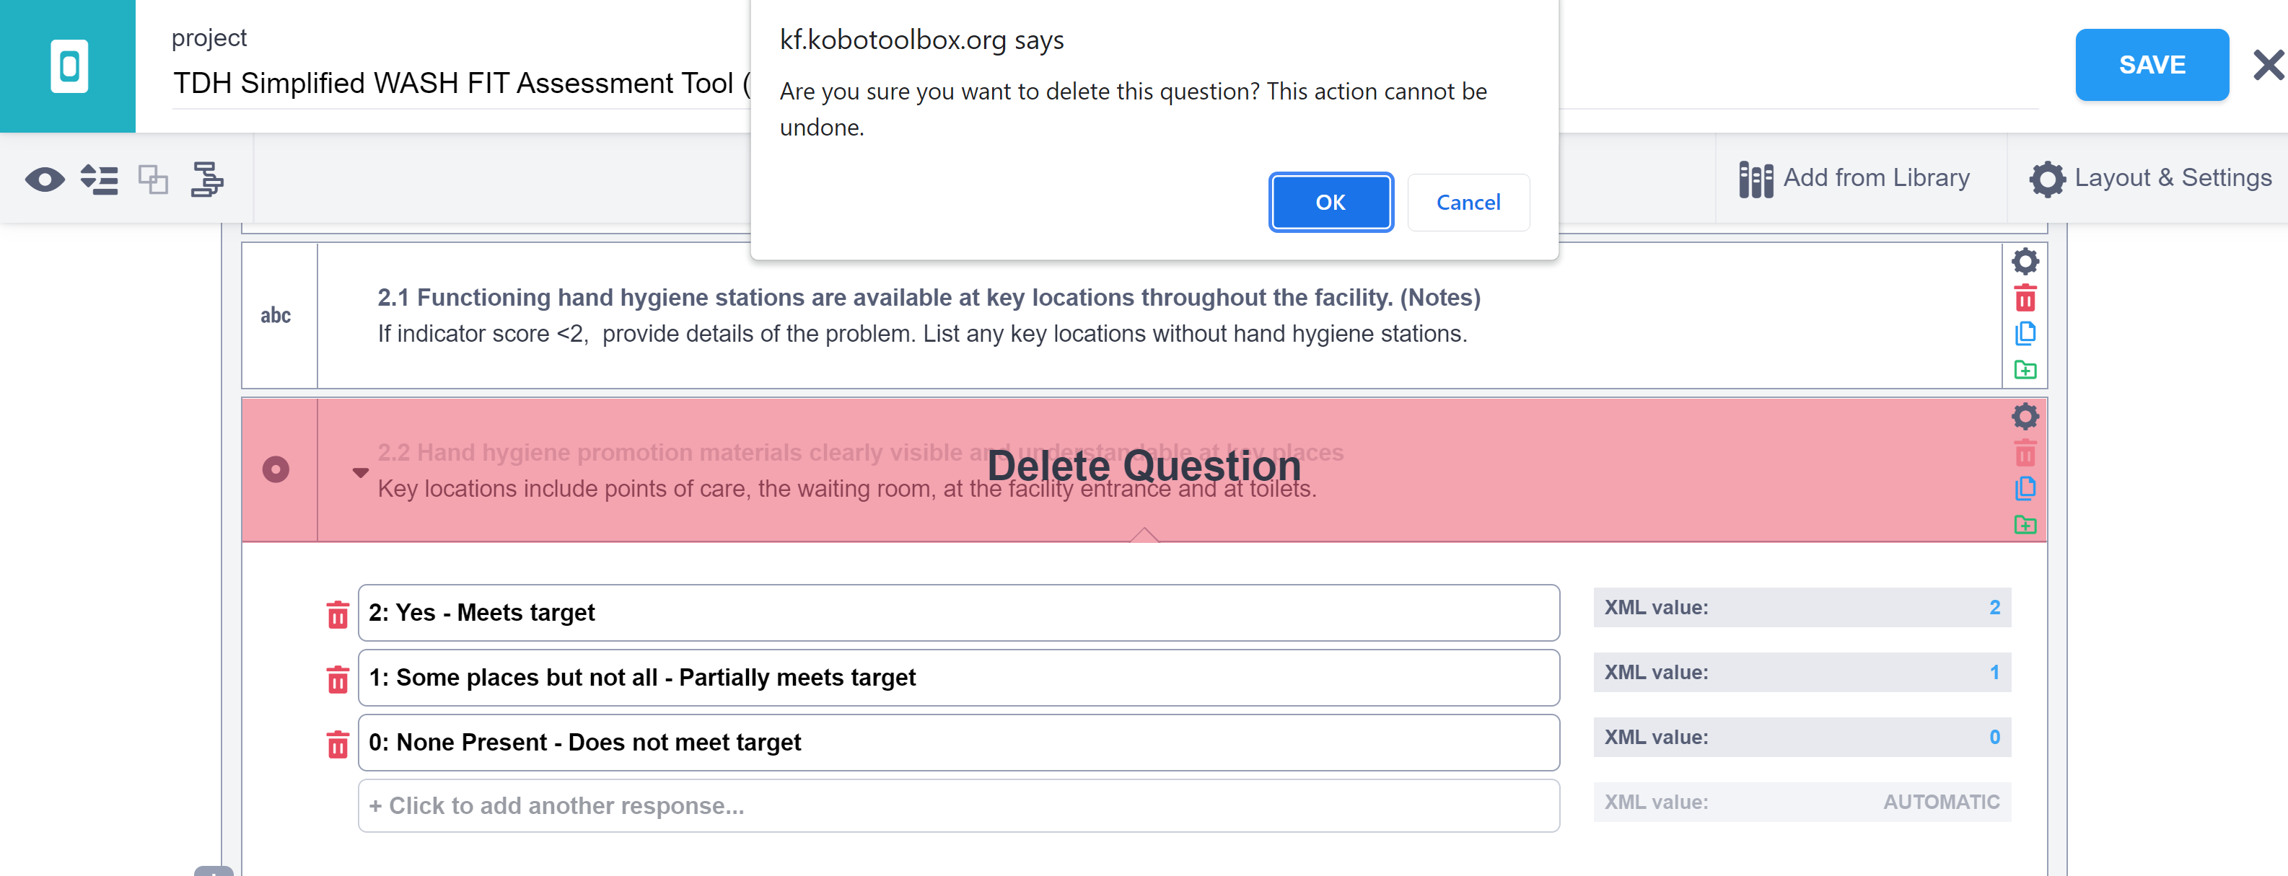
Deleting a Question
Notes:
When you delete a question, you cannot get it back. KoBoToolbox will ask you to confirm before deleting. If you delete and did not mean to and if you haven’t yet saved the file, you could always close it without saving and revert to your original file. But if you’ve made other changes, you would lose those too.

Slide 23
Deleting a Question
Remove the calculation from each formula
For example: If you deleted question W_4, you would remove the areas shown outlined in green.
Notes:
If you delete a question, you must delete it in the formulas as well, so that the calculations work and so that your form will work. In this example, if you removed question W_4 you need to remove the whole phrase in the formula where W_4 is mentioned. I would suggest you do a “find” for W_4 to make sure you’ve deleted all the references.

Slide 24
Adding a Question
Step 1: Click the gear to see the settings
Step 2: Change the data column name to match the question number. For example W_25.
Step 3: Scroll down to the formula section for the domain
Step 4: Add the calculation to each formula
For example: If you added question W_25, in the first formula you would add: + if($(W_25)=“2”,1,0) and similarly in the second and third formulas but changing the “2” to “1” or “0”.
Notes:
This may seem a bit overwhelming at first. However, you don’t have to understand the full syntax of the formulas to add a question. Just make sure you have a unique identifier in you data column name (for example (“W_25”) and then copy the formula and insert it in each location. You will have to add to each of 3 formulas. The top formula you’ll see has “2” in each portion – these count all the number of indicators that met the criteria, the middle formulas have “1” in each portion, so counts everywhere that partially met the criteria and the last formula counts the number of indicators that did not meet the criteria.

Slide 25
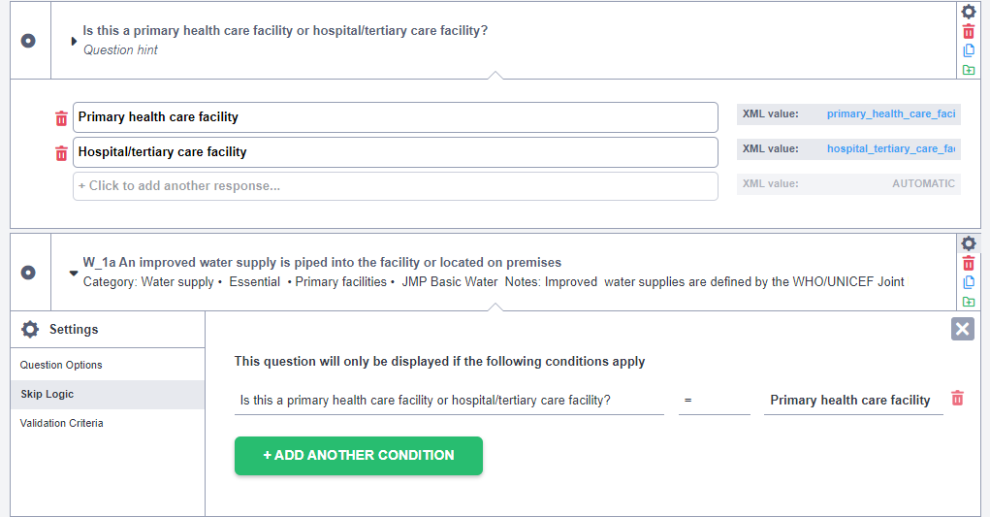
Changing Skip Logic
1. Click the gear to see the settings
2. Click Skip Logic
3. Set the criteria using any previous question
NOTE: Make sure your formulas are correct.
Notes:
Skip logic is used in a few locations where you answer a different question based on a criteria (e.g. what type of facility you are in). In this example, you answer different questions on water supply based on whether the HCF is a primary facility or a hospital/tertiary facility. The skip logic conditions make it so that only questions relevant to the type of facility you are in show up. Another example in WASH FIT is where you answer different questions based on the type of sanitation system (whether the HCF has a piped sewer connection or on-site disposal).
Here’s how to change it if needed.
Also remember the note above in utilizing the survey. If you change your answer to the primary question, please unclick any old answers otherwise the scoring will not work properly.

Slide 26
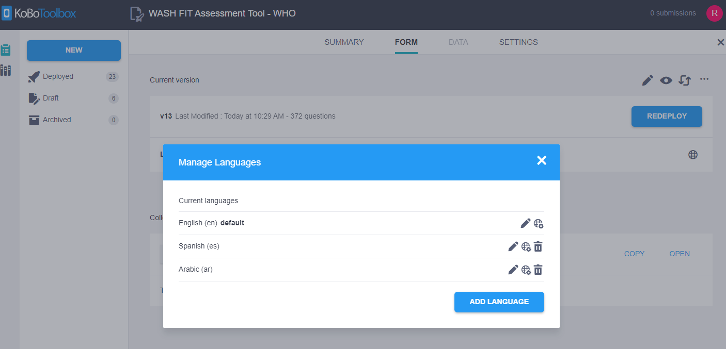
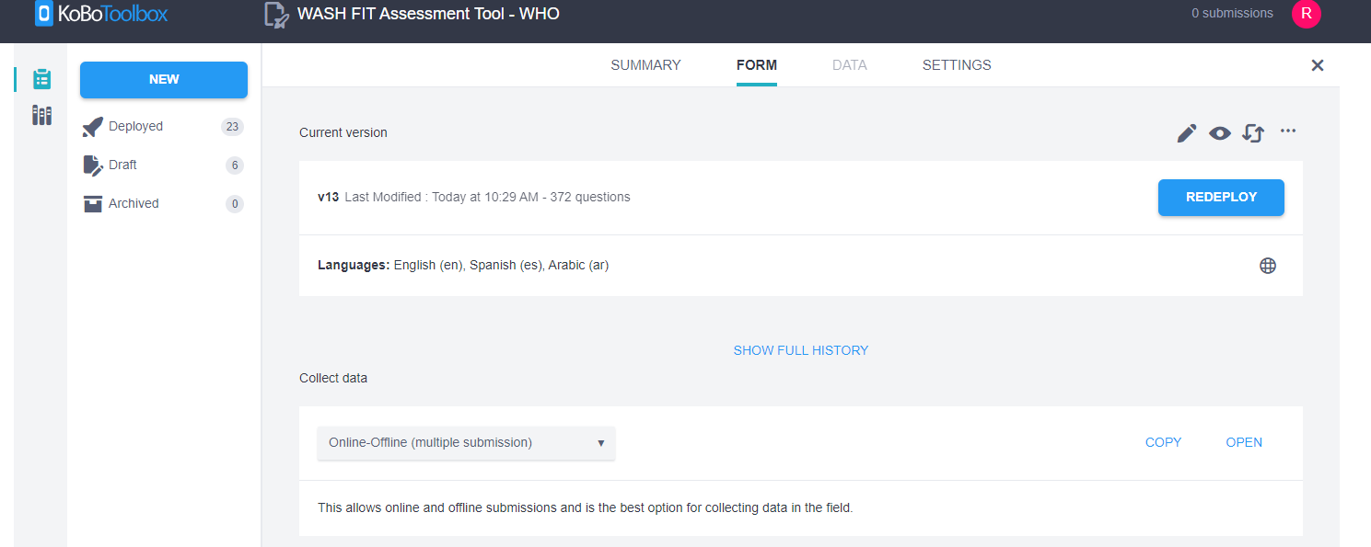
Creating a Form in a Different Language
Step 1: Add language in KoBoToolbox.
Step 2: Click “Download XLS”

Slide 27
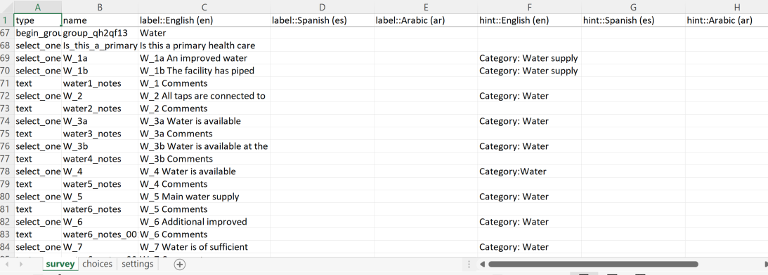
Creating a Form in a Different Language
Step 3: Work within the XLS file to translate (Google translate can do an automatic translation that can then be checked/modified by a real translator. For example, if adding a Spanish translation, you would add the question (“label”) in column D and the Category and Notes (“hint”) in column G.
Step 4: Make sure to translate both in the “survey” and the “choices” tab.
Notes:
Note: Both “Category” and “Notes” go in the same cell in column G. To make sure they’re separated by an extra line, press Ctrl and Enter at the same time.

Slide 28
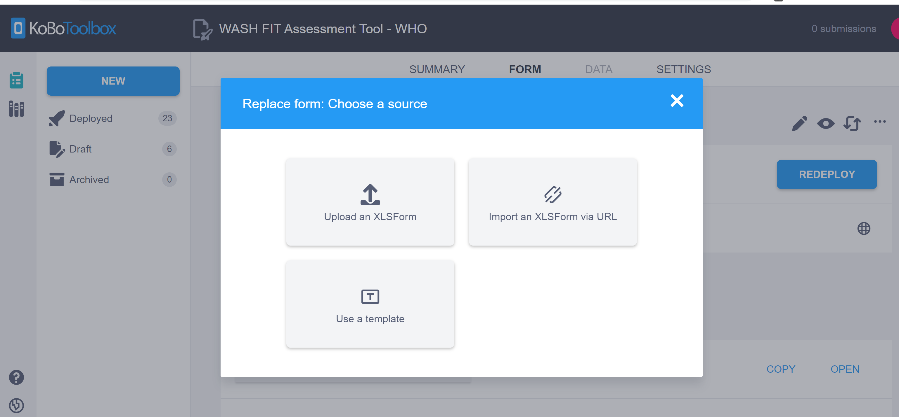
Creating a Form in a Different Language
Step 5: Re-upload the XLSForm file.
Step 6: Redeploy the form

Slide 29
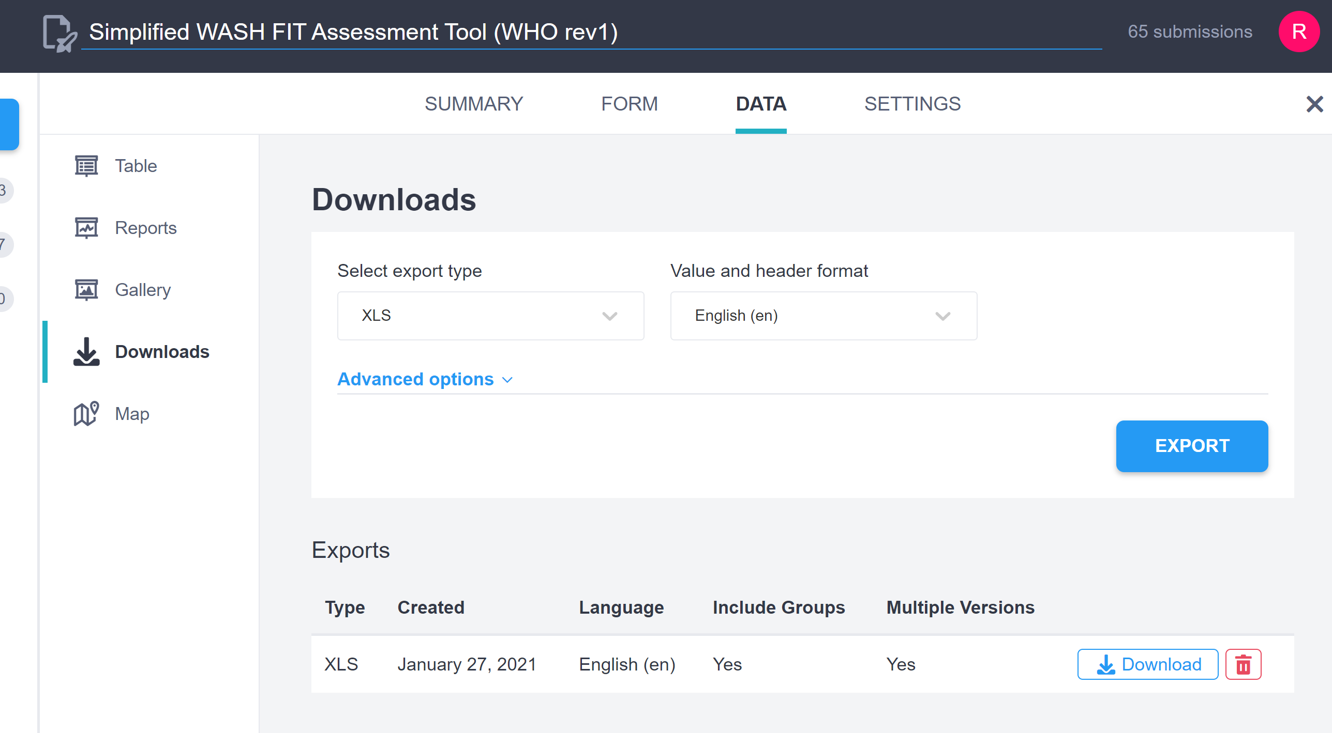
Accessing Data after Collection
Step 1: Click the “DATA” tab
Step 2: Click “Downloads” (Note, KoBoToolbox will automatically produce some tables, etc. but it’s unlikely to be what you need.)
Step 3: Click “EXPORT”
Step 4: Data will show up here
Step 5: Data will download to an excel file
Notes:
KoBoToolbox will show you its own analytics (see the tabs that say “Table”, “Reports” and “Gallery” but it’s not likely going to be the information that you are looking for, so it’s probably better to download to excel so that you can modify it for your own use.
Note: Each time you export it will provide a new file. These will all be saved.

Slide 30
Excel Data after Collection
Example of General information
Example of an indicator answer
Example of indicator tally
Example of water score
Notes:
This shows a little bit how the data looks when it comes out. (Much more data is in the file than can be displayed on this page)
Every question from the tool is list along the first row and the data from each survey is in a row beneath it.
In this example you can see the assessors name and health facility name (the rest of the general information is hidden up to question W_16). Then you can see the answer from W_16 and the scoring data. Also note that there are a number of blank cells. Some were not filled out (for example the comments) but also KoBoToolbox provides a blank cell even if it just contained a formula. When you’re processing data, you may wish to delete these columns.
Now you have an excel spreadsheet that you can use to run statistics (i.e. comparing facility scores in regions)
If you go back and survey the same facility after improvements have been made you could easily compare the facilities by showing them on subsequent rows.

Slide 31
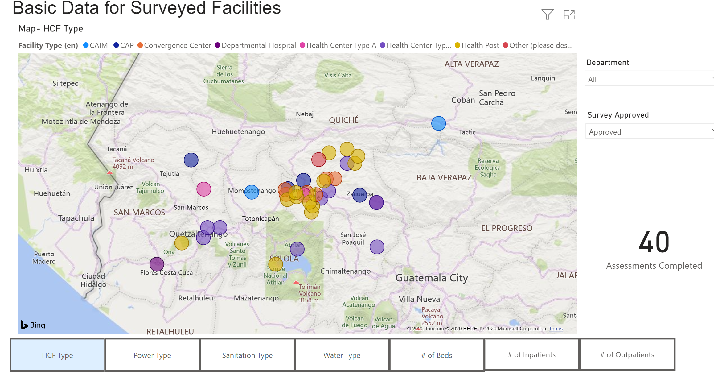
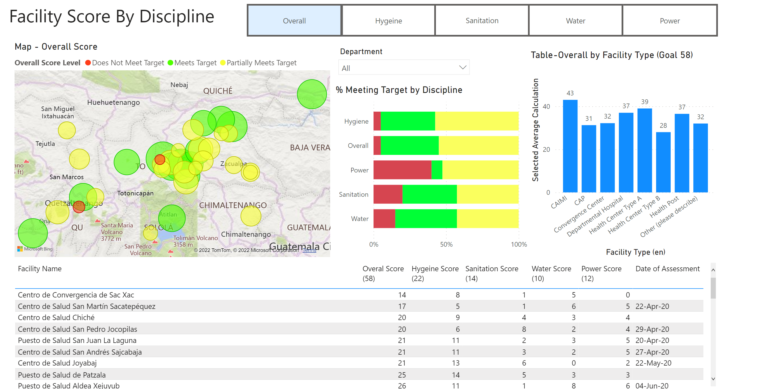
Data Use
Data can be analyzed using Excel, PowerBI or any analytics software.
Notes:
https://app.powerbi.com/view?r=eyJrIjoiMWNlZjFhN2MtNTYyYy00MWMwLTliMzctNTZkZjc4OGQ4ZjQzIiwidCI6IjkwNTliNmUzLTgxYzgtNGQzYS05ZDNiLWU2YTFkYzQ0ODE3NSIsImMiOjF9
There are a number of ways that data can be processed once it is downloaded from KoBoToolbox. A few options include making graphs and tables directly in excel or using an analytical software such as PowerBI. Many analytical software programs can upload an Excel table and then be used to produce maps, graphs and charts. Typically, however, you will need to “clean” the data before uploading so that it’s easier to manage. (For example, removing unused cells or truncating titles to be more manageable). This is an example of data that was put into PowerBI from the excel file downloaded from KoBoToolbox.

Slide 32
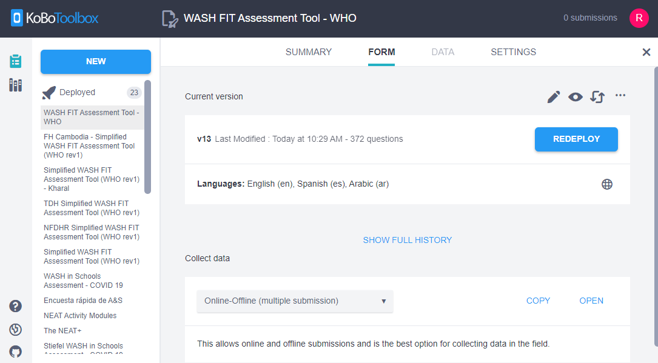
Reminders
Always redeploy the form after any changes.
The link for the survey stays the same, however, remind users to refresh their browser to see the new version.
KoBoToolbox has a reasonable Help Center and Community Forum if you get stuck

Slide 33
Questions?
For further information/support and resources:
General WASH FIT guidance (includes WASH FIT guide, other training materials and related resources): www.washinhcf.org/wash-fit
If you have additional questions or you would like to share your experience of using WASH FIT: washinhcf@who.int or www.washinhcf.org/contact-us/

