Slide 1
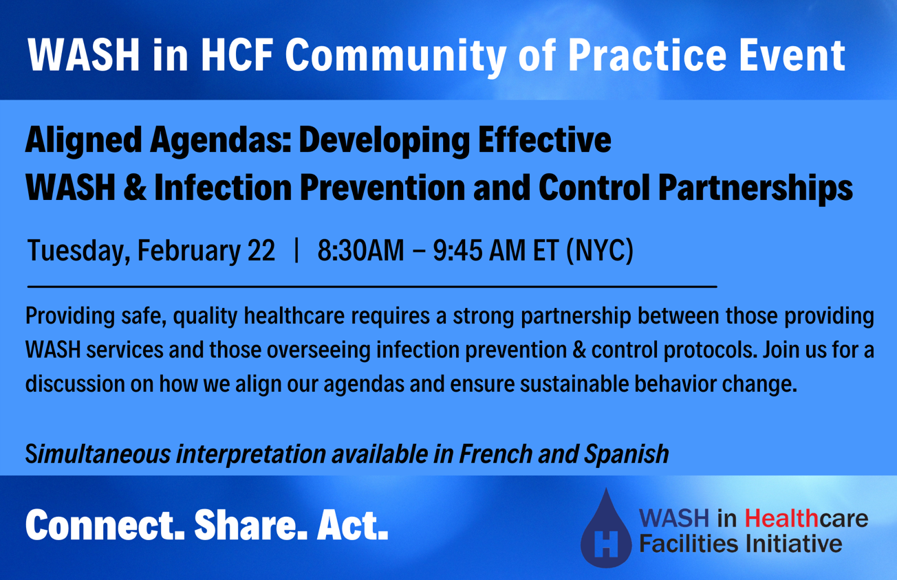

Slide 2




This Community of Practice is an action-oriented learning platform that brings together the WASH and health communities to focus on policy, evidence, and practice in WASH in HCF.
CONNECT partners
SHARE experiences
Encourage groups to ACT
Notes:
This webinar is a part of the WASH in HCF initiative.
Our goal is to expand the conversation, connecting the expertise and experience of our partners and colleagues to the members of the WASH and health community who have expressed interest in “moving to action” in WASH in HCF. We welcome all to participate these webinars, whether you’re a seasoned expert on WASH in HCF, or someone for whom this topic is brand new.
REMINDER WE HAVE SIMULTANEOUS INTERPRETATION

Slide 3

WASH in HCF Community of Practice Basic Principles
WASH is a fundamental prerequisite for quality care within a healthcare facility and there cannot be effective infection prevention and control without adequate WASH.
WASH in healthcare facilities is a solvable issue and will require multiple systems, sectors, and stakeholders to work together to see sustainable improvements.
The Community of Practice is open to all who seek to learn and share about WASH in healthcare facilities. We welcome all and respect the diversity of perspectives who participate.

Slide 4

In Memory of Global Health Champion, Dr. Paul Farmer
“The essence of global health equity is the idea that something so precious as health might be viewed as a right.”
Photo Credit: Partners in Health

Slide 5
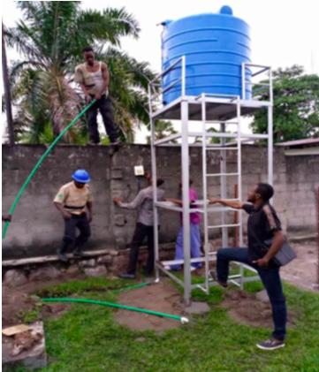
Success Corner
CRS Applies the Clean Clinic Model of Catholic HCF in DRC during COVID:
Over four months, CRS:
trained health workers and cleaners to enable them to effectively play their role in strengthening the WASH system in the HCF
developed WASH improvement action plans based on identified gaps
provided direct support to HCF through supervision visits, coaching, and inspection on COVID-19 specific IPC activities
provided WASH consumables, like handwashing stations, soap and disinfectant
Results:
HCF developed comprehensive and efficient WASH service delivery models
Improved oversight and support to HCF and the archdiocese/medical bureau has engaged staff within HCF on COVID-19 mitigation and prevention principles.

Slide 6
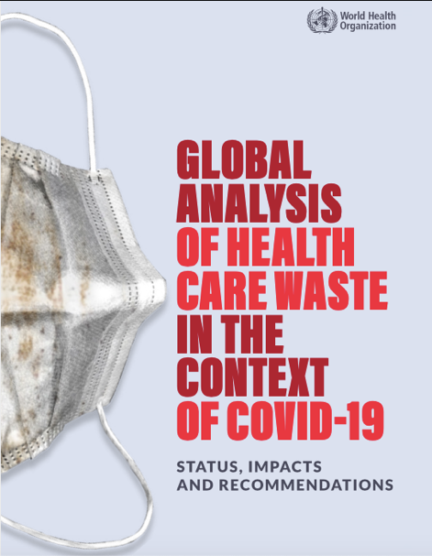
New Publication Alert
WHO published a report this month aimed at:
Quantifying the additional COVID-19 healthcare waste generated through the UN procurement system
Describe current healthcare waste management systems and their deficiencies
Summarize emerging best practices and solutions to reduce the impact of waste on human and environmental health.
Find it on WASHinHCF.org/resources or in our follow up email with resources from this session

Slide 7
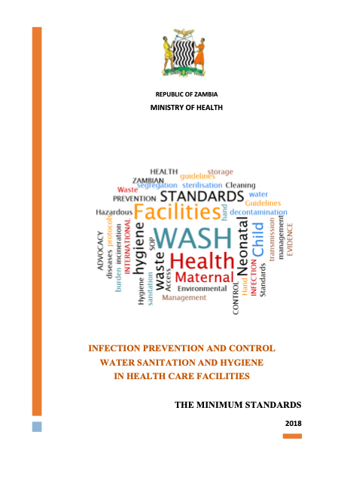
Older (but Newly Available) Publication Alert
Posted on WASHinHCF.org’s “Resources” section last week: Zambia MOH’s minimum standards, guidelines/SOPs, and training manual for IPC and WASH - together!
Though originally published in 2018, these documents are still highly relevant.

Slide 8
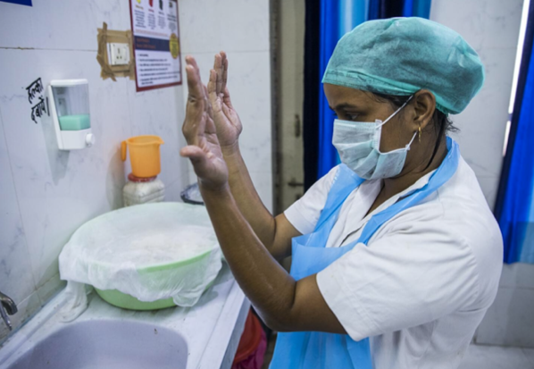
WASH & IPC – Working Together

Slide 9


Complexities of WASH in HCF
WASH in HCF is an issue that falls between two sectors - WASH and Health.
These two sectors often work in parallel but not may work directly with one another.
WASH is responsible for WASH in HCF because you have the technical expertise.
Health is responsible for WASH in HCF because you own the healthcare facilities.
Notes:
Example from UNICEF experience. With gov’ts may be other sectors coming into the discussion .

Slide 10


Language Barriers
IPC and WASH personnel often come from different backgrounds and do not always speak the same “language”. Both skill sets are necessary to create sustainable, safe WASH in HCF.
IPC:
Often clinicians
View the HCF through a clinical lens focused on patient care settings
Concerned about issues like PPE, surgical site infections, patient safety, etc.
WASH:
Often engineers or WASH specialists in non-HCF settings
Focused on infrastructure
View the HCF through the environment
Less knowledgeable about clinical activities
Notes:
Gagan: Also may like to add role of communications and C4D as both Health and WASH can get sometimes hardware focussed.

Slide 11
Example of WASH & IPC Overlap
The WASH/IPC Venn Diagram
Below is an example of the kinds of activities requiring both WASH services and IPC protocols:
WASH
1. Hand Hygiene
2. Environmental Cleanliness & Laundry
3. Medical Equipment Processing
4. Healthcare Waste Management
IPC
Notes:
These IPC topics can be further amplified and supported by WASH sector, given their unique expertise (e.g., infrastructure, engineering)"

Slide 12
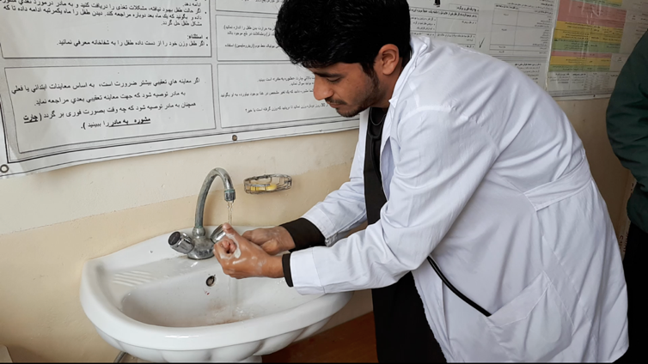
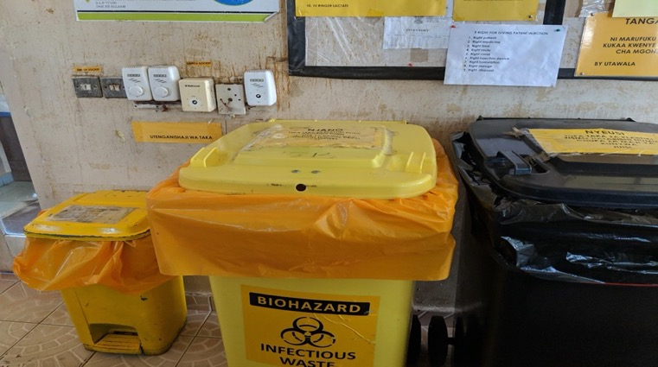
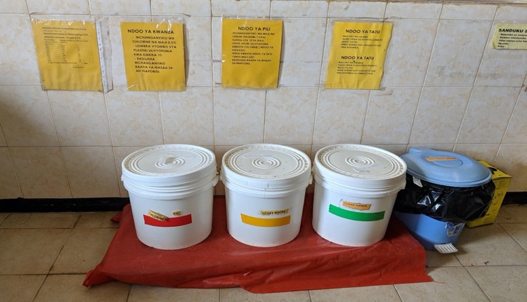
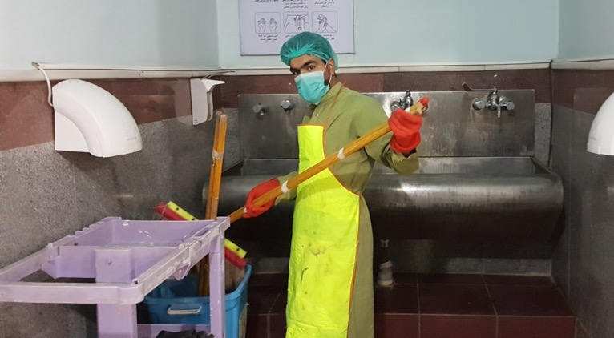
Hand Hygiene
Healthcare Waste Management
Medical Equipment Processing
Environmental Cleanliness

Slide 13
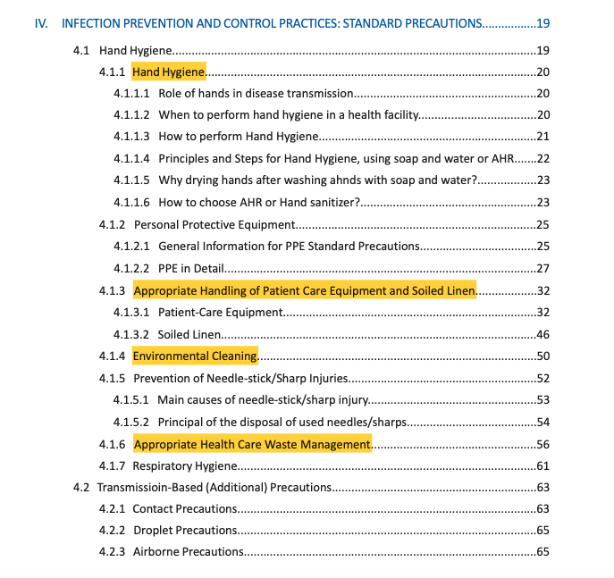


Slide 14
Health Facility Levels
Keep in mind, different health services are provided at different types of facilities.
Thus, the specific activities that overlap in the WASH/IPC Venn Diagram will differ in a hospital providing surgical services vs. a health center solely providing outpatient care.
It may also impact the organization and management around IPC and the safety culture.
WASH
IPC

Slide 15






Given that certain IPC practices require WASH services,
what are the implications of inadequate WASH in healthcare facilities?

Slide 16
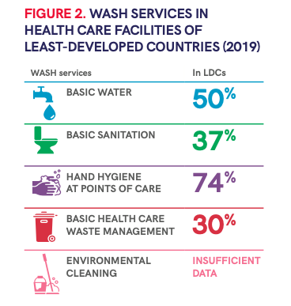
Inadequate WASH Services
Additional concerns not covered in the JMP:
Water quantity
Continual water availability + seasonality
Water quality
Number of functional toilets/patient
Hygienic conditions
Climate resiliency

Slide 17
Why do we need IPC/WASH Partnerships?
  There has been an assumption in IPC guidance (particularly those originating from well-resourced countries) that WASH services are readily available at HCF, overlooking the challenges faced by many HCF in LMICs where WASH services are limited or entirely non-existent.
  Therefore, IPC policies and guidelines are incomplete in these contexts and HCF will struggle to ensure staff practice IPC protocols so long as WASH services remain inadequate.
  Why the disconnect? Previously, there was limited data on the scope of the issue. Now that we better understand the need, it is time to revisit the relationship between IPC and WASH in resource-limited HCF.

Slide 18

Integration as a Path Forward
  How can we move ahead to better align our agendas?
  We propose integration as a path forward, ensuring WASH is integrated into IPC agendas and strategies.
  Determine the WASH service availability in HCF
  Consider revising IPC standards and SOPs to include WASH
  Reduce the barriers and inequities between the two sectors and improve sector coordination
  Reminder: as overlapping sectors, there will remain issues that both will need to work on separately. Think about your Venn Diagram for WASH/IPC and where it makes sense to integrate!

Slide 19
Key Takeaways
WASH services are required for key IPC activities, leading to an overlap of WASH and IPC within a healthcare facility (Venn Diagram example).
Existing IPC guidelines often overlook the inadequacy of WASH services in HCF, compromising approaches for sustained IPC behaviors.
Given the recent data highlighting the gaps in WASH in HCF, it is time to revisit the relationship between IPC and WASH to address these realities and determine how to ensure IPC protocols can take place given these conditions.
Integration is proposed as a path forward, revising existing policies and strategies to reflect both the deficit of WASH and the expectations of IPC.

Slide 20
Ways to Get Involved
Subscribe to the listserv to receive updates on events and resources (link in chat). Join live sessions and connect with others in the space.
Send us topic recommendations. We want to know what you want to learn about and discussion.
Nominate a success story. Every live session + newsletters will highlight successes, big and small, in WASH in HCF.

Slide 21
