Slide 2
ENVIRONMENTAL CLEANING
WASH FIT technical module
Add date & location
Notes:
Introduce yourself if you have not already, and make sure you insert the date and location to the slide before you start

Slide 3



Learning objectives
By the end of the session, participants will:
Describe the importance of having an organized approach to cleaning in order to achieve a safe health environment
Understand why it is important to clean health care environments
Describe the best institutional practices associated with cleaning
Outline the association between cleaning best practices and WASH FIT indicators
Recognise the most important products/resources, processes, supplies & equipment associated with effective & safe cleaning and disinfection
All group discussion
Icons to look out for
Group
work
Links with climate
resilience
Notes:
READ SLIDE and pause to make eye contact and make sure participants are clear on the outline of this module and what they will learn.

Slide 4
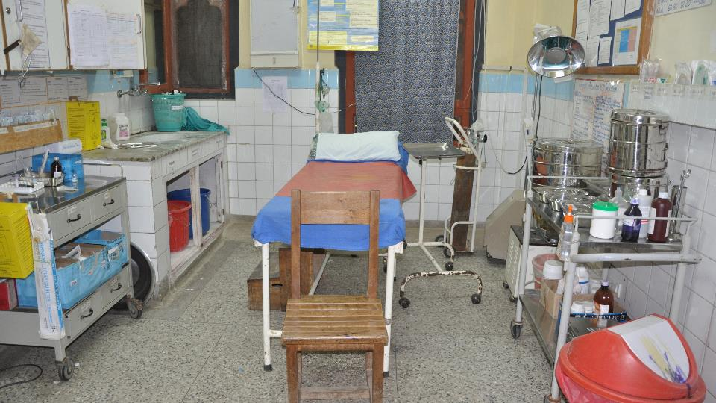
What does a
safe, clean environment
mean to you?
Notes:
READ THE QUESTION
NOTE FOR TRAINER: Take just a few moments to ask the participants this warm up question – ask them to shout our their thoughts (there are no right or wrong answers)

Slide 5
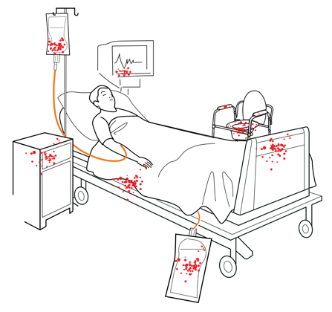
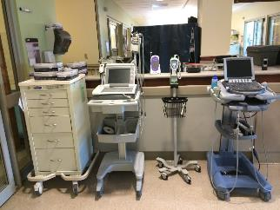
Introduction - why it is important to clean (1)
Cleaning and disinfection (when needed based on risk) of environmental surfaces and (what is termed) non-critical patient care equipment, renders the health care environment safe for patients, health workers and others.
Non-critical patient care equipment poses a risk because it:
  Comes into contact with (patient) intact skin or,
  Is touched by hands (mainly health workers) during health care delivery.
Environmental surfaces pose less of a risk but still become contaminated
Notes:
READ THE SLIDE
SAY:
Examples of non critical patient care equipment in a clinical setting include:
IV poles, blood pressure monitors, stethoscopes, mobile computers and workstations, incubators, wheelchairs.
Environmental surfaces include:
Tables, chairs, bedrails, light switches, floors, and at times walls.
other interventions/tasks that use equipment that breaches the skin and will then come into contact with mucous membranes or body fluids poses a higher risk than those already listed, but should be managed by clinical staff and those who are experienced in disinfection and sterilization procedures for these specific health care items (WHO guidance exists on this but is not covered in this module)
NOTE FOR TRAINER:
It might be prudent to stop and take questions at this point to be sure people are clear on these terms and the items the rest of this module relates to in day to day practice, as associated with WASH

Slide 6


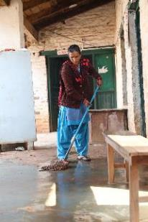
Group work
Why it is important to clean (2)
10 mins
  Question: in the health care environment, how do non-critical items and environmental surfaces become contaminated and potentially harmful?
  Discuss the following in small groups:
Where might potentially harmful microorganisms (germs) live?
What is the ‘way’ for potentially harmful microorganisms to move from where they live?
Who might be at risk from these potentially harmful microorganisms?
A cleaner at a rural HCF in Nepal
© WaterAid
Notes:
READ THE SLIDE (this aims to warm up the participants by exploring germs and cleaning – no prior knowledge is expected)
SAY:
Discuss the three questions in small groups for 5 mins.
Then be ready to shout out some answers and I will write them on a flip chart and we will discuss
THEN SAY:
Where can microorganisms live and/or multiply?
In/on people including their skin (e.g., patients, staff) - note that normally these organisms on skin are completely harmless to healthy people and make up our skin flora (see the hand hygiene module)
On surfaces - try to get participants to mention their commonly encountered environmental surfaces
Equipment - try to get participants to mention surfaces they commonly see
How they can move?
If environmental surfaces or equipment is contaminated and not cleaned as per recommended cleaning schedules
Anyone can touch a surface or equipment and then touch another surface moving the mircorganisms around the health care environment
Anyone can then touch a surface or equipment and get germs on or in their body, or someone elses (and then this might subsequently cause an infection).
Even if gloves are worn this is a risk - and it is important to note that both cleaning and cleaning of hands at the right time go together in preventing the spread of germs
Who might be most at risk?
Patients who are already vulnerable (susceptible) from underlying diseases are most at risk from germs getting on to and entering their body.
But health workers can also at times be at risk
It is important to end by stating that there are solutions to protecting patients and health workers - cleaning and hand hygiene at the right times (among other infection prevention measures). Check whether any participants are unclear or anxious. You can also explain people can learn more from the list of resources featured at the end.

Slide 7
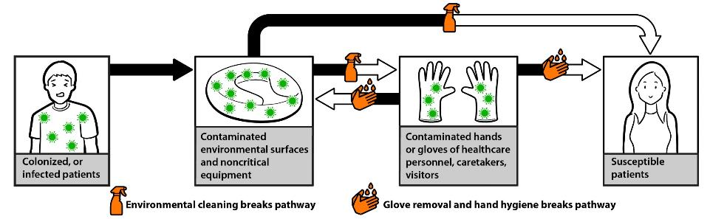
Why it is important to clean in visuals (3)
Courtesy of Centers for Disease Control and Prevention, USA 2020
Notes:
SAY: this visual summarises the discussion from the previous slide and is from a recently issued international best practices cleaning manual (see the resources list)

Slide 8
To summarise
The action of cleaning - a definition:
The physical removal of foreign material (e.g., dust, soil) and organic material (e.g., blood, secretions, excretions, microorganisms) from surfaces, i.e. the action taken to wipe, mop, etc.
Physically removes rather than kills microorganisms.
Achieved with water, detergents, and using the ‘mechanical action’ (e.g., friction, scrubbing).
Always the first step in any environmental cleaning process.
Notes:
READ THE SLIDE
SAY: it is important to be clear on definitions. Now we will focus on the best practices required to make cleaning happen in health care

Slide 9






An organised approach to cleaning involves six elements
  An organizational structure for cleaning activities, including administrative support, integration of cleaning within facility management and supportive supervision
  A staffing plan for each patient care area, including contingency plans for additional cleaning staff
  Ongoing training and education
  A summary of the cleaning schedules and procedures for each patient care area, in line with the facility policy, with timely reminders of actions for everyone
  Routine monitoring (audit) and feedback
  Sufficient, well-maintained infrastructure, supplies and products.
These are relevant whether cleaning is provided by in-house services or contracted from outside
Notes:
READ THE SLIDE and say, the following slides provide further details for each of these elements which are considered best practices.
You can tell participants to refer to the sources of this information, the CDC/ICAN Guidance, for more information listed in the resources slide - this will be most suitable to those establishing cleaning programmes rather than those who clean.

Slide 10
1. Organisational structures
What is needed to ensure effective cleaning?
Administrative support:
Designated facility-based manager or focal person responsible for overall cleaning
Availability and approval/validation of a cleaning policy
Annual budget
Communication and integration of the programme in the facility:
Multi-sectorial planning committee including all facility stakeholders & routine meetings with other key stakeholders
Management and supervisory structures:
Cleaning programme organizational chart
Facility supervisors
Management of the environmental cleaning services area
Which stakeholders need to be engaged for an effective, integrated cleaning programme?
Notes:
READ THE SLIDE
SAY: “Which stakeholders need to be engaged for an effective, integrated cleaning programme?” Shout out what you think?
NOTES FOR TRAINER (potential answers to use if people do not shout these):
Cleaning program manager
IPC or hygiene committee
Facilities management
Other admin staff including those in charge of procurement
Clinical staff/representatives from wards from each department
Contracting company rep (if applicable)
SAY: even if you are not in a position to make these things happen to ensure effective cleaning, you should be aware that they are critical for best practices and to support all those who clean. If you cant influence these things to happen, maybe you can advocate for these, or raise questions in your facility??

Slide 11
2. Staffing plans
What is needed to ensure effective cleaning?
What do staffing needs depend on?
# of inpatient beds
Types of services (e.g., high-risk areas where cleaning is more intense)
Bed occupancy levels
Type of cleaning (e.g., routine vs terminal cleaning when a patient goes home)
Should take into account:
Reasonable shift length
Regular breaks
Contingencies (e.g., outbreaks or other emergencies that need cleaning services to deal with them immediately)
No single-best practice method for determining staffing needs exists, but consider :
Using workload software
Making comparisons with other facilities
Empirical calculations at facility level
Job descriptions and performance standards are also critical
Cleaning staff should be present in the facility on a daily basis
Notes:
READ THE SLIDE
SAY:
Do you know how staffing levels are calculated at the facilities you work with/in? Shout out any examples
SAY:
It is important to note that this is also dependent on multi-sectoral/key stakeholder working as often those working in WASH may not be able to influence staffing levels, but effective cleaning and a safe health care environment cannot be achieved without this.

Slide 12
Organizational structures
Organizational structure & WASH FIT
Related WASH FIT indicators to be assessed:
There is a clear and detailed facility (or ward) cleaning policy or protocol which is clearly displayed, implemented and monitored.
The required number of cleaning staff or staff with cleaning responsibilities are available in the ward/facility every day/when cleaning is needed and have time dedicated to performing cleaning activities.
Policy and practices to improve the occupational safety of cleaners and health care waste technicians are available and implemented.
An annual budget for environmental cleaning supplies and equipment exists and is sufficient for all needs.
A dedicated area for storage, preparation and care of cleaning supplies and equipment exists ("environmental cleaning services area"), is kept clean and well maintained, and is used according to its purpose.
Notes:
READ THE SLIDE
SAY: using the WASH FIT assessment tool helps to address requirements, these are example indicators from WASH FIT that relate to the organizational structure

Slide 13
3. Training & education
What is needed to ensure effective cleaning?
  Formal training schedules should include:
    Introduction to infection prevention and control (IPC) (how cleaning helps prevent infections)
    Cleaning practice and review (including prudent use of products and technique)
    Workplace safety related to cleaning and disinfection
    Water efficiency & conservation
Training should be PARTICIPATORY
a) practical (hands-on), b) at appropriate literacy level, c) repeated annually (refresher), d) conducted prior to staff working on their own & e) led by experienced trainers.
Notes:
READ THE SLIDE

Slide 14
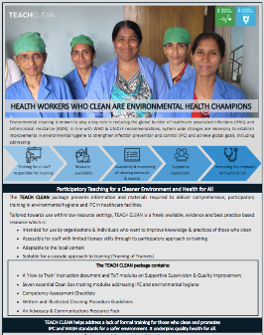
Lessons identified from the training of those who clean (from countries)
Participatory approach greatly appreciated
Including health care professionals who clean &/or supervise cleaners → helps foster mutual respect
Scheduling training can be challenging → must fit around cleaning rotas
High turn-over of cleaners → need for repeat training
Important to have consistent availability of equipment & supplies
Post-training supportive supervision is key, including reminders using illustrated guidelines to be used day-to-day
TEACH CLEAN was created by The Soapbox Collaborative & the London School of Hygiene & Tropical Medicine. For free copy, visit: https://www.lshtm.ac.uk/research/centres/march-centre/soapbox-collaborative/teach-clean
Notes:
READ THE SLIDE
SAY:
the lessons identified here are based on the use of a participatory training package (called TEACH CLEAN) – details of the pack and a link are at the bottom of the slide.
The lessons here are from training that took place in Gambia, India, Myanmar &Tanzania.
The training approach that resulted in these lessons included: information for trainers and an outline of tools to be used to deliver comprehensive participatory training in basic IPC & environmental hygiene to all staff who clean in health care facilities.

Slide 15
Training example: illustrations of surface cleaning processes
Use fresh cleaning cloths to start
Change cleaning cloths when no longer saturated
Change cleaning cloths between each patient zone (in high-risk areas)
Make sure you have enough cleaning cloths to finish the cleaning session
Never double-dip!
(Illustration From Soapbox, 2018 “TEACH CLEAN”) see link on previous slide
Notes:
READ THE SLIDE
SAY:
SHOUT OUT ANSWERS TO THESE QUESTIONS (only take a few moments):
Do you know whether the training to describe and demonstrate the process of cleaning – visualized on this slide - is undertaken in the health care organizations you work in or with?
Do you think using illustrative guides and practical sessions would work in your settings, would you establish this if not already in place?

Slide 16
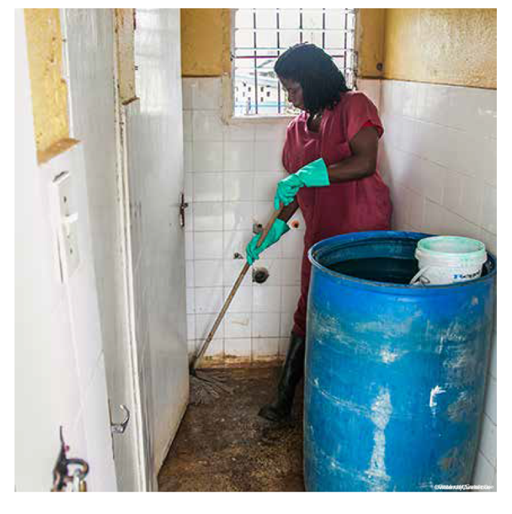
Training & education
Training & education & WASH FIT
Related WASH FIT indicator to be assessed:
All staff responsible for cleaning have received training on cleaning.
A cleaner at a health facility in Zambia
© ©WaterAid/Carielle Doe
Notes:
READ SLIDE
SAY: that again it is important to link what we are discussing for training and education of environmental cleaning with the indicators within the WASH FIT assessment tool

Slide 17
4a. Cleaning schedules
What is needed to ensure effective cleaning?
Cleaning schedules should include:
Frequency of cleaning
Method of cleaning:
  Product(s)
  Processes (for all surfaces)
  Person(s) responsible
Schedules, determined on transmission risk level:
  A risk level can be applied to a specific room, ward or entire department
  Higher risk may require different product(s) or processes
* See Handout for interactive session on cleaning method & frequency
15 mins
Notes:
READ THE SLIDE
SAY:
Suggested cleaning schedules for patient care areas based on risk level, as well as how to calculate your own risk level, can be reviewed in detail in the CDC/ICAN Best Practices document, listed at the end of this module in the resources.
SAY:
look at the handout “Interactive session: Risk-assessment for determining environmental cleaning method and frequency”
work in groups to undertake the exercise, in total we have 15 mins so be prepared to give feedback after 10 mins

Slide 18
4b. Cleaning procedures
What is needed to ensure effective cleaning?
Standard operating procedures (SOP) that provide an outline of step-by-step processes for cleaning, in the most relevant format, e.g. illustrative outlines as well as written
  Every area including every type of patient area should have its own SOP to include the numbered steps in the order they should be completed
Supplies and equipment (established and reliably available)
  Also including personal protective equipment (PPE) and hand hygiene supplies to ensure safety for those who clean (and equity for this role in the health care environment)
Disposal and reprocessing steps
  Waste and laundry/linen management
  How supplies and equipment should be safely handled (e.g., sent for cleaning or disposed of)
Notes:
READ THE SLIDE
SAY: this is really important for those who clean and to be well prepared at organizational level

Slide 19
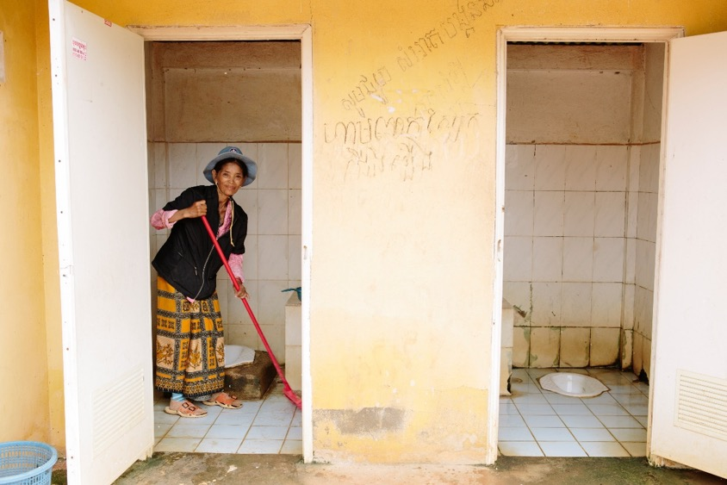
Schedules & procedures
Schedules & procedures & WASH FIT
Related WASH FIT indicator to be assessed:
Toilets are cleaned at least once each day and a record of cleaning is signed by the cleaners and displayed visibly
WaterAid/ Tom Greenwood
Notes:
READ THE SLIDE
SAY: that participants can access the WASH FIT assessment tool to read where this indicator is featured

Slide 20
4c. Timely reminders
What is needed to ensure effective cleaning?
Visual cleaning records (e.g. checklists) - developed for long term use in hospital systems, and maintained in every ward (a SOP to support this may be necessary)
  Helps to ensure that cleaning is occurring as specified in facility policy and serve as prompts and accountability and tracking mechanisms, as well as opportunities to provide positive feedback to those who clean
  Specify the location (e.g., maternity unit, toilets), cleaning session (e.g., routine cleaning, terminal cleaning), date, and name/signature of cleaning staff
  Allocate responsibility for tasks, considering literacy (in central locations or where the cleaning task occurs means that they can be reliably supported by supervisory or other staff on a daily basis)
Notes:
READ THE SLIDE
SAY: are you using cleaning records and if you are, are they used as intended, do people forget to use them, do people think they help or not?
NOTE FOR TRAINER:
Take just a few moments to hear answers. If no one is using cleaning records say that these are often a useful tool if used properly

Slide 21
5. Monitoring & feedback*
What is needed to ensure effective cleaning?
Routine monitoring
Can be achieved in different ways:
  Direct (e.g., observation, visual assessment) and indirect methods (e.g., marking with fluorescent gel) for cleaning performance
  Objective (e.g., measuring whether organic matter remains on a surface after cleaning, referred to as “ATP systems”) over subjective methods (visual assessment of cleanliness) where possible to assess cleaning outcomes
Direct feedback is critical for improvement
Timely feedback to staff
For coaching, to inform training needs
Monthly reporting, summary & trends also useful
Notes:
READ THE SLIDE
SAY: monitoring and feedback is important. However it is important to note that some of the technology referred to in the CDC/ICAN manual may not be routinely available (e.g. ATP systems) but other approaches can still be taken.

Slide 22
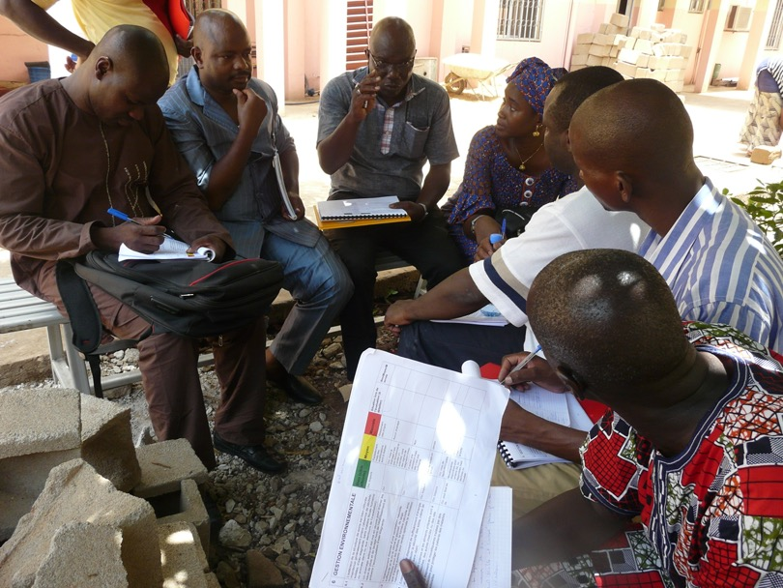
Monitoring & feedback
Monitoring & feedback & WASH FIT
Related WASH FIT indicator to be assessed:
Record of cleaning available for patient care areas, general wards or whole facility and is signed by the relevant cleaner each day
A WASH team discussing the results of an assessment, Mali © WHO/Arabella Hayter
Notes:
READ THE SLIDE

Slide 23
6. Infrastructure, supplies & product management
What is needed to ensure effective cleaning?
Designated space at the facility (“environmental cleaning services area”) is important
Availability of facility approved products and supplies
Procurement supply management systems should:
  Avoid stock-out of cleaning supplies and equipment!
  Procure furniture and patient equipment that can be easily and effectively cleaned!
Characteristic | Selection guidance
Cleanable | Avoid items with hard-to-clean features (e.g., crevasses). Do not use carpet in patient care areas. Select material that can withstand repeated cleaning.
Easy to maintain and repair | Avoid materials that are prone to cracks, scratches, or chips, and quickly patch/repair if they occur. Select materials that are durable or easy to repair.
Resistant to microbial growth | Avoid materials that hold moisture, such as wood or cloth, because these facilitate microbial growth. Select metals and hard plastics.
Nonporous | Avoid items with porous surfaces, such as cotton, wood and nylon. Avoid porous plastics, such as polypropylene, in patient care areas.
Seamless | Avoid items with seams. Avoid upholstered furniture in patient care areas.
Notes:
READ THE SLIDE

Slide 24
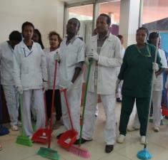
Infrastructure, supplies & product management
Infrastructure, supplies & product management & WASH FIT
Related WASH FIT indicator to be assessed:
Appropriate and well-maintained materials for cleaning (i.e. detergent, mops, buckets, etc.) for cleaning in a range of different areas and surfaces are available and sufficient.
A team of cleaners in Ethiopia
© WHO
Notes:
READ THE SLIDE

Slide 25
Infrastructure, supplies & product management
The most important product for cleaning? Water!
Avoid running tap continuously when cleaning (especially outdoor spaces).
  Fill bucket with the amount of water needed & use only the water inside to clean.
  Avoid opening & closing the tap every time you wet your cleaning cloth prevents wasting water.
Check for leaking taps.
  Ensure regular checks of taps, e.g. when cleaning
  If broken, report and fix immediately to prevent water waste.
Are those you work with aware of the issue of conserving water and the associated climate issues?
The Climate and Water modules provide more information on this important matter
Notes:
READ THE SLIDE
SAY:
water is often in short supply so increasing awareness of water conservation amongst those who clean is critical
Are those you work with aware of the issue of conserving water and the associated climate issues?
The Climate and Water modules provide more information on this important matter
NOTE FOR TRAINER:
Take must a few moments to hear any participant reponses

Slide 26
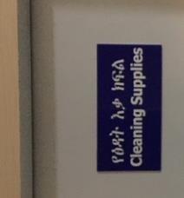
Best practices for products
A master list of facility-approved products & suppliers should be developed/available in the facility policy
Minimize the number of approved products to:
  Simplify the environmental cleaning process
  Simplify training requirements for staff
  Reduce potential for errors in preparation and use
  Support reduction in harmful products into the sanitation and wider environmental systems
Products should be stored to prevent exposure and degradation
Preparation of products, e.g. solutions must be prepared safely in dedicated areas and following instructions (pre-made or automated dispensing solutions are preferred).
Other factors to consider
Contingency planning
Supply-chain
Ease of use
Safety
Environmental disposal
Notes:
READ THE SLIDE
SAY:
In some countries governments may have approved list of products
Do your facilities have an approved list of products and suppliers?

Slide 27
Cleaning products vs. disinfectants
Cleaning products are:
  liquids, powders, sprays, or granules that remove organic material (e.g., dirt, body fluids) from surfaces and suspend grease or oil. Can include liquid soap, enzymatic cleaners, and detergents (most common).
Disinfectants are:
  chemical compounds that inactivate (i.e., kill) pathogens and other microbes and fall into one of three categories based on chemical formulation: low-level, mid-level, and high-level. Disinfectants are applied only to inanimate objects.
All organic material (body fluids) and dirt/soilage must be removed by a cleaning product before application of disinfectants.
Notes:
READ THE SLIDE
SAY:
For most cleaning procedures: liquid soaps/neutral detergents (pH 6-8), easily soluble in warm and cold water, is best
Specialized cleaning products should be considered on a case-by-case basis (e.g., toilet cleaners, floor polishers, glass cleaners)
Combined detergent-disinfectants can be used (when disinfection is needed) for most cleaning procedures:
Separate cleaning and disinfection steps are needed in some situations (e.g., cleaning body fluid spills)
Most environmental cleaning (surfaces and non-critical patient care equipment) procedures are accomplished with low-level disinfection
There are some cases where mid-level disinfection is required
Disinfection: a chemical process for inactivating microorganisms on inanimate objects. Disinfection occurs after the cleaning step. Direction must be given as to when disinfectants should used, they should not be use routinely and are for specific contamination.
Low-level disinfection: inactivates most vegetative bacteria, some fungi, and some viruses, but does not kill more hardy viruses (e.g. non-enveloped), bacterial genus (e.g. mycobacteria), or bacterial spores
Mid-level disinfection: kills inactivate vegetative bacteria, including mycobacteria, most viruses, and most fungi, but might not kill bacterial spores
High-level disinfection: kills all microorganisms, with the exception of small numbers of bacterial spores (not used for environmental cleaning!)
Mid-level disinfection may be required for specific hospital outbreaks of environmentally hardy pathogens (for example Candida auris, norovirus).
Mid-level disinfection is also recommended for disinfecting after cleaning of blood or body fluid spills
Some products combine a cleaner with a disinfectant (combined detergent-disinfectants)

Slide 28
Safety, the environment/climate and cleaning
Problem: Many traditional detergents and disinfectants contain persistent, toxic chemicals that can cause cancer, respiratory ailments, and eye and skin irritation. They can also contribute to environmental pollution during manufacture, use and disposal.
Solutions:
  Plan and schedule cleaning, ensuring that the appropriate methods, products and processes are applied with the correct frequency.
  Minimal and/or environmentally sustainable packaging is also an important consideration for those procuring products and materials.
Notes:
READ THE SLIDE
SAY:
The number of products available in a facility is an important factor in minimising the risks to safety and environmental contamination
Health procurement entities and facility managers should purchase and use unscented, environmentally safe cleaning products, with minimal and/or environmentally sustainable packaging. Methodical hazard analysis of ingredients in cleaning and disinfectant products helps identify those that are safe and those that should be replaced with a substitute. Disinfectants with active ingredients based on alcohols, hydrogen peroxide and iodine compounds tend to have the least adverse impacts.

Slide 29
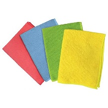

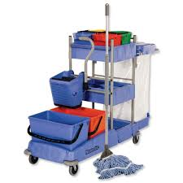
An overview of supplies and equipment
Surface cleaning: cloths can be cotton or microfiber
  Different colored cloths for color-coding; e.g.:
    one color for cleaning and one color for disinfection
    one color for toilets, one color for general patient areas, one color for isolation areas
Floor cleaning: mop heads or floors cloths (cotton or microfiber)
  Two or three-buckets, depending on need for floor disinfection (one bucket with rinse water always needed)
Cleaning carts should be stocked in sufficient quantities so that cleaning tasks can be completed without having to return to the storage area.
Notes:
READ THE SLIDE
Say:
Safety aspects also apply and should be accounted for in all facility SOPs, reminders, etc - such as PPE and wet floor signs
Other instruction is important including:
To separate clean and soiled items (e.g., cleaning cloths)
Never put personal items, food or beverages on the cart
Clean and disinfect cart at the end of the day
Never leave unattended, store in the dedicated area

Slide 30
Personal Protective Equipment (PPE) for cleaning
Type of cleaning task | Required personal protective equipment for cleaning staff
Routine cleaning (standard precautions) | None (unless spills or contamination risk—see below)
Terminal cleaning (standard precautions) | Reusable rubber gloves
Blood and body fluid spills and high contamination risk areas (e.g., cleaning bed of an incontinent patient, labor and delivery wards) | Gown and/or plastic apron Reusable rubber gloves Face shield or face mask and goggles (if splash risk or large spill)
Droplet precautions (routine and terminal cleaning) | Gown and/or plastic apron Reusable rubber gloves Face shield or face mask and goggles
Contact precautions (routine and terminal cleaning) | Gown and/or plastic apron Reusable rubber gloves
Airborne precautions (routine and terminal cleaning) | Respirator (N95 or FPP2), fit tested Reusable rubber gloves
Preparation of disinfectant products and solutions | According to specifications in SDS (manufacturer instructions) If SDS not available, then: Chemical-resistant gloves (e.g., nitrile) Gown and/or apron Face shield or face mask and goggles
5 mins
Notes:
ASK participants to focus on the images of PPE and to consider which of the items are needed for each of the cleaning tasks listed in the table
(Note – the answers are on the next slide for when the exercise by participants is complete)
SAY that hand hygiene at the right moments remains a constant and critical intervention to protect self and others whatever PPE is worn. This includes after removal of PPE.

Slide 31
Personal Protective Equipment (PPE) for cleaning
Type of cleaning task | Required personal protective equipment for cleaning staff
Routine cleaning (standard precautions) | None (unless spills or contamination risk—see below)
Terminal cleaning (standard precautions) | Reusable rubber gloves
Blood and body fluid spills and high contamination risk areas (e.g., cleaning bed of an incontinent patient, labor and delivery wards) | Gown and/or plastic apron Reusable rubber gloves Face shield or face mask and goggles (if splash risk or large spill)
Droplet precautions (routine and terminal cleaning) | Gown and/or plastic apron Reusable rubber gloves Face shield or face mask and goggles
Contact precautions (routine and terminal cleaning) | Gown and/or plastic apron Reusable rubber gloves
Airborne precautions (routine and terminal cleaning) | Respirator (N95 or FPP2), fit tested Reusable rubber gloves
Preparation of disinfectant products and solutions | According to specifications in SDS (manufacturer instructions) If SDS not available, then: Chemical-resistant gloves (e.g., nitrile) Gown and/or apron Face shield or face mask and goggles
Hand hygiene action should always be applied, including after PPE removal
Notes:
This is included here for presenters to see the answers - present and read through this slide as a recap when the exercise on slide 29 is finished

Slide 32
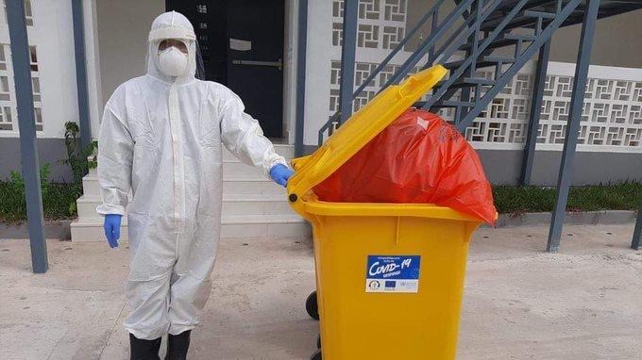
PPE for cleaning
PPE for cleaning & WASH FIT
Related WASH FIT indicator to be assessed:
Adequate PPE is available at all times and in sufficient quantities for all cleaning staff
Important!
Unnecessary use of PPE adds to environmental impact
Notes:
READ THE SLIDE
SAY:
recommendations for cleaning in this module covers all circumstances - this module does not specifically over COVID but the measures apply. However, during outbreaks and with specific organisms of concern there may be new international or national guidance, and local policies will dictate any changes to cleaning practices.

Slide 33
Key take-aways
Implementing environmental cleaning according to best practices requires strong organizational infrastructures, leadership, staffing, policies and procedures and budget
Environmental cleaning staff should always be trained and should be given positive reinforcement through monitoring and feedback
Environmental cleaning schedules and procedures (SOPs) should be developed for all patient areas based on risk-level
Cleaning products and disinfectants should be carefully selected and managed at the facility level (minimize the number of types of products used)
Records of cleaning, reliable availability of all cleaning equipment and supplies that keep those who clean safe, e.g. PPE and hand hygiene products, are also crucial
Notes:
READ THE SLIDE, TAKE ANY LAST URGENT QUS IF TIME PERMITS BUT NOTE THE FURTHER READING IN THE RESOURCES LISTED IN THE NEXT SLIDES

Slide 34
Resources
CDC and ICAN (2019) Best Practices for Environmental Cleaning in Healthcare Facilities in Resource-Limited Settings. Atlanta, GA: US Department of Health and Human Services, CDC; 2019. Available at: Environmental Cleaning in Resource-Limited Settings | HAI | CDC
WHO (2019) Implementation manual to prevent and control the spread of carbapenem-resistant organisms at the national and health care facility level WHO 2019: Implementation manual to prevent and control the spread of carbapenem-resistant organisms at the national and health care facility level [PDF – 98 pages]
WHO/UNICEF (2020) Water, sanitation, hygiene, and waste management for SARS-CoV-2, the virus that causes COVID-19. https://www.who.int/publications- detail-redirect/WHO-2019-nCoV-IPC-WASH-2020.4
WHO (2008) Essential environmental health standards in health care. https://www.who.int/publications/i/item/9789241547239
LSHTM (2019). TEACH CLEAN. Available from: https://www.lshtm.ac.uk/research/centres/march-centre/soapbox-collaborative/teach-clean
WASH FIT guide and assessment tool https://washinhcf.org/wash-fit
Full list of relevant reading available at:
https://washinhcf.org/resource/summary-of-all-who-and-related-resources-on-wash-in-hcf/
Notes:
Full list of relevant reading available at:
https://washinhcf.org/resource/summary-of-all-who-and-related-resources-on-wash-in-hcf/

