Slide 2

User-friendly WASH in health care facilities & how it applies to WASH FIT
WASH FIT technical module
Add date & location
Developed in collaboration with WaterAid
Notes:
Introduce yourself if you have not already, and make sure you insert the date and location to the slide before you start

Slide 3


Learning objectives
By the end of this session, you should:
Understand how and why some people experience exclusion and discrimination when using healthcare facilities
Understand how to improve participation of women and people with disabilities when implementing WASH FIT
Describe accessible and inclusive WASH solutions in HCFs within the WASH FIT model
Outline how WASH FIT indicators support inclusion and empowerment including accessible infrastructure and participatory processes
Link with a country
example
Icons to look out for
Group
work
Notes:
READ THE SLIDE

Slide 4
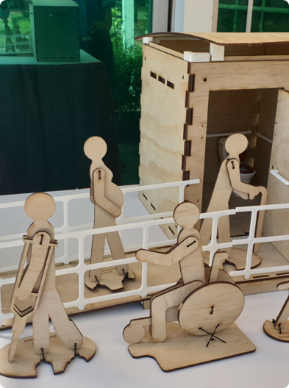
Overview
Exclusion: who is marginalised and why
Nothing about us without us: how to ensure participation and empowerment
Assessing the facility: participatory barrier and risk analysis in WASH FIT assessments
Taking action: practical solutions to develop and implement improvement plan
It’s a journey: how to reflect, adapt and improve
Notes:
READ THE SLIDE
SAY:
WASH FIT was initially designed for small (e.g. primary health care) facilities in resource constrained setting.
It has been used in bigger facilities (e.g. district hospitals and in some instances, larger national hospitals) but there are some limitations.
It works best in smaller facilities but can be adapted for bigger facilities. The basic 5-step methodology should remain the same, but the assessment form will need to be adapted to the national and local context (i.e. adding additional indicators to cover more complex settings such as requirements for major surgical and invasive procedures). This adaptation normally takes place at the national level by the Ministry of Health and WHO/UNICEF.
There are often requests to use WASH FIT for national estimates and country comparisons. Refer to the next slide for the differences between WASH FIT assessments and other survey formats using the JMP basic global indicators.
End by saying that here you can see the 5 steps of the cycle which we will focus on for much of this session – and this highlights the points made in the bullets.

Slide 5
Understanding who is marginalised and why
Step 1: Preparation

Slide 6

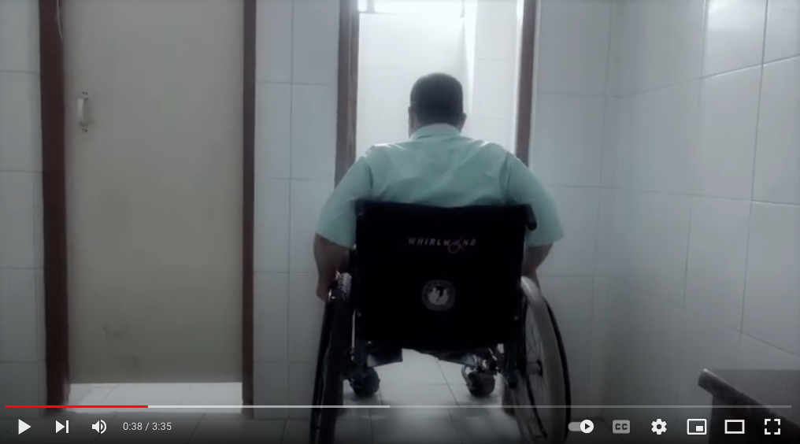
Who is marginalized and why?
3 min video
https://www.youtube.com/watch?v=QQYfjUM74A0
Notes:
PLAY THE VIDEO

Slide 7
Activity: Different health facility experiences
  Questions:
  What type of exclusion, marginalization or discrimination is this person experiencing?
  Why are they experiencing this?
  How does it relate to WASH in health facilities?
Group exercise
10 mins
Please choose one real-life quote and spend five minutes writing down or discussing the three reflection questions.
2
3
1
“I brought water to clean the plastic mat that they used because there is no water at the hospital. It’s mandatory to go to the clinic with water, they tell us to clean all the covers. My sister in law helped me..”
New mother, Tanzania
“People hush me up. I speak my mind and they dislike it. But unless I speak up, how else will the crisis here get solved?”
Female midwife, India
“We are not like pregnant women as they needs stretchers/ wheelchair at the time of delivery and its short term need but, our requirements are for long term. To be inclusive, we have to think for additional needs for specific groups.”
Woman with a disability, Myanmar
Notes:
SAY:
First, we are going to reflect on who experiences exclusion, why and what it means. There are three real-life quotes from different perspectives of healthcare workers and users (READ THE QUOTES)
Please Choose 1 quote and spend five minutes writing down reflections to the following questions - work in pairs
What type of exclusion, marginalization or discrimination is this person experiencing?
Why are they experiencing this?
How does it relate to WASH in HCF?
After 5 minutes, I will ask people to share one key reflection each.
Once you have chosen a quote, respond to the three reflection questions by writing down your responses.
Is everyone is clear on the instructions?
NOTE FOR TRAINER:
- Allow participants five minutes to read the quotes, choose one and write down their reflections. Give a one minute warning so participants know how long they have.
POINTS to help your 5 min discussion AFTER the exercise:
What type of exclusion, marginalization or discrimination is this person experiencing?
Why are they experiencing this? (hint: consider how their gender, role or disability is relevant)
How does it relate to power and WASH in HCF?
What type of challenges is this person experiencing?
Why are they experiencing this?
How does it relate to WASH in HCF?
Quote 1 Midwife
“People hush me up. I speak my mind and they dislike it. But unless I speak up, how else will the crisis here get solved?”
Not being listened to
Disrespected
Vulnerable and at risk of infection at work
Not listened to based on their gender
Midwives perspectives are not taken seriously
Less power than other roles in HCFs to change WASH solutions
Poor WASH impacts midwives in their daily work
Most midwives are women
Quote 2 HCF user with a disability
“We are not like pregnant women as they needs stretchers/ wheelchair at the time of delivery and its short term need but, our requirements are for long term. To be inclusive, we have to think for additional needs for specific groups.”
HCFs don’t meet practical needs of people with disabilities, such as aid and equipment to get around
Disability is being seen the same as health issues
Disability is not well-understood
Disability is seen as a ‘problem’ or a health issue which can be fixed, rather than a rights issue
WASH needs to be physically accessible in HCFs
People with disabilities have additional WASH needs which need to be recognized.
Quote 3 New mother in Tanzania
“I brought water to clean the plastic mat that they used because there is no water at the hospital. It’s mandatory to go to the clinic with water, they tell us to clean all the covers. My sister in law helped me..”
Women collects own water for birthing
Another women helps to clean
Risks to health and safety to women and newborn
Work burden falling on women
They are women
There are social norms that they have to collect water/do cleaning
Because she is giving birth
Because there is no water at the facility
There is limited WASH available to women giving birth
Women giving birth don’t have power to demand WASH
Women provide extra care and cleaning support

Slide 8
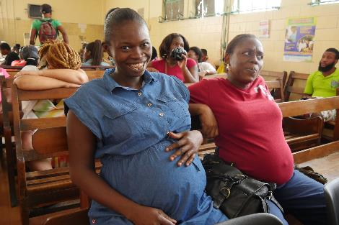
What is inclusive and empowering WASH in HCFs?
Inclusive and empowering WASH is people-centred, accessible and inclusive. In healthcare facilities, it encompasses physical accessibility as well as socio-cultural acceptability, provided through the security, privacy, independence and comfort of many different users.
Who uses WASH in health care facilities?
Women during childbirth and menstruating women; infants and children; older people; people with disabilities; people experiencing injury, illness or incontinence and female staff
© WHO/ Aphaluk Bhatiasevi
Notes:
READ THE SLIDE
SAY:
The design and management of WASH services in health care facilities must consider a variety of user needs.
Considerations: accessibility, safety, privacy, social appropriateness or acceptability and the comfort of these many different
Users include: women during childbirth and menstruating women, infants and children, older people, people with disabilities, people experiencing injury, illness or incontinence and female staff.
Female patients and staff may face negative impacts of cultural taboos around menstruation and post-birth bleeding.
Women’s WASH needs, and protection from gender-based violence

Slide 9
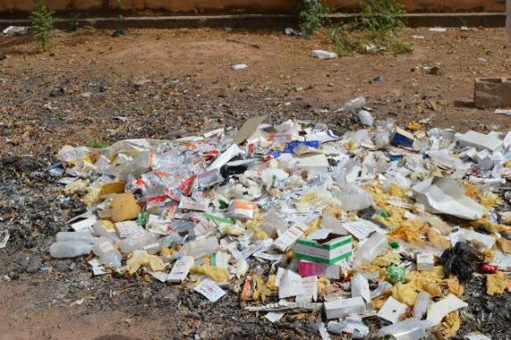
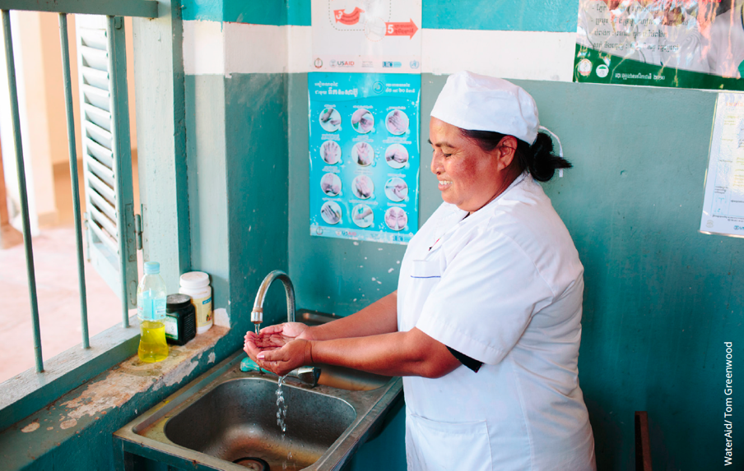
Poor WASH in health facilities impacts some people more than others
Factors that impact a persons access to WASH
Ethnicity & indigenous groups
Disability
Gender
age
Sexual orientation & gender identity
Religion
Poverty
Caste
Notes:
READ THE SLIDE
SAY:
There are many factors which impact a persons access to WASH in HCFs.
These include individual factors like their age, gender, race, or ethnicity.
Their disability, which caste group or religion they are from.
Poverty is also a factor that intersects with all of these, as does gender.
Poor WASH disproportionately impacts all of these groups, as they will likely experience greater discrimination, exclusion and marginalisation when using wash or health services.

Slide 10
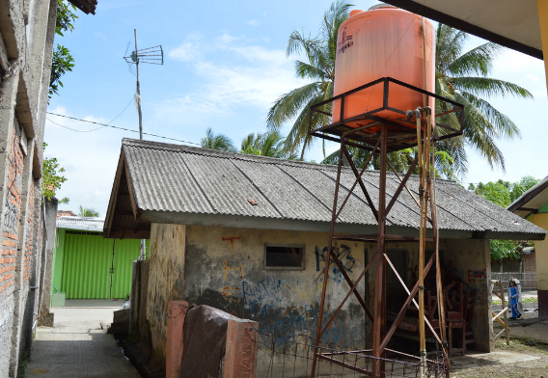
What does inclusive and empowering WASH in health care facilities look like?
Safe; private and well-lit
Meet menstrual hygiene requirements
Accessible to all HCF users
Accessible to staff working, especially women
Meets birthing and post-birthing needs (Maternity wards)
Meet requirements of caregivers and parents
Notes:
READ THE SLIDE

Slide 11
Forming diverse teams to improve WASH in health care facilities
Step 1: Establish the WASH FIT team
Participation at all levels
Notes:
SAY:
These principles particularly apply to the WASH FIT team.

Slide 12
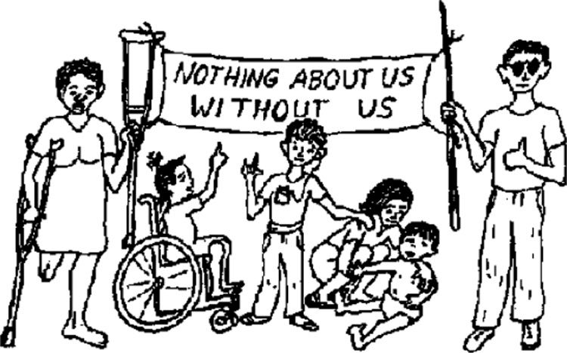
Diversity in decision-making
Every step of improving WASH in HCF must include diverse perspectives.
WASH in HCF policies and guidelines can outline participation.
Involve organisations of people with disabilities (ODPs), local women’s groups, or religious and ethnic groups in advisory boards; working groups and other forums, when working with Ministries of Health and other actors to develop WASH in HCF solutions.
Notes:
READ THE SLIDE
SAY:
Every step of improving WASH in HCF must include diverse perspectives.
WASH in HCF policies and guidelines can outline participation.
Involve organisations of people with disabilities (ODPs), local women’s groups, or religious and ethnic groups in advisory boards; working groups and other forums, when working with Ministries of Health and other actors to develop WASH in HCF solutions.

Slide 13
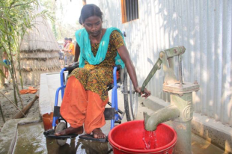
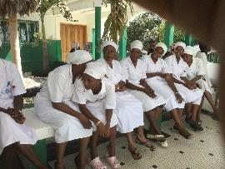
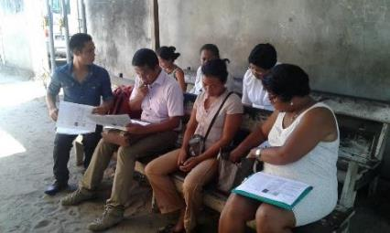
What does a diverse team look like?
People from marginalized groups (such as women, people with disabilities, people from lower income or education groups, indigenous groups etc.)
A set of team principles or ways of working to give everyone a voice
An equal gender-balance;
A diverse range of staff roles and levels– cleaners, nurses, midwives, directors and managers;
HCF users – such as a woman who has delivered a baby at the facility;
© Shumon Ahmed/CDD
Notes:
READ THE SLIDE
SAY:
A diverse team has:
Specifically invited people from marginalized groups to join (e.g., women, people with disabilities, the elderly, people from lower income or education groups, indigenous groups etc.)
A set of team principles or ways of working to give everyone a voice
An equal gender-balance;
A diverse range of staff roles and levels– cleaners, nurses, midwives, directors and managers;
HCF users – such as a woman who has delivered a baby at the facility;

Slide 14
Tips for facilitating meetings/workshops
Find out whether particular assistance or support is required to enable attendance and active participation in your meeting/event
Ensure promotional and meeting material is accessible
Choose an accessible venue
Use inclusive communication
Facilitate active participation during the meeting/event
Practice inclusive facilitation
Sensitive topics (eg menstruation) are discussed in safe spaces where women feel comfortable
Consideration for whether staff can speak freely
Notes:
READ THE SLIDE

Slide 15
Participatory barrier analysis
Step 2: Assess the facility
Understanding and assessing barriers together

Slide 16
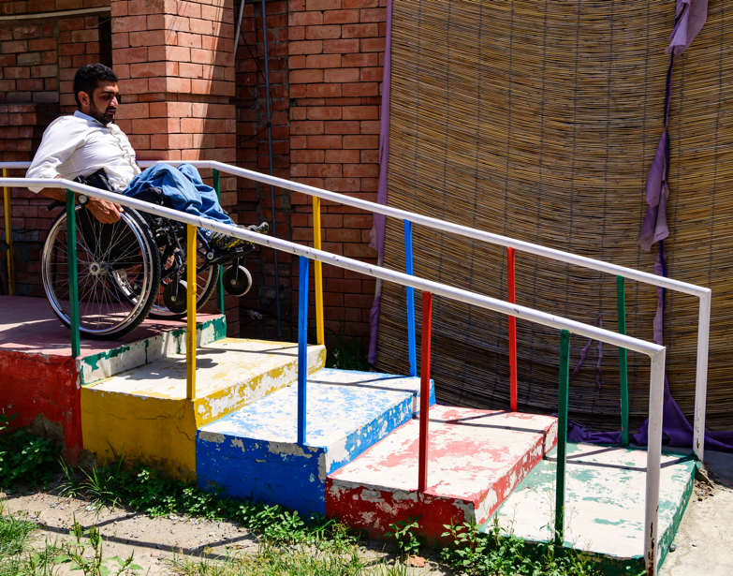
Barrier analysis approach
Undertake a WASHFIT assessment in an inclusive way
Raise awareness amongst staff of the barriers to using WASH in health care facilities
Give voice to diverse users
Use as a fun training tool with all levels of Ministries of Health and WASH
Pakistan WHO/Sebastian Liste
A barrier analysis is a participatory and practical tool that can be used in many ways and at all levels of the system
Notes:
READ THE SLIDE
.

Slide 17
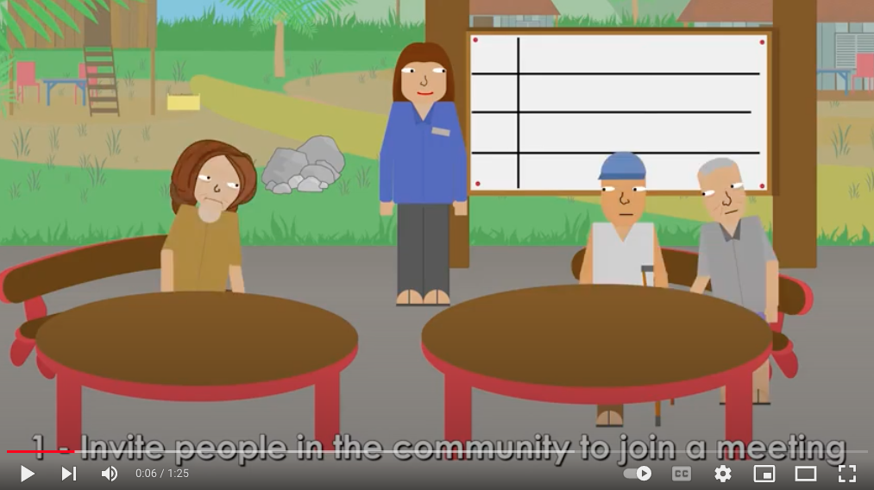

Click on this link to watch a short video about how to do a barrier analysis:
https://www.youtube.com/watch?v=auzQkENrbkM
Learn how to do a barrier analysis
1 minute video
Notes:
PLAY THE VIDEO

Slide 18
Practical activity: brainstorm barriers to WASH in health care facilities?
15 minute exercise
 | Gender | Disability
Physical
Social cultural
Institutional
Notes:
SAY:
Here is a practical tool for us to understand the barriers that people and groups face a little more in-depth is by using this barrier analysis process. It divides barriers into categories –
physical
institutional
social / cultural/ attitudinal
Our challenge in the WASH sector is to understand and help address the different barriers faced by people who are marginalised.
There are many barriers to inclusion which are not captured in the WASHFIT tool. It is important to understand and talk about what these are, as part of WASHFIT assessments. While we may not address all of these in our assessment, doing this awareness raising exercise together with other stakeholders will help to raise everyone’s understanding.
We are going to brainstorm what we think some of the common barriers to WASH in HCF from a gender and disability perspective - there are no right or wrong answers
Spilt into two groups
One group focuses on gender and one group focuses on disability
Spend 10 minutes brainstorming as a group what some of the physical, cultural and institutional barriers are to WASH in HCF. Use the template to fill in some ideas
After 10 mins I will ask you all to feedback, we will have 5 mins for that.

Slide 19

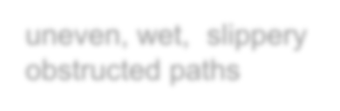




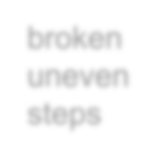

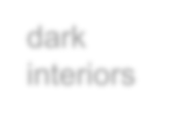













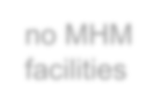







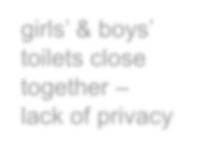












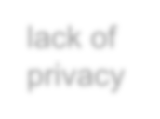


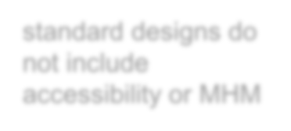
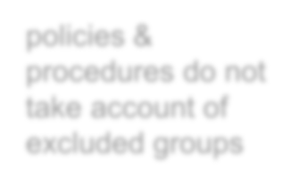




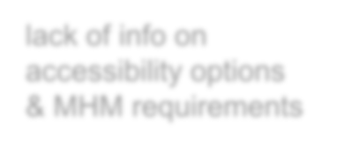

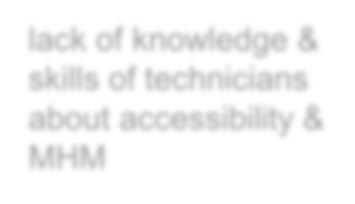





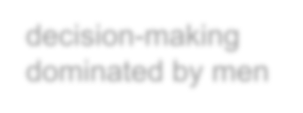
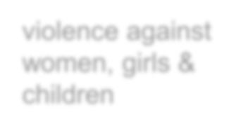







Barriers to inclusion
Physical - natural
distances to facilities
uneven, wet, slippery obstructed paths
contaminated unprotected sources
Physical - infrastructure
broken uneven steps
unsafe locations for women
high well wall
dark interiors
toilets insufficient
high platform with no step
door hard
very wide drop hole
no platform
high steps
^{no MHM} to close
facilities
from inside
girls’ & boys’ toilets close together – lack of privacy
danger of falling into well
unstable
narrow door
latrine difficult to clean
no door
nothing hole
lack of privacy
to hold onto
liable to
handpumps
collapse exhausting
Policy/ Institutional
to operate
standard designs do not include accessibility or MHM
policies & procedures do not take account of excluded groups
Poorer, lower caste,
women, disabled people excluded from consultation
lack of info on accessibility options & MHM requirements
lack of knowledge &
no planning to address security and privacy for women
skills of technicians about accessibility & MHM
Social/ cultural attitudinal
women’s
t ig
views ignored
decision-making dominated by men
violence against women, girls & children
aboos and
stigma
norance about
menstruation
Notes:
SAY:
Here is an example of some of the barriers in each category. We find that analysing and organising the barriers using this framework, also help to highlight the areas where an intervention can make the most difference.
Then we need to think about what are the solutions, what solutions can we help to provide, what solutions do we need to work with others to provide and what solutions are out of our area of focus.

Slide 20
Taking action
Step 3 & 4: Risk assessment and development an improvement plan
How to develop and implement user-friendly improvements
Notes:
SAY:
Step 4 is about how we can take action – here we explore the practical solutions to develop and implement improvement plan.
We look closely at what inclusive and accessible WASH looks like in HCFs

Slide 21
Menstrual Health
ESSENTIAL COMPONENTS
Access to information about menstruation and hygienic practices.
Access to menstrual materials.
WASH facilities/services, to:
  Wash the body and hands,
  Change menstrual materials in private,
  Clean and/or disposing of used materials.
Decision-making and participation is women-led (WASH committees etc).
“Menstruating in PPE is tricky, especially if you are used to heavy flow and there’s a chance you might stain your suit, as the material of our PPE is of poor quality too. It is shameful to share these things but it
is obvious, so the administrators should be sensitive!”
- Nurse-in-charge, India
Notes:
SAY:
Menstrual health is an important aspect of addressing WASH in HCFs
Menstrual health is a state of complete physical, mental, and social well-being and not merely the absence of disease or infirmity, in relation to the menstrual cycle.
Women health workers manage menstrual periods at work.
Women using health services manage menstrual and post-partum bleeding.
The components of menstrual health which are most critical to WASH in HCF are:
Access information about menstruation and hygienic practices.
Access menstrual materials
WASH facilities and services, to:
Wash the body and hands,
Change menstrual materials in private,
Clean and/or disposing of used materials.
experience a positive and respectful environment, free from stigma and psychological distress.
Decision-making and participation, such as going to work.

Slide 22
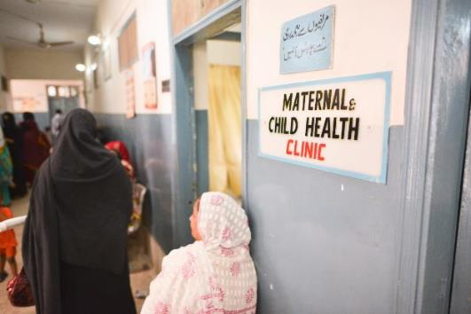
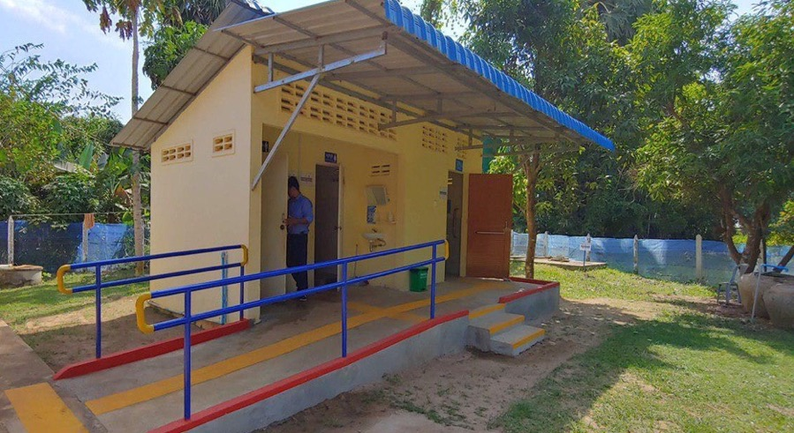
If the maternity ward is not WASH ready, identify a suitable location nearby:
  Central location that is safe and well-lit
  Clear pathways
  Wide pathways with raised edges
  Handrails or guidance ropes
  Clear signage identifying WASH facilities.
Notes:
SAY:
Here we share some detailed the features of accessible, safe and female-friendly facilities
Getting there: Getting to a facility that embraces WASH in a HCF requires the following considerations:
Facility is in a central location that is safe and well-lit
There are clear pathways that are free of hazards like branches
Pathways have raised edges along the sides
There are handrails or guidance ropes for a person with a vision impairment to follow along
Clear signage for WASH facilities are throughout the HCF
Ramps
Tactile markers on ground
Non-slip materials
central location close to people’s houses, clear, wide pathways with raised edges, guidance ropes or hand rails, signage for public facilities
Features to ensure accessibility and safety:
Clear pathways
Ramps
Handrails
Tactile markers on ground
Non-slip materials
Located in a safe place, close by

Slide 23
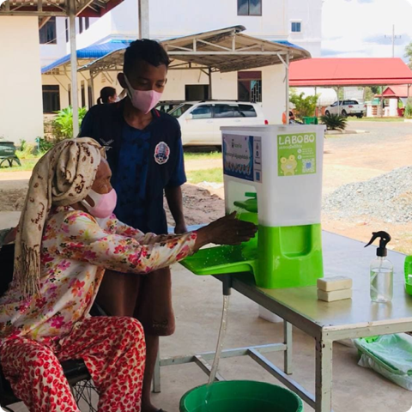
Safety & accessible features
Sex-segregated and clearly marked
Well lit, lockable doors with no gaps
Wide doorways or gates
Outward facing door with low handles
Ramps are a safe gradient (1:12)
Steps are wide (if ramp not possible)
Tactile markers on ground (if possible)
WASH FIT indicators:
2.3 Toilets or improved latrines clearly separated for male and female
2.10 Latrines are adequately lit, including at night
Notes:
READ THE SLIDE
SAY:
The next step to consider in WASH infrastructure is how easy it is to get inside the facility.
There are a range of features which can make it much easier for people with disabilities, limited mobility or who are heavily pregnant to get inside a facility as noted here and in the next slide

Slide 24
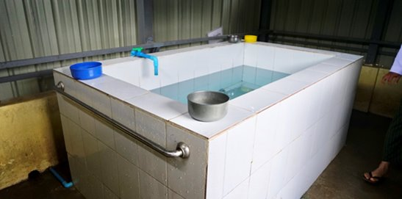
Safety & accessible features
Enough space maneuver inside if using a wheelchair, or for a support person
Handrails
Toilet seats
Water inside for cleansing that is reachable
Easy to use taps
Bins for disposing menstrual materials
Handwashing facilities at a low height
Non-slip flooring
WASH FIT indicators:
2.4 At least one toilet or improved latrine provides the means to manage menstrual hygiene needs
2.5 At least one toilet meets the needs of people with reduced mobility
3.2 Hand hygiene promotion materials clearly visible and understandable at key places
Notes:
READ THE SLIDE

Slide 25
WASH FIT indicator:
S_6: At least one usable, improved toilet provides the means to manage menstrual hygiene management (MHM) needs.
Menstrual hygiene management
MHM need | WASH in HCF solutions
Washing body and hands in private | Private toilet facility for women which is lockable.
Changing pads/materials in private | The toilet has water or toilet paper available to cleanse.
Cleaning or disposing of used materials | Private lockable toilet or washroom with water available. Disposal bin inside toilet. Waste management system to empty bin and safely dispose of used materials
Positive and respectful environment | Women on WASHFIT teams and participating in assessments to discuss their menstrual hygiene needs.
Notes:
READ SLIDE
SAY:
It is important to recognize who the WASH FIT indicators can help you achieve the necessary standards

Slide 26
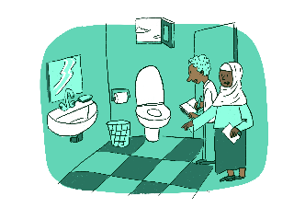
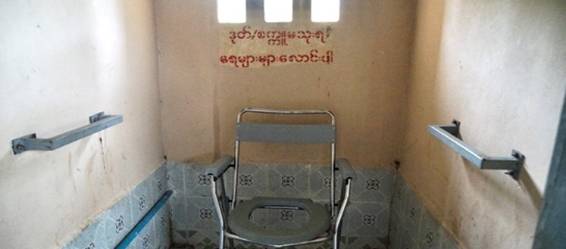
Simple & low cost improvements
Handrails
Temporary toilet seats
Bins inside for disposing menstrual materials
Ropes to guide someone along the path
Simple signage
WHO Philippines/Sebastian Liste
Notes:
SAY:
These features are about how people can interpedently, safely and comfortably use facilities, as well as move around inside.
Accessibility and safety features include:
Enough space maneuver inside if using a wheelchair, or for a support person
Handrails
Temporary or permanent toilet seats
Water inside for cleansing that is reachable
Easy to use taps
Bins inside for disposing menstrual materials
Handwashing facilities at a low height
Non-slip flooring
These features related to three WASHFIT indicators:
2.4 At least one toilet or improved latrine provides the means to manage menstrual hygiene needs
2.5 At least one toilet meets the needs of people with reduced mobility
3.2 Hand hygiene promotion materials clearly visible and understandable at key places

Slide 27
Monitoring and learning
Step 5: Monitor changes, reflect and adapt
Notes:
SAY:
Addressing GEDSI is a learning journey, that requires continual reflection, discussion and adaptation of approaches.
Small steps have a big impact
Awareness raising and learning is part of the process
Remember that it is about more than accessibility, it is also about social change and power

Slide 28
Discuss in pairs:
Imagine a WASHFIT team meeting is happening:
Where would different people be on the ladder based on there role, gender, age etc?
Why did you please them there?
What can a facilitator do to help different members move up the ladder?
Practical tool: Participation Ladder
5 minute exercise
WHO Philippines/Sebastian Liste
Notes:
READ THE BOX ON SLIDE
SAY:
Addressing GEDSI is a learning journey, that requires continual reflection, discussion and adaptation of approaches.
Small steps have a big impact
Awareness raising and learning is part of the process
Remember that it is about more than accessibility, it is also about social change and power
The participation ladder: is one tool that is great to use to monitor and reflect on participation.
The participation ladder is a visual tool which shows the different steps of participation, and the ability to contribute to a discussion, process or decision. It can be used to:
Raise awareness within the WASHFIT team of what good participation looks like
Monitor and track participation of individuals over time
Now are going to take five minutes to reflect on using the participation ladder - please break into pairs
Imagine you are a male cleaner working at a big rural hospital. You cannot read and write very well and you have difficulty seeing. You are in a WASHFIT meeting with the Director, two medical doctors and one nurse. The nurse is the only woman.
How do you confident do you feel during the meeting?
Looking at the participation ladder, where would you place your level of participation during that meeting? Why?
Where would you like to be on the ladder?
What would help you to get to that point on the ladder? What could a facilitator do?
Be ready to feedback your reflections after a new moments.

Slide 29
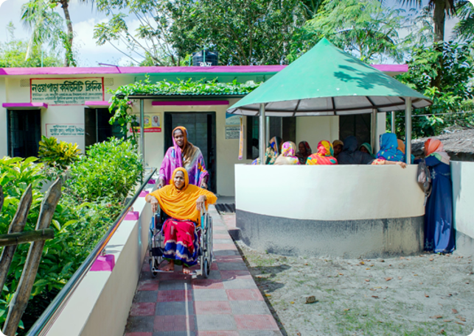
Inclusive and Empowering WASHFIT take-aways
Nothing about us without us: always make sure there is participation from diverse people
Some people will experience marginalization and exclusion from WASH in HCF due to factors like gender, age, disability, ethnicity and poverty
Barriers to WASH in health care facilities can be social, physical and institutional, and can be about power
WASH solutions must be accessible, safe, private and comfortable for diverse HCF users
WHO Philippines/Sebastian Liste
Notes:
READ THE SLIDE
SAY:
Here are key inclusive and empowering WASHFIT takeaways
Nothing about us without us: always make sure there is participation from diverse people
Some people will experience marginalization and exclusion from WASH in HCF due to factors like gender, age, disability, ethnicity and poverty
Barriers to WASH in HCF can be social, physical and institutional, and can be about power
WASH solutions must be accessible, safe, private and comfortable for diverse HCF users

Slide 30
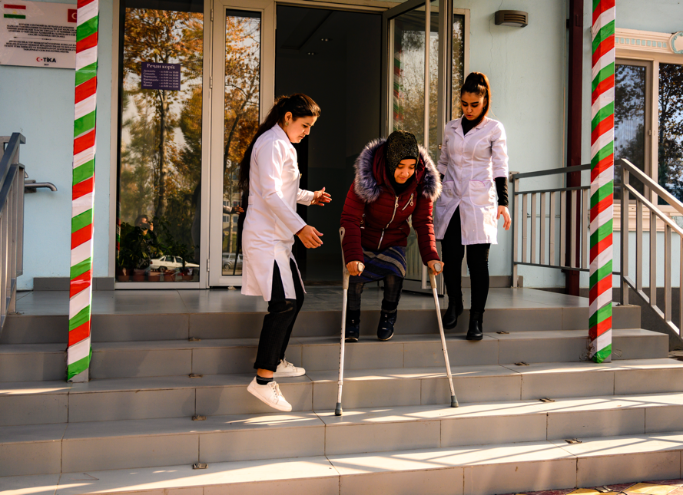
Questions?
WHO Tajikstan/Sebastian Liste
Notes:
NOTE FOR TRAINER:
Use the further reading list in advance to help you prepare for questions if necessary

Slide 31
Further reading list
WHO (2019). Delivered by women, led by men: A gender and equity analysis of the global health and social workforce. (Human Resources for Health Observer Series No. 24). Available at https://www.who.int/docs/default-source/nursing/delivered-by-women-led-by-men.pdf?sfvrsn=94be9959_2
WaterAid (2018). User-friendly WASH in Healthcare Facilities in Cambodia: developing a participatory management tool. Available at: https://washmatters.wateraid.org/publications/user-friendly-wash-in-healthcare-facilities-in-cambodia
Australian Government AusAID (2013). Accessibility Design Guide: Universal design principles for Australia’s aid program. Available at: https://www.dfat.gov.au/sites/default/files/accessibility-design-guide.pdf
WHO (2018). Standards for improving the quality of care for children and young adolescents in health facilities. https://apps.who.int/iris/bitstream/handle/10665/272346/9789241565554-eng.pdf?ua=1
WHO (2016). Standards for improving quality of maternal and newborn care in health facilities. https://www.who.int/publications/i/item/9789241511216
WHO (2012) Making health services adolescent friendly: developing national quality standards for adolescent friendly health services. https://apps.who.int/iris/handle/10665/75217
WaterAid Female-friendly toilet guide: https://washmatters.wateraid.org/publications/female-friendly-public-and-community-toilets-a-guide-for-planners-and-decision-makers
Unicef (2019). Guide to Menstrual Hygiene Materials: https://www.unicef.org/documents/guide-menstrual-hygiene-materials
WHO (2019). WATER, SANITATION, AND HYGIENE IN HEALTH CARE FACILITIES PRACTICAL STEPS TO ACHIEVE UNIVERSAL ACCESS TO QUALITY CARE. https://www.washinhcf.org/wp-content/uploads/2019/04/2019_WASH-in-HCF-Practical-Solutions-for-Universal-Access-to-Quality-Care_2April-compressed.pdf
WHO Philippines/Sebastian Liste

Slide 32
Supplementary slides
And further reading

Slide 33
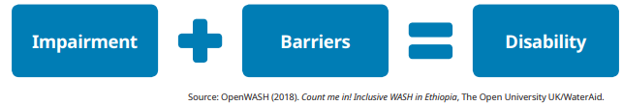
Understanding Disability
Physical
Institutional/Policy
Social/Attitudinal
WHO Philippines/Sebastian Liste
Notes:
READ THESE NOTES:
The definition of disability is: “Persons with disabilities include those who have long-term physical, mental, intellectual or sensory impairments which in interaction with various barriers may hinder their full and effective participation in society on an equal basis with others.”
This definition of disability is in the UN Convention on the Rights of People with Disabilities.
As WASH actors, we need to focus on removing the barriers that a person experiences, rather than focusing on their impairment. If we can address and reduce the barriers, then people will be able to enjoy their rights to WASH much more freely.
There are three types of barriers to be aware of:
Physical barriers
Institutional or policy barriers
Social and attitudinal barriers.

Slide 34
Poor WASH in HCFs impacts women
WHY?
Majority of nurses and midwives are women
Women giving birth are vulnerable to poor IPC.
Safety, privacy and dignity in using bathing facilities and toilets at a very vulnerable time.
Low levels of women’s leadership in health systems (despite female-dominated workforce)
Mistreatment of female healthcare workers
Vulnerability, mistreatment and abuse of women giving birth
Gendered division of labour
Notes:
READ THE SLIDE
This slide provides an overview of gender inequality issues that arise when thinking about gender inequality in healthcare settings, and what these mean for WASH solutions.
Some gender inequality issues include:
Lower-levels of women’s leadership in health systems: Despite being a female dominated workforce, low levels of womens leadership
Vulnerability, mistreatment and abuse of women giving birth: Women are at risk of physical, sexual and verbal abuse as well as neglect and lack of autonomy at time of delivery
Mistreatment and undervaluing of female healthcare workers: Women health care workers and roles such as cleaners can feel powerless to improve WASH in HCFs
Poor WASH for Infection, Prevention and Control in HCFs disproportionately impacts women
As workers: Women comprise the majority of frontline nurses and midwives globally
Women manage menstrual periods at work
As clients/users: Women giving birth.
Managing post-partum bleeding
Safety, security, privacy and dignity in using bathing facilities and toilets at a very vulnerable time
Poor WASH in HCF’s reinforces a gendered division of labour
All over the world, the responsibility for the daily, unpaid task of water collection falls on women and girls. These socially prescribed norms also exist in HCFs.
Unpaid

Slide 35



Case study: ‘user-friendly WASH in HCF’ in Cambodia
6 minute video
https://www.youtube.com/watch?v=YHftVsC97Ck
Notes:
READ THESE NOTES:
The definition of disability is: “Persons with disabilities include those who have long-term physical, mental, intellectual or sensory impairments which in interaction with various barriers may hinder their full and effective participation in society on an equal basis with others.”
This definition of disability is in the UN Convention on the Rights of People with Disabilities.
As WASH actors, we need to focus on removing the barriers that a person experiences, rather than focusing on their impairment. If we can address and reduce the barriers, then people will be able to enjoy their rights to WASH much more freely.
There are three types of barriers to be aware of:
Physical barriers
Institutional or policy barriers
Social and attitudinal barriers.

