Slide 2
Safely managed sanitation in health care facilities
WASH FIT technical module
Add date & location
Notes:
Introduce yourself if you have not already, and make sure you insert the date and location to the slide before you start

Slide 3
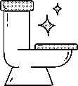

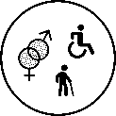

Learning objectives
By the end of this session, you should be able to:
Describe the minimum requirements for sanitation in health care facilities
Understand what “safely managed sanitation” is and why it is important for human health and providing safe care
Understand the links between AMR and sanitation in health care facilities and what can be done to address the problem
Describe the different sanitation technology options and the effects of climate change on technologies
Understand how to make sanitation facilities user friendly, gender-inclusive and climate-resilient
Group
work
Icons to look out for
Link with GEDSI
Link with climate
resilience
Notes:
READ THE SLIDE

Slide 4
Part 1: Minimum requirements
Minimum sanitation requirements
Importance of safe sanitation
Antimicrobial resistance in health care facilities
Notes:
READ THE SLIDE

Slide 5


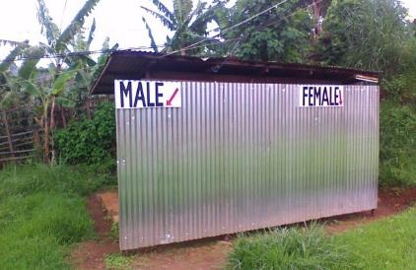
Sanitation
QUIZ
5 mins
According to latest global estimates (2020), what proportion of health care facilities do not have a toilet?
Define what is meant by “safely managed sanitation”.
Toilets should have a hand washing station within _____ metres.
1 shower should be available for every _____ users.
Toilets should be cleaned every _________.
Notes:
SAY:
- spend 5 minutes discussing the questions/statements with the person next to you and be ready to shout out answers after a few moments

Slide 6
Sanitation
ANSWERS
Globally, 1 in 10 health care facilities do not have a toilet
A system which safely manages health risks from exposure to excreta at all steps of the sanitation service chain (containment, conveyance and treatment).
Toilets should have a hand washing station within 5 metres.
1 shower should be available for every 40 users.
Toilets should be cleaned every day.
Notes:
READ THE SLIDE
SAY:
1. Latest JMP data (2020), published in 2020: 72% of health care facilities worldwide had access to improved and usable latrines in 2019. However, one in ten health care facilities globally, and three out of ten in sub-Saharan Africa, had no sanitation service in 2019.
3. Hand washing stations at toilets should have soap and water, rather than alcohol-based handrub, as ABHR does not remove fecal matter from hands.
5. Toilets should be cleaned at least once a day, and more if needed due to soiling, high patient load, etc. A record of cleaning should be pinned to the wall to encourage accountability.

Slide 7
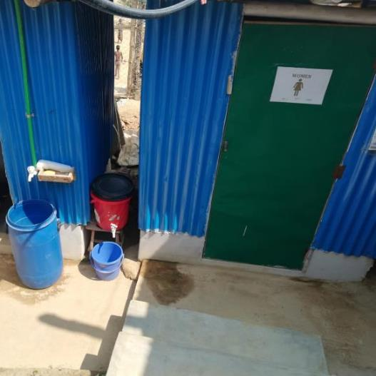
Minimum sanitation requirements
Toilets (latrines) should:
Be onsite, usable & accessible
Offer privacy & be clean
Be clearly separated for male and female or provide privacy (i.e. single stall/room) if gender neutral
At least one should meet the needs of people with limited mobility and menstrual hygiene management needs.
Functioning hand washing station within 5m.
Gender segregated toilet with handwashing station
Notes:
READ THE SLIDE
SAY:
A toilet/latrine should have a door which is unlocked when not in use (or for which a key is available) and can be locked from the inside during use, there should be no major holes in the structure, the hole or pit should not be blocked, water should be available for flush/pour flush toilets, and there should be no cracks, or leaks in the toilet structure. It should be within the grounds of the facility and it should be clean as noted by absence of waste, visible dirt and excreta and insects).
Toilets should have hand washing stations (of water and soap), rather than alcohol-based hand rub which does not remove faecal matter from hands.

Slide 8
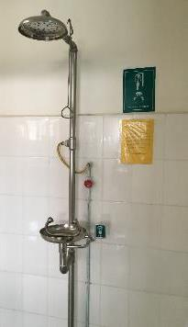
Minimum sanitation requirements
Numbers of toilets
  Inpatients: 1 per 20 users
  Outpatients:
    Minimum: 2 (1 for staff and 1 for patients),
    Ideally: 4 (male/ female staff & male/female patients; one should be accessible to those with limited mobility)
Showers
  Inpatients: 1 per 40 users
  And shower available in the labour and delivery area
Notes:
READ THE SLIDE
SAY:
the minimum number of facilities is 2, this is to be realistic about what really small health care facilities can provide. For bigger facilities, there should be more toilets available.

Slide 9
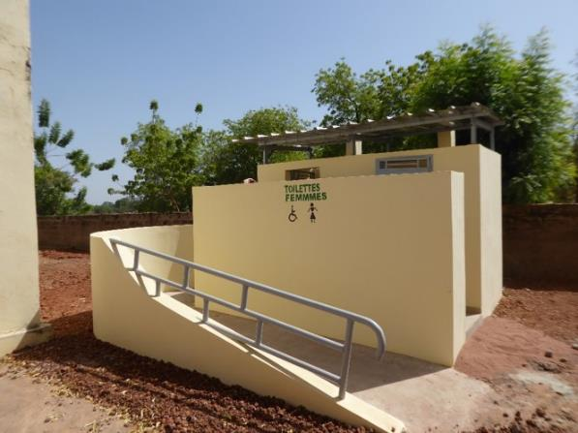
Why is safe sanitation important?
Human faeces is the most common source of microbial pathogens (germs).
One gram of human faeces has over 1,000,000,000 pathogens.
The faeces of those seeking treatment in health care facilities could be particularly infectious
→ Cholera easily spreads from faeces of infected individuals.
A fundamental human right that
→ Promotes dignity, wellbeing and health seeking behaviors
Notes:
READ THE SLIDE
SAY:
Sanitation in all spheres of life is a human right.
Safe sanitation that meets users physical and cultural needs (through accessibility, privacy, culturally appropriate anal cleaning etc.) is essential: lack of sanitation can deter women form choosing to give birth in a health facility.
The human right to sanitation also include the right to be negatively impacted by unmanaged sanitation from others (e.g. excreta leaked into communities contaminating open ground, open drains, irrigation water and food crops, fishing and swimming areas). This is particularly important for health facilities where wastewater and faecal sudge is likely to carry a higher load of pathogens (including resistant bugs) than the surrounding community.

Slide 10
Health hazards of inadequate sanitation
Diarrhoea
Neglected tropical diseases
Vector borne diseases
Spread of antimicrobial resistance
Patient and health worker wellbeing, dignity and safety
leading cause of disease and death for children > 5 years
e.g. helminth infections, trachoma, schistosomiasis
e.g. Lymphatic filariasis, West Nile Virus, malaria, Zika
through diarrhoea + use of antimicrobials, and in environment when faecal waste inadequately treated
compromised with inadequate sanitation.
Notes:
SAY:
Diarrhoea, a major public health concern and a leading cause of disease and death among children under five years in low- and middle income countries (Prüss-Üstün et al. 2016);
Neglected tropical diseases such as soil-transmitted helminth infections, schistosomiasis and trachoma that cause a significant burden globally (WHO, 2017); and
Vector-borne diseases such as West Nile Virus or lymphatic filariasis (Curtis et al., 2002; van den Berg, Kelly-Hope & Lindsay, 2013), through poor sanitation facilitating the proliferation of Culex mosquitos.
Unsanitary conditions have been linked with stunting (Danaei et al., 2016), which affects almost one quarter of children under-five globally (UNICEF/ WHO/World Bank, 2018) through several mechanisms including repeated diarrhoea (Richard et al., 2013), helminth infections (Ziegelbauer et al., 2012) and environmental enteric dysfunction (Humphrey, 2009; Keusch et al., 2014; Crane et al., 2015)
Spread of AMR is mostly linked to antibiotics but the term antimicrobial is preferred as it covers antivirals, anthelminthics and antifungals.

Slide 11
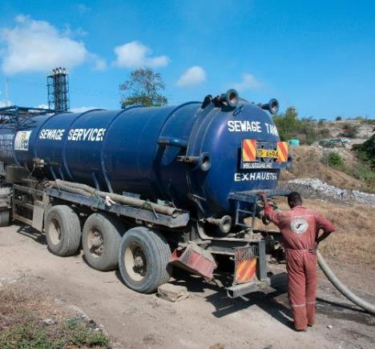
BRAINSTORM
2 mins
What is the sanitation chain and what are the five elements?
Can you define a “safe sanitation system”?
© Linda Strande
Notes:
SAY:
- Take a moment to discuss these questions with the person next to you - be prepared to provide your answers which we will note down
NOTES FOR TRAINER (TO USE WHEN TAKING FEEDBACK):
Consider all steps of the sanitation chain: Toilet, containment, conveyance, treatment, end use/ disposal. Note, there should be no reuse of HCF wastewater.
Sanitation measures to protect public health are both single- and multi-component, and include technologies.
Safe sanitation systems separate human excreta from human contact at all steps of the sanitation service chain carrying excreta from the toilet to its eventual safe use or disposal. Failures at any step of the sanitation chain result in negative health outcomes – and in other realms of life. That’s why it is critical to ensure that risks are managed along the whole sanitation service chain – from toilets, to containment, to transport, treatment, and finally safe use or disposal of wastewater and faecal byproducts.
Health hazards associated with the sanitation chain may be microbial (the focus of the WHO guidelines), chemical or physical.
Refer to Chapter 3 of Sanitation Guidelines for definitions: https://www.who.int/water_sanitation_health/publications/guidelines-on-sanitation-and-health/en/

Slide 12
The sanitation chain
Safely management sanitation systems
Are toilets connected to a sewer and treatment plant or on-site treatment?
A primary barrier that breaks transmission within health facilities and to the surrounding community (also avoiding environmental pollution)
Safely contain and treat excreta at all steps of the sanitation chain
Designed and used to separate human excreta from human contact & the environment, including groundwater, land used for farming
Toilet
Containment – storage / on-site treatment
Conveyance
Treatment (off-site)
End use/ disposal
Notes:
READ THE SLIDE
SAY:
Safe sanitation systems must meet these requirements in a manner consistent with human rights, while also addressing co-disposal of greywater, associated hygiene practices and essential services required for the functioning of technologies.
Consider all steps of the sanitation chain: Toilet, containment, conveyance, treatment, end use/ disposal. Note, there should be no reuse of HCF wastewater.
Sanitation measures to protect public health are both single- and multi-component, and include technologies.
Safe sanitation systems separate human excreta from human contact at all steps of the sanitation service chain carrying excreta from the toilet to its eventual safe use or disposal.

Slide 13
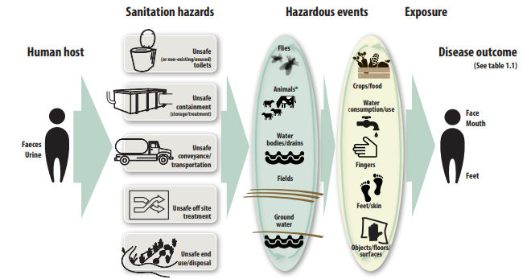
Transmission of excreta-related pathogens
Sanitation is a primary barrier to this transmission
Notes:
SAY:
This figure is taken from the WHO Sanitation guidelines.
The transmission of excreta related pathogens can occur within many points of the sanitation chain (unclean toilets, unsafe containment-e.g. latrines which contaminate unconfined aquifers, unsafe transport through leaking trucks and by sanitation workers without sufficient PPE, unsafe treatment through septic tanks or leach fields that are not operated as designed and do not facilitate sufficient die-off of pathogens, and unsafe end use including irrigating fields with wastewater that is not sufficient treated.
Control measures (any barrier or action that can be used to prevent or eliminate a sanitation-related hazardous event or reduce it to an acceptable level of risk) are needed throughout the sanitation chain.

Slide 14
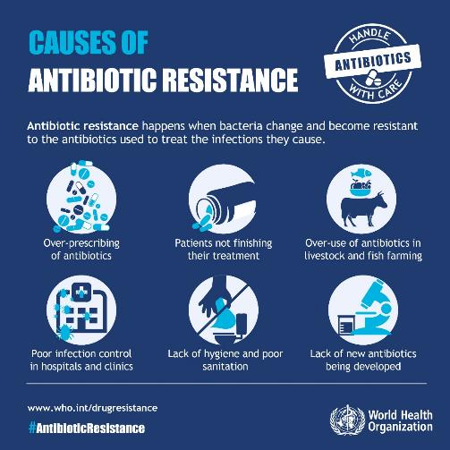
Antimicrobial resistance (AMR) in health care facilities
What is AMR?
When bacteria, viruses, fungi and parasites change over time and no longer respond to medicines making infections harder to treat and increasing the risk of disease spread, severe illness and death.
Why does it occur in health care facilities?
Lack of access to WASH, especially sanitation
Poor infection prevention and control
Lack of awareness and knowledge
Over/mis use of antimicrobials
Notes:
READ THE SLIDE
SAY:
Wastewater from health care facilities carries higher proportions of resistant bacteria and residues from last line of defense antimicrobials

Slide 15
Addressing AMR in health care facilities
Safe collection, storage, and minimally secondary treatment of wastewater and sludge (on or off-site) should be prioritized to control spread of AMR.
Secondary treatment sufficient but higher level of treatment may provide additional protection.
Effective treatment systems remove AMR-resistant bacteria at similar rates as other bacteria
Drinking water treatment (e.g filtration or chlorination) to reduce waterborne diarhoea and need for antibiotics
Practice infection prevention and control measures including hand hygiene to limit spread
Primary treatment = physical treatment e.g. solids screened or allowed to settle
Secondary treatment = biological processes (e.g. bacteria + air) to remove pathogens
Tertiary treatment = additional biological and/or physical-chemical treatment
* Well designed and managed septic tanks with a sand filter/leach field can provide secondary treatment.
For more on the hygiene-related aspects of AMR, refer to the Hand Hygiene module
Notes:
READ THE SLIDE
SAY:
Safe sanitation systems and hygiene practices can serve as critical barriers between sources of AMR and human exposure.
Hand hygiene can limit transmission of organisms that are antimicrobial resistant via touch, while safe toilets, containment, conveyance, treatment (of wastewater and sludge) and safe end use and disposal as well as drinking water treatment and source water protection, are all critical barriers that can prevent the transmission of AMR pathogens from faecal sources to humans.
In addition, population-level interventions can reduce the problem of AMR by limiting antibiotic prescription, increasing public outreach and communication about appropriate antibiotic usage, and establishing policies that limit unneeded antibiotic use or discharge of contaminated wastes.
It is important that all health care facilities either safely treat wastewater onsite or send fecal waste (e.g. either through well managed sewage system or sludge treatment). Secondary treatment (e.g. at least two step process with physical and biological treatment) will greatly reduce the microbiological risks (e.g. diarrhoeal disease, transmission of AMR infections). Where there is additional risks either from contamination (e.g. heavy metals, toxic substances) and/or possible re-use of wastewater more advanced treatment (tertiary) is needed. Health care facility managers and staff should seek to understand their sanitation system and engage with sanitary experts to incrementally improve the safety of the system where deficiencies are found.

Slide 16
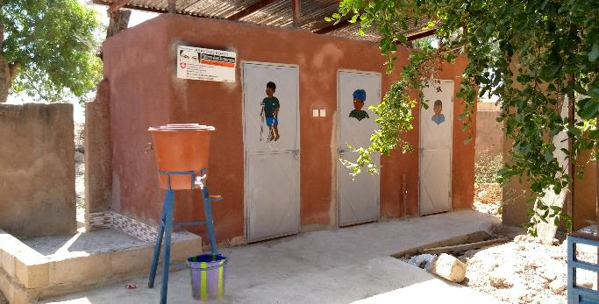
Part 2: Sanitation technologies
On-site treatment options
Off-site options
Emptying and conveyance
Notes:
READ THE SLIDE

Slide 17
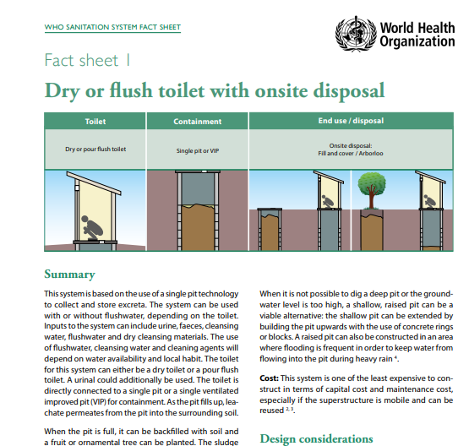
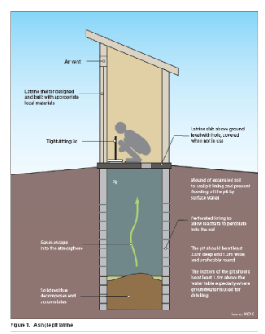
Sanitation system fact sheets and inspection forms
11 system fact sheets exist covering:
Applicability
Design considerations
Operation and maintenance
Measures to protect public health
Accompanied by sanitary inspection forms and management advice sheets
7 most common types of sanitation designs
To identify key risks and appropriate remedial actions
Fact sheets and forms: https://www.who.int/teams/environment-climate-change-and-health/water-sanitation-and-health/sanitation-safety/sanitation-inspection-packages
Notes:
READ THE SLIDE
SAY:
The sanitation system fact sheets (Annex 1 of the WHO guidelines) provide guidance on some of the most frequently-used sanitation systems. Each describes the applicability of the system in different contexts; design, operation and maintenance considerations; and mechanisms for protecting public health at each step of the sanitation service chain. Depending on the setting, various sanitation technology and infrastructure options can be designed, combined, operated and managed at different scales to form a functional service chain.
A sanitary inspection is an on-site inspection and evaluation, by qualified individuals, of all conditions, devices, and practices in the sanitation system that pose an actual or potential danger to the health and well-being of the various exposure groups. It is a fact-finding activity that should identify system deficiencies - not only potential sources of hazardous events, but also inadequacies and lack of integrity in the system or that could lead to hazardous events

Slide 18
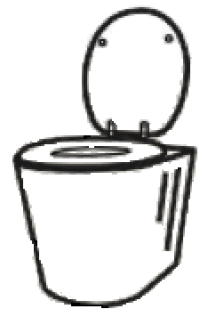
Toilet options
Design
Compatible with:
  water availability
  intended next steps for containment and conveyance
  anal cleansing and menstrual hygiene management (MHM) practice
Suitable for all intended users (human rights criteria: available, accessible acceptable, affordable)
Slab or pedestal made from durable, cleanable material
Prevents odor, insect and rodents (water seal or lid)
Prevents ingress of stormwater
Operation & Maintenance
Supplies and behaviors for anal cleansing, toilet cleaning, flushing or covering excreta (e.g. with ash or lime)
Incremental measures
Shared or public toilets in HCF or dense/ emergency settings have additional measure for safe use
  sex separation (or unisex with hand hygiene and MHM in cubicle),
  locks,
  lights,
  MHM,
  disability access
  formal management system)
Notes:
READ THE SLIDE

Slide 19
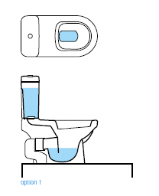
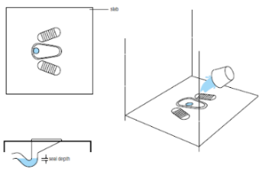
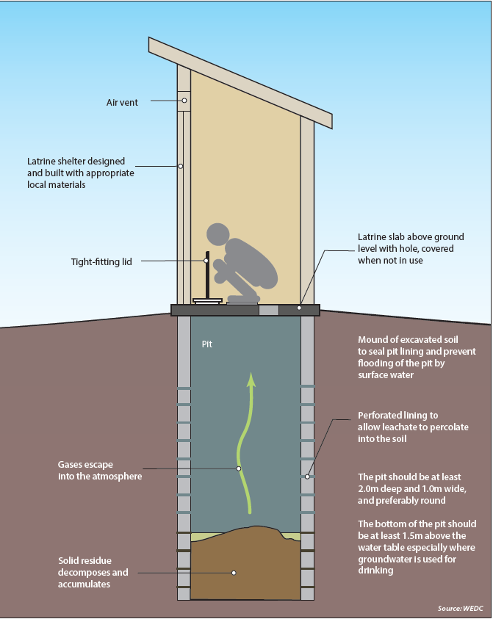
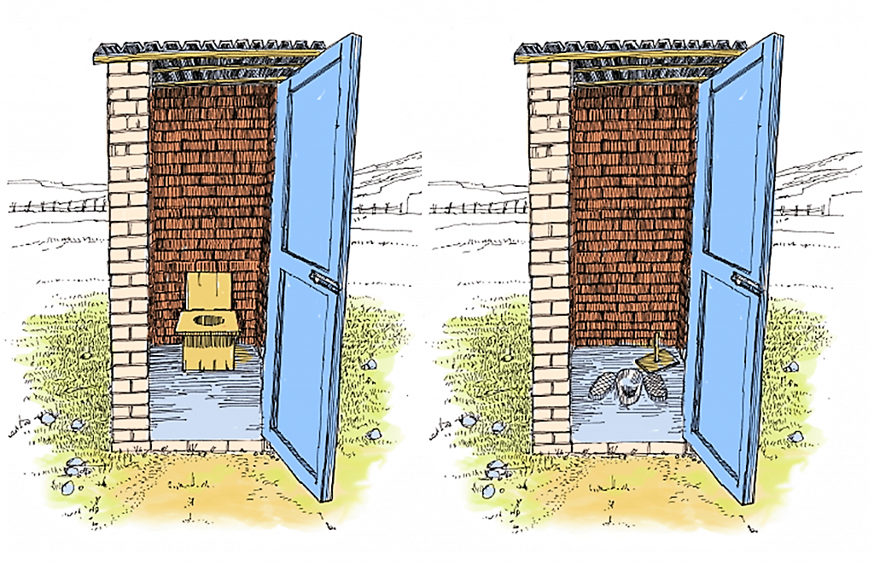
Toilet options
Dry (no flush) toilet
Pour flush or cistern toilets
Sit down pedestal and keyhole squat no flush toilets
Notes:
SAY:
A pour flush toilet is more suited in areas where there is a regular water supply, higher usage and an available septic tank to receive and treat the liquid waste. A biogas reactor can alternatively be used to treat the waste. This type of treatment may require more regular operation and maintenance but as the added advantage of producing gas which can be used for cooking or heating. It is best where there is sufficient personnel to manage and an on-site need for the gas.

Slide 20
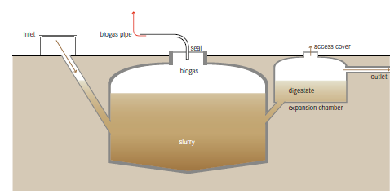
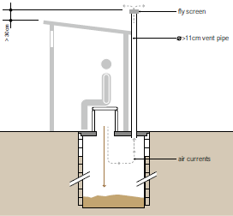
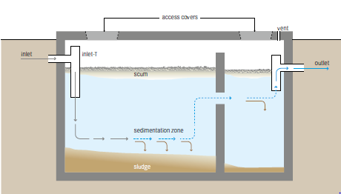
On-site treatment options
(with periodic emptying and disposal on or off-site)
Single, ventilated pit latrine
Bio-gas reactor or septic tank
Notes:
SAY:
Sanitation systems fall into two broad categories: onsite and offsite systems. Onsite treatment is: a sanitation technology or system in which excreta (referred to as faecal sludge) is collected and stored and emptied from or treated on the plot where they are generated.
Safe containment ensures products generated from the toilet are retained within the containment technology and/or discharged to the local environment in a manner that does not expose anyone to the hazard or contaminate water sources.
For rural primary care facilities with plenty of space/land, few patients and few resources a single, ventilated pit latrine may be the best option. It is important that the latrine is upgradient and at a safe distance (> 15 m) from a water source. Once the pit is full, it either needs to be emptied using hand tools, vacuum truck or pumping systems and taken off site for further treatment or covered and a new pit dug.
Refer to Sanitation System fact sheets in the WHO Guidelines for more information. Source: Compendium of Sanitation Technologies. Eawag, Switzerland. 2018.

Slide 21
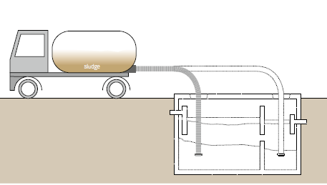
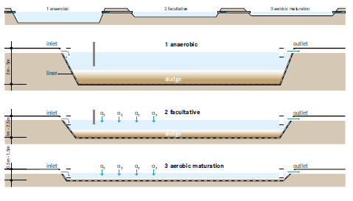
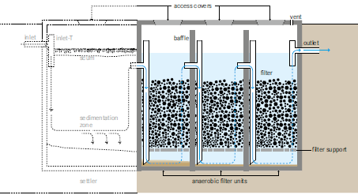
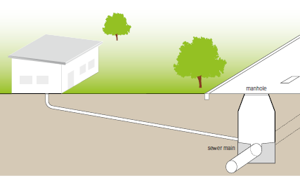
Off-site options (or on-site treatment for large health care facilities)
Waste stabilization pond
Motorized collection
Gravity sewer
Anaerobic filter
Notes:
SAY:
Off-site systems definition: a sanitation system in which excreta (referred to as wastewater) is collected and transported away from the plot where they are generated. An off-site sanitation system relies on a sewer technology for transport.
Manual and motorized emptying and transport refers to the different ways by which faecal sludge can be removed from the facility location.
(Top left) Motorized emptying and transport (also known as mechanical emptying and transport) refers to the use of any vehicle or device equipped with a motorized pump and a storage tank for emptying and transporting faecal sludge. People are required to operate the pump and maneuver the hose, but the faecal sludge is not manually lifted or transported. Wet systems such as septic tanks and fully lined tanks are commonly emptied using motorized emptying and transport.
Motorized collection is more suitable in urban areas where sludge can be taken to a sludge treatment facility. The sludge truck depending on the size and access to the toilet may have difficulty in accessing the toilet and this should be taken into consideration. A number of smaller sludge removal technologies now exist for use in dense urban areas.
(Bottom left) Sewer-based systems comprise networks of underground pipes. Types of sewerage include:
• conventional gravity sewers: convey blackwater from toilets and greywater along with, in many cases, industrial effluents and storm water through large diameter pipes to a treatment facility, using
gravity (and pumps when necessary)
• simplified sewers: a lower cost design installed using smaller pipes at a lower depth and shallower gradient than conventional gravity sewers.
• solids-free sewers: similar design to simplified sewers but including pre-treatment of sludge to remove solids.
Gravity sewer
A gravity sewer is one of the easiest means by which a health care facility can transport waste and is the most common system in high income countries. However in many low and middle income countries well managed sewage systems do not exist. Health care facility managers can advocate for increased investments by utilities to prioritize servicing health care facilities. Large sewer systems may be difficult to maintain and costly (in terms of pipes and energy for pumping) and increasingly cities are looking at smaller, satellite type treatments.
Waste stabilization pond
This type of treatment system consists of several ponds in series which allow for settling and removal of biological material through anerobic and aerobic processes. It may be used by a city, a university or even a large hospital. They are especially suitable in warm climates and where there are few resources for a more technologically advanced treatment system. These ponds use natural biological treatment which take time because removal rates are slow and is not effective in removing pathogens and nutrients. They require a large amount of space and thus are not appropriate in dense urban areas. If well designed, operation and maintenance are minimal. It does not require power.
Anaerobic filter
This is a more sophisticated system where wastewater flows through filters that traps particles and because of an active biomass also biodegrade organic matter. It has only a moderate area requirement and a long service life. Like waste stabilization ponds, has low reduction in pathogens and nutrients and requires expert design and construction.
Source: Compendium of Sanitation Technologies. Eawag, Switzerland. 2018.

Slide 22
Dry toilets & waste stabilization ponds provide highest pathogen removal
Type | Pathogen reduction level | Treatment products and pathogen level | Best suited for/conditions required:
Containment technologies
Dry toilet with single pit | High (except Asacaris eggs) | Sludge stabilized into humus with low pathogens | Few users Medium soil permeability
Dry toilet with twin pits | High (except Asacaris eggs) | Sludge stabilized into humus with low pathogens | Few users Medium soil permeability
Flush toilet with open bottomed tank | Low | Liquid leachate high in pathogens is adsorbed aerobically into soil; removal dependent on soil conditions | Few users Water available Medium soil permeability
Flush toilet with septic tank connected to soak pit | Low | Liquid sludge has high pathogens, but these are absorbed aerobically in the soak pit | Average number of users Water available
Wastewater treatment technologies
Waste stabilization pond | High | Liquid sludge with low pathogens Effluent with low pathogens | Many users Water & land available Personnel to maintain
Constructed wetlands | Medium | Plants-no pathogens Effluent with medium pathogens | Many users Water & land available Personnel to maintain
Anaerobic upflow sludge blanket reactors | Low | Liquid sludge with high pathogens Biogas | Many users Water & land available Personnel to maintain
Notes:
READ THE SLIDE

Slide 23
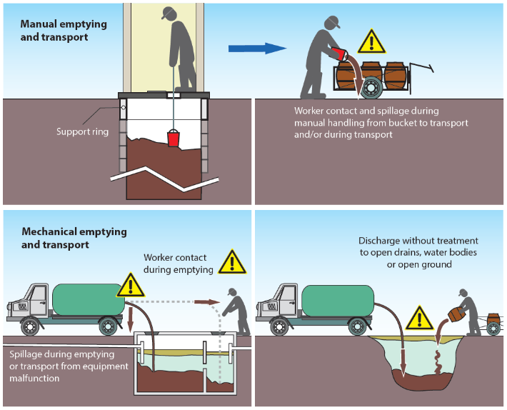
Emptying and conveyance – minimizing risk to waste handlers
Be aware of risks associated with handling wastewater and/or faecal sludge.
Health facilities should equip workers to understand and follow SOPs.
All workers to have available consistently & correctly wear personal protective equipment (PPE) – gloves, masks, hats, full overalls and enclosed footwear – particularly where manual sewer work or emptying is required.
Notes:
READ THE SLIDE
SAY:
Conveyance describes the transport of products from either the toilet or containment step to the treatment step of the sanitation service chain.
For example, where sewer-based technologies transport wastewater from toilets to wastewater treatment plants
Safe conveyance limits exposure of the workers carrying out operation and maintenance, the community living and working in the vicinity of the work, and wider community who could each be exposed to pathogens through ingestion and inhalation of faecal pathogens.
Worker safety is incredibly important and those handling fecal sludge are exposed to dangerous pathogens, chemical agents and often working in dark, confined and dangerous spaces. In addition to infectious disease, they can suffer from eye and skin burns, musculoskeletal disorders, puncture wounds and even death by asphyxiation. Standard operating procedures and guidelines, accompanied by training and mentoring, appropriate PPE and formalization of the workforce (e.g. a contract with regular salary) can help prevent many of the most common health risks and ensure this important part of the workforce is healthy and can optimally complete their jobs.

Slide 24
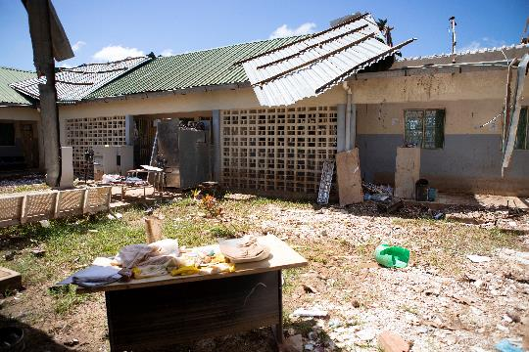
Part 3: Climate change and sanitation
Impact of climate change on sanitation systems
Resilience of different technologies
Improvements to strengthen climate resilience of sanitation systems
Notes:
READ THE SLIDE
SAY: this section of the training will address each of these three areas.

Slide 25
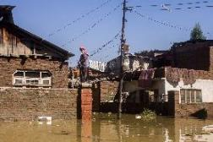
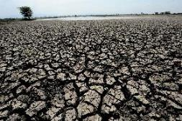

Climate impacts on sanitation
More intense precipitation or inundation caused by sea-level rise (extreme rainfall events, floods, landslides, etc.) | Flooding of on-site systems destruction of facilities spillage overflow environmental contamination
Long-term declines in rainfall and run‑off (long-term drought etc.) | Impedes function of water-reliant sanitation systems e.g. flush toilets, sewerage
Higher temperatures & heatwaves (warmer surface water & soil temperatures) | Malfunction, breakdown or inaccessibility of sanitation systems strong odours during heatwaves deters use of latrines
Notes:
READ THE SLIDE
SAY:
Sanitation is an important vehicle for indirect climate change impacts on health.
What are the health impacts of each of these problems?
The health consequences arising from climate impacts on sanitation systems include
increased risk of disease/illness from exposure to pathogens and hazardous substances via environmental contamination,
and/or increased risk of disease/illness resulting from a lack of adequate sanitation where systems have been destroyed or damaged.
Poor and vulnerable groups without access to good quality health care and fundamental public services experience overlapping forms of disadvantage and are likely to face the worst effects
More rain:
Increased risks of water- and vectorborne diseases and antimicrobial resistance spread.
Increased risks of health impacts associated with undernutrition
Less rain:
Increased risks of water- and vectorborne diseases (e.g. due to a lack of water for cleaning, resulting in poor sanitary conditions and poor hygiene).
Increased risks associated with undernutrition resulting from interaction with diminished food production and intake in poor regions, and increases in diseases associated with undernutrition.
Increased risk of water- and vector- borne diseases linked to untreated wastewater use for food production
Higher temperatures:
Health impacts resulting from unsafe use or non-use of sanitation systems (e.g. physical or mental conditions arising from suppressed urge to urinate/defecate).

Slide 26
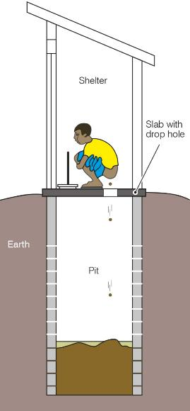
How resilient are different sanitation technologies?
More resilient | Pit latrines Low flush on-site systems
Less resilient | High volume onsite systems Conventional sewerage Modified sewerage
Pit latrine
Notes:
SAY:
Adaptation measures for building sanitation system’s climate resilience could be designed under six broad categories:
Technologies and infrastructure
Financing,
Policy and governance
Workforce,
Information systems
Service delivery
Measures such as data collection and monitoring systems, disaster response and rehabilitation plans, and behaviour change programmes can support effective adaptation. Communities, who have existing experience in adaptation for sanitation, should be actively engaged in sanitation system planning processes.
Source: WHO, 2019. Discussion paper on sanitation, climate change and health. https://www.who.int/water_sanitation_health/sanitation-waste/sanitation/sanitation-and-climate-change20190813.pdf?ua=1

Slide 27
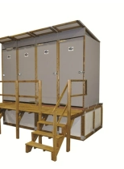
Improving climate resilience of sanitation technologies
Locate toilets in an area of the facility which is less prone to floods, erosion, etc. (e.g. away from low-lying areas, sharp drop-offs)
Toilets with an open pit or soak-away should be located upgradient at least 15 m away from sources of water and a minimum of 1.5m above the water table.
Raised and/or are temporary enclosed toilets that can be regularly emptied
In water scarce or flood prone areas, use low or waterless toilet designs e.g. urine-conversion dry toilets).
Clean toilets more regularly when there is greater demand or risks (e.g. during a cholera outbreak)
Notes:
READ THE SLIDE

Slide 28
Improving climate resilience of sanitation technologies
For existing toilets:
Schedule emptying of septic tanks and pits prior to the time of year which is prone to flooding
Restrict access to areas when excreta may have flooded out
During times of water scarcity, check that the local community are not growing food crops in wet soils around soak pits
Notes:
READ THE SLIDE

Slide 29
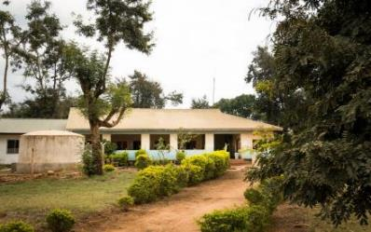

Selecting a sanitation system
Each week, 10 women give birth at the facility.
Of these, on average, two women spend the night and the rest return home after a few hours.
40 outpatients a week (average) are treated.
Once a week a vaccination clinic is held which 50 children attend.
It is a rural facility and not connected to a sewer.
QUIZ
Recall the example from the water module
1. What type of sanitation system would you recommend?
2. How many toilets are needed?
3. What measures would you take to make the system climate resilient?
5 mins
Notes:
SAY:
Discuss each question with the people next to you for a few moments and then we will take feedback to discuss as a whole group

Slide 30
Answer
Ventilated pit latrine or pour flush standing toilets and septic tank + leach field.
Once latrine is full:
  cover and dig a new pit or
  have someone come empty the pit.
At a minimum: 2 toilets (1 for staff and 1 for patients/families) and ideally 3-4 toilets (1 or 2 for staff, 1 for male, 1 for female patients)
Toilets may not get a huge amount of use, apart from during vaccination clinics
Simple climate resilient measures:
  raising pits and latrines above ground
  regular cleaning schedule (with ability to increase frequency/funds to pay for extra cleaning) with increased use
Notes:
READ THE SLIDE

Slide 31
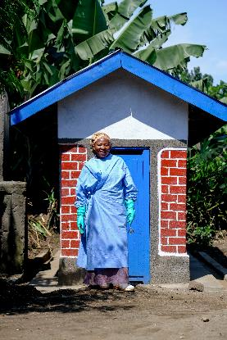
Part 4: Improving and maintaining services
Improving accessibility
Managing and maintaining sanitation facilities
Plumbing improvements
Notes:
READ THE SLIDE

Slide 32
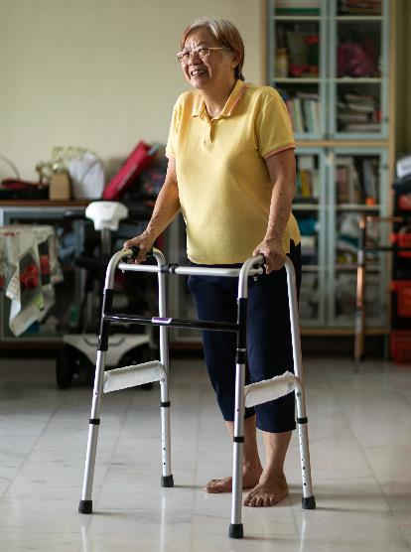
Accessing sanitation services is a challenge for many
Children
Older people
Pregnant women & women in labour
People with disability/disabilities
Patients having had surgery & other medical procedures
Women & girls (due to social stigma and constraints)
Indigenous groups and people with particular beliefs about sanitation and toilets (linked to religion or other)
Notes:
READ THE SLIDE
SAY:
why are sanitation services a challenge for these groups? What are some common problems that these users face?

Slide 33
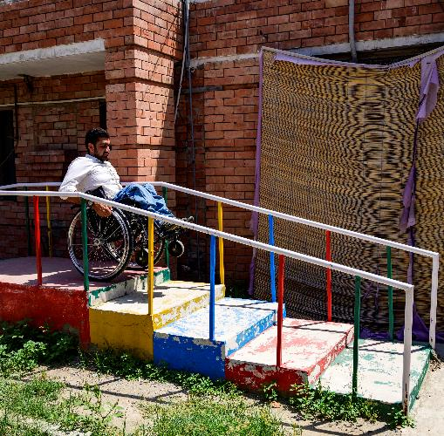
Accessing sanitation services is a challenge for many
Common problems include:
squat toilets with no handrails
insufficient space in toilets to move around
pathways to toilets (and water facilities) difficult to use, particularly for people with limited mobility such as wheelchair users
lack of privacy and safety for women and girls
Notes:
READ THE SLIDE

Slide 34
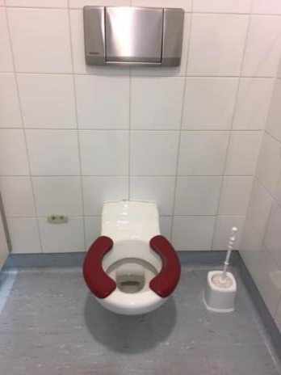
Toilets
No stairs or steps
Handrails for support are attached to floor or sidewalls
Door at least 80 cm wide
Toilet has raised seat and backrest
Cubicle has space for circulation/ maneuvering
Light switches at an accessible height
Well-lit pathway and cubicle, lockable door
Sinks, taps and water
Top of the sink 75 cm from the floor
Knee clearance
Lever-type taps
Grab rails
Improving accessibility – a basic human right
Toilet adapted for children (lower and smaller seat)
Notes:
READ THE SLIDE
SAY:
All criteria are included in the WASH FIT indicator “At least one functional improved toilet meets the needs of people with reduced mobility”

Slide 35
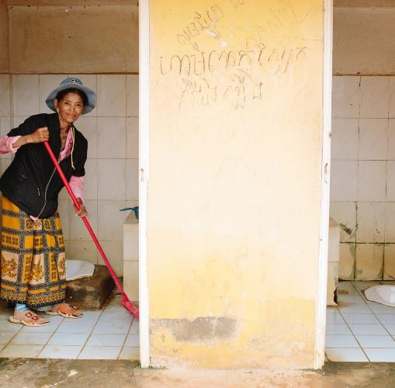
Managing and maintaining sanitation facilities
Clean toilets every day and have a signed record of cleaning clearly visible.
  Staff available onsite to perform cleaning tasks
  Daily spot checks
Check and empty/replace consumables – e.g. anal cleansing material, paper and MHM bins, flushing scoop, soap for hand hygiene
Have a process is in place for rapidly addressing dirty or broken toilets,
  User feedback;
  Health care leaders take responsibility for unclean/non-functioning toilets
Technical staff trained, and able to conduct regular operation and maintenance of plumbing, toilet and storage/treatment facilities
© WaterAid, Tom Greenwood
Notes:
READ THE SLIDE
SAY:
in what way could toilets increase the likelihood or severity of disease or other problems?
Toilets that are not well constructed and/or made of a non-durable material that prevents cleaning of the slab (or pedestal).
Toilets that are not kept clean and where excreta remain on the toilet and/or surfaces of the room housing the toilet.
Toilets where no anal cleansing products, and/or handwashing facilities and/or facilities for disposal of menstrual hygiene products are available.
Toilets that are kept locked for long periods of the day or night, and/or do not offer sufficient security and/or privacy.
Steps to take to ensure toilets protect human health:
Cleanliness: the toilet and all surfaces of the room that it is in (e.g. bathroom, washroom, rest room, cubicle etc.) should be kept clean and free of excreta.
Cleaning arrangements: Locally-available cleaning materials should be safely stored and used, and all people carrying out cleaning should observe safe working practices. Where the toilet is public or shared, a regular cleaning schedule should be in place, with provision made for supply of cleaning materials and personal protective equipment (PPE).
Where dry toilets are used, a ready supply of ash, soil, lime or sawdust should be available within the facility, with which users can cover faeces after defecating. This helps to prevent flies and minimize odours.

Slide 36
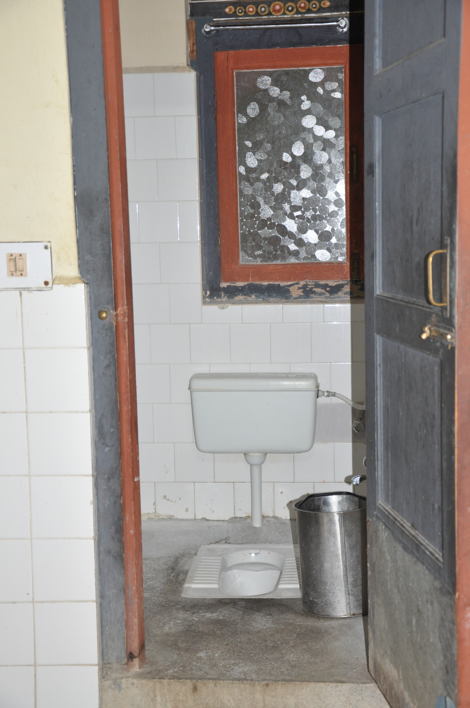
Maintaining plumbing to support safer sanitation systems
Septic system
  Periodic emptying of sludge
  Free from pooling water - not discharging to open ground or open drains
Soakage pits/septic effluent
  Appropriate setback distance from on-site water sources
Toilets
  Not blocked
  Flushes properly
  Not continuously running (overflowing)
Clean toilet with functioning flush in Bhutan
Notes:
READ THE SLIDE
SAY:
The sanitation management advice sheets provide more detailed inputs on considerations for operating, maintaining and repairing key sanitation risks.
The most important are having regular checks to ensure small problems are caught before they lead to significant harms, wastage of resources or inability for users to access toilets-the latter can result in open defecation in and around health care facilities.

Slide 37
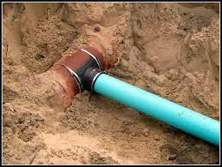
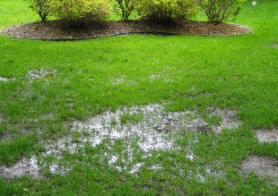
Maintaining plumbing to support safer sanitation systems
Sewer connections
  No leaks
  Sewer conveys solids and liquids with minimal leaks/overflows to treatment facility or sewer.
  Check downstream to see if the sewer goes to a safely managed treatment plant or whether septic effluent flows into a community open drain or other water source.
Sewer connection
Pooling water / wastewater
Notes:
READ THE SLIDE
SAY:
The sanitation management advice sheets provide more detailed inputs on considerations for operating, maintaining and repairing key sanitation risks. https://www.who.int/teams/environment-climate-change-and-health/water-sanitation-and-health/sanitation-safety/sanitation-inspection-packages
The most important are having regular checks to ensure small problems are caught before they lead to significant harms, wastage of resources or inability for users to access toilets-the latter can result in open defecation in and around health care facilities.
The picture of the sewer connection on the left meets the standards whereas the right, with pooling water/wastewater does not.

Slide 38
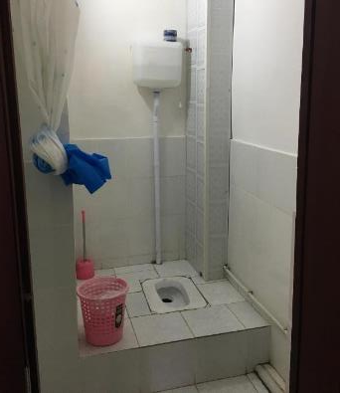
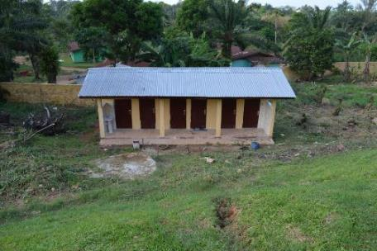
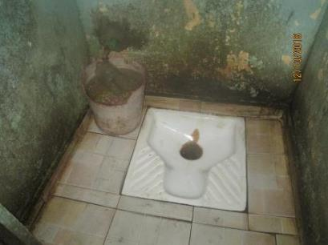
QUIZ
Do these toilets meet basic requirements?
If not, in what ways can they be improved?
Consider gender equality, disability and social inclusion issues
3 mins
Outpatient toilets, district hospital, Liberia
Toilet for in-patient ward, Tajikistan
Toilet for delivery room, Mali
Notes:
READ THE SLIDE
SAY: take a few moments to review these photos and discuss in a small group the questions posed.
NOTES FOR TRAINER:
Depending on how much time is available, participants could focus on one picture or discuss more than one.
TAKE FEEDBACK AND SAY:
Left:
Toilets are down a steep hill which makes access difficult for many users.
No clear pathway or ramp.
Handwashing station (left hand side) is within 5m of toilets (have to assume if water/soap available)
Cannot tell from picture if cubicles are separated for male/female. Improvement: Ensure each cubicle is clearly labelled
Middle:
Toilet is well maintained, lighting is adequate, it is clean and there are no obvious cracks, leaks or standing water
Bin for disposing of MHM
Not accessible (lack of grab rails, no ramp). Improvement: install low-cost ramp
Limited privacy (only curtain, not possibly to lock toilet)
Right
Toilet dirty & blocked
No provision of MHM

Slide 39
Key take-aways
Sanitation facilities must be accessible to all users, protect against spread of infections and meet the wellbeing needs of patients.
A clean well functioning toilet is important but not enough – faecal waste should be safely collected, transported, treated and disposed.
Regular cleaning and maintenance of toilet facilities is a low-cost, high impact measure to manage risks from fecal waste.
Spread of AMR can be reduced through safely managed sanitation systems – high-tech, high-cost options are not necessary.
Notes:
READ THE SLIDE

Slide 40
WASH FIT sanitation indicators
Indicators in bold are “essential”
1 | Facility has a sufficient number of improved toilets for patients | Toilets
2 | All patient toilets are available and usable | Toilets
3 | All toilets have functional handwashing stations within 5 metres | Toilets
4 | At least one improved toilet is available for staff, and toilet(s) is clearly separated or labelled | Toilets
5 | Improved toilets are clearly separated/labelled for male, female or gender-neutral and provide privacy (i.e. single stall/room) if gender-neutral | Toilets
6 | At least one usable improved toilet meets menstrual hygiene management needs | Toilets
7 | At least one functional improved toilet meets the needs of people with reduced mobility | Toilets
8 | [For non-sewered systems or on-site treatment and storage] Faecal sludge is fully contained for later emptying and treatment off-site or fully contained and treated in situ. Liquid effluent either drains to the ground from the bottom of the container, or via a leach field, soak pit or closed drains, or safely stored. | Faecal sludge management
Notes:
READ THE SLIDE
SAY:
Look out for the sanitation icon at the top right of the slide – this appears throughout the WASH FIT guide and highlights any examples linked to sanitation.

Slide 41
WASH FIT sanitation indicators
Indicators in bold are “essential”
9a | [Sewered systems] Toilets are connected without leaks to a public sewer system. The sewer conveys excreta and wastewater with no leaks/overflows to a well-managed treatment system. | Wastewater management
9b | [Non-sewered systems; not applicable to pits that are covered and closed when full] Faecal sludge from the container is periodically emptied without spills by trained personnel with appropriate protective equipment and either a) removed off-site to treatment or b) safely disposed of by burying on-site | Faecal sludge management
10a | [Sewered systems] Well-designed and well-managed wastewater treatment plant provides at least secondary treatment and meets performance standards | Wastewater management
10b | [Non-sewered systems, where treatment is off-site] Well-designed and well-managed faecal sludge treatment plants, with publicly available operation records, are used and meet performance standards | Faecal sludge management
11 | A stormwater (i.e. rainwater) drainage system is in place that diverts water away from the facility into a safe drainage or leach field area; there is no standing water within the facility grounds | Stormwater management
12 | Stormwater is captured and reused for washing, cleaning, watering plants and toilet flushing | Stormwater management
13 | [Only if there is a greywater system] Greywater from sinks and laundry facilities is safely captured and has separate plumbing (e.g. no cross-connections with drinking water or faecal waste). | Greywater management
Notes:
READ THE SLIDE

Slide 42
Sanitation: further reading
General
WHO (2008). Essential environmental health standards in health care. https://www.who.int/publications/i/item/9789241547239
WHO (2018). Guidelines on sanitation and health. World Health Organization, Geneva.
https://www.who.int/publications/i/item/9789241514705 Also available in Arabic, French, Russian and Spanish.
WHO (2020). State of the World’s Sanitation: An urgent call to transform sanitation for better health, environments, economies and societies. https://www.who.int/publications/i/item/9789240014473
World Bank, International Labour Organization, WaterAid, WHO (2019). Health, safety and dignity of sanitation workers: an initial assessment. https://documents.worldbank.org/en/publication/documents-reports/documentdetail/316451573511660715/health-safety-and-dignity-of-sanitation-workers-an-initial-assessment
International Organization for Standardization (2011). ISO 21542:2011 (Building construction – Accessibility and usability of the built environment) http://www. iso.org/iso/home/store/catalogue_tc/catalogue_detail.htm?csnumber=50498
Technologies
Eawag (2014). Compendium of Sanitation Systems and Technologies. 2nd Revised Edition https://www.eawag.ch/en/department/sandec/publications/compendium/
WHO (2015). Sanitation safety planning: manual for safe use and disposal of wastewater, greywater and excreta. http://www.who.int/water_sanitation_health/publications/ssp-manual/en/ (2nd edition due for publication in 2022)
WSSCC (2010). Hygiene and Sanitation Software: An Overview of Approaches. https://sswm.info/sites/default/files/reference_attachments/PEAL%202010%20Hygiene%20and%20Sanitation%20Software.%20An%20overview%20of%20approaches.pdf
Health Habitat Australia: How does a septic tank work? https://www.youtube.com/watch?v=uuORuwb4cfs&t=3s
Smart Sanitation Solutions Examples of innovative, low-cost technologies for toilets, collection, transportation, treatment and use of sanitation products. ttps://www.joinforwater.ngo/sites/default/files/library_assets/360_NWP_E2_Smart_Sanitation.pdf

Slide 43
Sanitation: further reading
AMR
WHO (2020). Technical brief on water, sanitation, hygiene (WASH) and wastewater management to prevent infections and reduce the spread of antimicrobial resistance (AMR)
WHO (2019). Turning plans into action for antimicrobial resistance (AMR) Working Paper 2.0: Implementation and coordination https://www.who.int/publications/i/item/turning-plans-into-action-for-antimicrobial-resistance-(-amr)-working-paper-2.0-implementation-and-coordination
WHO, FAO & OiE. Global Database for Antimicrobial Resistance Country Self-Assessment https://amrcountryprogress.org/
WHO, FAO & OiE (2019). Monitoring and evaluation of the global action plan on antimicrobial resistance: framework and recommended indicators. https://apps.who.int/iris/handle/10665/325006
Emergencies
WHO (2011). Technical notes on drinking water, sanitation and hygiene in emergencies. http://www.who.int/water_sanitation_health/publications/2011/tn9_how_much_water_en.pdf
WHO/WEDC (2013). Updated technical notes on WASH in emergencies (set of 15). https://www.who.int/teams/environment-climate-change-and-health/water-sanitation-and-health/environmental-health-in-emergencies/technical-notes-on-wash-in-emergencies
WHO/UNICEF (2020). Water, sanitation, hygiene and waste management for SARS-CoV-2. https://www.who.int/publications-detail-redirect/WHO-2019-nCoV-IPC-WASH-2020.4
Infographics
WHO, WATERAID (2019) Combatting AMR through WASH and IPC in healthcare https://washinhcf.org/wp-content/uploads/2021/07/WASH_IPC_AMR_techbriefOct2020.pdf
WHO (2019). AMR. A major public threat. https://cdn.who.int/media/docs/default-source/integrated-health-services-(ihs)/amr/ipc_amr_a4.pdf?sfvrsn=ede4a5cd_7
Notes:
SAY: Full list of relevant reading available at:
https://washinhcf.org/resource/summary-of-all-who-and-related-resources-on-wash-in-hcf/

Slide 44
Supplementary slides
Notes:
Read from the slide and explain that this section of the training will address each of these three areas.

Slide 45
Select excreta-related pathogens: to be controlled through safe sanitation
Pathogen | Health significance | Transmission pathways
Campylobactor spp. | Most common bacterial cause of diarrhoea. | Predominately food and water from animal contamination
Clostridium difficile | Common cause of diarrhoea globally | Person to person predominately in care settings through poor hygiene
E. Coli (ETEC) | Leading cause of childhood diarrhoea in low-income countries | Predominately food and waterborne.
Vibrio cholerae | Causes acute watery diarrhoea which can lead to death by dehydration | Predominately food and waterborne.
AMR opportunistic pathogens (e.g. carbapenem-resistant) | Colonize intestines; can lead to bloodstream infections, including sepsis | Person to person
Polioviruses | Frequently asymptomatic. A small proportion of people will develop paralysis. | Person to person; some outbreaks have been associated with breakdown of sanitary infrastructure.
Cryptosporidium spp. | One of most common causes of childhood diarrhoea globally. | Person to person; large number of food borne and waterborne outbreaks
Giardia intestinalis | Most common human protozoan gastrointestinal pathogen | Typically waterborne, also person to person
Extracted from Table 6.1 in WHO Guidelines on Sanitation and Health
Notes:
This table is only a small selection of the excreta-related pathogens. It highlights that there are many different types (bacteria, viruses and protozoa) for which the health significance and transmission pathways vary as well. Safely managed sanitation is important for ensuring that health care facilities do not amplify or become a source of outbreaks. This has been the case with cholera where health care facilities lack safely managed toilets which are regularly cleaned and available to all patients.

