Slide 2
Safe and environmentally friendly health care waste management
WASH FIT technical module
Add date & location
Notes:
Introduce yourself if you have not already, and make sure you insert the date and location to the slide before you start

Slide 3




Learning objectives
By the end of this session, you should:
Understand the risks caused by unsafe health care waste management practices in health care facilities
Understand the process of health care waste management from generation to safe treatment and disposal
Outline waste management guidelines in the context of COVID-19
Understand which waste treatment options are the most environmentally-friendly and be aware of mitigation measures against climate change
Apply an incremental improvement approach
All group discussion
Group
work
Icons to look out for
Links to climate
resilience
Notes:
READ THE SLIDE

Slide 4
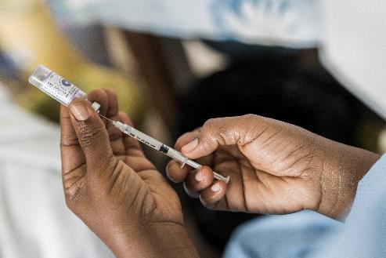
Part 1: Waste treatment technologies
Waste management from generation to final disposal
Segregation and waste minimization
Collection and storage
Waste in the context of COVID-19
Notes:
READ THE SLIDE

Slide 5

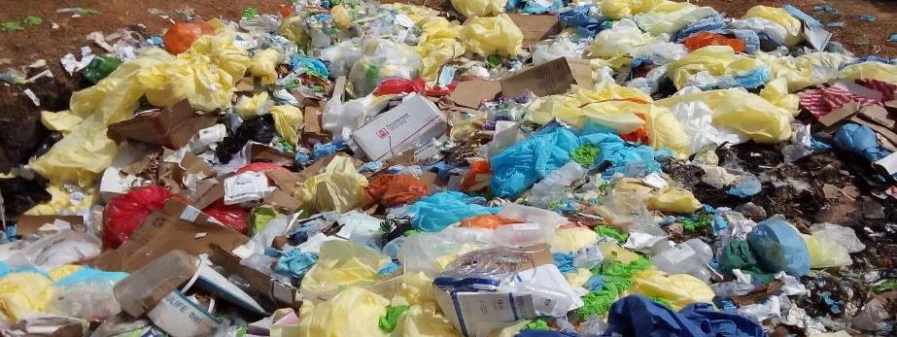
What is wrong in this picture?
2 min
Notes:
SAY:
Please shout out some ideas. What has caused these problems? What is the impact on human and environmental health? What could be done about it? Have they seen similar problems in the country/local area/place of work?
NOTE FOR TRAINER:
Use the opportunity to understand what level of knowledge participants have.
SAY:
Waste is:
Not segregated: yellow and black bags are all mixed together
Exposed: intravenous lines open dumped
No fence – open area. Dogs and other animals may scavenge, waste pickers may also enter the site, not protected from human contact.
Some of the waste looks like it is starting to degrade indicating it has been stored for more than the recommended 48 hours

Slide 6
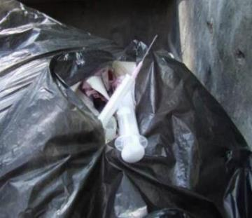
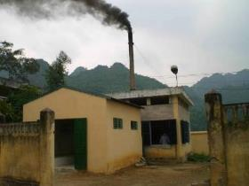
Health impacts of improper waste management
Needle-stick injuries to health care workers (Hepatitis B and C)
Transmission of infectious disease (e.g. antimicrobial resistant infections)
Inhalation of pollutants (dioxins and furans)
Exposure to chemicals, including heavy metals such as mercury
Notes:
READ THE SLIDE
SAY:
In 2010, contaminated injections caused an estimated 1.7 million hepatitis infections, 315,000 hepatitis C infections and 33,800 new HIV infections.
Incinerated materials containing or treated with chlorine can generate dioxins and furans, which are human carcinogens and have been associated with a range of adverse health effects. Incineration of heavy metals or materials with high metal content (in particular lead, mercury and cadmium) can lead to the spread of toxic metals in the environment.
Mercury containing devices are e.g., fluorescence bulbs, mercury containing thermometers or sphygmomanometers
More information can ne found in WHO fact sheet on health care waste: https://www.who.int/news-room/fact-sheets/detail/health-care-waste

Slide 7
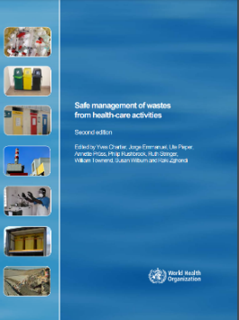
General knowledge
QUIZ
2 min
On average, what percentage of waste in health care facilities is non-hazardous or ‘general’ health care waste?
What percentage of health care waste is regarded as hazardous?
What proportion of health care facilities in Least Developed Countries lack basic waste services?
Notes:
SAY:
Shout out your guesses/answers
NOTE FOR TRAINER:
Consider using polling technology, e.g. zoom poll or mentimeter

Slide 8
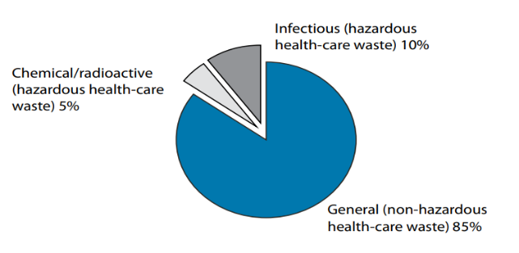
Answers
1. 75% - 90% of waste produced is similar to domestic waste
→ usually called ‘non-hazardous’ or ‘general health-care waste’
→ no biological, chemical, radioactive or physical hazard
2. 10-25% of health-care waste is regarded as ‘hazardous’
→ may pose a variety of environmental and health risks
3. 7 out of 10 facilities lack basic waste management in least developed countries
Notes:
SAY:
The 10% of infectious waste also includes sharp waste and pathologic / anatomical waste (biohazardous waste)
what are typical types of non-hazardous waste generated in a HCF?
Non-hazardous waste is usually similar in characteristics to municipal solid waste. More than half of non-hazardous waste from hospitals is paper, cardboard and plastics, whilst the rest comprises discarded food, metal, glass, textiles, plastics and wood.
Basic health care waste management refers to health care facilities that segregate and treat their waste (through burning, autoclaving, sending off site for treatment or other methods). For details refer to the latest data from the WHO/UNICEF Joint Monitoring Programme: https://washdata.org/data/healthcare#!/
NOTE FOR TRAINER:
These are estimations and it is important to measure the quantity of waste in each setting.
Refer to: WHO, 2014. Safe management of wastes from health care activities. Second Edition. https://www.who.int/publications/i/item/9789241548564

Slide 9
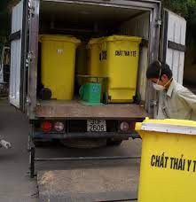
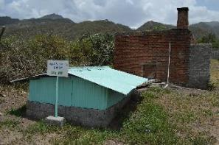
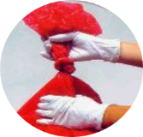
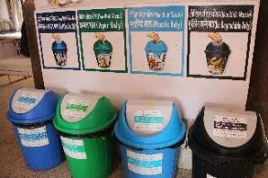
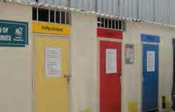
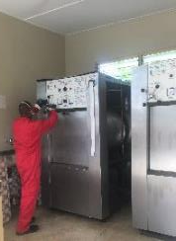
Measures to reduce waste and improve management
Segregation
Collection
Transport
Storage
Treatment
Final disposal
Generation/
Minimization
Notes:
SAY:
This module walks participants through each step of the waste management process from generation/minimization to final disposal.
Reducing the amount of waste generated at a facility is critical to having enough capacity to safely manage and treat waste. It also saves money (e.g. through less use of gloves, for example, and instead practicing regular hand hygiene). Segregation is also very important as it reduces the amount of hazardous waste that then needs further treatment.

Slide 10
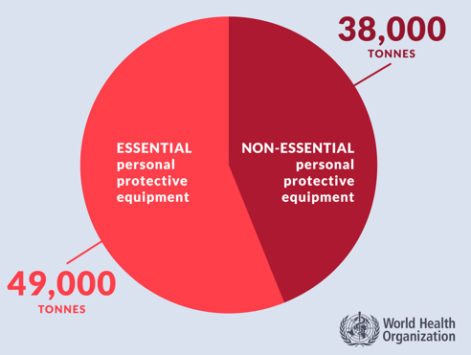
Waste minimization
Critical step!
  Nearly half of personal protective equipment that the UN distributed for COVID-19 was “non-essential” and not needed to keep health workers and patients safe (e.g. foot and shoe covers, some gloves)
Reducing packaging and use of more bio-based packaging can also reduce waste volumes (and save money)
Segregation
Collection
Transport
Storage
Treatment
Final disposal
Generation/
Minimization
Notes:
READ THE SLIDE
SAY:
The most important action is to reduce the amount of waste being generated: don’t use gloves when not needed or other non-essentials, less and more ecological packaging, procuring more items “just in time” to ensure they are used. Countries are working to reduce waste volumes in various ways. For example, England had initiated a “gloves off” campaign in 2018 to reduce unnecessary glove use by health workers and improve hand cleaning at the right time using the right technique. And this was not done just for sustainability reasons. Use of non-sterile gloves has been associated with significant potential for cross-contamination and transmission of health care associated infections because they are often used when not needed, put on too early, taken off too late or not changed at critical points. The campaign was multi-faceted and included education with health care staff, patients and community, development a communication strategy and materials, in-facility training, mentoring and support. One of the most effective engagement methods was something as simple as holding a stand in the hospital canteen where nurses, staff, patients and carers had give aways, quizzes and education material. Fast forward to the pandemic and England was able to more easily support appropriate glove use as the national campaign had already been underway for 2 years.
Read more in the 2022 WHO report “Global analysis of health care waste in the context of COVID-19” https://www.who.int/publications/i/item/9789240039612

Slide 11
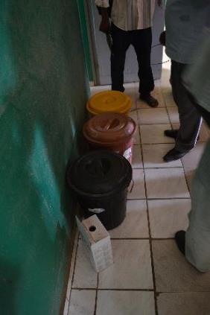
Segregation
2 min
Can significantly reduce the amount of waste that requires treatment
Segregate at source, where waste is generated
3-bin standard system:
  General
  Infectious
  Sharps
Paper
Plastic
Glass
  + additional bins
for recycling of general waste
Black container (lined)
Yellow container (lined)
Sharps box / Needle cutter
Segregation
Collection
Transport
Storage
Treatment
Final disposal
Generation/
Minimization
Notes:
SAY:
why is segregation important?
Different types of waste require different handling, treatment and disposal. If waste is not segregated, hazardous waste will contaminate other waste meaning 100% of waste will need to be treated as infectious. This puts added burden on waste management technologies, e.g. overfilling of incinerators, more fuel is needed to operate incinerators/autoclaves.
If waste is segregated, much of the waste can be sent for recycling which reduces the overall environmental impact and provides an added revenue source to support waste management
SAY: what are the requirements for bins?
NOTE FOR TRAINER: let participants shout out answers for 2 minutes then SAY:
Labelled (images, words or colour coded)
Leak proof liners inside
Covered (lid) with pedal to open
Not overflowing
Available at all points of care

Slide 12

Common non-hazardous waste
Packaging materials (paper, cardboard, plastic)
Plastic bottles & cans
Food containers and organic food remains
Broken/old equipment or furniture (e.g. tables, chairs)
Dispose through:
Available landfills
Municipal waste disposal sites
Facility waste pit
Recycling
Composting
Example of non-hazardous waste in Nepal
Segregation
Collection
Transport
Storage
Treatment
Final disposal
Generation/
Minimization
Notes:
READ THE SLIDE
SAY:
Using posters to indicate proper segregation at points of care is important. These may be nationally or locally designed.

Slide 13
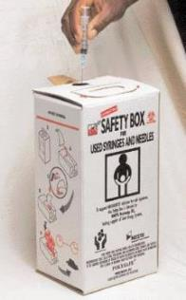
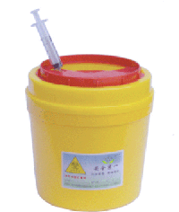
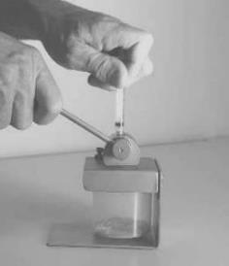
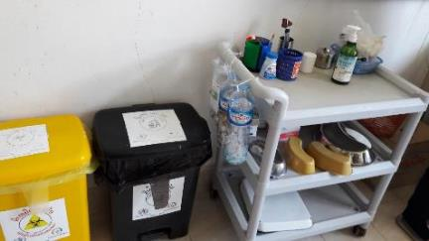
Segregating infectious and sharp waste
Segregation
Collection
Transport
Storage
Treatment
Final disposal
Generation/
Minimization
Cardboard sharps box (UN standard)
Plastic sharps container
Needle cutter
Needle is cut from syringe body, sharps container can be used for longer
Low resource option
Plastic bottles replace sharps container;
Sharps container on trolley to move around ward
Notes:
READ THE SLIDE
SAY:
The examples shown on the left hand side:
Option 1 (cardboard box): to discard a complete syringe (needle)
Option 2 (plastic sharps container): includes a strip off device to separate the needle from the syringe.
The 2nd and 3rd picture are devices which separate the needle from the syringe barrel (plastic sharp box and needle cutter)
Advantage
Smaller volume of sharp waste, as the syringe barrel can be disposed as normal infectious waste in the designated bag
Disadvantage
Additional handling of sharps, which might cause a higher risk of needle stick injury and/or infection.

Slide 14
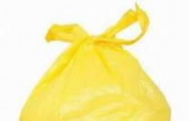
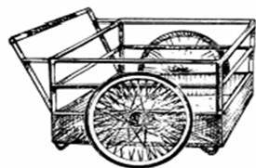
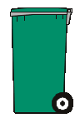
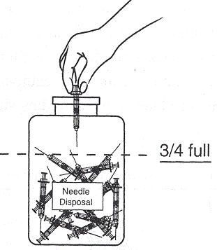
Collection & transport
Tie bags securely and replace after removing
Collect according to schedule or when ¾ full
Appropriate personal protection equipment (PPE) for waste handlers
Perform hand hygiene after handling waste
Hazardous and non-hazardous waste collected & transported separately
Use covered trolley, wheelbarrow, wheeled bin or cart
  Should be used only for waste transportation
  Equipment cleaned and disinfected at the end of each working day
Segregation
Collection
Transport
Storage
Treatment
Final disposal
Generation/
Minimization
Notes:
READ THE SLIDE
SAY:
You do not need to spend much time on this slide. Highlight the importance of hand hygiene and appropriate PPE use and that waste should be regularly collected and transported for treatment/disposal.
Bins should be disinfected e.g. with chlorine (0.2%) solution
Washing / disinfection areas should be available also for the waste handlers – like the persons transporting the waste!

Slide 15
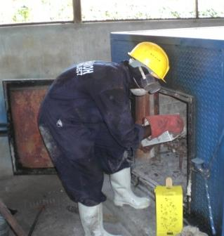

PPE for waste handlers
Heavy duty gloves
Mask/goggles or face shield
Long-sleeved gown/apron
Closed shoes
Depending on the task, a hard hat may be recommended
REMEMBER!
Perform hand hygiene immediately after removing personal protective equipment
Health care waste worker wearing PPE, Kenya
Segregation
Collection
Transport
Storage
Treatment
Final disposal
Generation/
Minimization
Notes:
NOTE FOR TRAINER: this guidance applies to waste handlers who are dealing with treatment infrastructure and machinery, not those collecting waste from wards.
READ THE SLIDE
SAY:
Wear appropriate personal protective equipment (PPE)
Handle waste with care
Practice hand hygiene before and after handling waste
Do not re-sort waste
Never carry waste bags/containers against body
Avoid heavy loads (use transport tools)

Slide 16
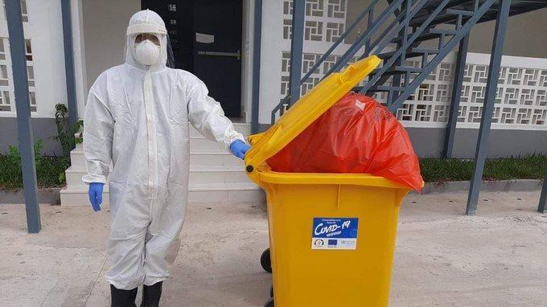
2 min
Rational use of PPE: What PPE does this worker need to protect against COVID-19? What are the consequences of using too much PPE?
Notes:
READ THE SLIDE
SAY:
Shout out what you think
For most COVID-19 interactions (e.g. patient consultations, caring for a patient in a general ward, testing, vaccinations), medical mask is often all that is needed. In certain cases, eye protection and gloves also needed. Hair and shoe covers are never recommended, nor is a full body suit as seen in this photo. See details in WHO Global analysis of health care waste in the context of COVID-19.
Use of unnecessary PPE:
Wastes money (in the US alone, 6 billion could have been saved in the first 6 months of the COVID-19 pandemic if health care workers used safe, reusuable medical masks instead of disposable medical masks
Increases carbon emissions through additional shipping of items
Larger amount of waste generated
Higher waste treatment and disposal demand with costs additional funds, can overwhelm existing waste workers
Higher environmental impact by air emissions from burning / incineration (furans and dioxins) / landfilling: greenhouse gasses (CO2, CH4, N2O)

Slide 17
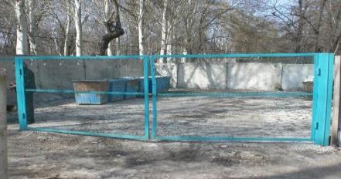
Storage of non-hazardous waste
Size of storage area: based on volume of waste generated and frequency of collection
Fenced to prevent unauthorized access (waste picker, animals) and paved
Easy access for municipal waste collection trucks
Where recycling takes place, separate areas for recyclables should be available
Waste storage in Tajikistan
Notes:
READ THE SLIDE
SAY:
A roof is recommended to prevent that the container are filling up with water and to keep the waste away from direct sun (depending on the rainfall in the country)

Slide 18

Storage of infectious & sharp waste
Floor and walls are sealed or tiled to allow easy disinfection
Well ventilated & protected from rain
No other types of waste stored (i.e. general waste)
Storage does not exceed maximum time limit
Inaccessible to unauthorized persons/children, animals, insects and birds
Labelled with biohazard symbol
Segregation
Collection
Transport
Storage
Treatment
Final disposal
Minimization
Notes:
READ THE SLIDE
SAY:
The flow of waste building for the storage and treatment of infectious and sharp waste should be from hazardous towards non-hazardous:
- Entry of the waste through the reception room, where it is weighted and documented.
Then it is stored.
From there it is taken to the treatment equipment.
The empty bins can be cleaned and in case of the use of an autoclave or other alternative treatment technology the waste is disposed as general waste.
Time limits for storage
Limits depend on climate and times will differ according to the season (summer/winter).
Range from 24hrs in hot/summer climates to 72 hours in temperate/winter climates.
Waste can be stored for more than a week when stored below 8° C (e.g. in a fridge or in winter with temperatures below 8 °C)
Sharp waste can be stored longer! It should be collected and stored for treatment when ¾ filled.

Slide 19

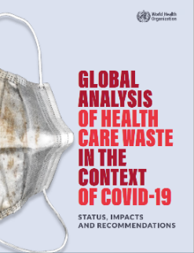
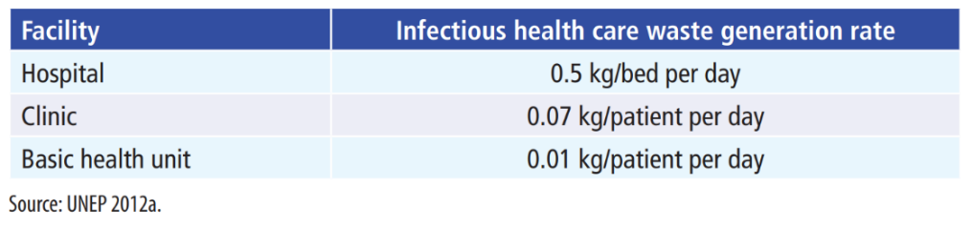
How much infectious waste is generated in a typical facility in a day?
QUIZ
5 min
During COVID-19, volumes of waste have dramatically increased. What are the reasons for this?
0.5
0.07
0.01
How much waste would a hospital with 200 beds and an occupancy rate of 80% generate in one day? One month? One year? How much would typically be hazardous?
Notes:
SAY:
Break into small groups and take a few moments to think and talk about this question, be prepared to feedback your answers
AFTER FEEDBACK IS TAKEN FROM GROUPS, SAY:
Waste during the COVID-19 pandemic has increased because:
-overuse of PPE (e.g. using gloves, full body suits, hair and foot covers when not needed)
-increase use of rapid diagnostics and vaccines for all populations, all of which comes with packaging
-individually wrapped masks and other PPE items (e.g. use of additional packaging)
-single use food containers and utensils (out of fear of fomite transmission)
-increased use of disposable by all populations (health workers, patients, families)

Slide 20
How much infectious waste is generated in a typical facility in one year?
ANSWER
200 beds x 0.5 kg/bed x 0.80= 80 kg/day
80 kg/day x 30 days/month= 2,400 kg/month
2,400 kg/month x 12 months/year= 28,800 kg/year (28.8 tonnes)
If waste segregated, only 4,320 kg (4.32 tonnes)of waste is hazardous needs to be treated.
On average, 40% of health care waste can be recycled.
Notes:
READ THE SLIDE
SAY:
Waste during the COVID-19 pandemic has increased because:
-increased use of disposable by all populations (health workers, patients, families)
- an exemplary calculation of a hospital with 200 beds and an occupancy rate of 80%: 0,5 kg per day and bed X 200 bed X 80% = 80 kg per bed and day
NOTE FOR TRAINER:
Explain in people want to understand more they can read it in this document which is in the list of resources UNEP 2012 Compendium of Technologies for Treatment / Destruction of Healthcare Waste https://wedocs.unep.org/bitstream/handle/20.500.11822/8628/IETC_Compendium_Technologies_Treatment_Destruction_Healthcare_Waste.pdf?sequence=3&isAllowed=y

Slide 21
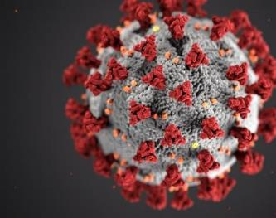
Health care waste in the context of COVID-19
Waste generated from facilities treating COVID19 patients does not require special or additional treatment.
→ standard best practices should be followed and enforced.
Very low risk of fomite transmission of SARS-CoV-2. No evidence that direct, unprotected human contact during the handling of health care waste has resulted in the transmission of the COVID-19 virus.
General waste: segregated from infectious in clearly marked bins, bagged and tied, and disposed as general municipal waste.
Infectious waste: produced during patient care, including those with confirmed COVID-19 infection (e.g. sharps, bandages, pathological waste)
  collected safely in clearly marked lined containers and sharp boxes.
  treated (preferably on-site) with alternative treatment technologies like autoclaving or high temperature burn incinerators, and then safely disposed.
For waste moved off-site: critical to understand where and how it will be treated and disposed.
Notes:
READ THE SLIDE
SAY:
Continue to enforce or re-enforce best practices for HCWM, including assigning responsibility and sufficient human and material resources to treat and dispose of waste safely.

Slide 22
Coping with higher volumes of waste
2 min
Waste from waiting areas of health care facilities or at home during home based quarantine: non-hazardous
  Should be packed in strong black bags and closed/tied securely before disposal to municipal waste services.
  If no waste services available: consider interim solutions (safe burying or controlled burning)
It is important to asses the existing waste treatment capacity as the volume of waste during an outbreak will increase (mainly PPE) and additional handling, storage and treatment capacity might be needed.
Use available waste treatment equipment to full capacity by increasing operation times
Provide / procure additional treatment capacity such as autoclaves and high temperature burn incinerators and ensure their sustained operation through sufficient human and financial resources and/or centralized treatment.
Notes:
READ THE SLIDE
SAY:
what examples they can think of when there may be higher volumes of waste? What kinds of waste might increase during these scenario?
TAKE ANSWERS AND THEN SAY:
E.g. COVID (PPE, plastic packaging etc.), other outbreaks, extreme weather events resulting more sick/injured people accessing health services; mass vaccination campaigns (needles, syringes), refugee camps with sudden influx of people
As an interim emergency measure, e.g. if no waste services are available, waste can be buried until more sustainable measures are in place.
Manual chemical disinfection of waste (e.g. chlorine solution): is not recommended as it is not regarded as a reliable and efficient method. It depends on concentration, contact with surfaces, temperature, time etc. Furthermore handling high concentrations of chlorine can lead to skin and eye irritation and respiratory problems by the handlers. In low resource settings, using chlorine in an attempt to treat waste can divert chlorine from more important/useful applications including for water treatment and disfinection (after cleaning) of surfaces.
To increase waste treatment capacity, equipment may be operated during evenings and weekends

Slide 23
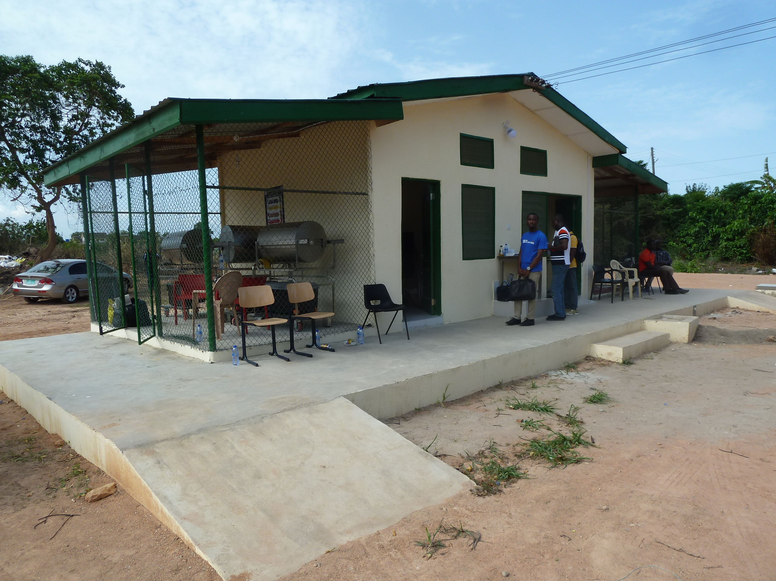
Part 2: Waste treatment technologies
Hierarchy of waste treatment options
How to select the best technology
Burn vs. non-burn technologies

Slide 24
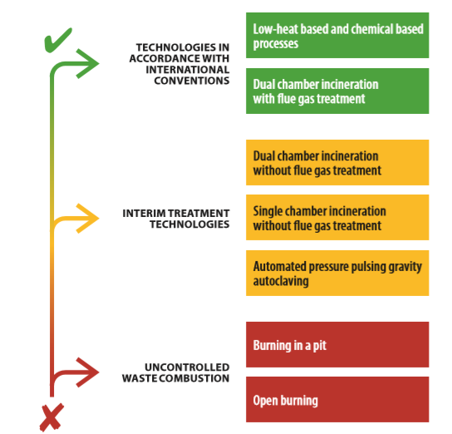
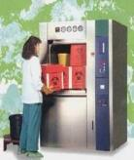
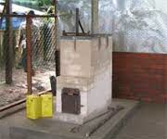
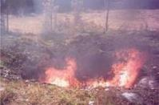
Heirarchy of waste treatment options
Segregation
Collection
Transport
Storage
Treatment
Final disposal
Minimization
Notes:
READ SLIDE
SAY:
Green
preferred options as these limit emissions to the environment (autoclave does not emit emissions, emissions from incineration can be cleaned by a flue gas cleaning system).
Technologies in accordance with International Conventions
Yellow
interim solutions.
Technologies used to incrementally improve practices and move towards meeting international standards
Red
considered as the last resort options
not recommended but sometimes the only feasible option for emergency or as an interim solution.
should be minimized and eliminated as soon as possible and wherever feasible.

Slide 25
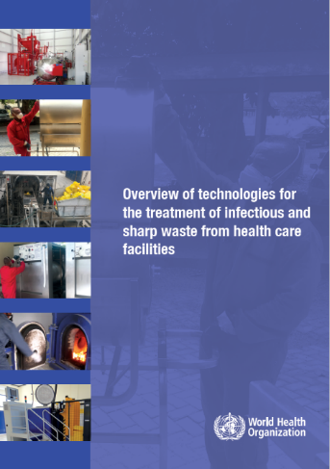
Selecting the best technology
Based on:
National & international regulations
Available budget (initial investment and ongoing maintenance)
Infrastructure (space)
Available energy (electricity, water, fuel etc.)
Type & quantity of waste generated
Available final disposal options (recycling, landfill)
Segregation
Collection
Transport
Storage
Treatment
Final disposal
Minimization
Notes:
READ SLIDE
SAY:
The WHO publication shown here has more details on each of these criteria and rates available technologies against them. Refer to the supplementary slides for a list of technologies which do, and do not, meet the requirements of the Stockholm and Basel Conventions.

Slide 26
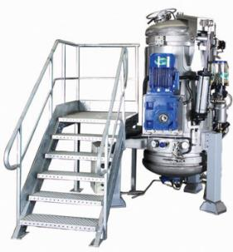
Non-burn treatment options
UNDP Jordan project video: https://www.youtube.com/watch?v=E2Na8-G7NUQ
Treatment by steam ~121°C or ~134°C
No hazardous emissions or ash
Only for infectious / sharp waste
After treatment, waste is non-hazardous, some may be recycled
Most environmentally friendly
Recommended to confirm waste is sterile by chemical or biological indicator
Typical size ranges from 35-200 liters treatment capacity
Needs continuous water and power supply
Segregation
Collection
Transport
Storage
Treatment
Final disposal
Minimization
Notes:
READ THE SLIDE
SAY:
Increasingly, there are a number of lower cost autoclaves which use considerably less power and water (as little as 3 liters per cycle) than traditional autoclaves. These are being implemented in places like Laos PDR. To learn about autoclaves, considerations, etc, visit:
NOTE FOR TRAINER:
You may wish to show a short video from a UNDP project Jordan which shows health care workers using an autoclave. The video is 3.35 min long.

Slide 27
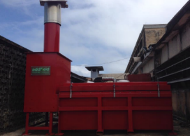
The following should not be incinerated…
Incineration
Should comply with the Stockholm Convention
High temperature required to prevent release of POPs (dioxans & furans)
  2 chambers: 850°C & 1100°C
In low resource settings, locally constructed incinerators are an interim option
Pre-heating, use of high-quality clay, sliding (rather than hinged) doors can improve performance of locally constructed incinerators
Pressurized gas containers
Sealed ampoules or vials (explode in the chamber)
Chemical waste (e.g. reactive chemicals, aldehydes)
Halogenated materials (e.g. PVC plastics)
Waste containing mercury, cadmium and other heavy metals
Radioactive waste
Notes:
READ THE SLIDE
SAY:
Low-temperature burning / small scale incineration is commonly used in low-resource settings. Low cost, easy to install, but it generates hazardous emissions. However, this option is still better than using open burning.
Disadvantage: release of combustion by-products into atmosphere and generation of residual ash, which is hazardous for health and environment.
Combustion by-products are dioxin and furans (POPs).
Dioxin and furans causes negative effects on the environment and health of humans including:
skin toxicity,
immunotoxicity, neurotoxicity,
negative effects on reproduction,
teratogenicity,
Endocrine disruption, and a predisposition to cancer
POPs: Persistent Organic Pollutants (POPs) are toxic substances composed of organic (carbon-based) chemical compounds and mixtures. They include industrial chemicals like PCBs and pesticides like DDT. They are primarily products and by-products from industrial processes, chemical manufacturing and resulting wastes.
Stockholm Convention is a legally binding treaty to protect human health and the environment from POPs. Parties are required to use the BAT and BEP limit the levels of dioxins and furans in air emissions to 0.1 ng I-TEQ/Nm3.

Slide 28
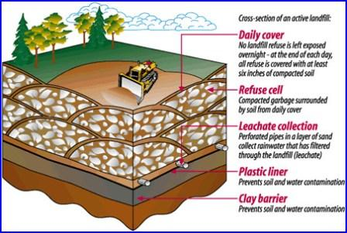
Disposal: general waste
Protected pit
In facility grounds
Municipal landfill
Lined landfill prevents leachate from contaminating the environment (preferable)
Segregation
Collection
Transport
Storage
Treatment
Final disposal
Minimization
Notes:
READ THE SLIDE
SAY:
Landfill: waste is isolated from the surrounding environment (groundwater, air, rain). This isolation is accomplished with a bottom liner and daily covering of soil. A sanitary landfill uses a clay liner to isolate the trash from the environment.

Slide 29
Disposal: ash and placenta waste pits
Source: Technical Specifications, Health Care Without Harm / MSF
Segregation
Collection
Transport
Storage
Treatment
Final disposal
Minimization
Notes:
SAY:
Pits should be as follows:
Not accessible to unauthorized persons (fenced, locked)
If possible, located on higher ground – the bottom should be 1.5 meter away from the water table.
Ash pit should be lined with watertight bricks or concrete lining to prevent contamination to the soil and water (ash is considered as hazardous waste)
Placenta pit does not need to be entirely lined, with concrete, as it is biodegradable and will sooner or later be transferred to soil.

Slide 30

GROUP WORK
10 mins
You are responsible for waste management at a facility.
The director of your facility receives complaints from the local community about smoke from the incinerator used for treating infectious and sharp waste and is asking you to improve the situation.
What are the positives and negatives about using incineration?
What measures should you take to address the community’s concerns? Which actions take priority?
What improvements could you make along the waste chain?
Segregation
Collection
Transport
Storage
Treatment
Final disposal
Minimization
Notes:
SAY:
Please get into groups of 3-5 and take about 5 minutes to discuss these questions, taking notes, and be prepared to feedback to the whole group.
COLLECT FEEDBACK FROM GROUPS AND THEN SAY:
First: Assess the waste segregation efficiency, operation procedure of the incineration process and the knowledge / awareness of the operator
Possible mitigation measures:
Discuss and implement measures to reduce the volume of waste generated (e.g, only use gloves when indicated and increase use of soap and water or alcohol based hand rub to improve hand hygiene); talk to district and national officials about purchasing products with less and more ecological/recyclable packaging
Training on segregation for those generating waste (improve segregation– e.g. not too much wet waste in bags and if very wet, the bags should be marked. (Wet waste prevents the waste from getting to sufficiently high temperatures and results in the release of black smoke).
Training waste handlers/operators how to use operate the incinerator properly – preheating of incinerator, keeping correct temp in the first and second chamber, air flow, turbulence, correct waste feeding etc.
Enhanced monitoring of waste generation/segregation and operation of incinerators. This should be done regularly by a dedicated person.
Provide SOPs, posters, for waste segregation and waste treatment
Initiate community awareness meetings about waste management.
Technical improvements
Repair incinerator (immediately and on an ongoing basis)
Plan for safer and environmentally friendly waste treatment tech in future (preferably non-incineration technologies)

Slide 31
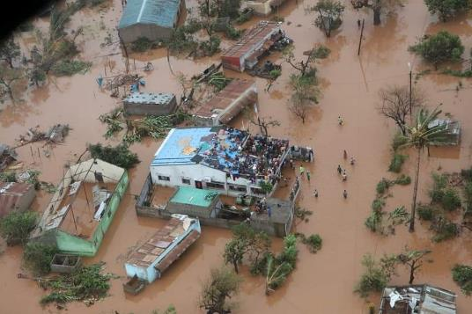
Part 3: Climate change and waste
The links between health care waste and climate change
Climate resilient improvements

Slide 32

Climate change and waste
Shipping and packaging and health commodities (PPE, vaccines, diagnostics, medicines) which all end up as waste is large contributor to carbon emissions from the health sector
Incineration and landfill leads to emission of greenhouse gasses (CO₂, CH₄, N₂O)
  → Methane (CH₄): 28x the global warming potential of CO₂
Changes in hydrology and temperature affect the stability of waste containment structures
Increased rainfall and flooding affect waste containers
  → Spreads contaminants
Disruption to waste management chain from local flooding
Notes:
READ THE SLIDE
SAY:
Solid waste management can have exacerbating effects on the climate especially due to the emission of greenhouse gasses: Transporting health care waste in vehicles using fossil fuels, inadequate incineration, inappropriate incinerator technology, or the incineration of unsuitable materials results in GHG emissions and the release of pollutants into the air
Changes in hydrology and temperature can affect the stability of waste containment structures (e.g. waste pits) within the health care facility
Increased rainfall and flooding can lead to inundation of the facility and affect waste containers with spreading of contaminants (including hazardous). Consider this risk when planning and checking waste containers - placement and protection.
Even if facility is not flooded but the surroundings are, there can be disruption of the waste management chain (e.g. flooding of road, railway affect waste collection and off-site treatment), so extra containment capacity needs to be in place at the facility.
Low lying coastal facilities are at increasing risk from inundation.
CO$2$ = carbon dioxide, CH$4$ = methane and N$2$O = nitrous oxide

Slide 33
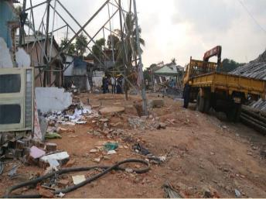
Strategies to mitigate climate change
Waste prevention and reduction: strategies are employed which result in a reduction in the quantity of waste generated
Waste recycling: Non-hazardous waste is safely recycled
Sufficient waste containers are in stock and/or frequency of emptying planned and resourced in case demands on health care facilities increase
Safe storage capacity is available for additional waste generated during climate-events and/or emergencies
Repairing a dumpsite after its collapse from heavy rains
Colombo, Sri Lanka
Notes:
READ THE SLIDE

Slide 34
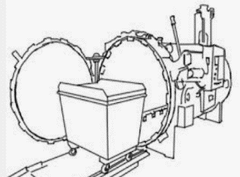
Climate-resilient improvements
Phase out incineration and implement non-burn technologies
  non-burn technologies can safely disinfect, neutralize or contain waste (e.g. autoclaves)
Flood prone areas
Alternative storage in elevated containers and/or transporting off-site
Ash pits are watertight are not over filled
Waste treatment areas and pits are elevated to prevent flooding
Autoclave treatment of medical waste
Drawing of a large autoclave - a non-burn, more environmentally friendly technology
Notes:
READ THE SLIDE
SAY:
Incineration, especially low-temperature incineration leads to green house gas emissions and is particularly harmful to human health through the release of dixoins and furans which are carcinogenic. Health care facilities and the health sector in a country should work towards incrementally phasing out incineration and/or using high temperature incineration with scrubbers and instead installing non-burn technologies-the most common being autoclaves. Employing reverse logistics and centralized treatment can facilitate use/management of autoclaves which require more resources and technical management compared to low temperature incineration.

Slide 35
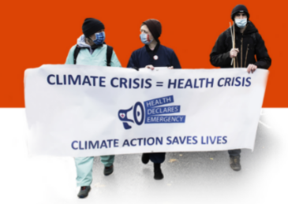
UN Conference of Parties (CoP) 26 commitments
As of 2022, > 50 countries have committed to low-carbon and sustainable health systems as part of CoP 26 commitments
  More sustainable waste management is a tangible measure for realizing these commitments
Waste should be monitored, resourced/financed and included in all health sector CoP 26 country action plans
Find out what your country is doing and advocate!
Addressing waste should be a part of climate action
Notes:
READ THE SLIDE
SAY:
Climate commitments made through CoP 26 presents an opportunity to increase attention and resources for safe and sustainable waste management.
The list of countries and their commitments for climate and health from CoP 26 can be found here: https://www.who.int/initiatives/cop26-health-programme/country-commitments

Slide 36
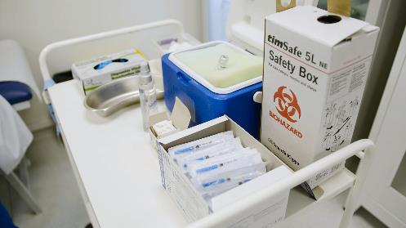
Part 4: Improving health care waste practices
Examples of simple, low-cost improvements
Longer-term, more resource intensive improvements
Improving sustainability of waste management practices

Slide 37

Simple, low-cost improvements
Regular staff training, mentoring and awareness raising activities (clinical & non-clinical staff)
Purchase bins for better segregation
Waste minimization – composting, recycling, rational PPE use
Document quantities of waste generated
Fence and weather-proof waste storage areas
Work with municipality to improve waste collection
New waste pits once existing pits full
Plan for further improvements including a dedicated budget
Incremental improvement approach will be required
Notes:
READ THE SLIDE
SAY:
What are some of the simpler, lower-cost interventions that are possible? Would these options differ between smaller and larger facilities?
The key, in low-resource settings, is to focus on incremental improvement. Remember the waste hierarchy ladder – if open-burning is the current situation then focus on constructing a locally-made, low-cost, lower temperature incinerator. In higher-resource settings, facilities should be moving towards more environmentally friendly practices, e.g. non-burn technologies
A long-term strategy including waste reduction and investment for system upgrading should be developed to supplement and guide annual HCWM plans.
In smaller facilities, centralized treatment may be more realistic, but will require careful planning and logistics. It may be difficult for a facility to verify what happens to the waste once it leaves the facility but some effort should be made to verify that waste is being safely treated and disposed of, not merely dumped in municipal waste supplies.

Slide 38
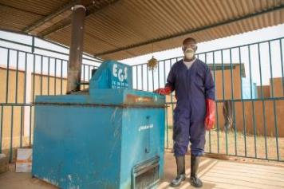
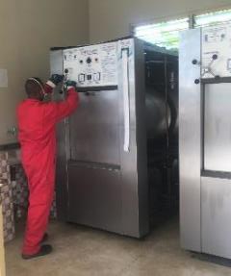
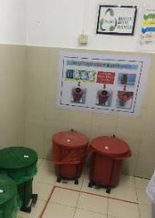
How to make incremental improvements
Training on waste segregation & rationale use of PPE
Reminders at points of care
Develop reverse logistics system:
Waste is regularly & safely transported to centralized plan with non-burn technology
Build lockable, covered storage areas
Build low-cost incinerator as interim solution
Long term, most expensive
Medium term
Immediate improvements, minimal cost
Notes:
READ THE SLIDE

Slide 39
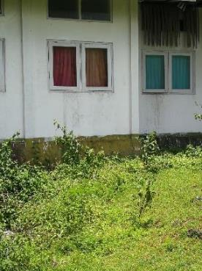
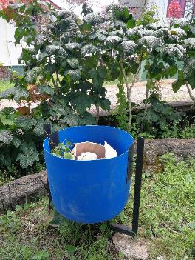
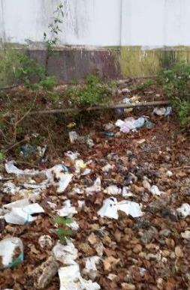
Example of low-cost improvements in Indonesia
After
Before
Waste outside nutrition clinic identified as a major problem
Cleaning campaign for 1 month
Bins installed for general waste in grounds
Clean surroundings, risk of infection and injury decreased
Notes:
READ THE SLIDE
SAY:
This facility in Indonesia is the same as the one showing the alternative risk prioritization method. One of the simple, low cost improvements identified was to tidy up waste at the facility.

Slide 40
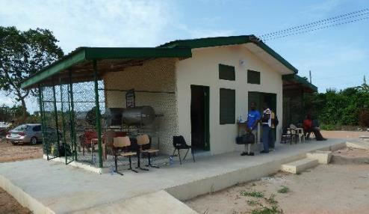
Longer-term improvements
Upgrade from low- to high-temperature incineration with air pollution control
Switch from burn to non-burn technologies
Solar power for waste technologies
Centralized treatment and reverse logistics
Procure biobased/renewable materials and safe reusable PPE with more ecological packaging.
Dedicated waste treatment building with an autoclave, Ghana
Notes:
READ THE SLIDE
SAY:
These improvements may require more considerable costs and time.

Slide 41
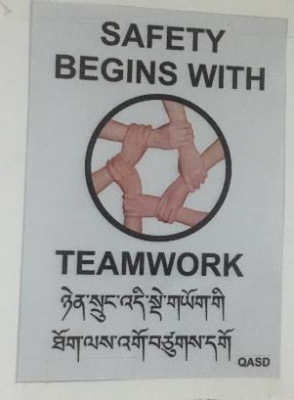
Increasing sustainability of waste practices
National level
Legal framework, rules and guidance is available, standardized, known and available for all
Stakeholders understand that proper waste management is important for health and environment!
Facility & district level
Adequate budget available
Training on HCWM part of district and facility organizational culture
Regular maintenance and repair of equipment and infrastructure
Continuous monitoring and mentoring of staff
Notes:
READ THE SLIDE
SAY:
What could you do to increase sustainability in your facility or facilities you work with? What do you think needs to be done at national and local level? These are things you can think about as we finish the session and to support your action planning going forward.

Slide 42
Key take-aways
Segregate hazardous and non-hazardous waste at the point of generation
Use sharp boxes – never recap or reuse needles
Keep infectious and sharp waste away from patients and public
Treat infectious and sharp waste before disposal – preferable with environmentally friendly technologies like autoclaving
Plan for incremental improvement of waste systems where resources are limited
As much as possible, adapt waste systems to reduce negative impact on climate
Notes:
READ THE SLIDE

Slide 43
WASH FIT waste management indicators
1 | Functional waste collection containers are available in close proximity to all waste generation points for non-infectious (general) waste, infectious waste AND sharps waste | Segregation
2 | Waste is correctly segregated at all waste generation points | Segregation
3 | Reminders on correct waste segregation is clearly visible at all waste generation points | Segregation
4 | Appropriate protective equipment and resources to perform hand hygiene are available for all staff responsible for handling waste and in charge of waste treatment and disposal | Personnel
5 | Reminders and training in place to promote and monitor rational use of personal protective equipment | Waste reduction
6 | Strategies to reduce the quantity of waste generated are employed throughout the facility, including procuring items using less and more sustainable packaging | Waste reduction
7 | [N/A if no local recycling available] Recyclable non-hazardous waste is segregated and sent to municipal recycling plants | Waste reduction
8 | A dedicated waste storage area is available which is fenced and secure and of sufficient capacity where sharps, infectious and non-infectious waste is stored separately | Storage
9 | Infectious waste is stored for no longer than the safe limit (as determined by the climate) before treatment/disposal | Storage
Indicators in bold are “essential”
Notes:
READ THE SLIDE
SAY:
Using the WASH FIT assessment tool will help you to address many aspects of waste management and may allow for a detailed improvement plan

Slide 44
WASH FIT waste management indicators
10 | [On-site treatment only] Waste treatment technology (incinerator or alternative treatment technology) for the treatment of infectious and sharp waste is built to the appropriate standards, well-maintained, functional and of a sufficient capacity for waste generated | Treatment
11 | [On-site treatment only] Sufficient energy/fuel is available for incineration or alternative treatment technologies | Treatment
12 | Waste is collected for off-site treatment safely and regularly and sent to an appropriate, licensed waste treatment facility | Treatment
13 | Functional burial pit/ fenced waste dump or municipal pick-up available for disposal of non-infectious (non-hazardous/ general) waste | Disposal
14 | [On-site treatment & disposal only; Where there is a risk of flooding] Waste pit(s) are built to withstand climate-related events and emergencies (e.g. flooding) and/or there is a backup waste storage site available | Disposal
Indicators in bold are “essential”
Notes:
READ THE SLIDE

Slide 45
WASH FIT waste management indicators
15 | [On-site; where incineration is used] Dedicated ash pits are available for disposing of ash from incineration | Disposal
16 | Anatomical/ pathological waste is put in a dedicated pathological waste pit/ burnt in a crematory or buried in a cemetery. | Disposal
17 | Pharmaceutical waste is treated and disposed of safely either at a centrally managed safe treatment & disposal facility (i.e. off-site) or sent back to the manufacturer or incinerated by industries using high temperature kilns. | Pharmaceutical waste
18 | A member of staff is adequately trained for management and oversight of health care waste and carries out his/her duties to the appropriate professional standards | Personnel
19 | Staff who handle or dispose of waste and health care workers are vaccinated against Hepatitis B (and any other recommended vaccinations, according to national guidelines) | Personnel
20 | [When demand increases due to outbreaks or climate-related events] Strategies to deal with additional waste are employed when demand increases | Emergency preparedness
Indicators in bold are “essential”
Notes:
READ THE SLIDE

Slide 46
Further reading
UNEP (2003). Technical guidelines on the environmentally sound management of biomedical and healthcare waste. http://archive.basel.int/pub/techguid/tech-biomedical.pdf
UNEP (2007). Guidelines on best available techniques and provisional guidance on best environmental practices relevant to Article 5 and Annex C of the Stockholm Convention on Persistent Organic Pollutant. http://chm.pops.int/Implementation/BATandBEP/BATBEPGuidelinesArticle5/tabid/187/Default.aspx
WHO (2003). Aide-memoire for a strategy to protect health workers from infection with bloodborne viruses. https://apps.who.int/iris/handle/10665/68354
WHO (2014). Safe management of wastes from health care activities. Second Edition. https://www.who.int/publications/i/item/9789241548564
WHO (2017). Safe management of wastes from health care activities: a summary. https://apps.who.int/iris/handle/10665/259491
WHO (2019). Overview of treatment technologies for infectious and sharp waste from health care facilities. https://apps.who.int/iris/handle/10665/328146
UNDP/WHO/HCWH/GEF Green Healthcare Waste website https://greenhealthcarewaste.org/
WHO (2020). Water, sanitation, hygiene, and waste management for SARS-CoV-2, the virus that causes COVID-19. Interim guidance. https://www.who.int/publications/i/item/WHO-2019-nCoV-IPC-WASH-2020.4
WHO (2018). Fact sheet on health care waste: https://www.who.int/news-room/fact-sheets/detail/health-care-waste
WHO (2022). Global analysis of health care waste in the context of COVID-19 https://www.who.int/publications/i/item/9789240039612
UNEP (2012). Compendium of Technologies for Treatment / Destruction of Healthcare Waste https://wedocs.unep.org/bitstream/handle/20.500.11822/8628/IETC_Compendium_Technologies_Treatment_Destruction_Healthcare_Waste.pdf?sequence=3&isAllowed=y
USAID/PATH (2008). Small scale autoclaves to managed medical waste https://pdf.usaid.gov/pdf_docs/Pnado504.pdf
Full list of relevant reading available at:
https://washinhcf.org/resource/summary-of-all-who-and-related-resources-on-wash-in-hcf/

Slide 47
Supplementary slides

Slide 48
Examples of different types of waste
Category | Examples
Sharps | Used or unused sharps (i.e. hypodermic, intravenous or other needles; auto-disable syringes; syringes with attached needles; infusion sets; scalpels; pipettes; knives; blades; broken glass
Infectious | Waste suspected to contain pathogens and pose a risk of disease transmission (i.e. waste contaminated with blood and other body fluids; laboratory cultures and microbiological stocks
Pathological | Human tissues, organs or fluids; placentas; body parts; unused blood products
Pharmaceutical, cytotoxic | Pharmaceuticals that are expired or no longer needed; items contaminated by or containing pharmaceuticals Cytotoxic waste containing substances with genotoxic properties, e.g. waste containing cytostatic drugs (often used in cancer therapy); genotoxic chemicals
Chemical | Waste containing chemical substances (i.e. laboratory reagents; film developer; disinfectants that are expired or no longer needed; solvents; waste with high content of heavy metals, e.g. batteries; broken thermometers and blood pressure gauges)
Radioactive | Waste containing radioactive substances (i.e. unused liquids from radiotherapy or laboratory research; contaminated glassware, packages, or absorbent paper; urine and excreta from patients treated or tested with unsealed radionuclides; sealed sources)

Slide 49



Bins and containers: further guidance
Waste categories | Colour and markings | Type of container | Collection frequency
Infectious waste |  | Leak-proof strong plastic bag placed in a container (bags for highly infectious waste should be capable of being autoclaved). | When three-quarters filled or at least once a day.
Sharp waste |  | Puncture-proof container. | When filled to the line or three-quarters filled.
Pathological waste |  | Leak-proof strong plastic bag placed in a container. | When three-quarters filled or at least once a day.
Chemical and pharmaceutical waste |  | Plastic bag or rigid container. | On demand.
Radioactive waste |  | Lead box. | On demand.
General health-care waste | Black or grey coloured bag | Plastic bag inside a container or container which is disinfected after use. | When three-quarters filled or at least once a day.

Slide 50

Comparison of treatment technologies
(which comply with the Stockholm and Basel Conventions options)
Legend
Low
Medium
High
Very high
Notes:
Refer to Chapter 2, page 6 of WHO Overview of technologies for the treatment of infectious and sharp waste from health care facilities for more information.
https://apps.who.int/iris/handle/10665/328146

Slide 51

Interim waste treatment technologies used in low resource settings
Low
Medium
High
Very high
Segregation
Collection
Transport
Storage
Treatment
Final disposal
Minimization
Notes:
Refer to WHO Overview of technologies for the treatment of infectious and sharp waste from health care facilities for more information.
https://apps.who.int/iris/handle/10665/328146

Slide 52
What capacity should the waste treatment technology be?
HOSPITAL
Waste generation rate per day and bed x the number of beds x bed occupancy rate
CLINIC/BASIC HEALTH UNIT
Waste generation rate per day x the average number of patients / day
Question:
100 bed hospital; 100 % Bed Occupancy Rate (BOR); 0.5 kg infectious waste per bed per day and
1-hour cycle time, 5 hours waste treatment per day.
What capacity is needed in (Kg/h)?
Segregation
Collection
Transport
Storage
Treatment
Final disposal
Minimization
Notes:
Quiz – ask participants to guess the answers.
Hospital
100 beds x 100 % (BOR) x 0.5 kg /bed/day = 50 kg infectious waste per day
50 kg / 5 working hours =10kg per hour
Result:
This hospital needs a technology with a treatment capacity of about 10 kg per hour. Or – if the waste is treated every 2 days: 20 kg/h

Slide 53


Bio-digestion
To treat organic (e.g. food) and pathological waste
Two chambers increase retention time, pathogens die naturally
Digested waste flows into sewers without further handling
Biogas can be used as fuel for cooking or water heating
Segregation
Collection
Transport
Storage
Treatment
Final disposal
Minimization
Notes:
- Biodigesters can be a valuable waste disposal option for any facility which has large amounts of organic waste, especially pathological waste like placenta, and food or kitchen scraps.
- They consist of large underground chambers, built of brick or concrete, and are often seeded with cow dung which provides bacteria to break down the waste.
- Having two digestion chambers, one after the other, keeps the placenta in the systems for long enough- at least 90 days is recommended- for any pathogens to degrade.
- Some water is added along with the waste, to keep the contents of the chamber liquid enough to flow freely. As more waste is put into the digester, digested waste overflows at the other end, into the sewer or septic tank. This means that the waste never needs to be handled again, which adds another layer of safety.
- As the waste breaks down, it creates biogas, which has a high content of methane and can be used as a renewable fuel. The easiest and most efficient uses are cooking and water heating.
- An experienced designer and construction company are needed, though there is often national level experience in the WASH and agricultural sector. A well built digester needs little maintenance and can last for over 20 years.
How common are biodigesters and how easy/difficult are they to install?
They are not yet well established, but excellent examples in Nepal as well as our own in Tanzania and I know of one in Zambia. They require expert design and installation- but that is true of all technologies. Also, many countries have good expertise in the WASH or agricultural sector, so cross-fertilisation is possible.
Are they predominately in hospitals or in smaller facilities too? What incremental improvements could be used?
The incremental change could come from piloting at some of the larger HCFs, and then moving down the chain as it becomes more established. Technically, it can be done at a small HCF, but neither the need nor the benefit are so large. Below 10-12kg of waste per day, the gas produced will be very limited and may not be of great interest to the HCF staff.
This blog may be useful. https://greengrowthknowledge.org/blog/win-win-disposing-medical-waste-biodigestion

Slide 54


General waste disposal: guidance for protected pits in low-resource settings
Cross-sectional view
Top view
Segregation
Collection
Transport
Storage
Treatment
Final disposal
Minimization
Notes:
Minimal approaches to health-care waste management need to be used in remote health-care facilities and underdeveloped areas. In addition, minimal practices may also be necessary in temporary refugee encampments and areas experiencing exceptional hardship.
Consequently, the safe burial of waste on hospital premises may be the only viable option available at that time. Even in these difficult circumstances, the hospital management can establish the following basic principles:
Access to the disposal site should be restricted to authorized personnel only.
The burial site should be lined with a material of low permeability, such as clay, dung and river silt, if available, to prevent pollution of shallow groundwater and nearby wells.
New water wells should not be dug near the disposal pit.
Only infectious health-care waste should be buried (if general hospital waste were also buried on the premises, available space would be quickly filled).
Larger quantities of chemical wastes should not be buried at one time; however, burying small quantities occasionally is less likely to create adverse pollution
The burial site should be managed as a landfill, with each layer of waste covered by a layer of soil to prevent odours and contact with the decomposing waste, and to deter rodents and insects.
Once the pit is constructed, the safe burial of waste in minimal circumstances depends critically on staff following sensible operational practices. This must be insisted upon, and the local health-care manager must realize their responsibility for making an organized waste-disposal system work properly

Slide 55
Last resort options for emergency settings
Encapsulation
Packs hazardous materials in containers made of impervious and non-reactive material.
Containers are sealed with concrete, plastic, or steel for burial or storage.
Used for disposal of expired vaccines & medications
Open burning (pit)
  Only in an emergency setting in absence of incinerators/autoclaves.
  Causes higher smoke pollution and other health risks
Segregation
Collection
Transport
Storage
Treatment
Final disposal
Minimization
Notes:
Burning in a pit should be undertaken in a confined area – away from public and the health facility. The waste should be burned within a dugout pit, followed by covering with a layer of soil
Expired pharmacies can also be inerted. Inertization is a variant of encapsulation and involves removing the packaging materials, paper, cardboard and plastic, from the pharmaceuticals. Pills need to be removed from their blister packs. The pharmaceuticals are then ground, and a mix of water, cement and lime added to form a homogenous paste. More information:
https://www.who.int/water_sanitation_health/publications/unwanted-pharmaceuticals/en/
These methods should only be a last-resort

Slide 56


Documentation
  Standard Operating Procedures (SOPs) / protocols (e.g. for segregation, collection, transport, storage, treatment, disposal, spillages):
    Possible hazards
    Responsible person, emergency contact,
    Step-by-step procedure, dos and don’ts.
  Incident reports (sharp incidents etc.)
  Record of waste generated (quantity/ weight [kg])
Segregation
Collection
Transport
Storage
Treatment
Final disposal
Minimization
Notes:
Are there reporting systems about needle stick incidents in your facility or/ country?
What is the standardized procedure for a needle stick incident (who needs to be informed, medical care, filling out forms)?
Why should you weigh and keep a record of the amount of infectious waste generated?
To observe changes in the amount generated and to invest in mitigation measures.
To prove that any activities to improve segregation and waste minimization are working.
To plan for what size and capacity of storage, treatment and disposal of waste is required.
To see if COVID-19 has had an impact on the quantity of waste generated

Slide 57



From linear to circular economy:
Long term goal
The circular economy is meant to reduce negative impacts along the life cycle of materials and products – by substituting of raw materials by secondary materials like recycled materials.
Example: Recycled paper for new packaging of pharmaceuticals
Source: IFC
Example: Four key steps in managing plastic
waste from PPE
Notes:
Source: IFC, Innovation in manufacturing personal protective equipment: toward sustainability and circularity. Washington (DC): International Finance Corporation; 2021

Slide 58

Country case studies: change is possible
Columbia (COVID-19 response)
Implemented sustainable purchasing - considering economic and socio-environmental impact of consumables + limit plastic
Extended operation times of available autoclave and microwave technologies to treat larger volumes of infectious waste
Strengthened training about proper PPE use and safe waste management
National guidelines include more sustainable products and practices for cleaning
Summary of Key Themes Ilustrated by case studies: WHO
Source: WHO, Global-Analysis-of-health-care-waste-in-the-context-of-COVID-19: Case-studies
https://washinhcf.org/wp-content/uploads/2021/12/WHO_2021_Global-Analysis-of-health-care-waste-in-the-context-of-COVID-19_case-studies.pdf

Slide 59


Private sector involvement in centralized waste treatment - Ghana
Private company in Accra established a centralized treatment hub to collect and treat infectious and sharp waste from HCFs by autoclaving
Active in Greater Accra Region in Ghana
  4 million inhabitants – high density area
HCFs which formally treated their waste by burning or dumping of waste are now using the centralized and environmentally friendly treatment option
Investment costs: ~1 million USD
Cost: about 1 USD / kg
Precondition: Authorities developed and enforced legal framework on HCWM
Notes:
Organizational structure: Private Public Partnership (PPP)
ZoomPak Ghana Limited, Government of Ghana with support of Turkish Government

