Slide 1
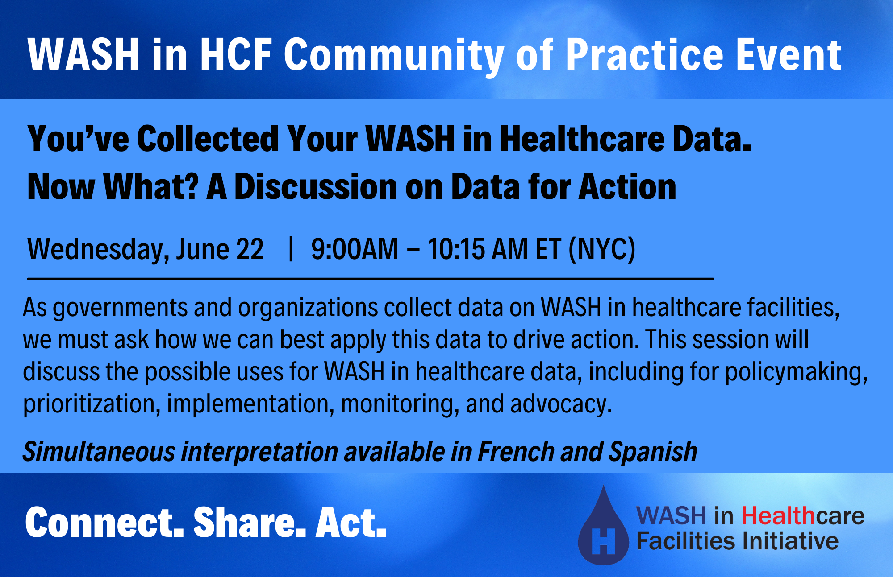

Slide 2


Interpretation
INTERPRETATION: Select English, French, or Spanish. Then, click “Mute Original Audio.”
INTERPRÉTATION: Sélectionnez Anglais, Français ou Espagnol. Puis, cliquez sur "Couper le son d’origine."
INTERPRETACIÓN: Seleccione Inglés, Francés o Español. Luego, haga clic en “Silenciar audio original."

Slide 3




This Community of Practice is an action-oriented learning platform that brings together the WASH and health communities to focus on policy, evidence, and practice in WASH in HCF.
CONNECT partners
SHARE experiences
Encourage groups to ACT
Notes:
This webinar is a part of the WASH in HCF initiative.
Our goal is to expand the conversation, connecting the expertise and experience of our partners and colleagues to the members of the WASH and health community who have expressed interest in “moving to action” in WASH in HCF. We welcome all to participate these webinars, whether you’re a seasoned expert on WASH in HCF, or someone for whom this topic is brand new.
REMINDER WE HAVE SIMULTANEOUS INTERPRETATION

Slide 4
WASH in HCF Community of Practice Basic Principles
WASH is a fundamental prerequisite for quality care within a healthcare facility and there cannot be effective infection prevention and control without adequate WASH.
WASH in healthcare facilities is a solvable issue and will require multiple systems, sectors, and stakeholders to work together to see sustainable improvements.
The Community of Practice is open to all who seek to learn and share about WASH in healthcare facilities. We welcome all and respect the diversity of perspectives who participate.

Slide 5
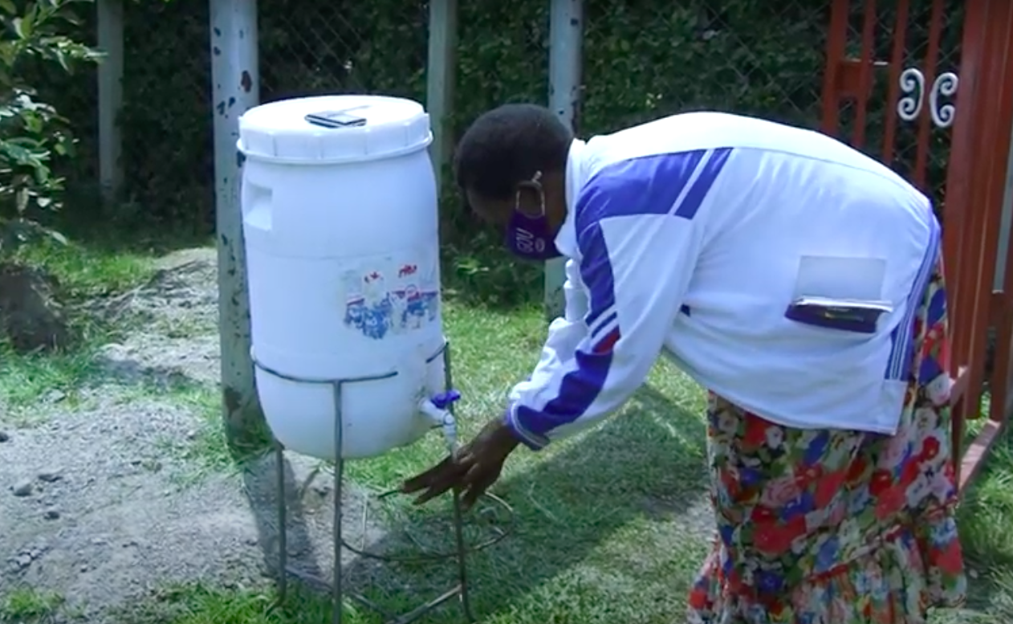
Success Corner
IRC COVIDWASH+ Project – Kabarole District, Uganda
Initially focused on emergency response to COVID-19 by boosting supplies like PPE and alcohol-based hand sanitizer for all health-workers.
Now, IRC has expanded to incorporate sustainable solutions such as training health on IPC and cleaners on their role in preventing the spread of hospital-acquired infections.
Medical waste is now well-managed thanks to the first licensed medical waste incinerator to serve all HCF in the district.

Slide 6

Complementary Resources for WASH FIT
WASH FIT 2.0 Assessment in Kobo Toolbox for digital data collection
Technical Factsheets: Climate, equity, plumbing, healthcare waste management, hand hygiene.
Training Manual + Training Slides
COMING SOON: Pre-recorded videos

Slide 7
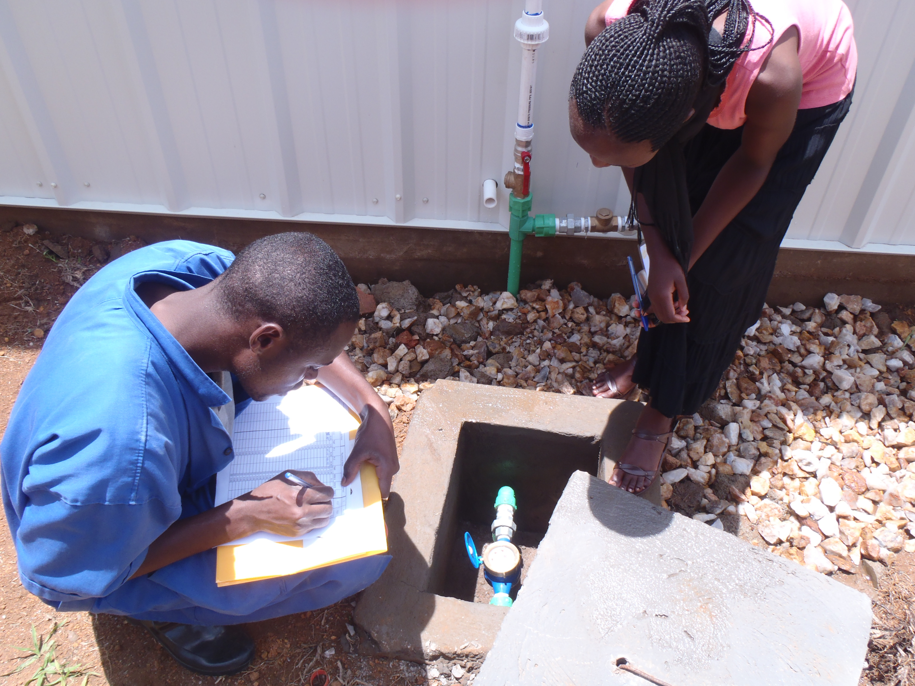
Overview of WASH in HCF Data for Action

Slide 8
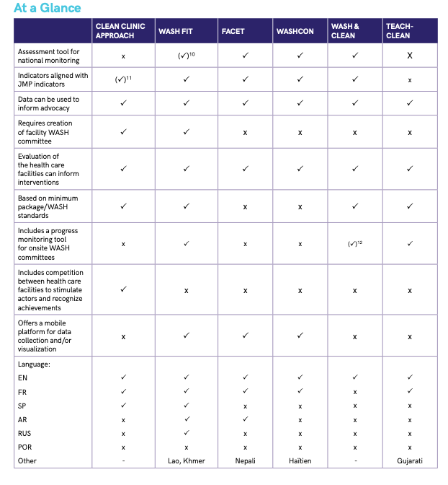
Sources of Data
WASH in HCF Assessments (e.g., WASH FIT, FACET, WASH Con, etc.)
HMIS
Large-Scale Facility Assessments (e.g., SPA)
Program Monitoring Tools

Slide 9
Now What? Data for Action
In addition to whatever initial intent for the data, there other ways you can use with it:
Program/project level implementation (monitoring, identifying facility needs, M&E)
Engagement with other orgs (lateral or upstream)
Policymaking
Advocacy
Budget/resource allocation
NOTE: Where you sit will impact how you use data
Notes:
Cue them up that we will want to hear from you all as part of the larger conversation. Discussion period from you all what are some of the way you’re using your data.
Example from Ghana

Slide 10
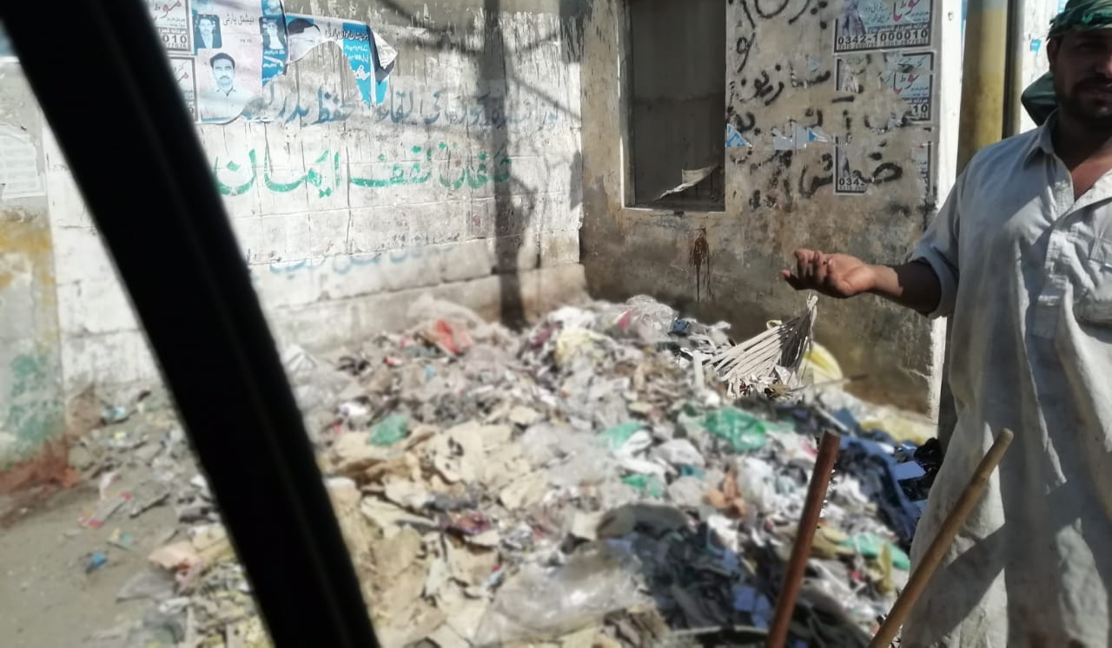
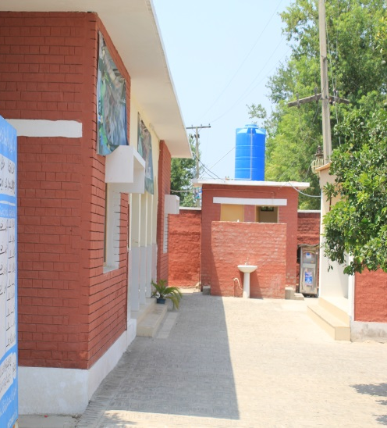
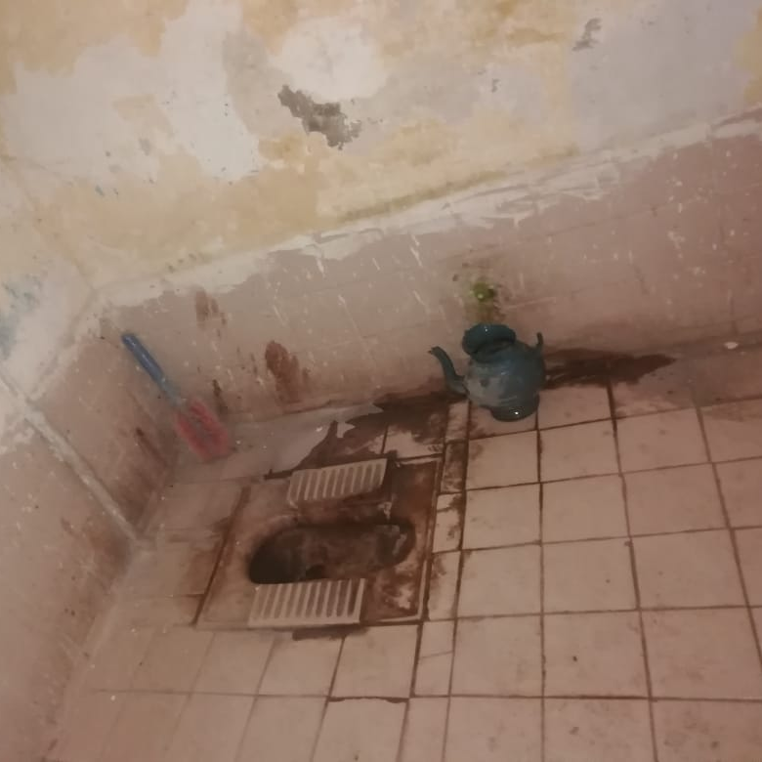
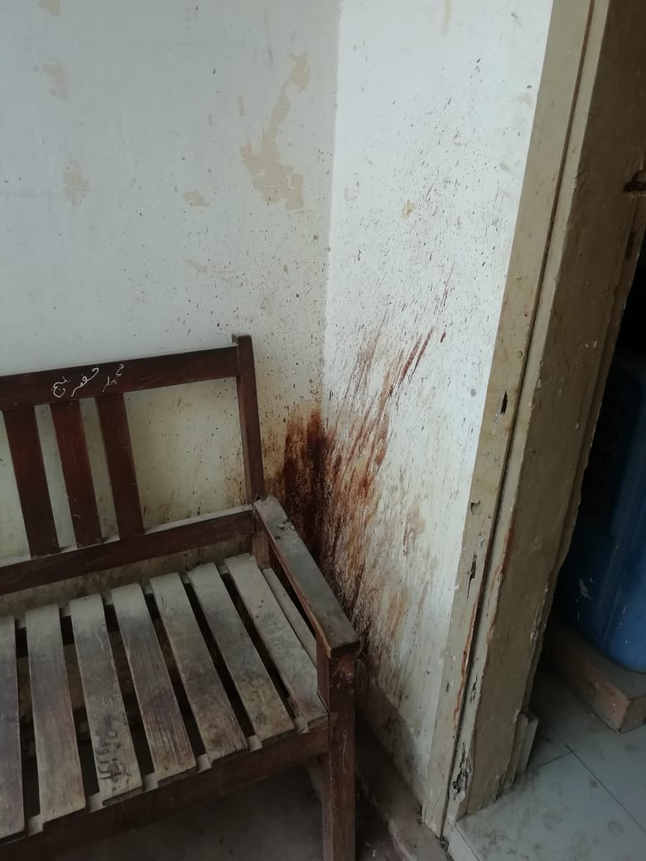

WASH in HCF_DATA FOR POLICY/STRATEGY
Investing in universal access to quality care in Pakistan
Notes:
The three pictures were taken from a District Health Office of a rural area to show the state of WASH and IPC in health system of Pakistan. There is a lot of efforts and resources required to bring quality change in health services in this system which cannot be achieved when both WASH and health works in isolation. This presentation is focusing on the need of that synergy in the bring positive changes in the health system of Pakistan.

Slide 11

PROFILE OF PUBLIC SECTOR HEALTH
FACILITIES IN PAKISTAN
Source: “Pakistan Economic Survey 2021-22”
Notes:
In Pakistan total number of public sector health facilities are 14,331. Of the total only 09% (1,282) of the health facilities are public secondary and tertiary hospitals. Remaining 91% (13,049) are the primary public sector health facilities. The catchment population of BHU is 10,000 to 25,000 population. RHC outreach is around 100,000 population. While hospitals serve districts and Tehsils(combination of 3 or more districts).

Slide 12


Study Objective
1 - To assess the status of WASH in Pakistan’s Health Care Facilities
2 - To generate WASH in HCF baseline data for monitoring and SDG reporting
3 - To identify bottlenecks hindering for improved WASH in Health Care Facilities
Data Collection Methodology
Three-Pronged Investigation Approach
Number of HCFs Surveyed through simple random sampling
*132/160 districts
Key Informant
Interviews
Province | Number of HCFs
 | Primary | Secondary | Territory | Total in sample | Total Surveyed | Percent
ICT | 16 | 0 | 0 | 16 | 16 | 100%
Punjab | 607 | 32 | 7 | 646 | 646 | 100%
Sindh | 456 | 20 | 2 | 478 | 478 | 100%
Baluchistan | 274 | 8 | 2 | 284 | 266 | 94%
KPK | 224 | 20 | 4 | 248 | 248 | 100%
KPMD | 177 | 5 | 0 | 182 | 145 | 80%
AJK | 196 | 4 | 0 | 200 | 200 | 100%
GB | 53 | 2 | 0 | 55 | 54 | 98%
Total | 2003 | 91 | 15 | 2109 | 2053 | 97%
82
Consultative Process
Focus Group
Discussions
92
Health Care Facility
Assessment Surveys
2,055
Provided by National Bureau of Statistics
Notes:
This slide is about the glimpse of the scoping study, as UNICEF supported this strategic activity to not only;
To assess the status of WASH in Pakistan’s Health Care Facilities
But also help generate baseline data WASH&IPC in HCF for reporting to JMP.
And additionally, it identify bottlenecks hindering the achievement of Universal quality of care services through improved WASH & IPC prospective
The WASHFIT tool customized to the Pakistan context and third-party assessment carried out in more than 2000 HCF across Pakistan through a provincially representative sample. This was coupled with Focus group discussions and Key informant interviews for qualitative analysis to find the reason on low WASH and IPC services.

Slide 13
WASH and IPC Services Benchmark _ HCF in Pakistan
Notes:
This slide is an overview of the finding on Scoping study;
Basic Water services;
Although the basic water availability is high as around 74% have adequate water available, however there is a disparity among provinces. Balochistan 51% primary facilities do not have adequate water.
Additionally, to achieve safely managed, water quality testing and monitoring is a huge challenge as only 16% of facilities are reported to be regularly monitoring the quality aspect.
Basic Sanitation services;
Although there are 100% facilities having toilets available but.. As many as 24% of toilets units are non-functional, only 33% facilities have gender segregated toilets and 18% have facility for physically challenged people which makes it 92% under limited services and only 8% facilities have basic services.
Hand hygiene service;
Around 31% facilities do not have hand hygiene service both in toilets or near service area. 15% are having limited services where functional handwashing station is available either in toilets or in service area. Soap is lacking in 31% of primary HCF compared to 51% in secondary HCF. 54% facilities have basic hand hygiene service.
HCWM service:
Only 14% facility provide basic service where segregation along with safe disposal is practiced. 31% facility have limited services where segregation is practiced but at the end safe disposal is not observed. As many as 55% facilities lack waste management service.
Basic Environmental Cleaning Services;
Only 33% facilities have basic service where cleaning on schedule and regular inspections done by sanitary inspector/facility in charge. Despite the availability of sanitary workers and cleaning material 26% observed have limited environmental cleaning services and in around 39% facilities no services are provided.

Slide 14
JOURNEY OF WASH & IPC IN PAKISTAN
JOURNEY OF WASH & IPC IN PAKISTAN
2024 Developing of scalable model to improve and maintain infrastructure
2022
SYSTEM STRENGTHENING- Developing standards, training manuals & Strategies for WASH&IPC in health facilities
2020-21
SCOPING STUDY- WASHFIT Introduction, Benchmarking, & BOTTLENECK ANALYSIS
2023
Monitoring & quality assurance framework and health workforce development
2019
STAKEHOLDER CONSULTATION- available evidences on WASH in health facilities
TO ACHIEVE UNIVERSAL ACCESS TO QUALITY CARE SERVICES
Notes:
Although the WASH and health are closing working together, but a visible change was noticed, when the all the stakeholders on the available evidences on the WASH in healthcare facilities. After detail deliberation and desk review of existing research work, it was found that Country does not have any institutional survey to know the status of WASH and IPC in healthcare facilities.
This has raised the demand to carryout a scoping study in the year 2020 that helped not only on having a benchmark on the status of WASH and IPC in the country, but also introduced the WASHFIT to govt of Pakistan and had provincial and national deliberations on the bottleneck analysis for achieving Universal quality of care services.
In 2022, we carryforward the momentum to start developing provincial WASH in healthcare facilities strategies along with developing standards, training manuals on WASHFIT, and keys indicators for monitoring of WASH services as system strengthening activities.
The next steps are to include these indicators in the DHIS/ HMIS for regular monitoring and evaluation of the health system along with the capacity development of health workforce.
We foresee that we support provincial health departments on developing scalable models which can be replicated through government ADP/ PC1 to achieve quality of care services in Pakistan.

Slide 15
WASH data for policies, strategies, standards
Desk Reviews
Policies, Plans, Guidelines, Standards, Manuals, Monitoring, Indicators, Formative Researches, Case studies, Best practices
----------------------
Scoping studies for WASH in HCFs in Pakistan
Minimum WASH in HCFs standards
WASH in HCFs
Indicators
WASH in HCFs Strategy and Action Plan Draft Report
Approval by Steering Committee
WASH in HCFs Strategy
and
Action Plan
Final Report
Technical Manual on WASH in HCFs
M&E Framework
Investment Program
2022-2030
Participative and consultative process
Notes:
This slide is on the strategy development for HCF in Punjab which is initiated in 2022. The same model will be replicated for the rest of provinces/territories. The overall approach uses available data like results of scoping study, global WASH ToT guidelines & costing tools for HCF implementation, available standards on HCF for WASH and IPC. Then carrying out desk review on gaps of WASH and IPC in minimum service delivery standards, monitoring indicators, review of available architecture design for primary, secondary and tertiary HCF which helped in developing a customized Package for HCF in Punjab which include, a technical manual on infrastructure development and a phase wise investment programme to achieve from no services to limited/ basic and safely managed WASH and IPC in province. The draft is developed and being reviewed by TWG/ steering committee. The overall methodology was consultative and participation of all the provincial stakeholders was ensured during this process.

Slide 16
Recommendations for actions
Govts do not function without data. Data is the key for advocacy at all levels.
With planning to report JMP, it’s a chance to also consider additional indicators for specific WASH and IPC needs of different health programmes i.e. RMNCH, COVID, EPI etc.
stakeholder consultations at federal, provincial and territories should be central in approach.

Slide 17

For more information please contact;
Mohammad Irfan Durrani, WASH Officer, UNICEF Pakistan
United Nations Children’s Fund | Pakistan Country Office
Street 5, Diplomatic Enclave, Sector G-5, Islamabad.
Follow us on Facebook, Twitter, Flickr and at www.unicef.org/pakistan

Slide 18
Ensuring the Delivery of Essential Health Services During the COVID-19 Pandemic: A WASH/IPC Response Across Five Countries
June 22, 2022
Sam Ongom
Monitoring & Evaluation Advisor, Uganda

Slide 19
Objective: Rapidly improve health care facility WASH services in 5 countries during the COVID-19 pandemic
Objective: Rapidly improve health care facility WASH services in 5 countries during the COVID-19 pandemic
Where: 174 health care facilities in five countries: (Bangladesh, India, Sierra Leone, Ghana, Uganda)
When: Sep 2020-Sep 2021 (Uganda workplan continued thru May 2022)
Partners: Christian Health Associations (Ghana, Sierra Leone, Uganda), mWater
Key Technical Approaches:
Strengthening health facility infection prevention readiness
WASH-focused quality improvement
  Prioritization of 4 measurable WASH improvement aims to drive improvements
  Virtual QI capacity-building/mentoring for District ‘QI Coaches’ – to be able to support facility teams to rapidly improve WASH services (virtual/in-person)
5 countries
174 health care facilities
113 public
facilities
42 faith-based facilities
3 local faith-based partners
19 private facilities

Slide 20
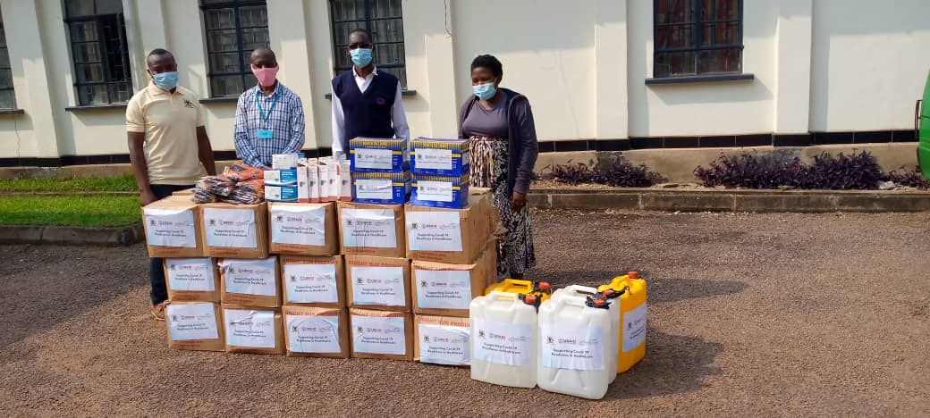
Phase I: Improving HCF Infection Prevention Readiness
Overview: Two-phased implementation approach
Limited infrastructure rehabilitation support to HCF water, sanitation, hygiene, waste management infrastructure in a sub-set of HCFs (74, 48%)
Distribution of essential Infection Prevention & Control commodities (PPE, soap, gloves, etc)
Publication and promotion of the global guidance document: Essential Supplies List For Infection Prevention and Control in Health Care Facilities

Slide 21
HCF-wide Infection Prevention Readiness Scoring System
Domain | Points Possible
COVID-19 Screening | 23
COVID-19 Triage | 7
COVID-19 Isolation | 24
Water infrastructure, access, availability | 8
HCF Hygiene & Infection prevention | 19
Healthcare waste management | 2
HCF Cleaning and SOPs | 7
HCF Policies/Strategies | 10
Total points possible | 100
*domain criteria are composed of WASH and IPC criteria from the Joint Monitoring Programme, IPCAF, and recent sector-wide COVID-19 guidance

Slide 22





Phase II: Strengthen Partner Capacity to Establish and Sustain an Infection Prevention Quality Improvement (QI) system:
Hubs and Spokes Model with virtual learning
QI coach training and practicum delivered by MOMENTUM Country and Global Leadership partner Institute for Healthcare Improvement (IHI)
Follow-up mentorship meetings
Virtual facility QI data review meetings via MOMENTUM Country and Global Leadership country staff.
Moderated WhatsApp for peer learning, performance support and Google site to host Just In Time learning moments.
In-person support for lower performing facilities.
DHMT/MCGL HUB
Organizes and Moderates
SPOKES
Infection Prevention Control (IPC) Teams within a facility participate
SPOKES
IPC Teams within a facility participate

Slide 23
Phase II: Methods to Monitor and Evaluate Progress
Make and sustain improvements across 4 prioritized quality improvement aims
  Percentage of health facility staff who adhere to mask protocol
  Percentage of individuals screened for COVID-19 upon arrival at facility per protocol
  Percentage of health facility staff who comply with hand hygiene protocol during interaction with patients
  Percentage of cleaning routines observed where the cleaner cleaned high-touch surfaces such as doorknobs, light switches, faucets, bed rails, bed surface
Maintain high HCF-wide and ward-level IPC readiness scores
Most significant change stories

Slide 24
Digital Data Management Activity
Draft new WASH/IPC tool
Review tool/w MoH IPC lead and incorporate feedback
Training of 20 MoH sub-national officers and 3 Jhpiego staff on Data Collection
Incorporated weights for questions and finalized tool
Cascade data collection training to 148 persons (health workers) from 50 HCFs
Newly drafted MoH tool +
MCGL-UGA tool
Review and test digital assessment tool/w Trainers and incorporate feedback
Develop Data dashboards
MoH sub-national officer Data Management Training
MoH owns and manages the data collection tools and dashboard
Uganda Water Project
Uganda Water Project
MCGL-UGA-COVID-19 WASH/IPC Quality Improvement Activity
MoH request to make tools permanent – No Cost Extension
Begin and test data collection and Quality Improvement activities
Starts April 18th

Slide 25
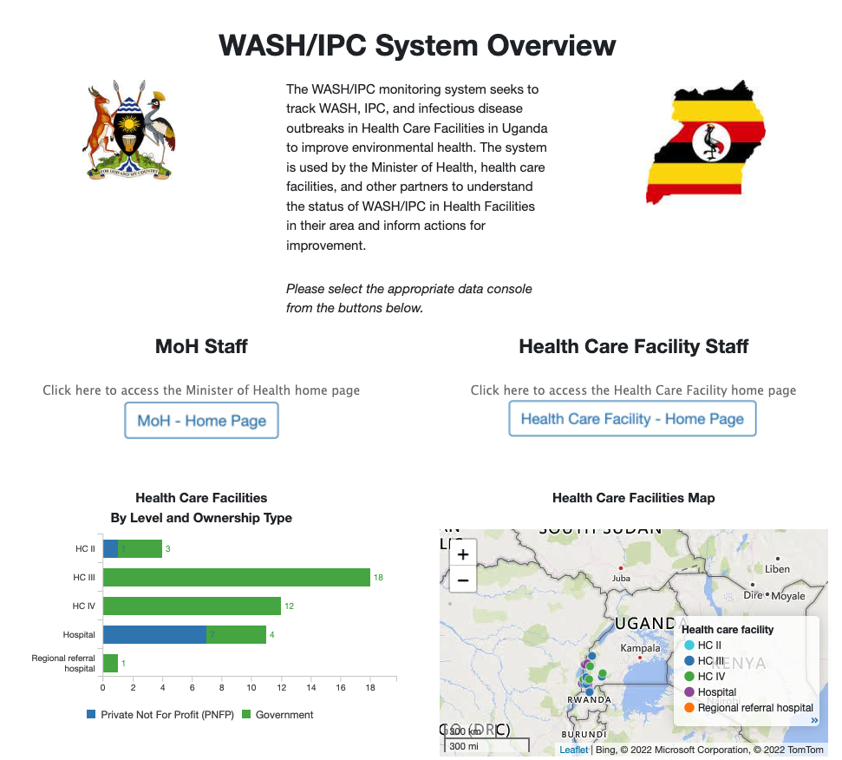
Data Dashboards
Digital Data Management Activity
Landing page at:
go.solstice.world/moh_uganda
Includes:
A data management console for the Minister of Health
A data visualization console for Health Care Facilities

Slide 26
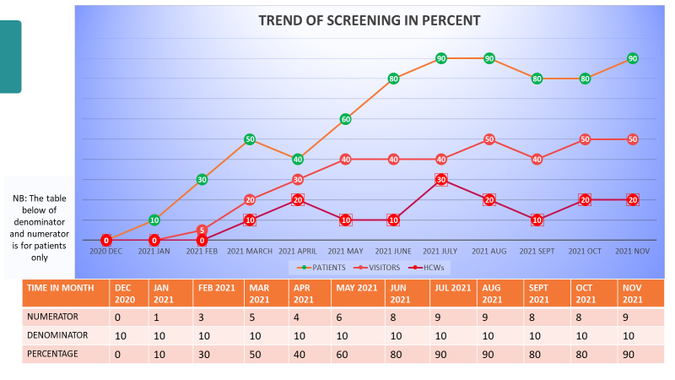
Data for action
Procurement for PPE items and minor repair works.
Informed key areas of mentorship including use of virtual platforms & IPC among HCW including cleaners.
Community sensitization efforts on COVID 19 by local leaders
Quality improvement projects & behavioral change at HCF level
Cross country sharing of best practices.

Slide 27
Impact on sepsis related to pregnancy
MOMENTUM Country and Global Leadership Uganda COVID-19 Activity
The project started in Aug 2020

Slide 28
Improved Availability of Basic WASH Services in Supported Health Facilities (baseline to endline) (n=152)
75% to 92%
23% to 55%
80% to 94%
59% to 91%
13% to 63%

Slide 29
Health facilities IPC readiness scores improved by an average of 22 points across all five countries

Slide 30
Recommendations for scaling up data for action
Use a common digital data management system that is accessible to all stakeholders and advocate for institutionalization of these systems and processes
Invest in technology equipment as much as possible, and designate for learning purposes
Engage all stakeholders in setting up and use of data for use from national to community level. Explore ways to connect national and local WASH systems (professional services) to health care facilities and HCF networks
Designate and build capacity at local level for data collection and analysis.
Support routine data reviews at facility, district and national level

Slide 31
Acknowledgements
USAID missions
District, provincial/state and national governments
MOMENTUM staff from our HQ offices and country offices
Christian Health Association partners
MWater team

Slide 32
Speaker contact information
Sam Ongom, Monitoring and Evaluation Advisor, MOMENTUM Country and Global Leadership, Uganda (sam.Ongom@jhpiego.org)

Slide 33

THANK YOU
@USAID_MOMENTUM
This presentation is made possible by the generous support of the American people through the U.S. Agency for International Development (USAID) under the terms of the Cooperative Agreement #7200AA20CA00002, led by Jhpiego and partners. The contents are the responsibility of MOMENTUM Country and Global Leadership and do not necessarily reflect the views of USAID or the United States Government.
@USAIDMOMENTUM
USAID MOMENTUM

Slide 34

Eau, Hygiene et Assainissement
en Milieu de Soin
DONNEE POUR LE PLAIDOYER
Experience de World Vision Niger
Juin 2022
Presentation
Headline

Slide 35

CONTEXTE
Situation generale alarmante en matiere d’acces aux Services EHA au Niger (Moins de 50 % avec acces a l’eau potable et moins de 10% a l’assainissement en milieu rural en 2018 selon le rapport des Indicateurs du Ministere de l’hydraulique et de l’Assainissement)
Evaluation de l’acces aux services EHA dans les communes de Torodi et Makalondi en partenariat avec l’IRC sur financement de la Coundation Hilton (CNHF) en 2018
Initiation d’un Projet WASH en Milieu de Soins a Torodi et Makalondi en collaboration avec l’OMS, CDC, l’IRC et le Ministere de la Sante sur Financement de la foundation Hilton en 2020
Baseline effectue en 2020 pour evaluer l’acces aux Services WASH a Torodi et Makalondi sous le Leadership de CDC
Demarrage des activites sur le terrain pour satisfaire les besoins des centres de sante cible en infrastructures et en renforcement des capacities des acteurs
Audience
name
35

Slide 36

Donnee Collectee: Baseline Torodi/Niger 2020
Accès au service basic pour l’eau : 19%
Accès au service basique en assainissement : 5 %
Accès au service limité en assainissement : 29 %
Proportion des centres de santé avec accès à 1 DLM avec de l’eau et du savon/solution hydroalcoolique au point de soins : 11%
Service de base de lavage des mains : 0%
Proportion des centres de santé avec un service limité de gestion de déchet : 26%
Proportion des centres de santé avec un service de base de tri de déchet : 0 %
Proportion des centres de santé avec un système de traitement : 48 %
Service de base nettoyage de l’environnement : 5%
Proportion des centres de santé avec des protocoles de nettoyage : 10%
Proportion des centres de santé avec des formations sur le nettoyage : 10%
36

Slide 37
Donnee Collectee: JMP 2019/Niger
Accès au service de base pour l’eau : 25%
Accès au service basique en assainissement : 0 %
Accès au service amélioré en assainissement : 74 %
Proportion des centres de santé avec accès à 1 DLM au point de soins : 60%
Service de base de lavage des mains : 4%
Proportion des centres de santé avec un système de tri de déchet : 52 %
Proportion des centres de santé avec un système de traitement de déchet : 48 %
Service de base nettoyage de l’environnement : 5%
Proportion des centres de santé avec des protocoles de nettoyage : 15%
Proportion des centres de santé avec des formations sur le nettoyage : 19%
37

Slide 38
Utilisation des Donnees/Actions Prises
Atelier de présentation et diffusion des résultats ;
Création de la Task Force WASH in HCF présidé par le SG du Ministère de la Santé Publique,
Création du Groupe Technique de Travail présidé par le Directeur de l’Hygiène Publique et de la Santé Environnementale regroupant les acteurs au niveau opérationnel ;
Adoption de l’outil WASH FIT par le MSP/P/AS au plan national ;
Formation des formateurs sur le WASH FIT au niveau national ;
Contextualisation de l’outil WASH FIT pour le Niger ;
Intégration progressive des indicateurs WASH dans le système d’information sanitaire du Niger ;
Elaboration en cours de la stratégie WASH in HCF pour le Niger ;
Elaboration en cours du référentiel des équipements de protection individuelle essentiels
Elaboration de la stratégie de plaidoyer WASH in HCF ;
Elaboration en cours d’un model type de latrines pour les centres de santé ;
Elaboration en cours d’un model type de zone a déchet pour le Niger
Les engagements annoncés et enregistrés au niveau de la DHPSE couvrent plus de 200 centres de santé a travers le pays
Mise a jour mensuele avec les acteurs au niveau national et global
Preparation d’un partage des donnees et d’experience avec les parlementaires
38

Slide 39
Recommendation
Creer les conditions pour le partage des donnees avec les acteurs essentiels (Etats, ONGs, UN System)
Creer un cadre exchange permanent sous forme de task force ou autre
Assurer que les autorites etatiques (Ministere de la Sante ou autre) prennent le LEAD des initiatives
Assurer que les moyens sont prevus pour le fonctionnement des cadre d’echange crees
Creer les conditions pour la remontee de l’information du terrain au niveau national.
39

Slide 41
Ways to Get Involved
Subscribe to the listserv to receive updates on events and resources (link in chat). Join live sessions and connect with others in the space.
Send us topic recommendations. We want to know what you want to learn about, what you feel needs more discussion.
Nominate a success story. Every live session + newsletters will highlight successes, big and small, around WASH in HCF.
Join our next session! Sept 2022 will focus on the built environment and user-centered design.

Slide 42
