Slide 1
Dr. (Mrs.) Mary E. Ashinyo
Physician Specialist Public Health with emphasis on epidemiology & Health Policy, health systems management and leadership.
WASH in Healthcare Facilities in Ghana;
Status & National WASH Costed Strategy
Deputy Director- Institutional Care Division – Ghana Health Service
Responsible for Quality Management including National WASH/IPC Program- National Focal Person.
Professional affiliation
Adjunct Assistant Professor | Department of Maternal and Child Health. University of North Carolina at Chapel Hill, U.S.A.

Slide 2
INTRODUCTION
01
STATUS OF WASH
02
COUNTRY EFFORTS ON WASH FINANCING
OUTLINE
03
CHALLENGES
04
REFLECTIONS
05

Slide 3
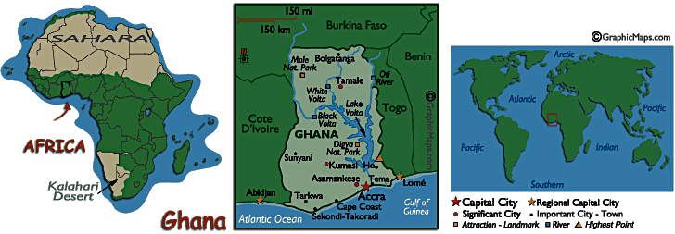
Introduction: Ghana Profile
HEALTHSECTOR
Vision: A healthy population for national development
Mission: Work towards the achievement of healthy lives for all people living in Ghana through an enabling policy framework that recognizes, empowers and brings together, in a coordinated manner, all stakeholders
Goal: To promote, restore and maintain good health for all people living in Ghana.
★
Land area: 239,000 square kilo metres
Border countries: Burkina Faso 549 km, Cote d'Ivoire 668 km, Togo 877 km
Total Population : >30 million*
Ten (+6) regions , 216 (+ 38) = 254 districts
Life Expectancy at Birth: 63.4 (M:F 62.5 : 64.4) years
*Projected from 2010 Census LE: Life expectancy
Notes:
Life Expectancy at Birth, WHO; Published in 2018

Slide 4
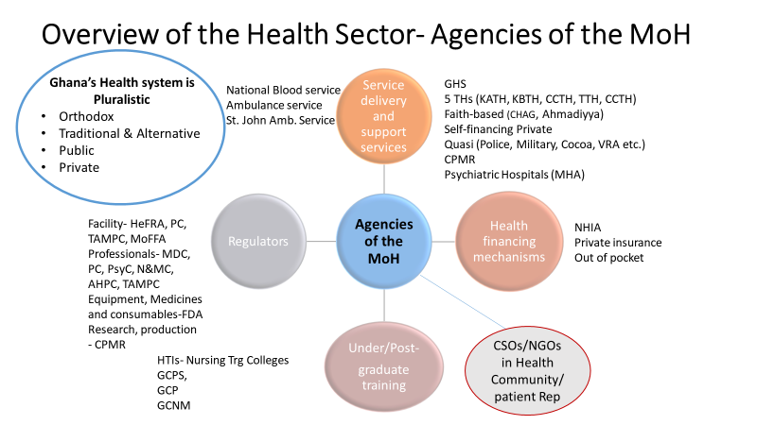

Slide 5
INTRODUCTION-STAKEHOLDER VOICES
WASH in Healthcare Facilities 2021
POLICY MAKERS
FRONTLINE PROVIDERS
PATIENTS
We are doing well but a lot remains to be done- more funding and data needed
Our directors are doing well but more leadership and political commitment needed
Sometimes washrooms are locked and you have to pay, micro economic of WASH
POLICY IMPLEMENTERS
FUNDERS
We are committed to improve WASH in healthcare facilities but we lack logistics.
WASH is very critical; we have done a lot but there remains more funding gaps exist.

Slide 6
An analysis of WASH database using routine data
Analysis of routine DHIMS data Q3 2021
BACKGROUND
WASH is essential for providing high quality and safe care, protecting frontline, care seekers and patients and prevents avoidable deaths. It is pre-requisite to IPC and preventing the spread of AMR pathogens. It is fundamental to health security, necessary for Primary Health Care, human rights, dignity, social justice and gender issues. It is top priority for women receiving maternal care, and critical for health and environmental SDGs. Gaps in WASH especially during the pandemic reveal inequities and a threat to #Leaving no one behind.
Objectives
To determine
The performance
Of WASH/IPC systems In HCFs across all 16 regions of Ghana at all levels of care
QUALITY ASSURANCE
Task team meetings
Extensive data cleaning
Triangulation
Stakeholder validation
Analysis aligned to JMP WASH ladder to make the results internationally relevant beyond national usefulness.
Methods
Literature reviews
Desk reviews
Extraction of routine data from DHIMS, conducted descriptive analysis.
WASH in Global Health
5.7-8.4 million people die each year from poor QoC in LMIC
15% patients get an infection during hospital stay
Infections with unclean births account for 26% of neonatal deaths and 11% of maternal deaths….> 1 million in all
In some countries, up to 20% of women get wound infection after C/S and approximately 20% of all cause global deaths are due to sepsis.
50% of HCFs lack basic water services, 63% lack basic sanitation, 26% lack hand hygiene services and 70% lack basic healthcare waste management services
World Health Organization
Rationale
In Ghana, several efforts have been made to improve WASH in HCFs and yet the status of WASH in HCFs remains unknown during the pandemic. Previous works e.g. WaterAid Ghana, Ashinyo et al, assessed the status of WASH in HCF in selected regions however, these did not provide a national picture

Slide 7
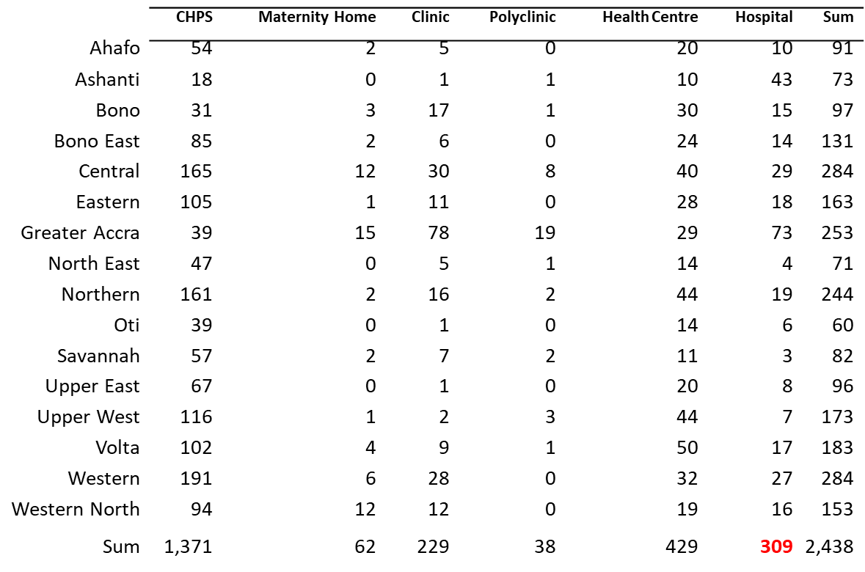

Slide 8
MONITORING & EVALUATION
WASH IN HCFs
PREVIOUS INDICATORS
NEW ADDITIONAL INDICATORS
Availability of focal person
Availability of assistant focal person
Availability of action plans
Proportion of facilities with basic, limited or no water services
Proportion of health facilities with basic, limited or no sanitation services.
Proportion of health facilities with basic, limited or no hygiene services
Proportion of health facilities with basic, limited or no waste management services. .
Urban /Rural distribution
Proportion of all staff trained
Proportion of doctors trained
Proportion of cleaners and waste management staff trained
Budget allocated
Budget approved
Budget spent
Gender in WASH- menstrual hygiene, governance & function
WASH/IPC committees
Availability of PPEs for all categories of staff
Healthcare associated infections- 4 areas
Environmental cleaning
Antimicrobial resistance and Stewardship .

Slide 10
Water-treands

Slide 12
Hygiene trends

Slide 14
KEY HIGHLIGHT; NATIONAL
WASH in Healthcare Facilities 2021
WATER
CHPS
45% HCF lack Basic water services and 6% have no water services at all.
SANITATION
WASTE
Only 21% of CHPS basic waste service, 32% - basic sanitation service, 37% - basic water, 40%- basic hygiene service
50% HCF have no basic sanitation services and 5% have no sanitation services at all.
HYGIENE
40% HCF lack basic services with 10% HCF having no waste management services at all
43% HCF lack basic hygiene services and 2% have no hygiene services at all.

Slide 15
Key efforts
POLICY: National WASH/IPC Policy and technical guidelines, National costed strategy, AMR/patient safety, HAIs all related programs
TRAINING CONTENT: Tailor-made modules for clinical staff, non-clinical, mortuary workers and administrative staff
TOOLS; Adapted WASH-FIT, standardized job aids & protocols.
MONITORING; Quarterly reporting in DHIMS on JMP indicators, field assessments, surveys, compliance assessments
CAPACITY BUILDING; Public and Private healthcare facilities
IINTEGRATION ACROSS PROGRAMS eg. Neglected tropical diseases (Schistosomiasis), WHO Quality of care Network, Nutrition program in COVID response, AMR One Health, Cholera Eradication plan etc
COMMUNITY INVOLVEMENT; Construction of boreholes and other infrastructure, and provision of WASH logistics
RESEARCH; wastewater surveillance in COVID-19, Healthcare worker safety, risk assessment.
Opportunities in WASH economics

Slide 16
Ghana’s National WASH Costed Strategy
The national WASH in HCF strategy revolves around four key areas. These are as follows:
  Minimum Standards and Guidelines for WASH in HCF
  Infrastructure and Costing for WASH
  Human Resources for WASH
  Funding and Sustainability for WASH
. The objectives of the National Strategy for WASH-IPC in HCF are as follows:
    1. To provide the context and legal framework for WASH in HCFs in Ghana.
    2. To provide a framework for sustainable implementation of national guidelines and standards for WASH in HCFs at all levels.
    3. To integrate WASH in HCF into the existing M&E system of the Ministry of Health and other related sectors like Local Government and the National WASH M&E systems.
    4. To provide a Strategy for Sustainability & Scaling-up to meet National, Regional and Global Targets.

Slide 17
Country Efforts: WASH Funding
Ghana has a National costed WASH strategy.
The methodology adopted for costing is the Life Cycle Cost Approach (LCCA), which considers all costs including all capital/investment costs, replacement/ rehabilitation costs and recurrent expenditure (for operation and maintenance and other expenses).
In Ghana, domestic funds constitute about 89% of healthcare financing (NHA, 2016). However, about 90% of WASH services is donor funded
Sustainable financing model depends largely on domestic funding for the continuous delivery of WASH services in healthcare facilities.
Strategy therefore highlights Funding sources to include:
  • Internally Generated Funds
  • Local assemblies (MMDAs)
  • Development partners
  • NGOS
  • Private sector financing.

Slide 18
No. | Water supply costing: Item | Lifespan (years) | Unit Cost (GHS)
1 | Water Supply
1.1 | Drilling & mechanisation of borehole with handpump | 5 | 25,000.00
1.2 | Drilling of borehole, mechanisation and installation with solar pump, solar panel & accessories, overhead pump and plumbing | 10 | 140,000.00
1.3 | Drilling of borehole, mechanisation and installation of electromechanical pump & accessories, overhead pump and plumbing | 10 | 110,000.00
1.4 | Provision of a hand pump only & installation | 5 | 8,500.00
1.5 | Provision of plumbing works | 20 | 7,000.00
1.6 | Pipe connection less than 1km | 20 | 2,500.00
1.7 | Pipe connection between than 1-5km | 20 | 6,000.00
1.8 | Storage tank (10,000 litres) and 3m stand | 20 | 22,000.00
1.9 | Storage tank (5,000 litres) and 2.5m stand | 20 | 17,500.00
No. | Handwashing Item | Lifespan (years) | Unit Cost (GHS)
3 | Handwashing
3.1 | Construction of a basin/sink and plumbing works (1-2No.) | 20 | 2,500.00
3.2 | Construction of a basin/sink and plumbing works (3-5No.) | 20 | 4,000.00
3.3 | Provision of Veronica buckets with stand (Type 1) | 2 | 800.00
3.4 | Provision of Veronica buckets with stand (Type 2) | 2 | 600.00
No. | Environmental Sanitation: Item | Lifespan (years) | Unit Cost (GHS)
4 | Environmental Sanitation
4.1 | Provision of refuse bins 240litre | 5 | 400.00
4.2 | Provision of refuse bins 120litre | 5 | 300.00
4.3 | Construction of drainage works (0.5 to 1km) | 20 | 7,500.00
4.4 | Construction of drainage works (1km to 2.5km) | 20 | 12,500.00
4.5 | Basic Incinerator | 20 | 10,000- 100,000
No. | Toilets and Urinals: Item | Lifespan (years) | Unit Cost (GHS)
2 | Toilets and Urinals
2.1 | Construction of 2-unit water closet | 20 | 18,000.00
2.2 | Construction of 2-unit KVIP | 15 | 16,000.00
2.3 | Construction of 2-unit toilet with biological treatment | 15 | 16,000.00
2.4 | Construction of 10-unit water closet | 20 | 110,000.00
2.5 | Construction of 10-unit KVIP | 15 | 80,000.00
2.6 | Construction of 10-unit toilet with biological treatment | 15 | 90,000.00
2.7 | Construction of urinal for Health Centre/CHPS compound | 15 | 7,500.00
2.8 | Construction of urinal for bigger healthcare facilities | 15 | 12,000.00
No. | Operation and maintenance and recurrent cost: Item | Period | Cat. B - Unit Cost (GHS) | Cat. C - Unit Cost (GHS)
5 | O&M and Recurrent Costs
5.1 | Refuse disposal | Monthly | 100
5.2 | Utilities (water & electricity) | Monthly | 300-1,000 | 100-500
5.3 | Printing of Hygiene Promotion Materials | Periodic | 2,500- 10,000 | 2,000
5.4 | Hygiene Promotion | Quarterly | 1,500-5,000 | 500-2,500
5.5 | Cost of cleaning/janitorial services | Monthly | 1,000-5,000 | 500-1,000
5.6 | Weeding and general environmental cleanliness | Monthly | 1,000-3,000 | 500-1,500
5.7 | Basic O&M of WASH facilities | Bi-annual | 3,000-8,000 | 2,000-5,000
5.8 | Basic repairs | Annual | 5,000-20,000 | 3,000-7,500
5.9 | Other miscellaneous costs | Annual | 5,000-30,000 | 2,000-10,000

Slide 19
REGION | Construction, Provision and Rehabilitation of WASH Facilities
 | Final Dispos- able of Solid Waste | Sanitation Facility | Hygiene Services/ Handwashing | Waste Management System | Water Supply | Sub-Total
ASHANTI | 5,781,864.84 | 17,450,454.84 | 886,564.73 | 1,080,849.29 | 5,908,444.78 | 31,108,178.48
AHAFO | 917,427.35 | 2,768,920.59 | 140,674.12 | 171,501.88 | 937,512.21 | 4,936,036.15
BONO | 1,948,157.31 | 5,879,803.85 | 298,721.54 | 364,184.31 | 1,990,807.50 | 10,481,674.50
BONO EAST | 1,346,865.33 | 4,065,022.83 | 206,522.17 | 251,780.09 | 1,376,351.68 | 7,246,542.10
CENTRAL | 1,135,964.16 | 3,428,494.42 | 174,183.55 | 212,354.68 | 1,160,833.35 | 6,111,830.16
EASTERN | 3,170,948.23 | 9,570,353.23 | 486,218.71 | 592,770.19 | 3,240,368.47 | 17,060,658.82
GREATER ACCRA | 2,290,874.13 | 6,914,169.84 | 351,272.17 | 428,251.05 | 2,341,027.28 | 12,325,594.46
NORTH EAST | 1,166,693.08 | 3,521,238.46 | 178,895.38 | 218,099.08 | 1,192,235.00 | 6,277,161.00
NORTHERN | 805,794.47 | 2,431,997.37 | 123,556.84 | 150,633.47 | 823,435.39 | 4,335,417.55
SAVANNAH | 657,862.07 | 1,985,517.24 | 100,873.56 | 122,979.31 | 672,264.37 | 3,539,496.55
OTI | 2,356,694.12 | 7,112,823.53 | 361,364.71 | 440,555.29 | 2,408,288.24 | 12,679,725.88
UPPER EAST | 2,900,502.71 | 8,754,111.86 | 444,749.83 | 542,213.69 | 2,964,002.20 | 15,605,580.31
UPPER WEST | 1,027,793.66 | 3,102,021.13 | 157,597.18 | 192,133.52 | 1,050,294.72 | 5,529,840.21
VOLTA | 1,611,317.57 | 4,863,175.68 | 247,072.07 | 301,216.22 | 1,646,593.47 | 8,669,375.00
WESTERN | 1,224,739.46 | 3,696,430.36 | 187,795.95 | 228,950.14 | 1,251,552.17 | 6,589,468.09
WESTERN NORTH | 1,932,820.33 | 5,833,514.75 | 296,369.84 | 361,317.25 | 1,975,134.75 | 10,399,156.92
TOTAL | 30,276,318.81 | 91,378,049.96 | 4,642,432.36 | 5,659,789.46 | 30,939,145.58 | 162,895,736.18
REGION | Annual Operation and Maintenance Costs
 | Final Disposable of Solid Waste | Sanitation Facility | Hygiene Services/ Handwashing | Waste Manage- ment System | Water Supply | Sub-Total
ASHANTI | 3,111,624.00 | 9,785,832.00 | 3,788,064.00 | 4,216,476.00 | 6,899,688.00 | 27,801,684.00
AHAFO | 361,008.00 | 1,135,344.00 | 439,488.00 | 489,192.00 | 800,496.00 | 3,225,528.00
BONO | 879,336.00 | 2,765,448.00 | 1,070,496.00 | 1,191,564.00 | 1,949,832.00 | 7,856,676.00
BONO EAST | 717,048.00 | 2,255,064.00 | 872,928.00 | 971,652.00 | 1,589,976.00 | 6,406,668.00
CENTRAL | 1,294,992.00 | 4,072,656.00 | 1,576,512.00 | 1,754,808.00 | 2,871,504.00 | 11,570,472.00
EASTERN | 2,275,344.00 | 7,155,792.00 | 2,769,984.00 | 3,083,256.00 | 5,045,328.00 | 20,329,704.00
GREATER ACCRA | 2,505,528.00 | 7,879,704.00 | 3,050,208.00 | 3,395,172.00 | 5,555,736.00 | 22,386,348.00
NORTH EAST | 263,304.00 | 828,072.00 | 320,544.00 | 356,796.00 | 583,848.00 | 2,352,564.00
NORTHERN | 885,960.00 | 2,786,280.00 | 1,078,560.00 | 1,200,540.00 | 1,964,520.00 | 7,915,860.00
SAVANNAH | 331,200.00 | 1,041,600.00 | 403,200.00 | 448,800.00 | 734,400.00 | 2,959,200.00
OTI | 463,680.00 | 1,458,240.00 | 564,480.00 | 628,320.00 | 1,028,160.00 | 4,142,880.00
UPPER EAST | 990,288.00 | 3,114,384.00 | 1,205,568.00 | 1,341,912.00 | 2,195,856.00 | 8,848,008.00
UPPER WEST | 844,560.00 | 2,656,080.00 | 1,028,160.00 | 1,144,440.00 | 1,872,720.00 | 7,545,960.00
VOLTA | 1,035,000.00 | 3,255,000.00 | 1,260,000.00 | 1,402,500.00 | 2,295,000.00 | 9,247,500.00
WESTERN | 1,190,664.00 | 3,744,552.00 | 1,449,504.00 | 1,613,436.00 | 2,640,168.00 | 10,638,324.00
WESTERN NORTH | 682,272.00 | 2,145,696.00 | 830,592.00 | 924,528.00 | 1,512,864.00 | 6,095,952.00
TOTAL | 17,831,808.00 | 56,079,744.00 | 21,708,288.00 | 24,163,392.00 | 39,540,096.00 | 159,323,328.00

Slide 20
CHALLENGES
1
Poor systems coordination- multiple tools and duplication of efforts threatens program efficiency
Data completeness and capture into reporting DHIMS <70%
2
Bottlenecks with WASH logistics procurement- need for ‘pulled procurement’- to improve quality and efficiency
Human Resource; Inadequate cleaning and waste management staff, poor participation of some professionals of multidisciplinary teams can threaten progress on WASH
3
Non-availability of DATA on WASH to make a strong economic case
Operational difficulties- vehicles, laptops for focal persons at all levels

Slide 21
Some Contextual reflections
Need to emphasize that economic gains must not only be monitory but health gains for each unit of investment in WASH such as DALYs
Private sector role as profit making vrs. government as non-profit
Funding gaps remain a critical challenge to National strategy implementation and may be underestimated…inadequate data
WASH in global health inequities
Stakeholder mapping and roles
Community contribution to WASH need to be

Slide 22

Over 20 Partners
WHO
UNICEF- COVID
Africa CDC
WORLD VISION
WATERAID
USAID -GLOBAL COMMUNITIES
USAID – JHPIEGO
USAID- BREAKTHROUGH ACTION
JICA
CRS
IRC
EMORY UNIVERSITY
ICAN
PATH
MoSWR
CONIWAS
KOFIH
KOICA

Slide 23
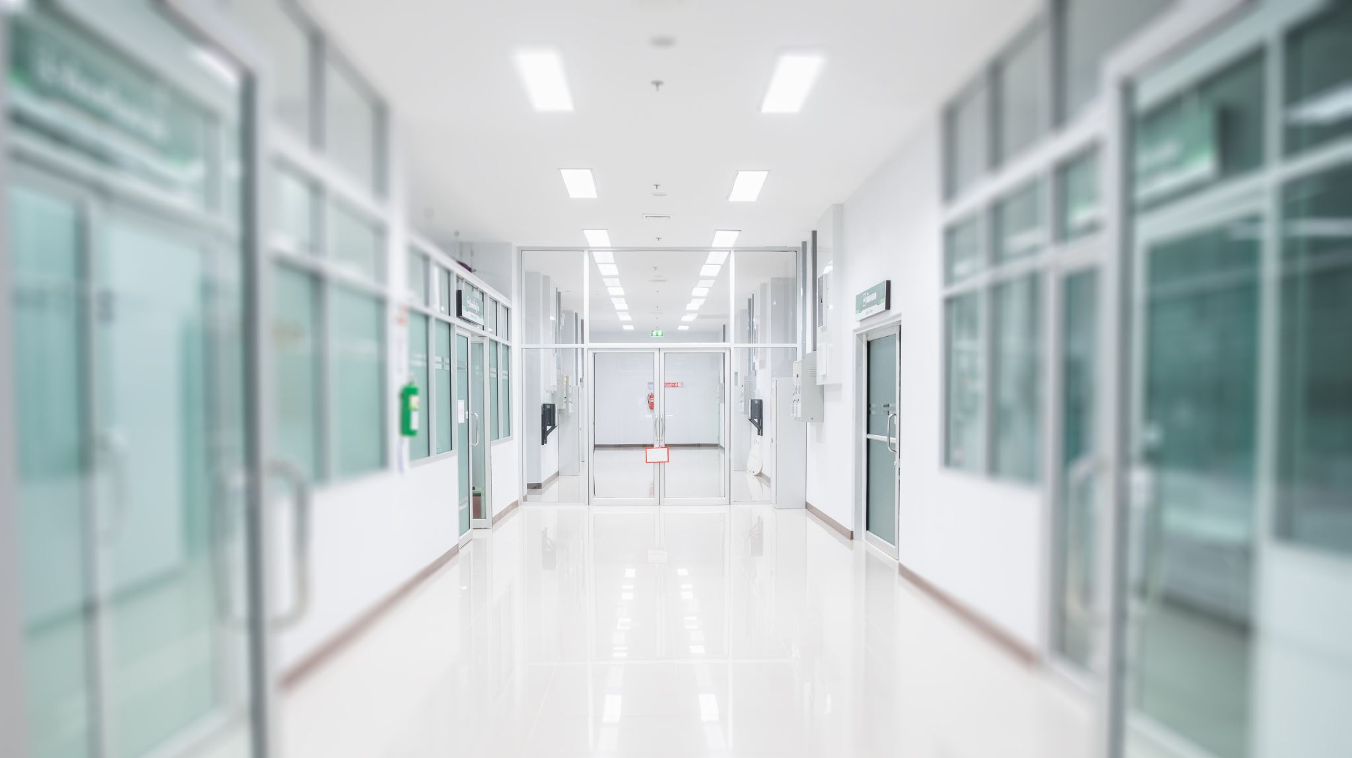
Acknowledgement
GHS Council
ODG
Divisional & Regional Directors
Korle Bu Teaching Hospital
School of Hygiene
MoSWR
Ghana Water Company
All Development Partners

