Slide 1
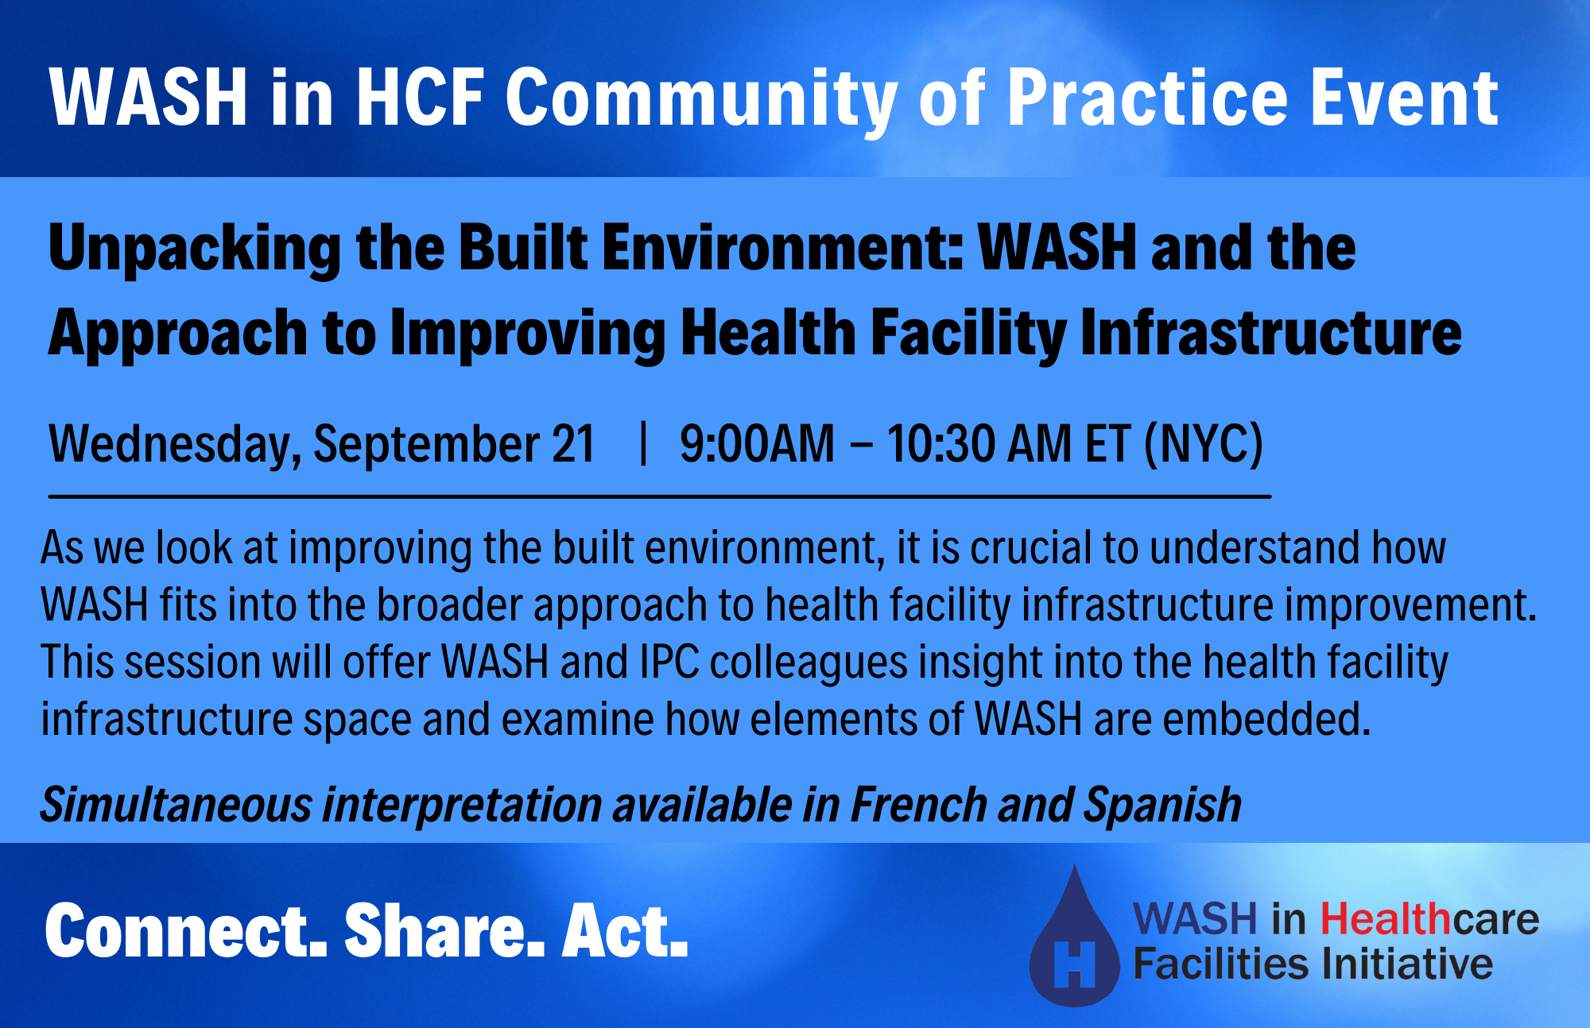

Slide 2


Interpretation
INTERPRETATION: Select English, French, or Spanish. Then, click “Mute Original Audio.”
INTERPRÉTATION: Sélectionnez Anglais, Français ou Espagnol. Puis, cliquez sur "Couper le son d’origine."
INTERPRETACIÓN: Seleccione Inglés, Francés o Español. Luego, haga clic en “Silenciar audio original."

Slide 3




This Community of Practice is an action-oriented learning platform that brings together the WASH and health communities to focus on policy, evidence, and practice in WASH in HCF.
CONNECT partners
SHARE experiences
Encourage groups to ACT
Notes:
This webinar is a part of the WASH in HCF initiative.
Our goal is to expand the conversation, connecting the expertise and experience of our partners and colleagues to the members of the WASH and health community who have expressed interest in “moving to action” in WASH in HCF. We welcome all to participate these webinars, whether you’re a seasoned expert on WASH in HCF, or someone for whom this topic is brand new.
REMINDER WE HAVE SIMULTANEOUS INTERPRETATION

Slide 4
WASH in HCF Community of Practice Basic Principles
WASH is a fundamental prerequisite for quality care within a healthcare facility and there cannot be effective infection prevention and control without adequate WASH.
WASH in healthcare facilities is a solvable issue and will require multiple systems, sectors, and stakeholders to work together to see sustainable improvements.
The Community of Practice is open to all who seek to learn and share about WASH in healthcare facilities. We welcome all and respect the diversity of perspectives who participate.

Slide 5

Success Corner
WEFTA’s Mpapa Health Center WASH Program
In collaboration with Sanitation and Water Action (SAWA), a Tanzania-based WASH NGO, Water Engineers for the Americas (WEFTA) is working to improve WASH resources for the Mpapa Health Center, a Catholic-run healthcare facility in the Mbinga Diocese of Tanzania.
The first phases of improvement took place between May-August 2022 and included:
  Water source improvements
  Transmission line construction
  Watershed protection.

Slide 6
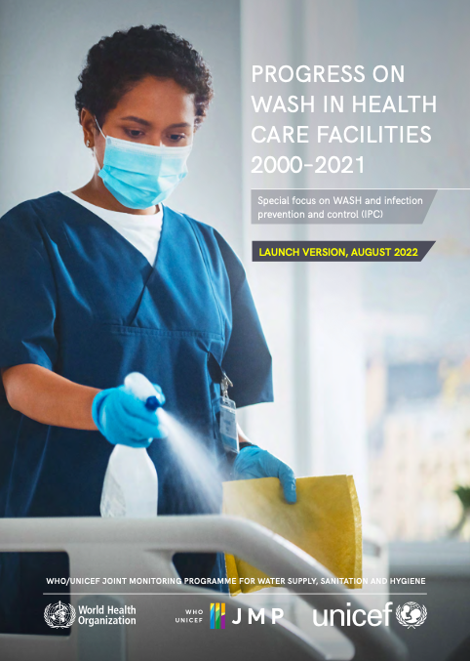
NEW JMP Report on WASH in HCF
The report provides the first estimates on hand hygiene:
  Half of health care facilities do not have basic hygiene service
  One in five health care facilities do not have basic water services
  10% of health care facilities have no sanitation services
Globally, 3.85 billion people lacked a basic hygiene service at their health care facility, 1.7 billion people lacked a basic water service at their health care facility, and 780 million people had no sanitation service at their health care facility.

Slide 7
PULSE CHECK:
This session is our final event of our first year the WASH in Healthcare Facilities
Community of Practice
We need your feedback to make Year 2 even better!

Slide 8

Healthcare Architect: Luis Vedor
Table of contents
HEALTHCARE INFRASTRUCTURE & WASH in HCF
  Healthcare Infrastructure definition
  WASH in HCF definition
2. HOSPITAL PLANNING & STRATEGIC PLANNING
  Strategic Planning
  Hospital Planning
3. HOSPITAL BUILD ENVIRONMENT
  Definition
  Requirements & considerations
CONSIDERATIONS
1 | Table of contents - general

Slide 9
Healthcare Architect: Luis Vedor
1 – Healthcare Infrastructure: Definition
DEFINITION: HEALTHCARE INFRASTRUCTURE
Is a healthcare institution providing patient treatment with specialized health science, auxiliary healthcare staff, and medical equipment. ("Hospitals". World Health Organization. Retrieved 24 January 2018)
Institution that is built, staffed, and equipped for the diagnosis of diseases, for the treatment (medical and surgical) of the sick and injured people, and for their housing during this process. (Hospital | Definition, History, Types, Services| Britannica).
KEY WORDS:
Prevention, diagnosis, treatment;
Health systems being instrumental for care, coordination and integration;
Healthcare Infrastructure (HCI) provides medical, surgical, or psychiatric care and treatment for the sick or the injured;
HCI provide a setting for education (doctors, nurses and other healthcare professionals) and for clinical research;
Different levels of care (primary, secondary, tertiary, quaternary, specialized, research, etc)
2 | Healthcare Infrastructure - definition

Slide 10
Healthcare Architect: Luis Vedor
1 – WASH in HCF: Definition
DEFINITION: WASH in HCF
It refers to the provision of water, sanitation, healthcare waste management, hygiene and environmental cleaning infrastructure, and services across all parts of a healthcare facility. (Water Sanitation and Health (who.int).
Infrastructure that supports water, sanitation, hygiene, healthcare waste management practices and helps prevent the spread of diseases within the healthcare facility and to the surrounding community. (WASH in Healthcare Facilities | CDC).
KEY WORDS:
Healthcare facility
Improving health system strengthening and health security
Different levels of healthcare facilities have different WASH needs
Without appropriate WASH infrastructure & services, patients, healthcare staff, communities are at increased risk of disease.
3 | WASH in HCF - definition

Slide 11
Healthcare Architect: Luis Vedor
Table of contents
HEALTHCARE INFRASTRUCTURE & WASH in HCF
  Healthcare Infrastructure definition
  WASH in HCF definition
2. HOSPITAL PLANNING & STRATEGIC PLANNING
  Strategic Planning
  Hospital Planning
3. HOSPITAL BUILD ENVIRONMENT
  Definition
  Requirements & considerations
CONSIDERATIONS
4 | Table of contents - 2

Slide 12
Healthcare Architect: Luis Vedor
2 - Hospital Planning & Strategic Planning
STRATEGIC PLANNING
STRATEGIC
THINKING
STRATEGIC
PLANNING
CONTINUOUS STRATEGIC
- Data analysis
- External guidance
- Creating doubts
- Generating ideas
- Analysis of situation
- Strategy formulation
- Implementation plan
- Strategic management
- Strategic evaluation
- Strategic redefinition
STRATEGIC PLANNING
HIGH LEVEL OF EFFICIENCY
AT LOWEST POSSIBLE COST
HOSPITAL PLANNING
HEALTHCARE SECTOR requires proper strategic knowledge, to make the most of the resources, achieving a high level of efficiency.
5 | Hospital Planning & Strategic Planning

Slide 13
2 - Hospital Planning: Definition
HOSPITAL PLANNING DEFINITION
Planning is the forecasting and organizing the activities required to achieve the desired goals.
Hospital buildings differs from other building types cause of the complexity of its function.
To be successful, a Hospital requires preliminary studies and proper planning to makes the process easy to manage.
HOSPITAL PLANNING
PLANNING PROCESS aims to ensure that health services align and adapt to changing patterns of health needs while making the most effective use of available resources.
6 | Hospital Planning - definition

Slide 14
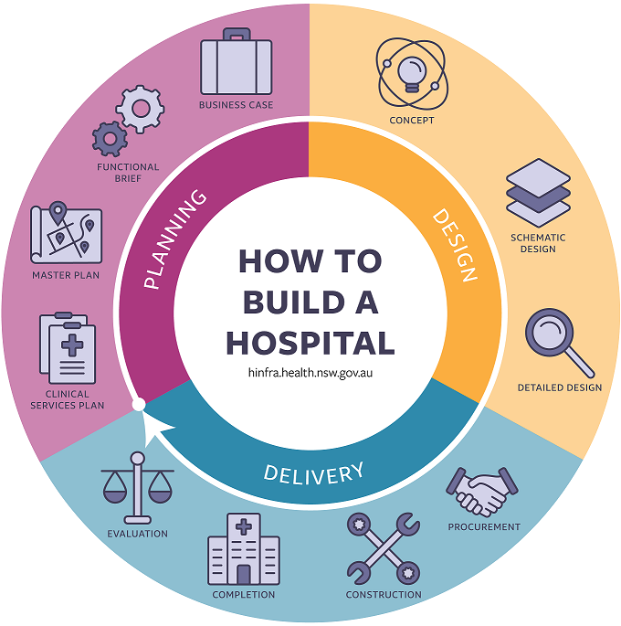
Healthcare Architect: Luis Vedor
2 - Hospital Planning: Overview
ASSESSMENT
FEASIBILITY STUDY
  REVIEW OF
  EXISTING
  FACILITIES
  NEED FOR
  ASSESSMENT
USER BRIEF
  (& its adequacy)
DETAILED PROJECT
TENDER
  ASSES FOR
  NEW FACILITIES AS PER NEED
AWARD OF CONTRACT
CONSTRUCTION & EQUIP
COMMISSIONING
7 | Hospital Planning - overview

Slide 15

Healthcare Architect: Luis Vedor
2 - Hospital Planning: Overview cont.
ASSESSMENT
PROJECT BRIEF
The role of the healthcare planning process is to produce the design brief to guide the outputs need to be achieved.
FEASIBILITY STUDY
HOSPITAL PLANNING
PROJECT PLANNING & IMPLEMENTATION
Proposal outline
Detailed project proposal
Approval of project
Resource allocation ($)
Land acquisition
Employer require. (User Brief)
Tender & award of contract
Construction planning
STRATEGIC PLANNING FOR THE FACILITY
COMMISSIONING
Construction project is aligned with strategies
Key stakeholders are involved
Builds a compelling case when going for approval
SHAKE DOWN PERIOD & EVALUATION
8 | Hospital Planning – overview cont.

Slide 16
Healthcare Architect: Luis Vedor
2 - Hospital Planning: Requirements
TEAM
  The Owner provide the representatives from all stakeholders in the health care organization as well the consultants to participate in the development of the User Brief. Multi-disciplinary team.
FUNCTIONAL PROGRAM
  Owner’s intent for the project. Basis of design. Includes type & sizes of departments, patient population, required staff, clinical & non clinical areas.
  List organized by department showing each room in the proposed project, indicating size by gross floor area
SPACE PROGRAM
HOSPITAL USER BRIEF
  To ensure the design & construction provides safety delivery of care, a safety risk assessment should be developed & includes the ICRA, PHAMA, etc.
SAFETY RISK ASSESSMENT
  Key elements of the physical environment and the functional/ operational requirements. All that influences patient outcome, satisfaction, dignity, privacy, confidentiality & safety as well as facility operations. Building infrastructure & systems, security, wayfinding, etc.
ENVIRONMENTAL CARE & FACILITY FUNCTION PROGRAM
  FF&E list with all items necessary to operate the facility & assist on acquisition, installation, & relocation. Maintenance requirements (how the facility will be operated and by whom) and training goals and criteria. Includes aspects of the commissioning of the equipment and systems etc.
EQUIPMENT
Operation & Maintenance
COMMISSIONING & HAND OVER
  Systems to be commissioned, CX activities, record of construction drawings (blue prints) , equipment manuals/ Evaluation of systems in operation.
9 | Hospital Planning – requirements

Slide 17
Healthcare Architect: Luis Vedor
Table of contents
HEALTHCARE INFRASTRUCTURE & WASH in HCF
  Healthcare Infrastructure definition
  WASH in HCF definition
  Considerations
2. HOSPITAL PLANNING & STRATEGIC PLANNING
  Strategic Planning
  Hospital Planning
3. HOSPITAL BUILD ENVIRONMENT
  Definition
  Requirements & considerations
CONSIDERATIONS
10 | Table of contents - 3

Slide 18
Healthcare Architect: Luis Vedor
3 – Built Environment: Definition
DEFINITION: BUILT ENVIRONMENT
Refers to the human-made surroundings providing the setting for human activity, ranging in scale from buildings and green spaces to neighbourhoods and cities that can often include their supporting infrastructure (water supply, energy networks).
Buildings are one of the most clear elements of the built environment because of their physical presence and purpose to protect against the natural or "un-built" environment. (Built environment – Wikipedia).
KEY WORDS:
Designing of a physical space
Connection between physical space and social consequences
Material spatial and cultural product of human labour
Protect against the natural / “un-built’’
11 | Buint Environment - definition

Slide 19
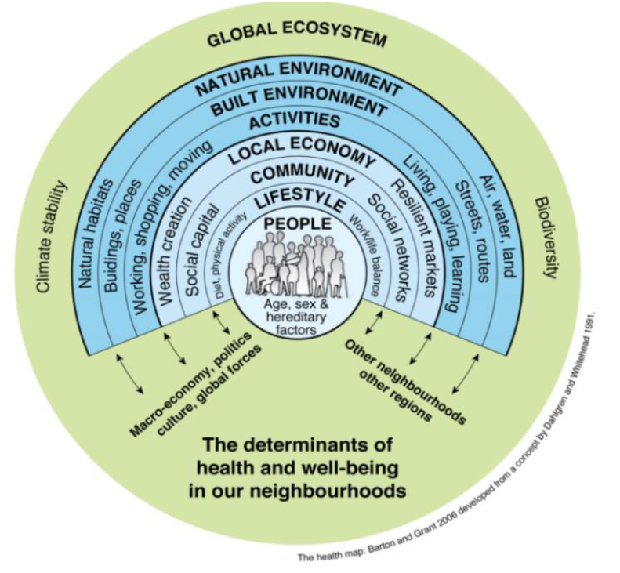
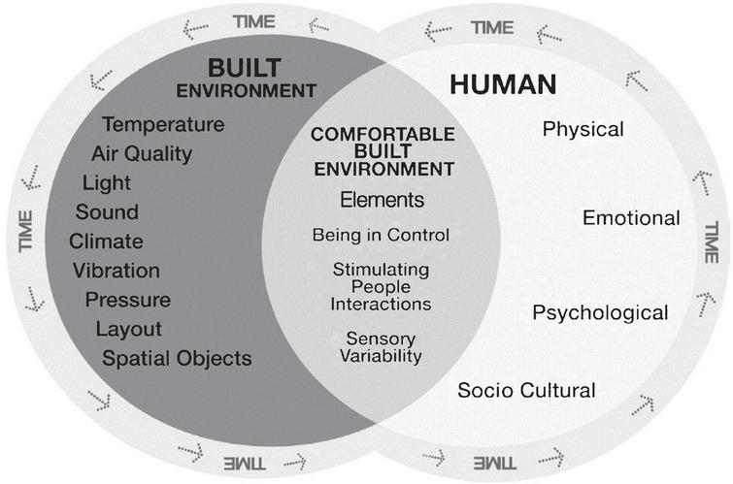
Healthcare Architect: Luis Vedor
3 – Hospital Built Environment
Broader vision:
Global ecosystem & the community on the master planning
Health & Wellbeing
Wider determinants of health
Sustainable environment
Modelling the relationship between the environment and human experiences - IOS Press
12 | Built Environment – broader vision

Slide 20
Healthcare Architect: Luis Vedor
3 – Hospital Built Environment
BUILDING AS A CLIMATE MODIFIER : identity to protect us from the outside environment and provide a safety and enhanced environment.
ENVIRONMENTAL CARE REQUIREMENTS
SAFETY RISK ASSESSMENT
Multidisciplinary, documented assessment used to identify hazards and risks and mitigate underlying conditions of the built environment that may contribute to adverse safety events.
Key elements of the physical environment:
- Functional and space requirements
- Circulation & flows (patient, visitors, staff, clean, dirty)
- Building infrastructure systems
- Wayfinding (interior & exterior)
- Fire protection requirements
- Privacy and confidentiality
- Security inc. back up systems
- Acoustic design (noise levels requirements)
- Indoor environmental quality (air quality standards)
- Equipment (medical & non-medical, movable, fixed)
- Communications & ITC
- Infection control risk assessment
- Patient handling and movement assessment
- Fall prevention assessment
- Medication safety assessment
- Behavioural and mental health risk assessment
- Patient immobility assessment
- Security risk assessment inc. emergency preparedness
13 | Built Environment – in Healthcare Infrastructure

Slide 21
Healthcare Architect: Luis Vedor
3 – Hospital Built Environment
BUILDING AS A CLIMATE MODIFIER
SUSTAINABLE DESIGN
HEALING ENVIRONMENT
Design can improve patient outcomes, staff morale and visitors experience.
Building location, orientation, & layout impact on effectiveness and increase efficiency.
Multisensory setting that engages the physical, emotional, spiritual, and social dimensions of the individual for the purpose of restoring and maintaining health and well-being.
OPERATION & MAINTENANCE
Care and minor maintenance of equipment associated with the daily operations and normal repairs, replacement of parts (preventative/ corrective, etc)
Inspecting, cleaning, servicing, preserving, lubricating, and adjusting, as required.
14 | Built Environment – in Healthcare Infrastructure

Slide 22
Healthcare Architect: Luis Vedor
3 – Hospital Built Environment
BUILDING AS A CLIMATE MODIFIER
DISASTER PREPAREDNESS
CLIMATE RESILIENSE
Adequate and reliable infrastructure, technologies and supplies form the backbone of the hospital.
Key infrastructure (such as well-planned spaces, water and energy, telecommunications) must support daily functioning, and be designed with redundancy to ensure continued safe and effective operation, even during a disaster or crisis.
Capacity of health care facilities to protect and improve the health of their target communities.
Empower health care facilities to be environmentally sustainable, by optimizing the use of resources and minimizing the release of waste into the environment.
Climate resilient and environmentally sustainable health care facilities contribute to high quality of care and accessibility of services, and by helping reduce facility costs also ensure better affordability.
15 | Built Environment – in Healthcare Infrastructure

Slide 23
Healthcare Architect: Luis Vedor
Table of contents
HEALTHCARE INFRASTRUCTURE & WASH in HCF
  Healthcare Infrastructure definition
  WASH in HCF definition
  Considerations
2. HOSPITAL PLANNING & STRATEGIC PLANNING
  Strategic Planning
  Hospital Planning
3. HOSPITAL BUILD ENVIRONMENT
  Definition
  Requirements & considerations
CONSIDERATIONS
16 | Table of contents - 4

Slide 24
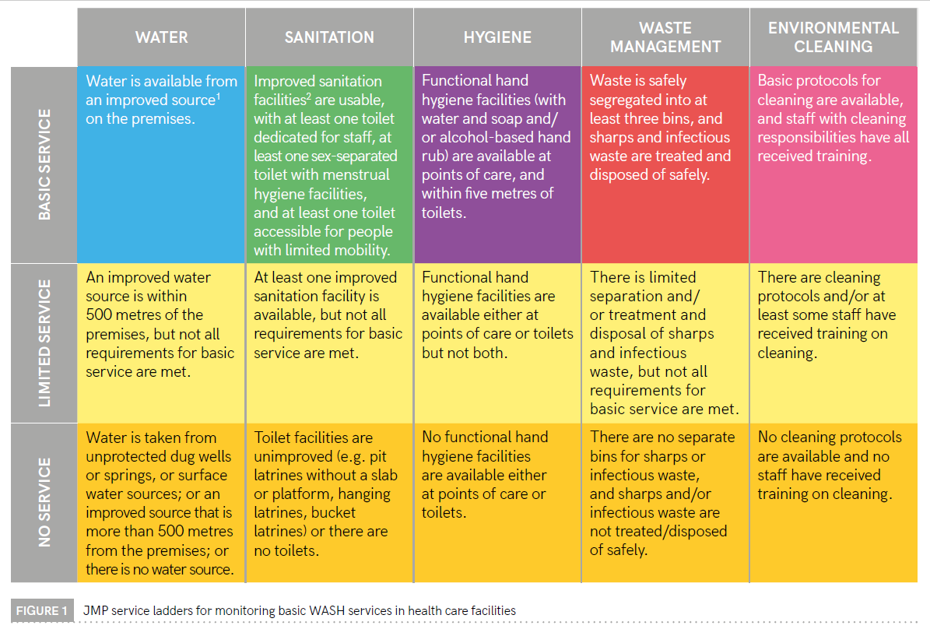
Healthcare Architect: Luis Vedor
4 – Considerations
HEALTHCARE SYSTEM
DIFFERENT LEVEL OF CARE
Primary
Secondary
Tertiary
Quaternary
DIFFERENT
TYPE OF HCF
Health centre
District Hospital
Provincial Hosp.
Specialized Hosp.
DIFFERENT
LEVEL OF WASH
Less complex
More complex
Joint Monitoring Programme for Water Supply, Sanitation and Hygiene (JMP)
WASH in Health Care Facilities – Global Baseline Report 2019 WHO & UNICEF/ JMP
17 | Considerations

Slide 25
Healthcare Architect: Luis Vedor
4 – Considerations
CONSIDERATION:
Healthcare sector requires proper strategic planning
Different levels of healthcare facilities also have different WASH needs
Need of assessments and feasibility studies
Multidisciplinary team to be involved during all phases of the project
Global built environmental and building built environmental
Safety Risk Assessment and Environmental requirements
Code compliance, approvals, standards and guidelines
HCF in a holistic approach including the community
Need of lessons learned, institutional memory
18 | Healthcare Infrastructure & WASH in HCF - considerations

Slide 26
Healthcare Architect: Luis Vedor
THANK YOU
FOR YOUR ATTENTION

Slide 27

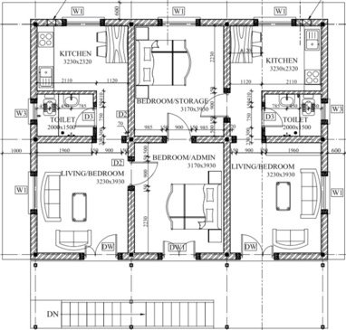
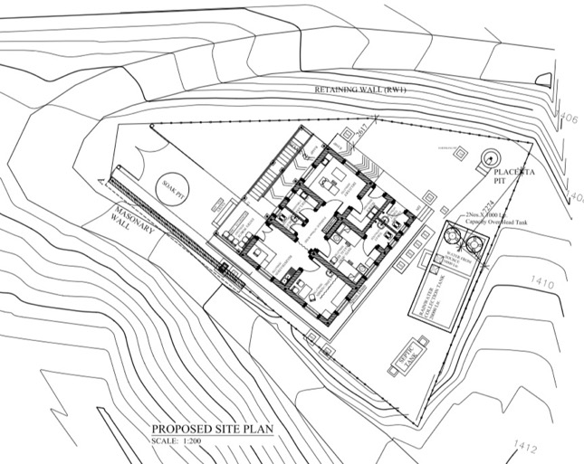
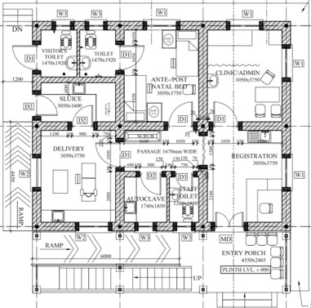
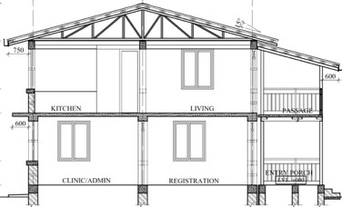


Kharpachowk Health Post Building
Kavre, Nepal
Ministry of Health
Rehabilitating Community Health and Protection Services
HCF: type D
Planning + implementation 2016 - 2019
Funding partner
Donor

Slide 28
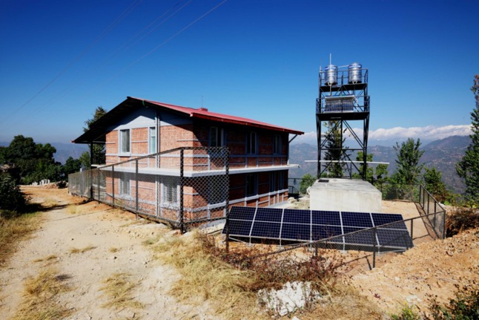
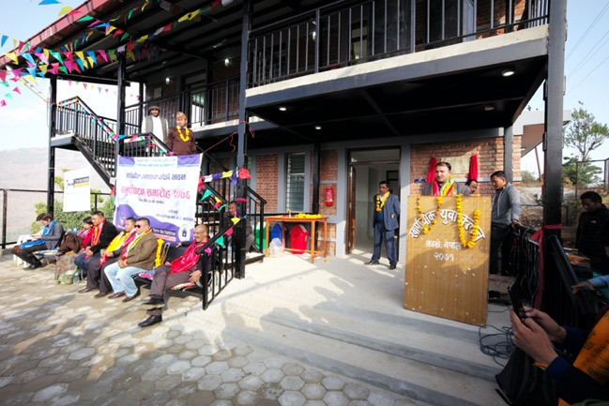
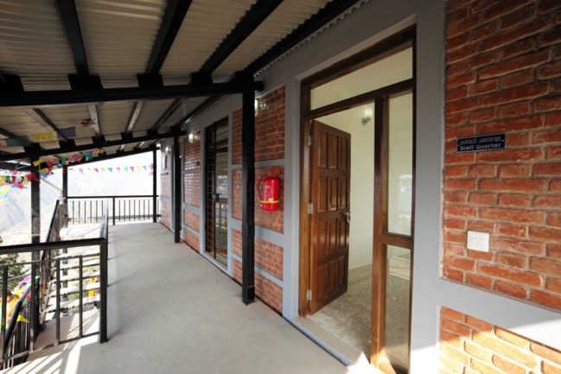
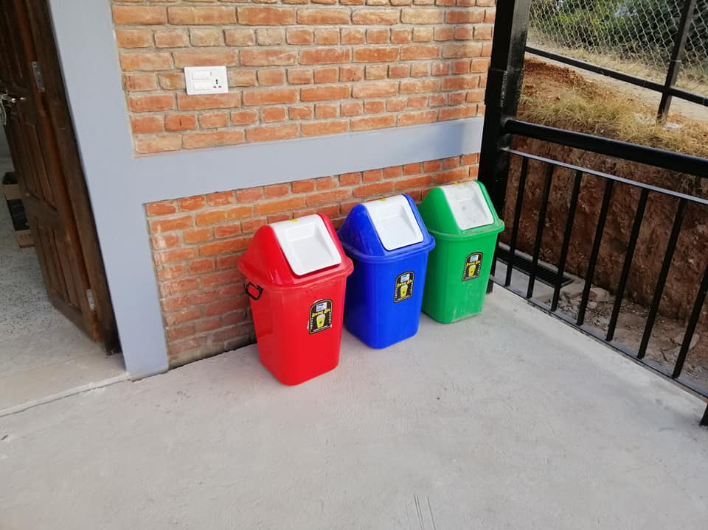
fencing, rain- + spring water, hot water, solar
common area, waiting, trainings, etc
staff quarter, assembly room, private area
garbage collection + disposal

Slide 29
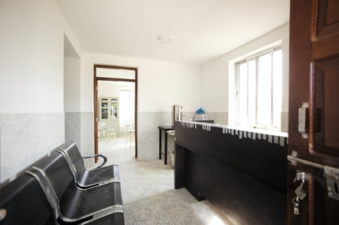
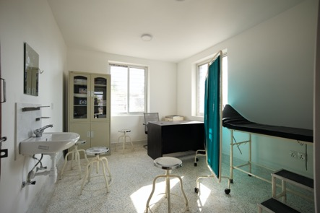
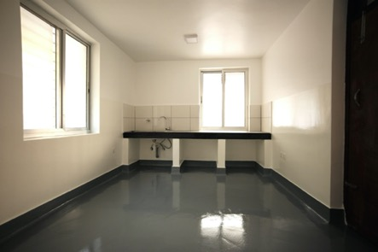
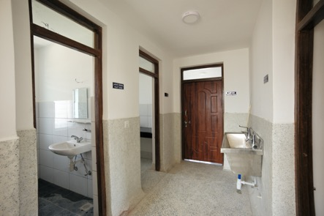
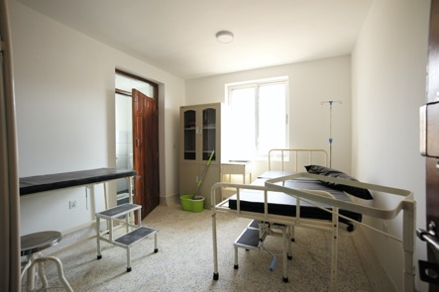
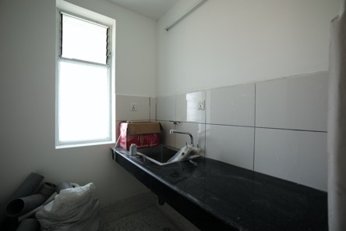
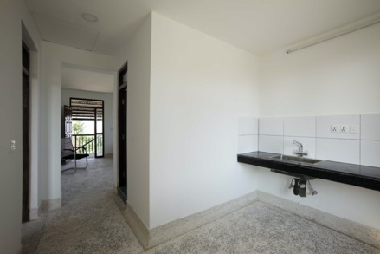
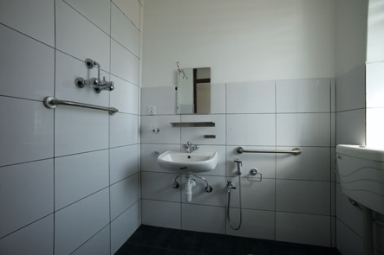
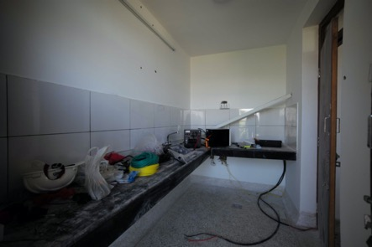

Slide 30
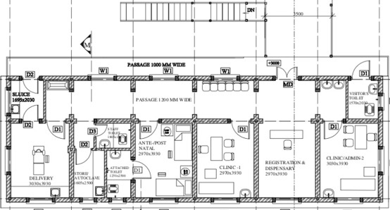
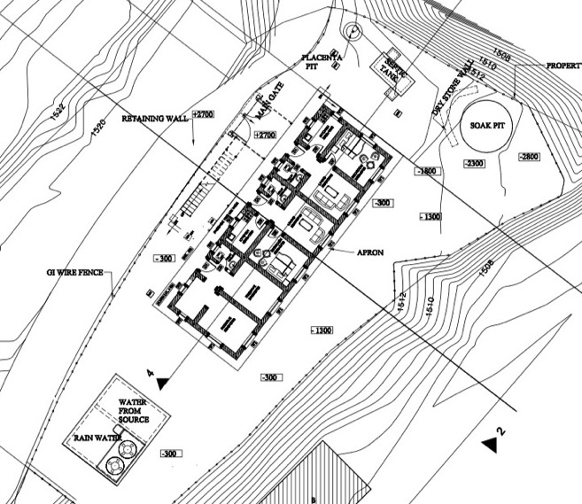
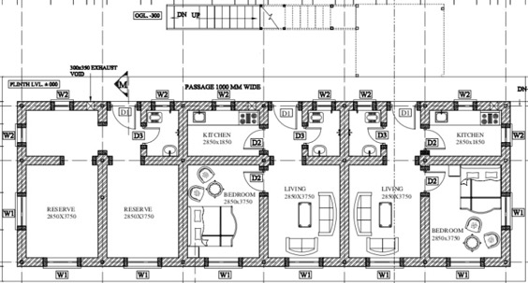
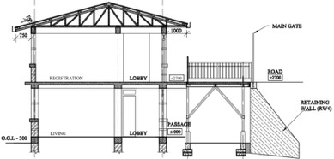
Majipheda, Health Post Building
Kavre, Nepal
Ministry of Health
Rehabilitating Community Health and Protection Services
HCF: type C
Planning + implementation 2016 - 2019
Funding partner
Donor

Slide 31
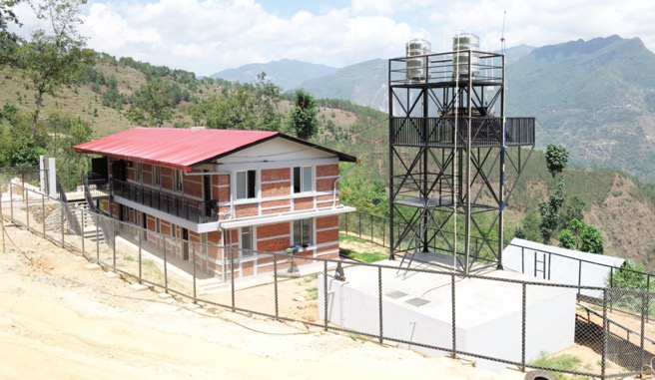
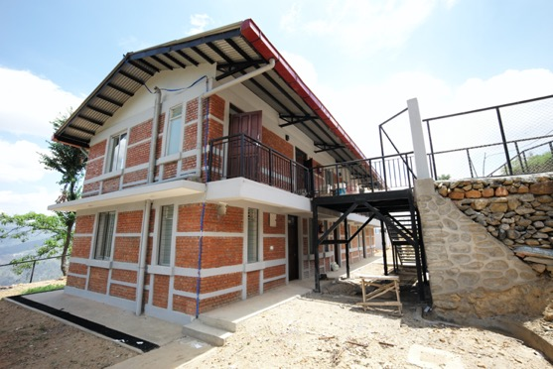
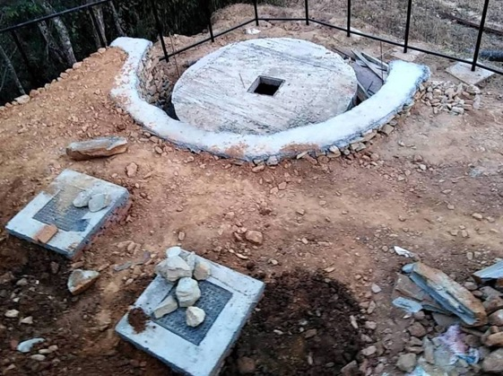
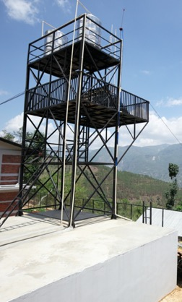

Slide 32
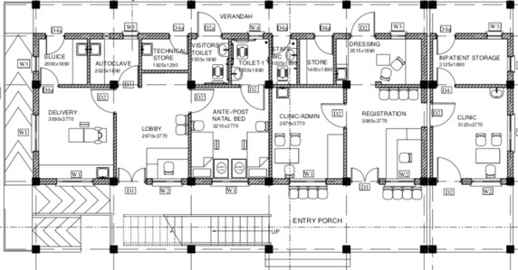
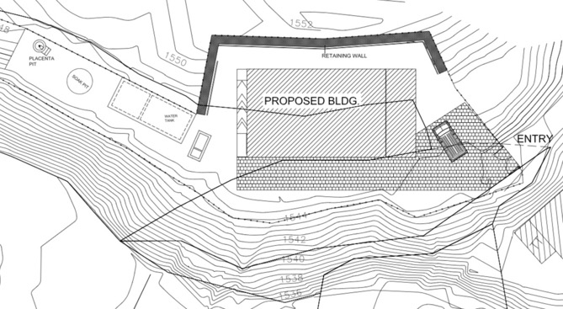
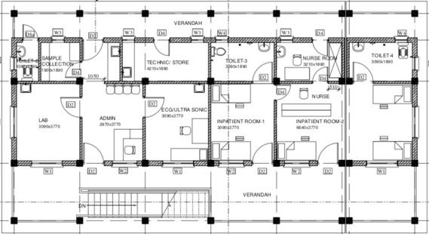
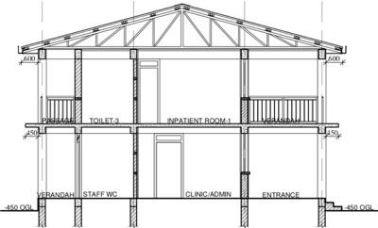
Kushadevi Health Post Building
Kavre, Nepal
Ministry of Health
Rehabilitating Community Health and Protection Services
HCF: type C++
Planning + implementation 2016 - 2019
Funding partner
Donor

Slide 33
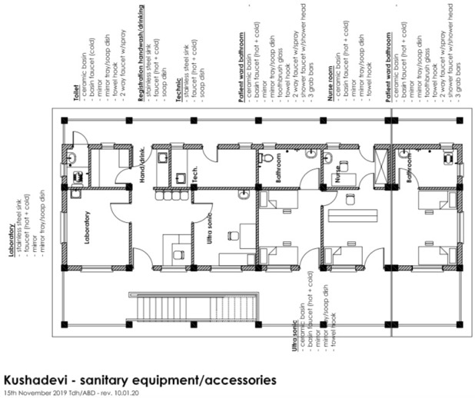
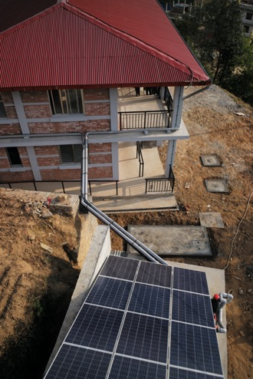
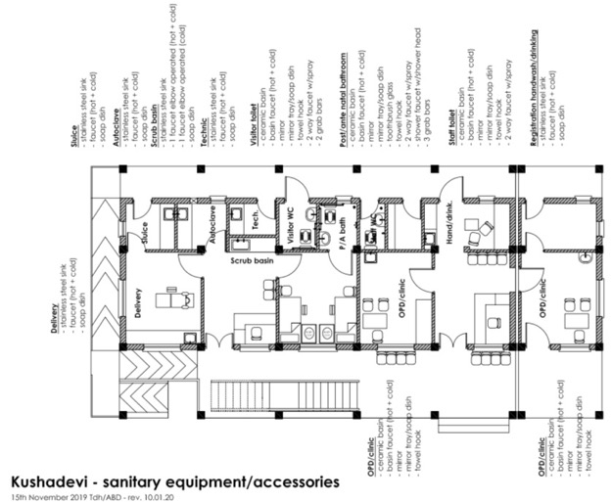
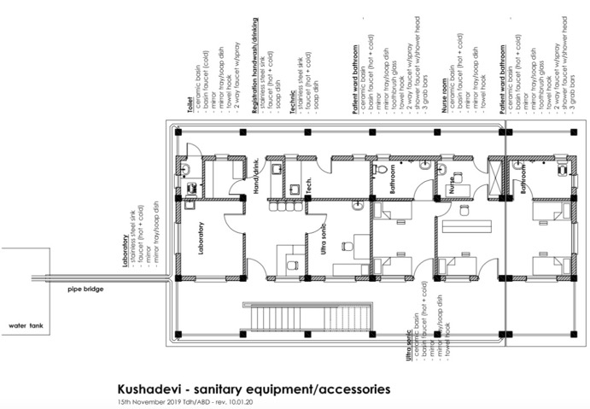
rain water harvesting

Slide 34
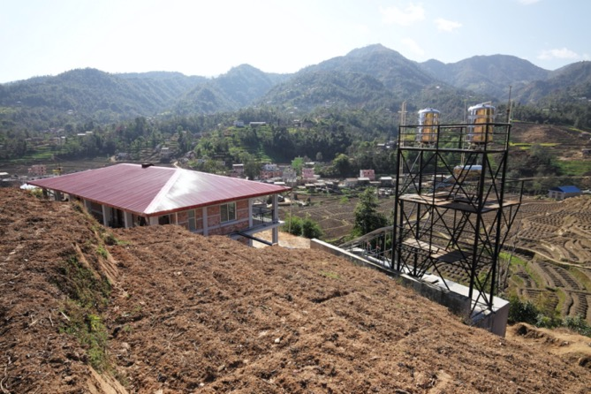
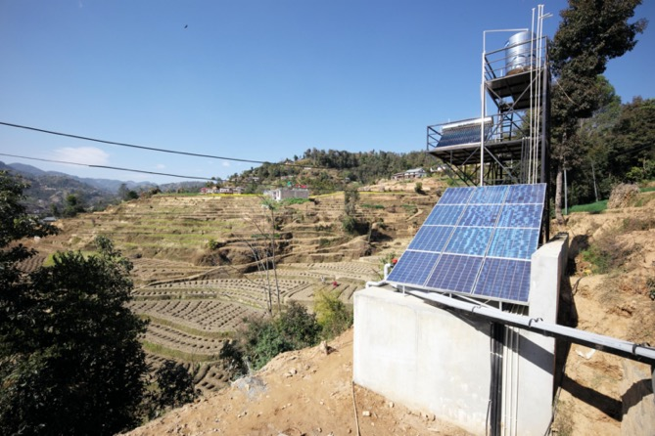
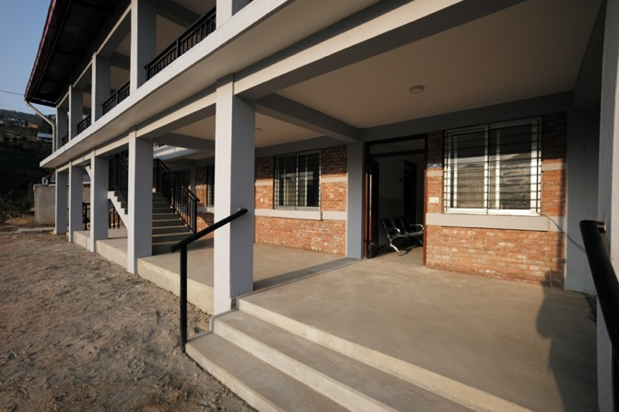
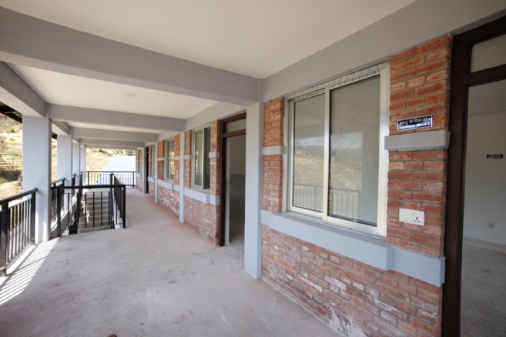
location
water tanks, hot water supply, solar back-up
admin, clinic, delivery, ante/post natal bedroom
lab, x.ray, ultra sonic, inpatient bedroom

Slide 35
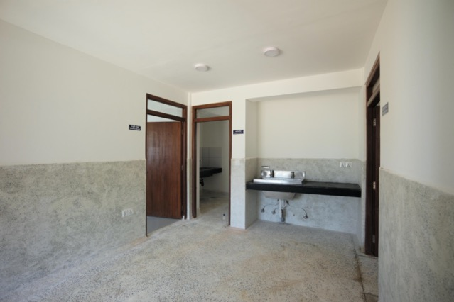
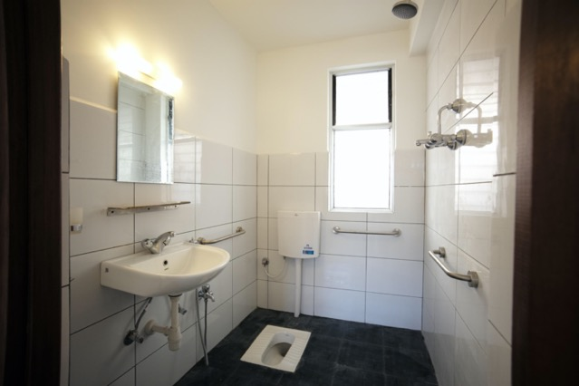
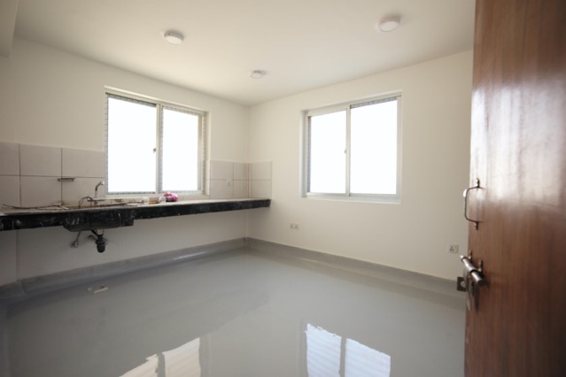
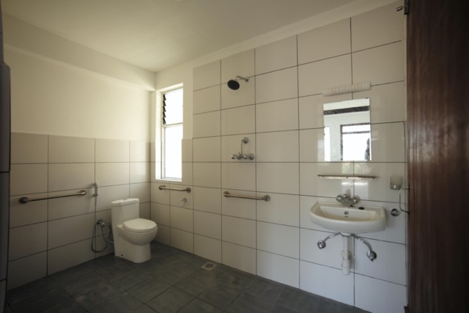
scrub basin
patient bathroom
delivery room
patient bathroom

Slide 36
Ways to Get Involved
Subscribe to the listserv to receive updates on events and resources (link in chat). Join live sessions and connect with others in the space.
Send us topic recommendations. We want to know what you want to learn about, what you feel needs more discussion.
Nominate a success story or share a resource you’ve developed. Every live session + newsletters will highlight successes, big and small, around WASH in HCF.

Slide 37

Upcoming Event : UNC Water and Health Conference
How Do You Measure Success for
WASH in Healthcare Facilities?
A Working Session on Indicators
Tuesday, October 25 | 8:30AM
Sunflower Room
We will have a similar session virtually for those
in November who cannot attend UNC.

Slide 38
