Slide 1
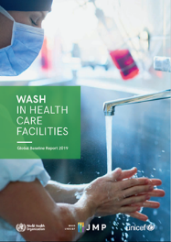
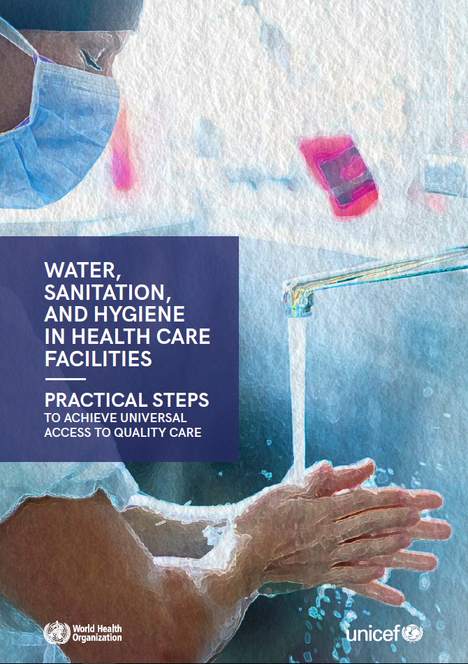
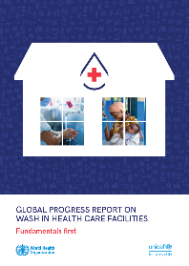
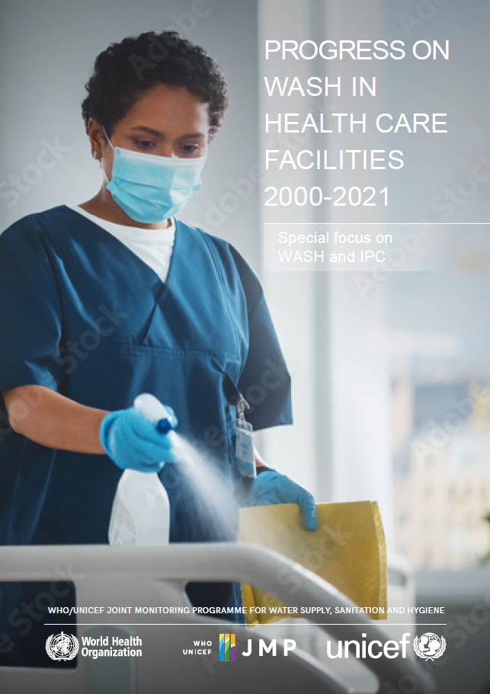
Progress on WASH in health care facilities 2000-2021:
Special focus on infection prevention and control
2019
2020
2022
7 February 2023
Rick Johnston (johnstonr@who.int) Tom Slaymaker (tslaymaker@unicef.org)
washdata.org

Slide 2
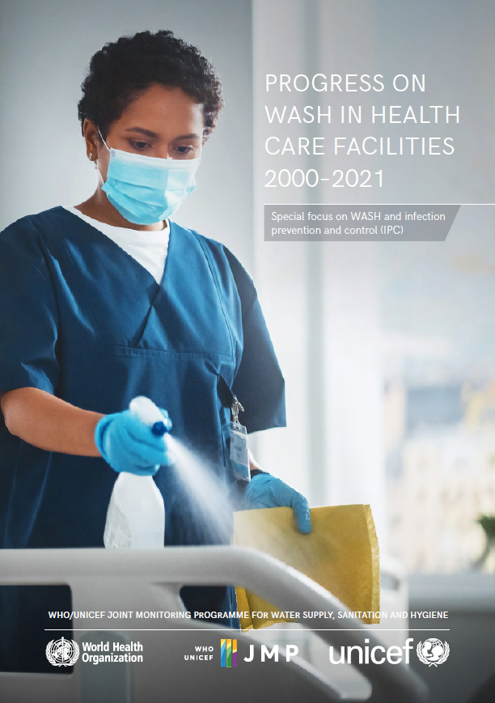
JMP 2022 progress report
Updates and supersedes data in 2020 “Fundamentals First” report
Full JMP report
  2020 report: one chapter from JMP, 20 figures
  2022 report: ~80 figures
Draws on data from 500+ national sources
  Facility surveys, MIS, Published reports
  Representing at least 933,000 health care facilities (up from 560,000 in the 2019 baseline)

Slide 3
SERVICE LEVEL | WATER | SANITATION | HYGIENE | WASTE MANAGEMENT | ENVIRONMENTAL CLEANING
BASIC SERVICE | Water is available from an improved source on the premises. | Improved sanitation facilities are usable, with at least one toilet dedicated for staff, at least one sex-separated toilet with menstrual hygiene facilities, and at least one toilet accessible for people with limited mobility. | Functional hand hygiene facilities (with water and soap and/or alcohol-based hand rub) are available at points of care, and within five metres of toilets. | Waste is safely segregated into at least three bins, and sharps and infectious waste are treated and disposed of safely. | Protocols for cleaning are available, and staff with cleaning responsibilities have all received training.
LIMITED SERVICE | An improved water source is available within 500 metres of the premises, but not all requirements for a basic service are met. | At least one improved sanitation facility is available, but not all requirements for a basic service are met. | Functional hand hygiene facilities are available either at points of care or toilets but not both. | There is limited separation and/or treatment and disposal of sharps and infectious waste, but not all requirements for a basic service are met. | There are cleaning protocols and/or at least some staff have received training on cleaning.
NO SERVICE | Water is taken from unprotected dug wells or springs, or surface water sources; or an improved source that is more than 500 metres from the premises; or there is no water source. | Toilet facilities are unimproved (e.g. pit latrines without a slab or platform, hanging latrines, bucket latrines) or there are no toilets. | No functional hand hygiene facilities are available either at points of care or toilets. | There are no separate bins for sharps or infectious waste, and sharps and/or infectious waste are not treated/disposed of. | No cleaning protocols are available, and no staff have received training on cleaning.

Slide 4
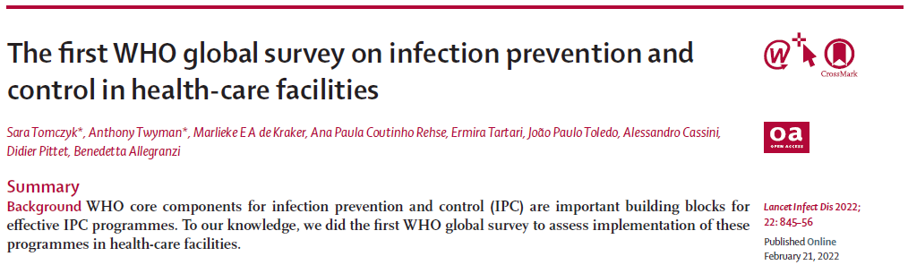
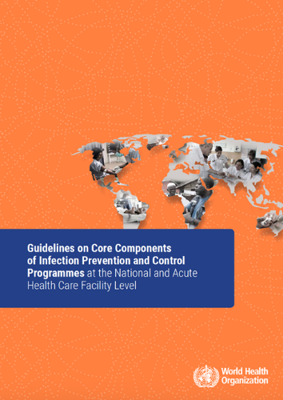
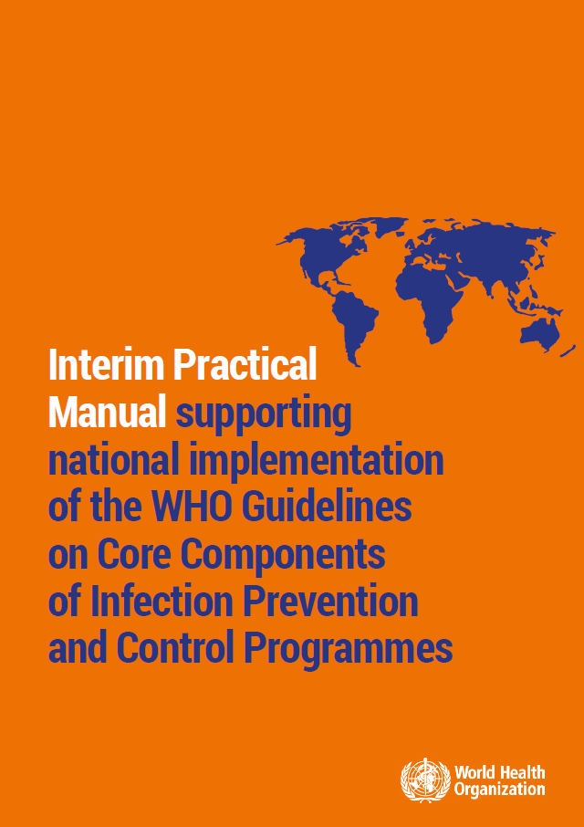
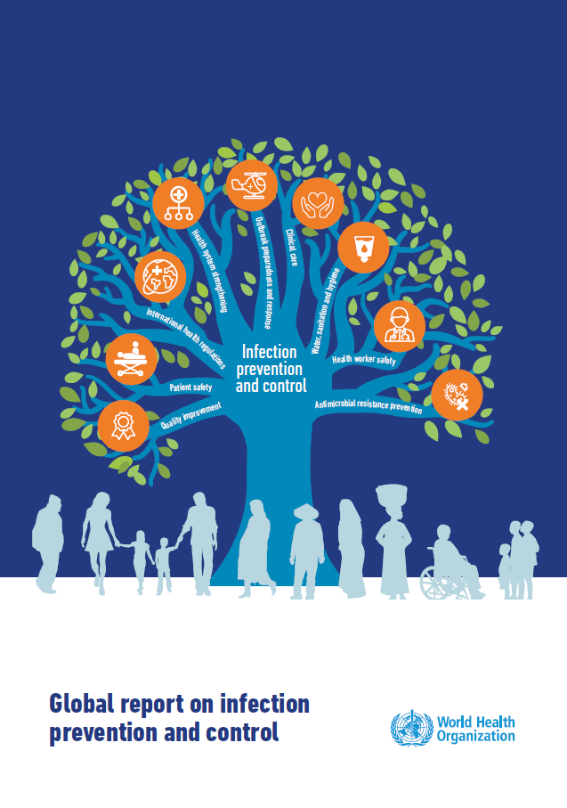
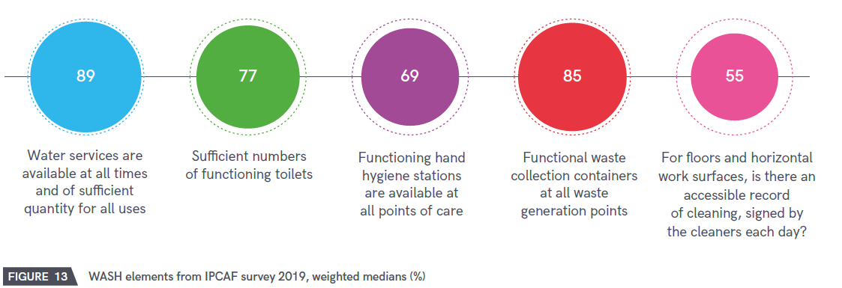
Special focus on WASH and infection prevention and control (IPC)
Explore linkages between WASH and IPC, why WASH is important for IPC
Direct WASH audiences towards IPC resources, frameworks

Slide 5
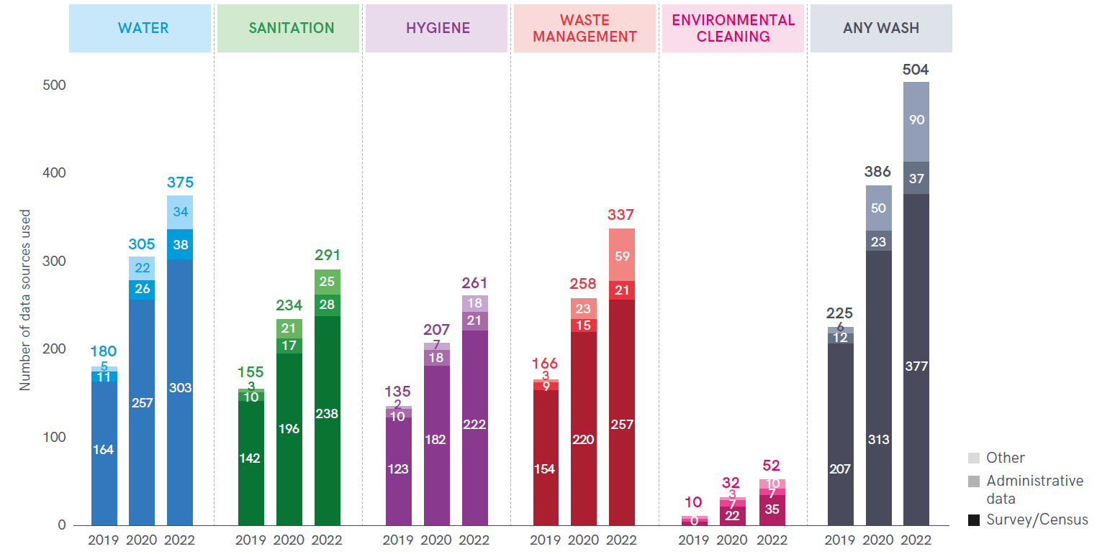
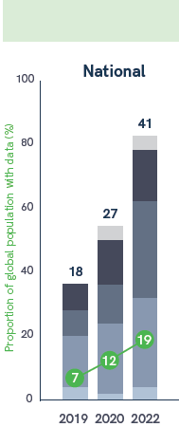
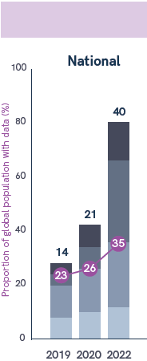
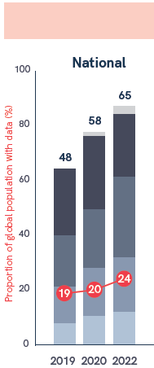
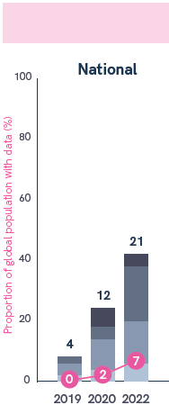
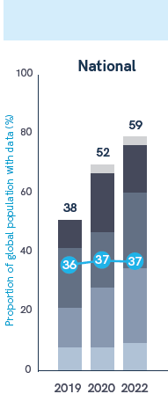
Numbers of countries
Proportion of population
30%

Slide 6
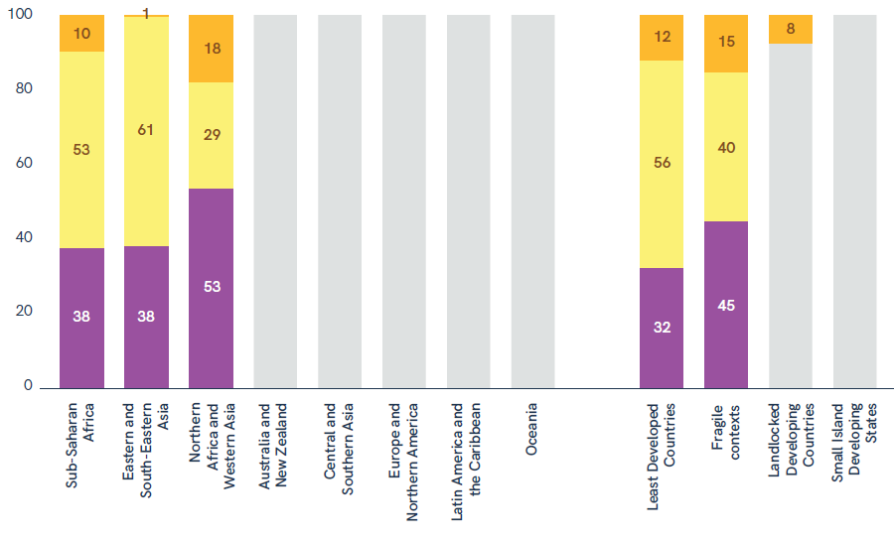
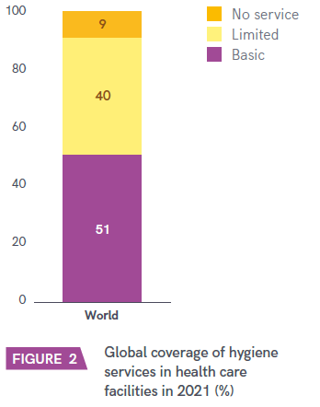
BASIC HYGIENE SERVICE
Functional hand hygiene facilities (with water and soap and/or alcohol-based hand rub) are available at points of care, and within five metres of toilets

Slide 7
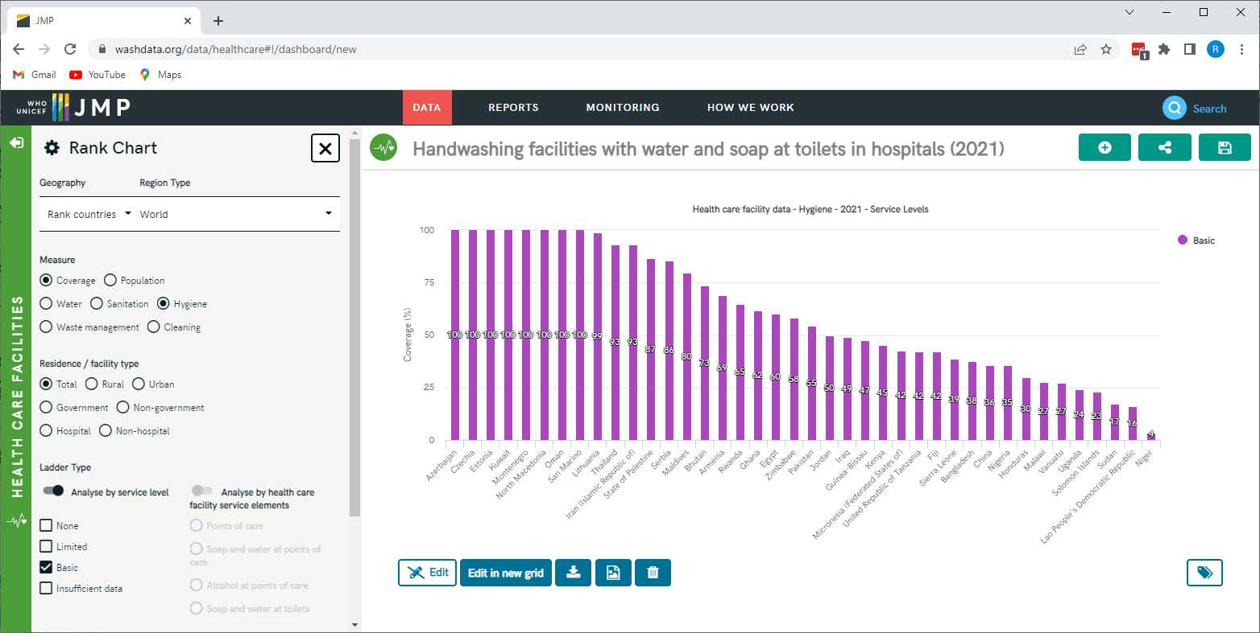
https://washdata.org/data/healthcare#!/
Basic hygiene services in health care facilities (2021)

Slide 8
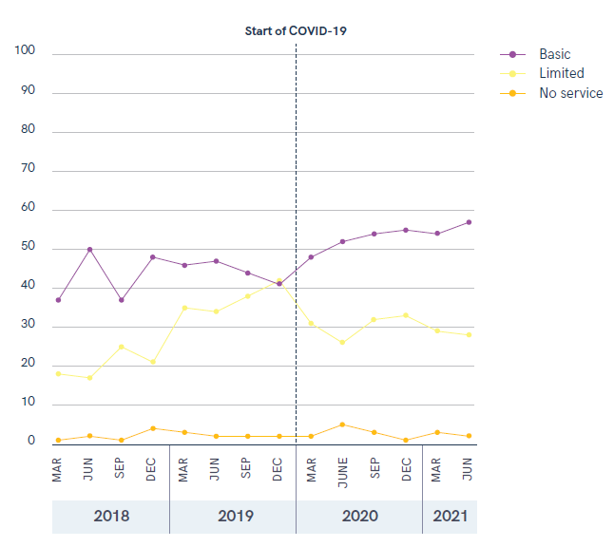
Ghana DHIMS
Routine MIS
COVID -> hygiene improvement interventions
Increase in basic
Decrease in limited

Slide 9
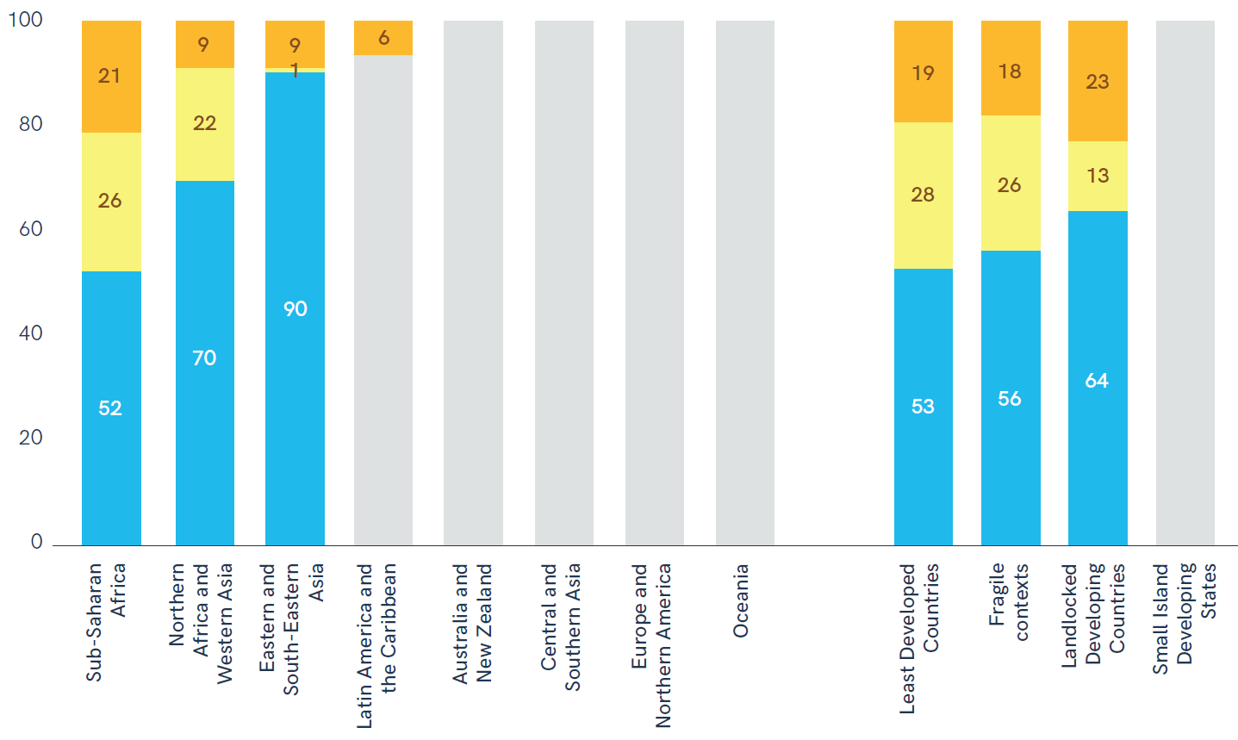
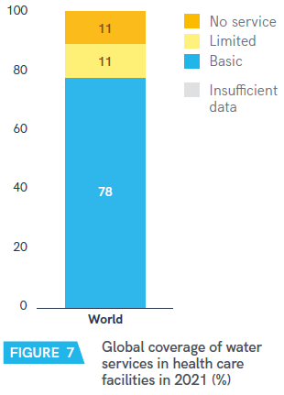
BASIC WATER SERVICE
Water is available from an improved source on the premises

Slide 10
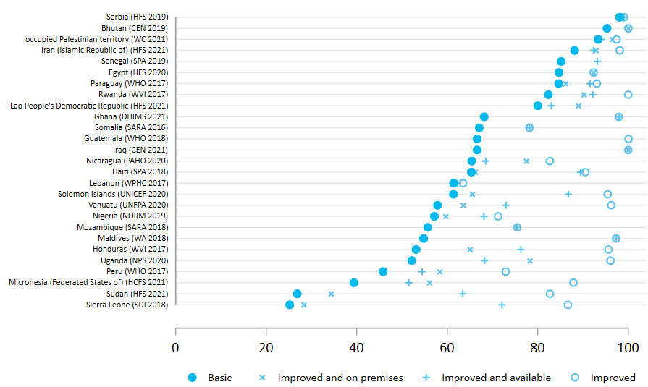
Many health care facilities have an improved water supply but lack a basic water service

Slide 11
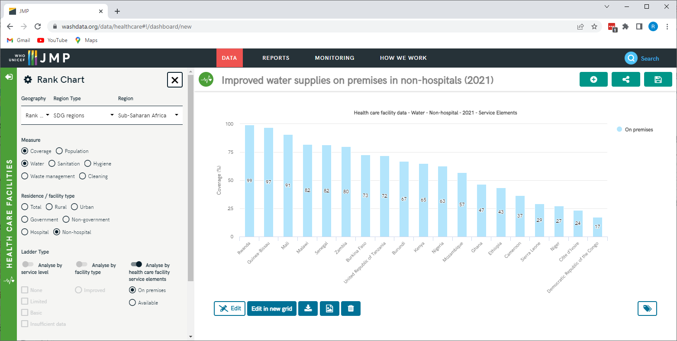

Slide 12
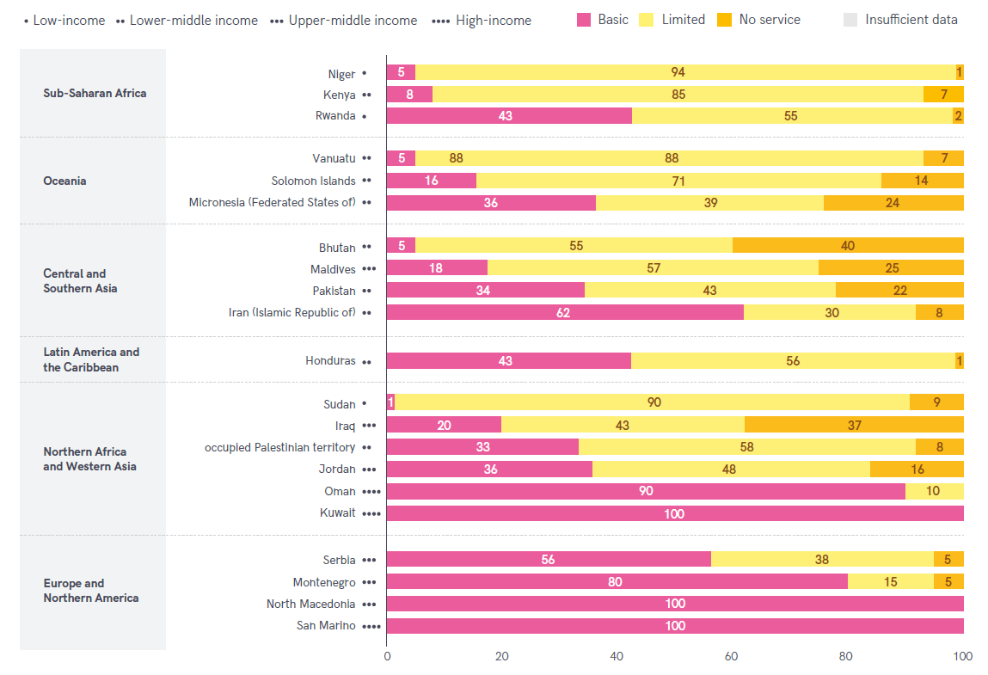
BASIC ENVIRONMENTAL CLEANING SERVICE
Basic protocols for cleaning are available, and staff with cleaning responsibilities have all received training

Slide 13
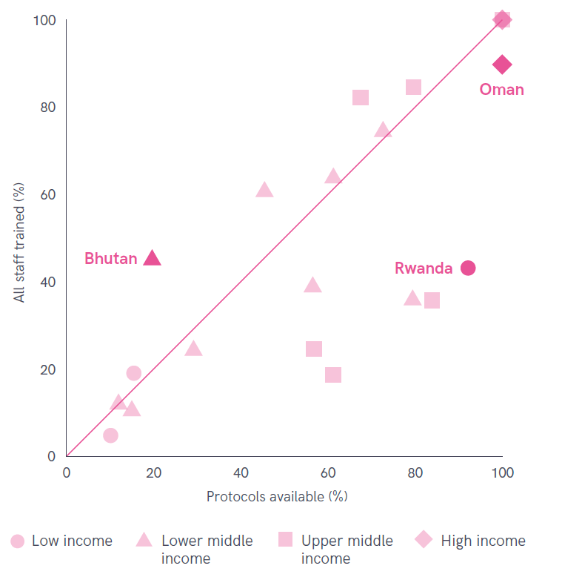
Limiting factor
Sometimes availability of protocols (e.g. Bhutan)
More often, incomplete training of staff responsible for cleaning (e.g. Rwanda)

Slide 14
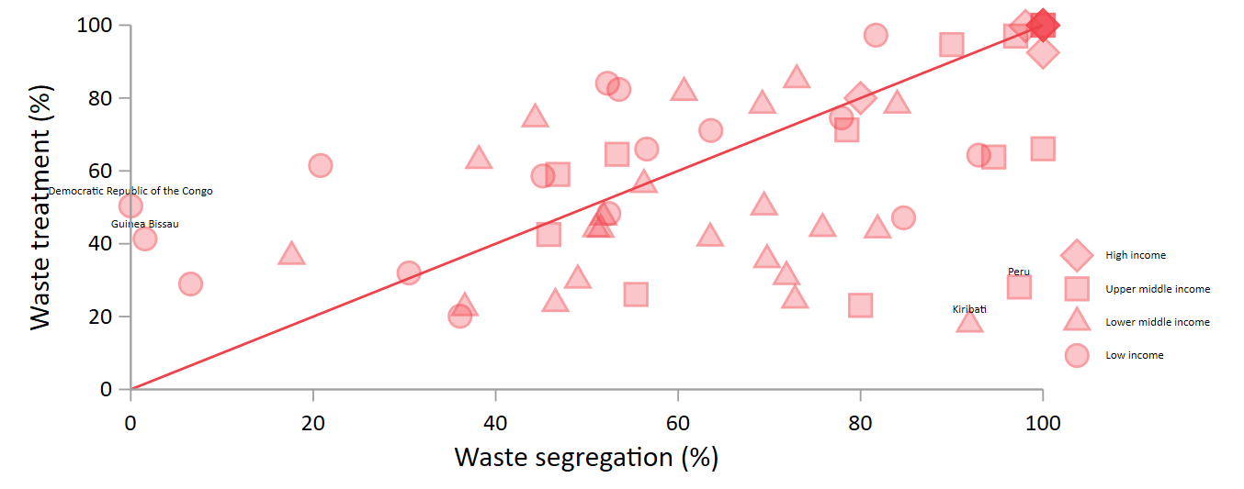
BASIC WASTE MANAGEMENT SERVICE
Waste is safely segregated into at least three bins, and sharps and infectious waste are treated and disposed of safely

Slide 15
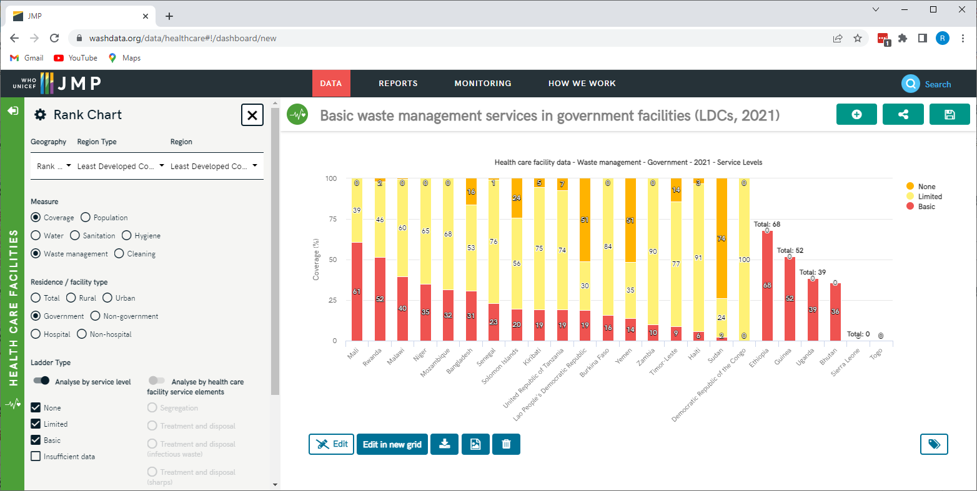

Slide 16
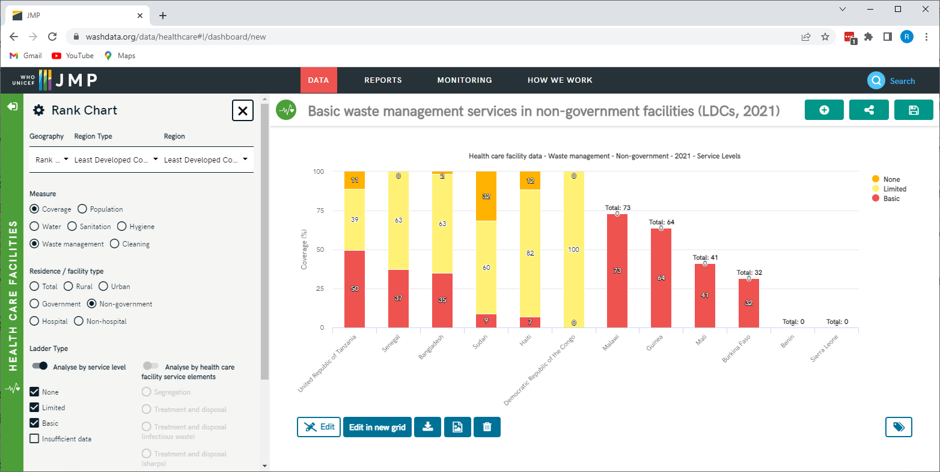

Slide 17
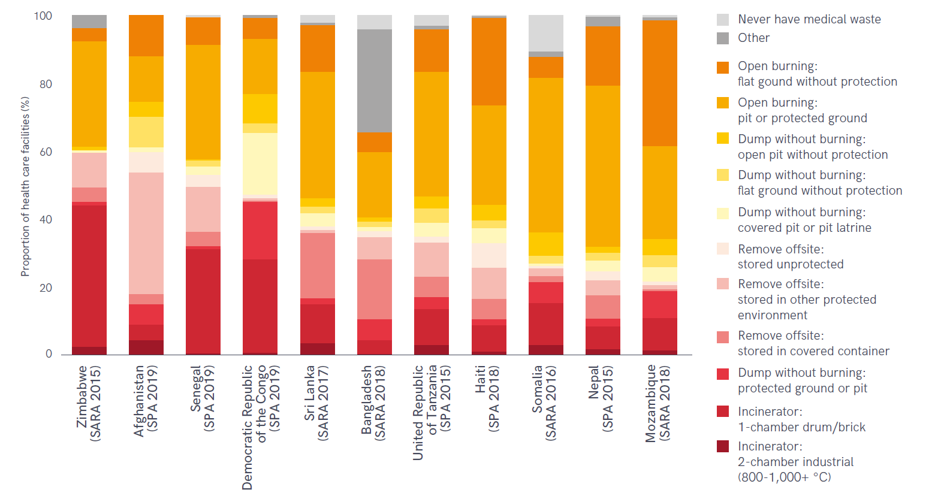

Slide 18
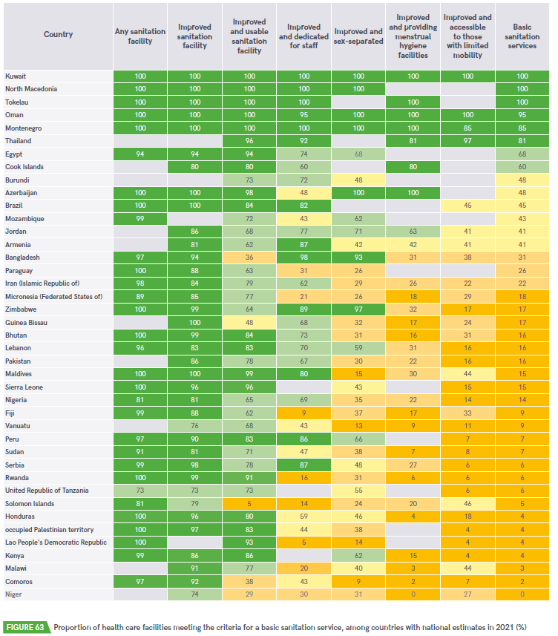
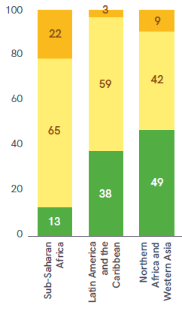
BASIC SANITATION SERVICE
Improved sanitation facilities are usable, with at least one toilet dedicated for staff, at least one sex-separated toilet with menstrual hygiene facilities, and at least one toilet accessible for people with limited mobility
41 countries
(up from 27)
3 SDG regions

Slide 19

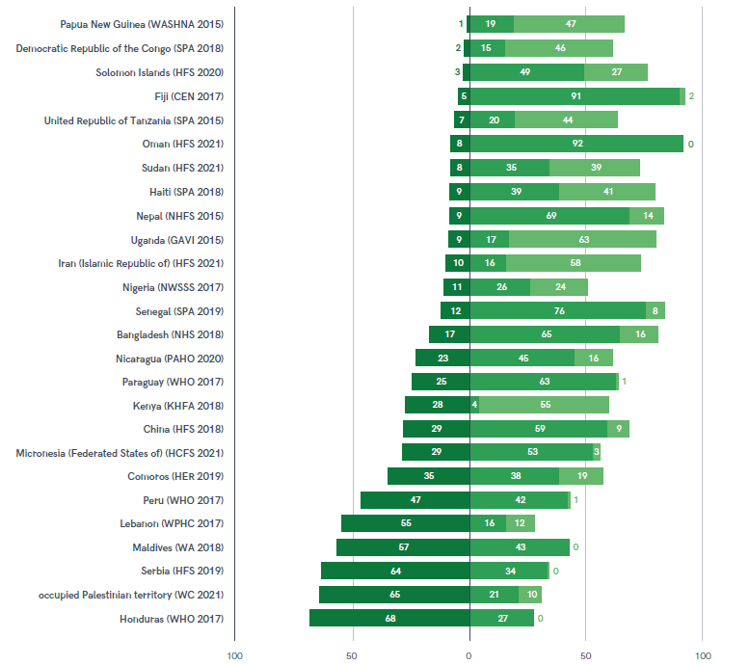

Slide 20
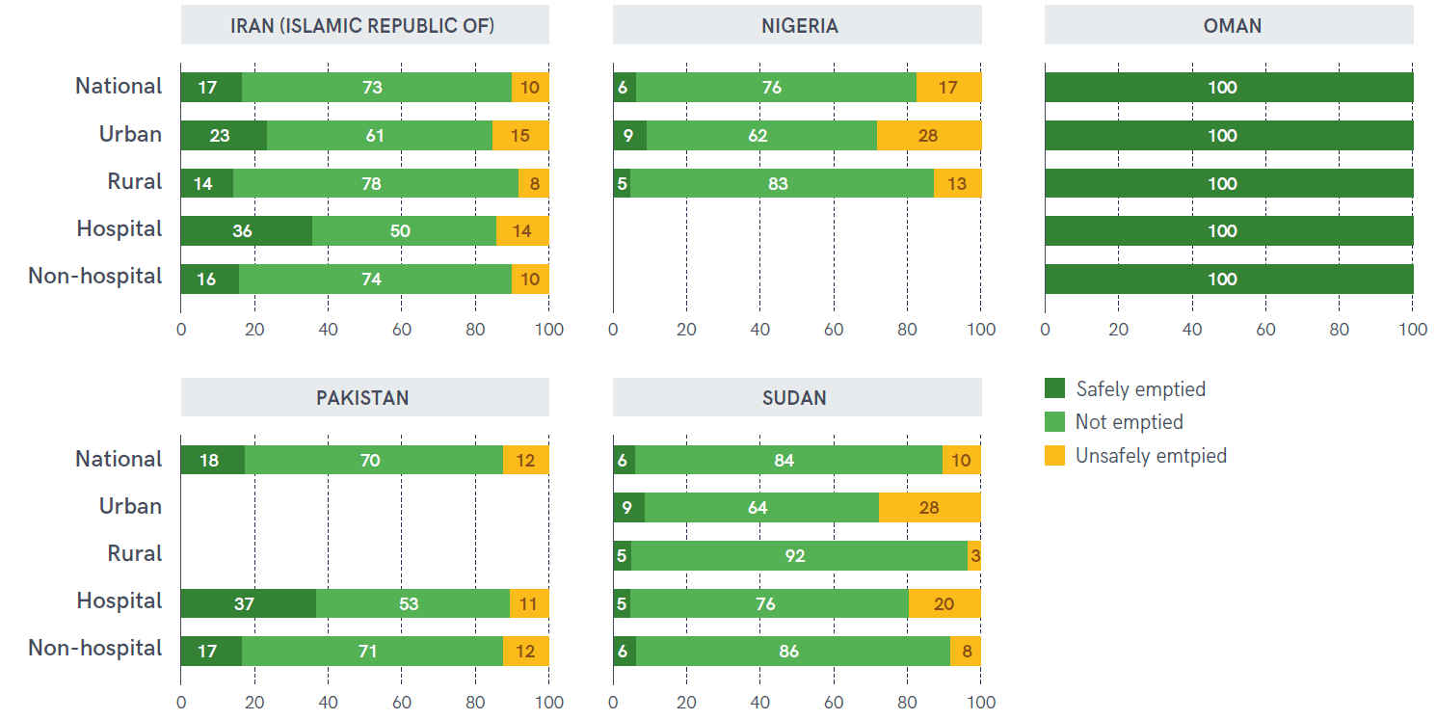

Slide 21
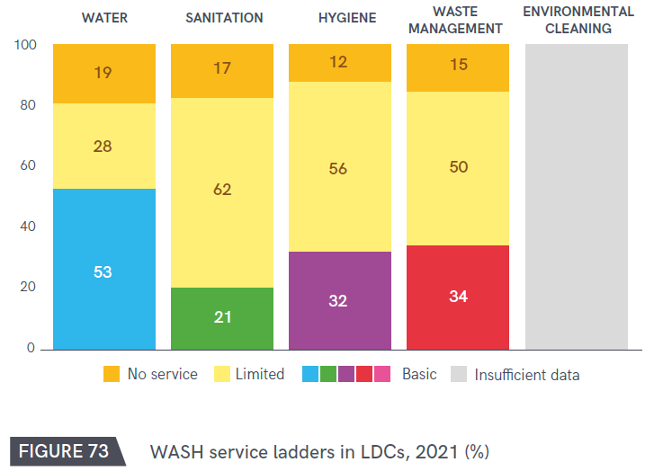
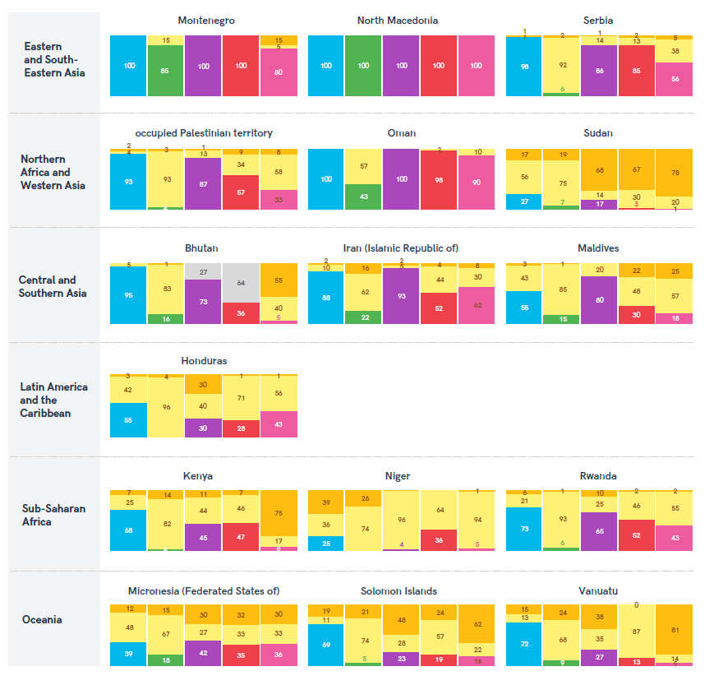
Multiple ladders
Four ladders: LDCs, fragile contexts,
sub-Saharan Africa
Five ladders: available for 16 countries

Slide 22
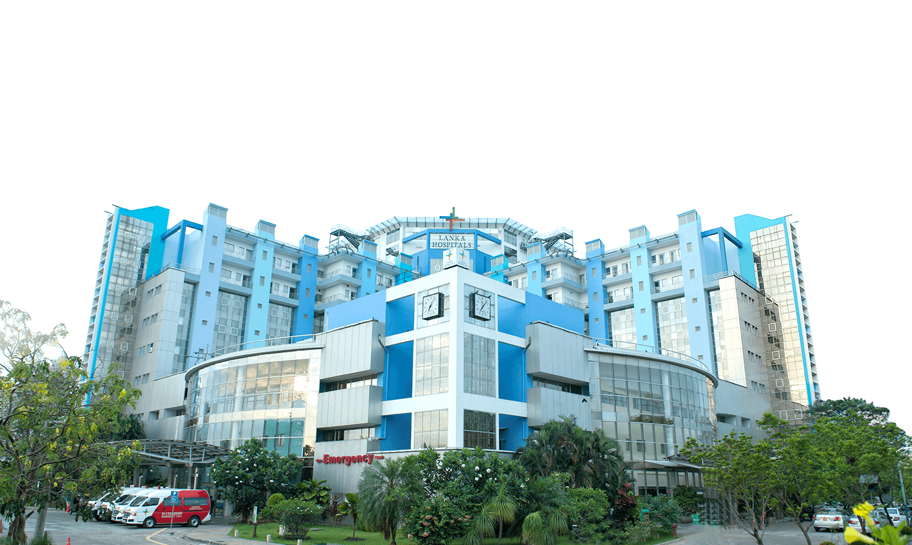
Thank you!
info@washdata.org

Slide 24
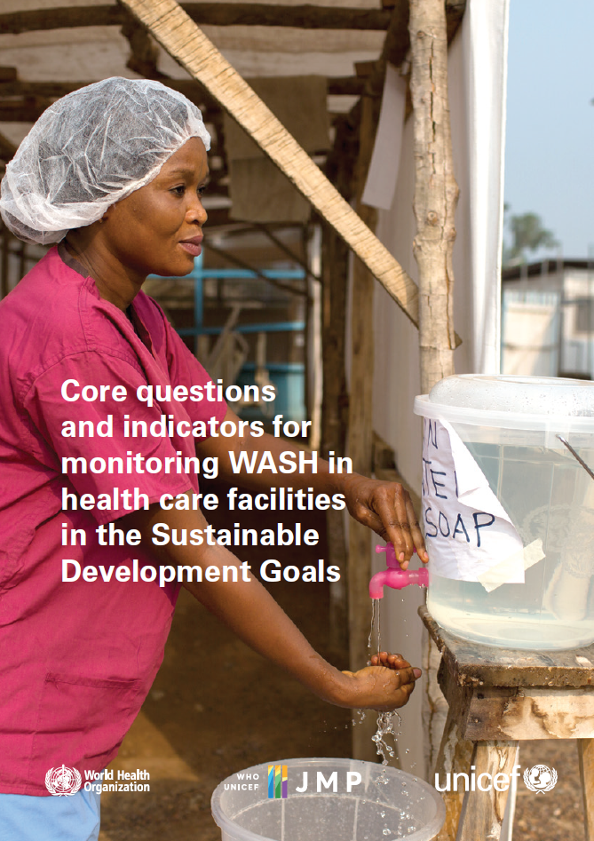
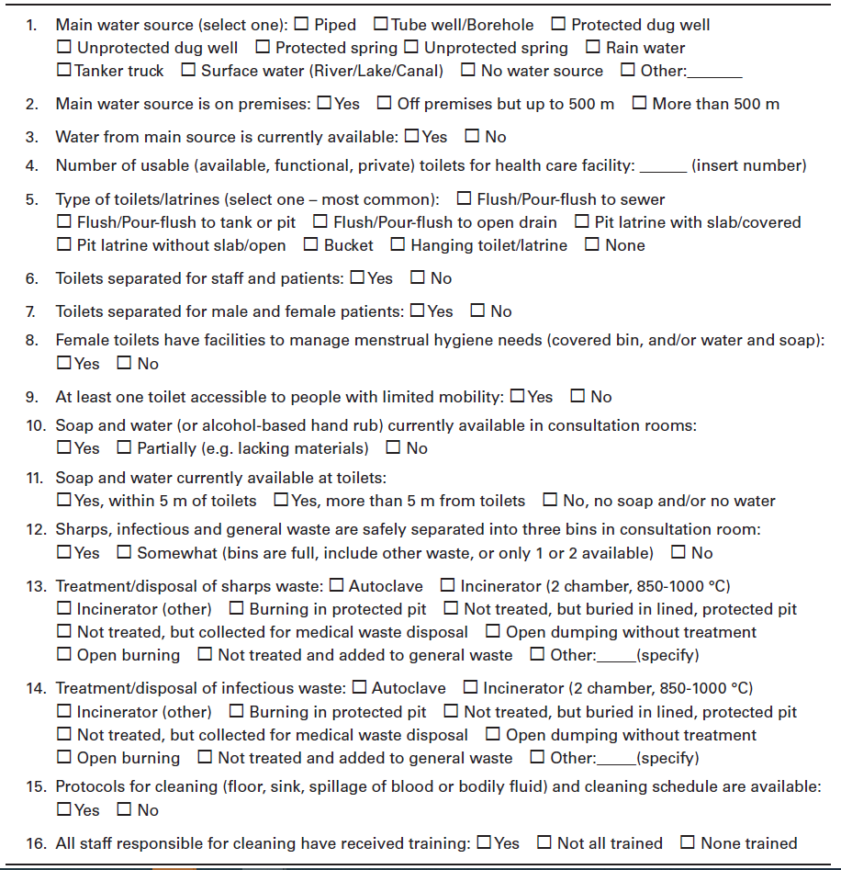

Slide 25
Numbers of data sources

Slide 26
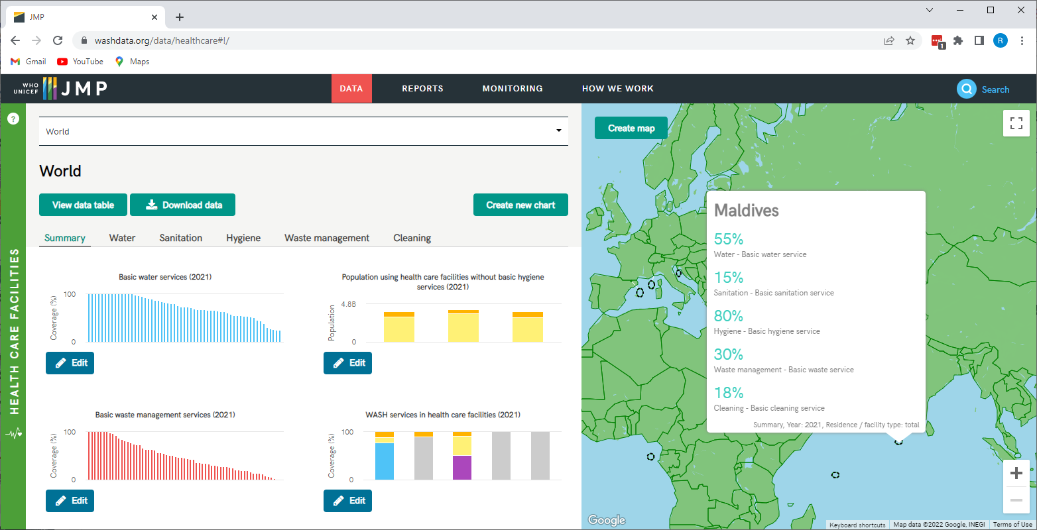

Slide 27
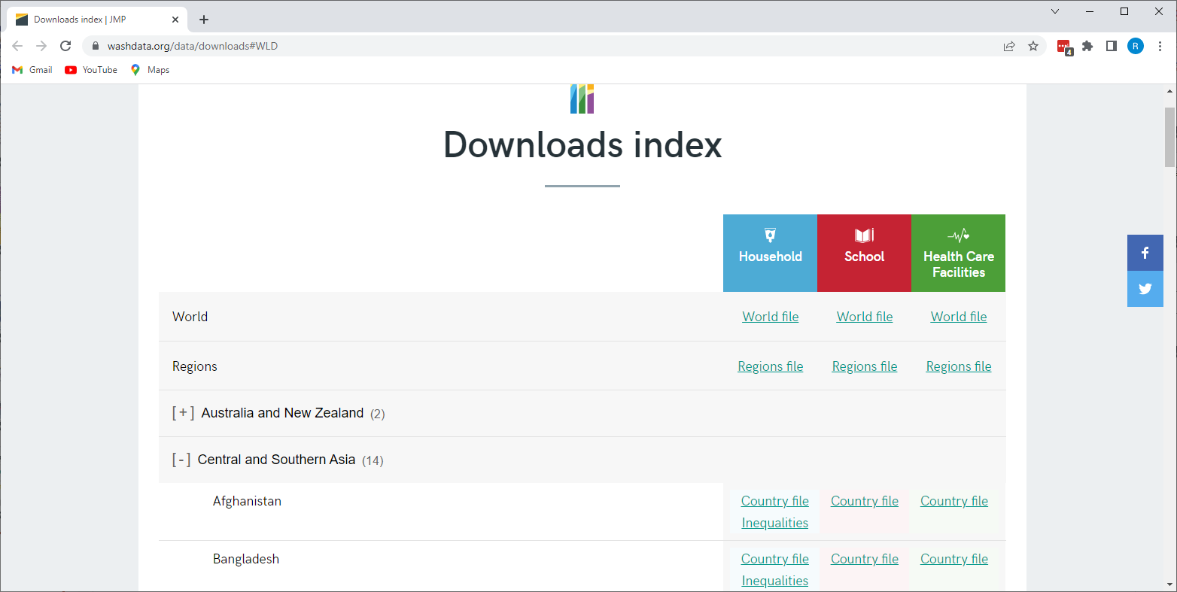

Slide 28
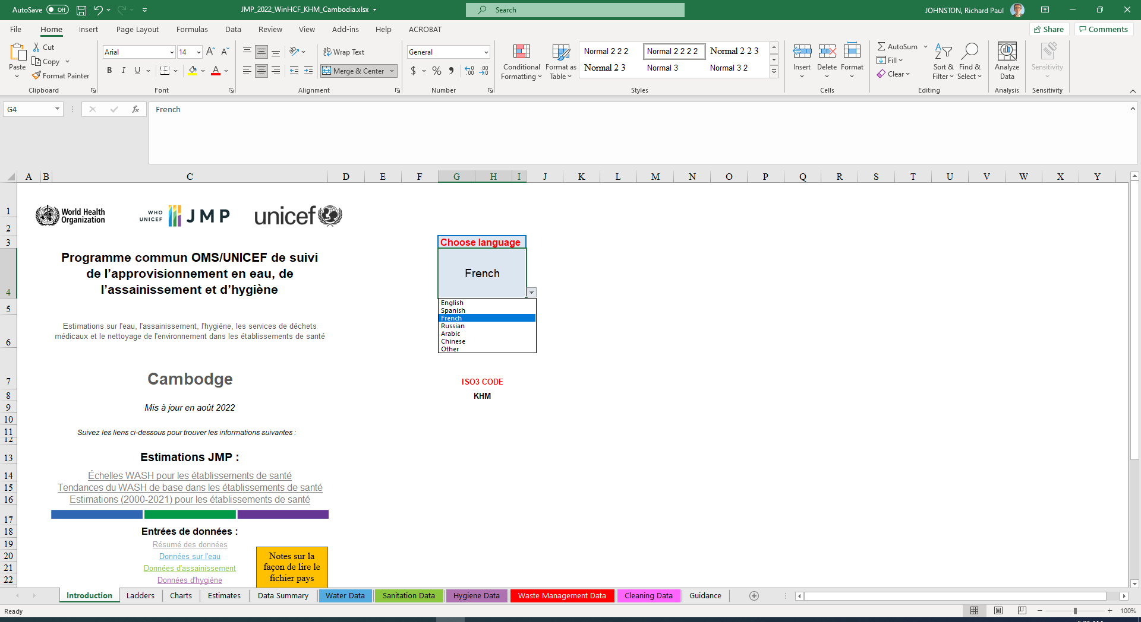

Slide 29
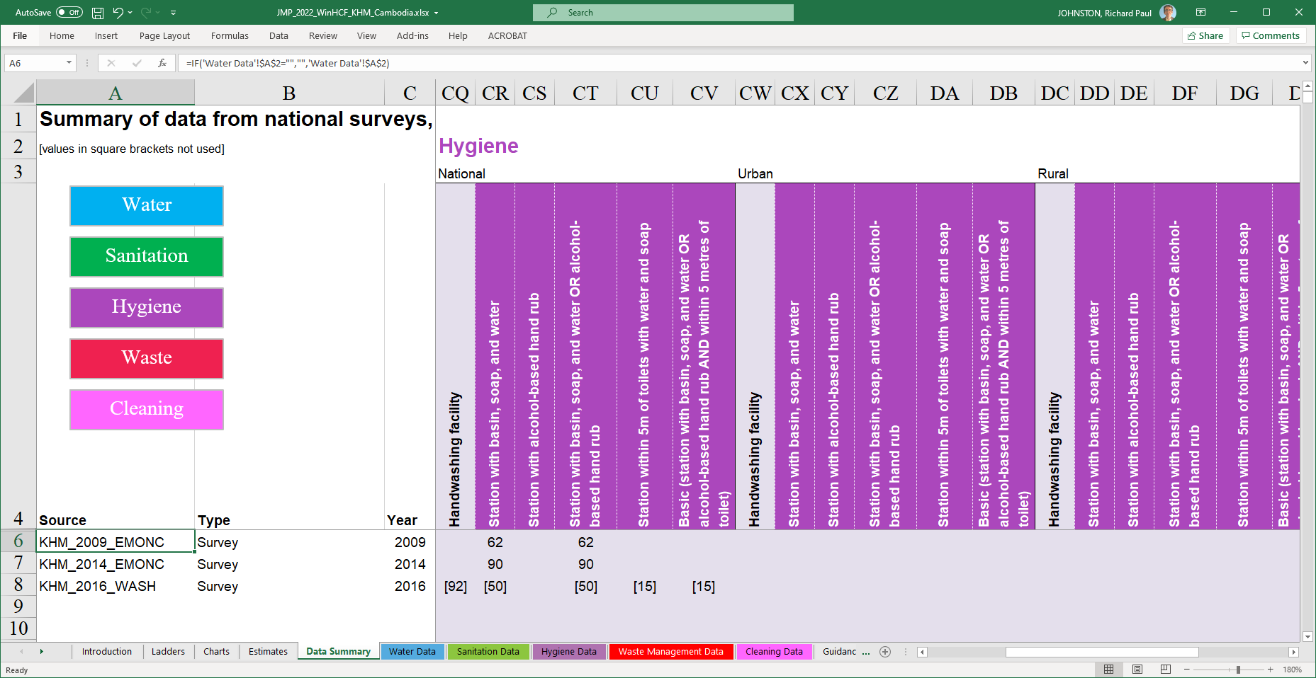

Slide 30
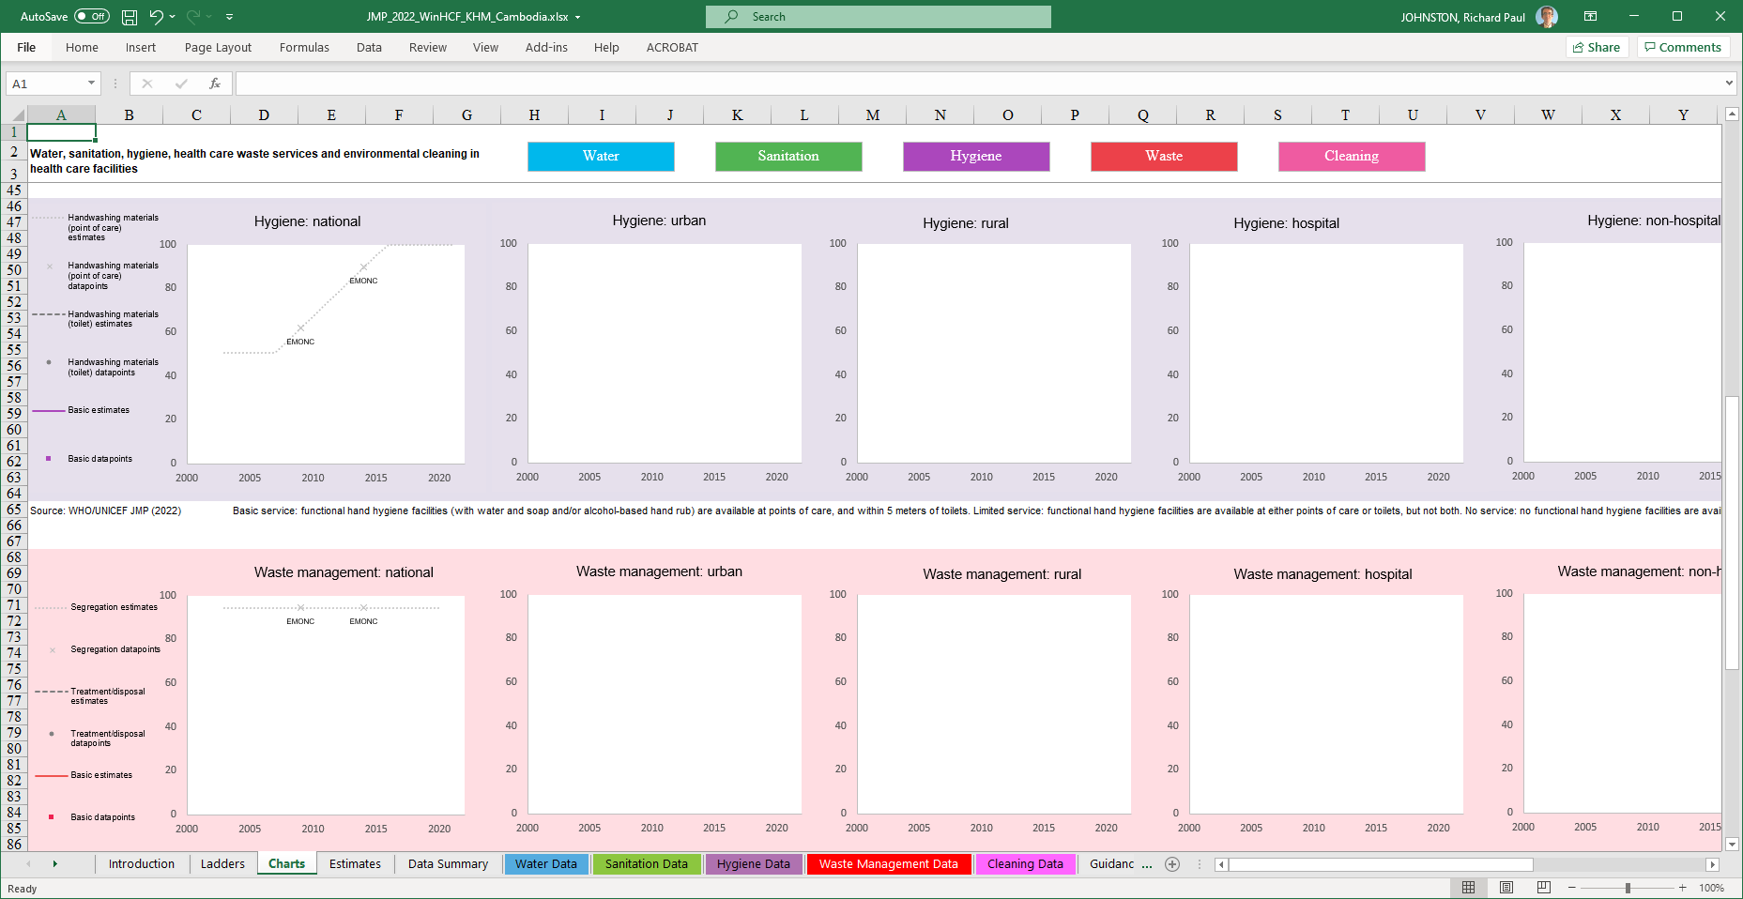

Slide 31
