Slide 1
Technical Series on WASH, waste and electricity in health facilities
Healthcare Waste and Green Technologies
5 December 2023
Dr Ute Pieper, WHO Consultant (WHO WASH)

Slide 2
Key facts
Climate change and the health sector
Healthcare's climate footprint is 4.4% of the global total. If the global health care sector were a country, it would be the fifth-largest greenhouse gas emitter on the planet.
Source: Arup / HCWH, Healthcare's climate footprint, 2019

Slide 3
Key facts
Sources of greenhouse gas emissions
Globally, the 3 primary sources of greenhouse gas emissions in 2019 were
electricity and heat (31%)
transportation (17%)
manufacturing & construction (12%)
All the shown sectors are directly or indirectly connected to carbon footprint of the health sector.
Waste in specific: ~ 3,2 %
Sum: 51.0619 billion t
Source: https://www.climatewatchdata.org/data-explorer/historical-emissions
Notes:
A greenhouse gas (GHG) is a gas that absorbs and emits radiant energy at thermal infrared wavelengths, causing the greenhouse effect. The primary greenhouse gases in Earth's atmosphere are water vapor (H₂O), carbon dioxide (CO₂), methane (CH₄), nitrous oxide (N₂O), and ozone (O₃).
These GHGs are shown as CO₂-eq: it is a metric measure used to compare the emissions from various greenhouse gases on the basis of their global-warming potential (GWP). E.g. On a 100-year timescale, methane has 28 times greater global warming potential than carbon dioxide and has therefore a higher GWP.

Slide 4
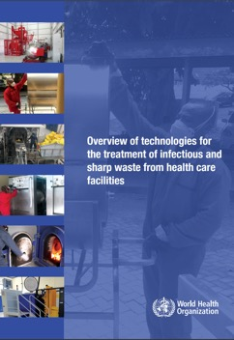
Selecting of treatment technologies
The choice of treatment system is contextual and involves consideration of:
National & international regulations
Environmental and occupational safety factors
Type & quantity of waste generated
Technology capabilities and requirements
Available budget (for investment and maintenance)
Operation and maintenance requirements
Infrastructure (space)
Available energy (electricity, water, fuel etc.)
Available final disposal options (recycling, landfill)
WHO’s overview of technologies provides guidance for health care facility administrators and planners, WASH and infection prevention control staff, national planners, donors and partners.
2
https://www.who.int/publications/i/item/9789241516228

Slide 5
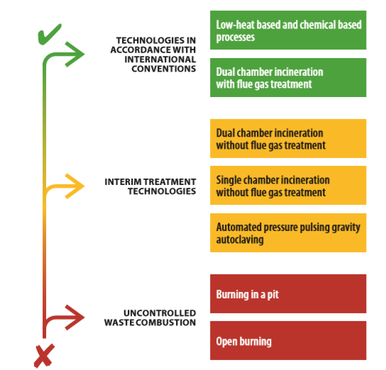
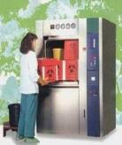
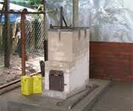
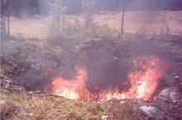
Hierarchy of waste treatment options
Preferred options: Technologies in accordance with International Conventions
Interim solutions: Technologies used to incrementally improve practices and move towards meeting international standard
Last resort option: Where there are no alternative treatment options
2
Segregation
Collection
Transport
Storage
Treatment
Final disposal
Minimization

Slide 6
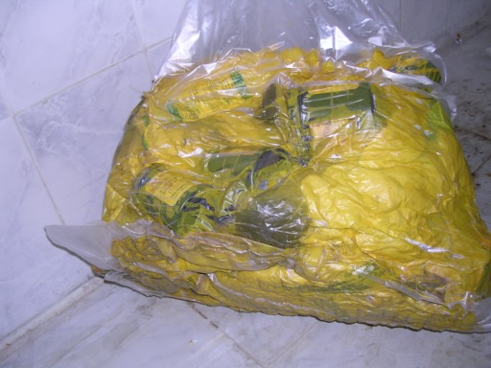
Low heat: Vacuum Autoclaves
Steam injection
Air is mechanically removed by a vacuum-pump: single pre-vacuum or fractionated vacuum
Decontamination of waste at 121 – 134 °C by steam
Considerations:
Waste is recognizable:
It can be reused (e.g., illicit reselling of vials)
It can be recycled (e.g., plastic of the syringes)
380/400 V or 240 V electricity connection is needed
Reliable water connection and specific water quality (soft water)
Inside -Pressure
Vacuum
Treatment
2 bar
1 bar
0,1 bar
Time

Slide 7
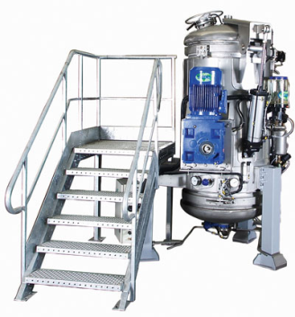
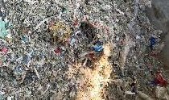
Hybrid Autoclaves (with shredder)
The waste is shredded before treatment ensure that the steam can reach all surfaces of the waste for decontamination.
Considerations:
Shredders are expensive (investment and operation)
380/400 V electricity connection is needed
Reliable water connection
Waste is rendered in small pieces (shredder):
Waste is unrecognizable
Reduction of volume
Illicit reselling of decontaminated materials not possible
Notes:
The French-built Ecodas is a vertical autoclave with an internal shredder. It is a pressure vessel containing a two-shaft shredder inside the vessel. After the waste is placed in the vessel at the top and sealed, the waste is first shredded and then steam is injected into the vessel. Since the inside of the whole vessel is heated to 138 °C and a pressure of 3.8 bars, only about 10 minutes of exposure is needed to reach high levels of disinfection, after which cooling water is sprayed along the outside walls of the inner chamber to cool the waste to 80 °C. A vacuum cycle is used to condense steam from the waste after which the bottom lid is opened to unload the treated waste at the bottom onto a bin.
Hybrid steam treatment systems with internal shredding can be used for anatomical waste or body parts.

Slide 8
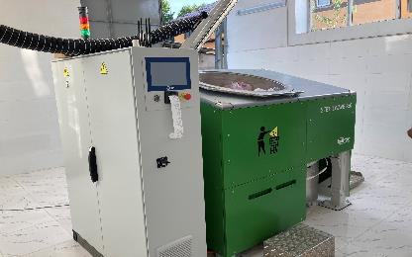
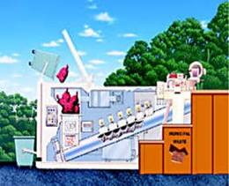
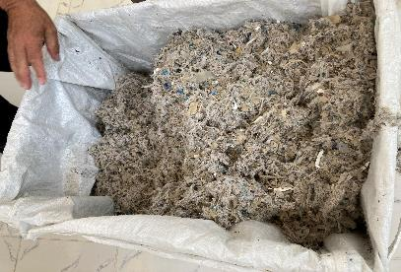
Waste Microwaves with shredder
In modern non-vacuum system, waste must be shredded prior to the disinfection process.
The shredded waste gets in the treatment chamber and will be transported by a screw for a defined time. Here, it will be penetrated by steam at a temperature of about 100 – 110°C.
The steam will be produced by microwaves, or the transporting screw will be heated by thermal oil.
Considerations:
Shredders are expensive (investment and operation)
380/400 V electricity connection is needed
Waste is unrecognizable / reduction of volume / NO Illicit reselling of decontaminated materials possible
No or little use of water
Note: waste must be humid to guarantee heating up by the microwaves!
Some microwaves have a water injection technology included.

Slide 9
With or without shredder?
Electricity considerations
Microwave with shredder
Autoclave without Shredder
Electricity: 380/400 Volt
Water connection (some brands)
Electricity: 380/400 Volt
Water connection
Quality of water for steam generation:
soft water / demineralized water
Wastewater connection
Capacity kg / cycle
Note: one cycle of a washing machine consumes 0,6 to 1 kWh (7 kg/cycle) = 500 kg / cycle would be 42-71 kWh (like the autoclave in this example)

Slide 10
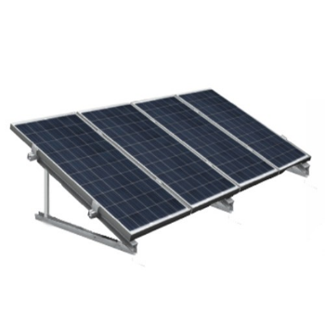
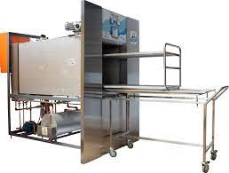
Case Study: solar energy use for autoclaving in Madagascar
Result of the UNDP GEF project Africa
Installation of an 80-liter waste autoclave in a referral hospital (15 kg of infectious waste per day)
Infrastructure:
Housing was constructed (storage room, autoclave room)
Electricity connection: high voltage (3-phase), 380 Volt
Water connection
Obstacle: not sufficient budget for electricity
Solution:
solar PV panels of total 3 kW capacity based on a Silicon monocrystal technology was installed on the roof (including 200 Ampere Batterie)
The PV system was installed in summer 2018
providing about 25% of the total electricity consumption of the hospital

Slide 11
Conclusions/recommendations
Think out of the box:
How to minimize the generated waste?
Is reverse logistics possible to prevent onsite waste treatment
Can central waste treatment technologies be used?
Is the solarization of the HCF an option to operate non-incineration technologies?
The local situation must be assessed to select the best available option for the specific situation (water, electricity, space, capacity, budget…)
Alternative treatment technologies should be preferred to incineration (no greenhouse gas emissions, no hazardous ash)
Technologies with integrated or post shredder is more energy (and cost) intensive as an additional process is included – advantage: the waste is unrecognizable.
The cost of the technology is not only the investment but also the ongoing operation and maintenance costs.

Slide 12
Thank you and Join the Action
For more information and to get involved contact:
washinhcf@who.int
WASH in HCF knowledge portal:
www.washinhcf.org
Twitter: @WASH_for_health

Slide 13
Technical resources
Documents & Tools
Global analysis of health care waste in the context of COVID-19 (2022)
WASH and COVID 19 technical brief (2020)
Overview of technologies for the treatment of infectious and sharp waste from health care facilities (2019)
WHO Safe management of wastes from health care activities (2017)
IPC/WASH Covid guidance
WHO manifesto for a healthy recovery from COVID-19: prescriptions and actionables for a healthy and green recovery (2020)
Compendium of WHO and other UN guidance on health and environment (section on priority settings, including health care facilities (2021)
WASH FIT Tool
Websites & Social Media
Videos & Courses
Cleaning and Disinfection
Waste Management
Training modules in health-care waste management
COVID-19 and work: Staying healthy and safe at work during the COVID-19 pandemic
Healthy and safe telework
Occupational health and safety for health workers in the context of COVID-19
All-Hazard Rapid Response Teams Training Package
Occupational safety and health in public health emergencies: a manual for protecting health workers and responders
HealthWISE - Work Improvement in Health Services
WHO WASH health care waste page
WASH in Health Care Facilities portal
WHO Infection prevention and control page
WHO occupational health page
Infographics
Sudden increases in volumes
Keeping health workers safe
Follow the waste hierarchy model
Nearly 1/3 of PPEshipped cannot be safely bagged or stored
The COVID-19 response is generating a mountain of extra waste
Training
SEARO- Certificate in health care waste management
Global- OpenWHO e-learning course on standard precautions in health-care waste management
HCWM module of WASH FIT
3-day basic course on HCWM
Training modules in health-care waste management - 25 Modules
Environmental cleaning in the context of Covid-19.
Monitoring and valuing WASH and waste services in health care facilities for safer, more equitable care.

Slide 14
Health Care Waste & Green Technologies
UNDP DIGITAL HUB & INDONESIA COUNTRY OFFICE
5 DECEMBER 2023

Slide 15
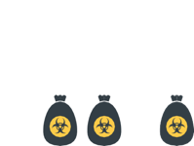
Challenges of Medical Care Waste and Green in Indonesia
Poor Visibility
Poor Waste Segregation
Inefficiency
Incomplete and Delayed Report
VS
Unmatched Treatment
Capacity Vs. Waste Burden
Multiple Stakeholders
(MoH, MoEF, third party)

Slide 16
Negative Impact
High Cost
Illegal Dumping
Health and
Environmental Hazard or
Contamination

Slide 17
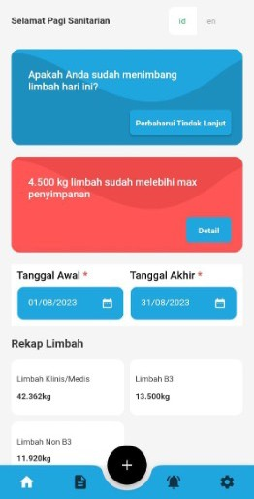
What is ME-SMILE?
MEDICAL WASTE IN SMILE
Real-time management and monitoring of medical waste based on website technology and mobile applications integrated with
IOT (Internet of Things) Digital Scales and QR Label Scanners that are efficient and easy to use for accountable labeling, weighing,
recording and reporting of medical waste data.
Technological innovation to strengthen
the medical waste chain system in Indonesia.

Slide 18
ME-SMILE Project Design
Software
Hardware
Human Resource
Informed-Decisions

Slide 19
ME-SMILE Key Features
Cloud Server
IoT Scales
Ministry of Health’s Mobile App and Dashboard
Operation in Ministry of Environmental
and Forestry’s Dashboard
Identified segregated waste bags from unique code (QR)
Real Time, Accurate, and Accountable Data

Slide 20
Supporting Policies
 | Waste-related | Digital-related
Global | WHO Safe management of wastes from health-care activities, 2nd ed, 2014 Overview of technologies for the treatment of infectious and sharp waste from health care facilities, WHO 2019 | UNDP Digital Strategy 2022-2025
Indonesia Ministry of Environment and Forestry (MoEF) | Law number 32 year 2009 on Environment Government Regulation number 22 year 2021 on Environmental Protection and Management. Minister of Environment and Forestry Regulation number P.56 year 2015 on Healthcare Waste Management.
Indonesia Ministry of Health (MoH) | Law number 17 year 2023 on Health Government Regulation number 66 year 2014 on Environmental Health Minister of Health Regulation number 2 year 2023 articulates the Government Regulation number 66 year 2014 on Environmental Health Minister of Health Regulation number 18 year 2020 on Regional-Based Healthcare Waste Management. Minister of Health Regulation number 17 year 2019 on Environmental Health in Hospitals | Indonesian Health Transformation, 6th Pillar - Transformation of Health Technology Digital Health Transformation Strategy 2024

Slide 21
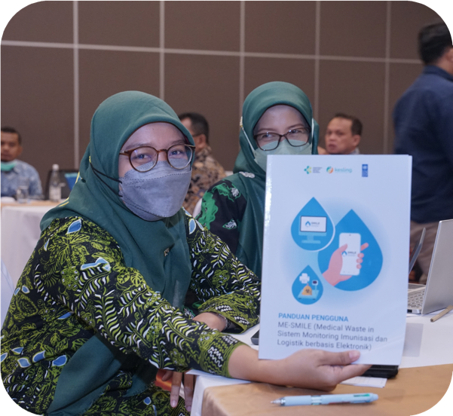
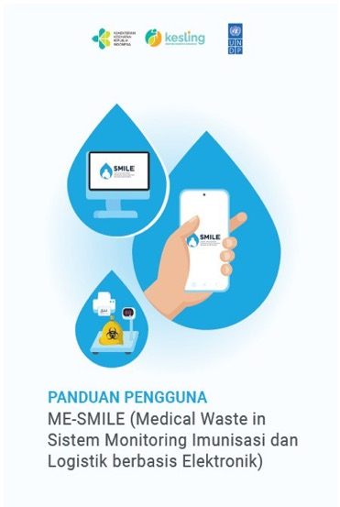
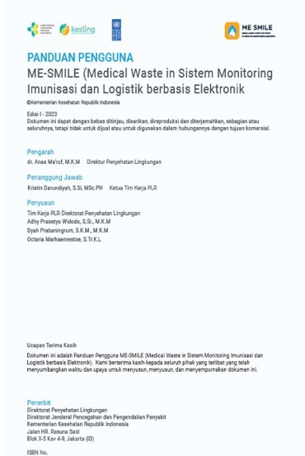
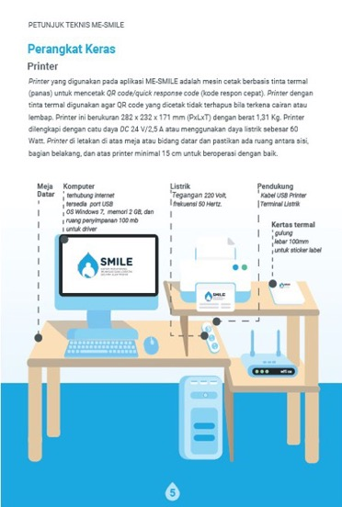
ME-SMILE Technical Guidelines 2023

Slide 22
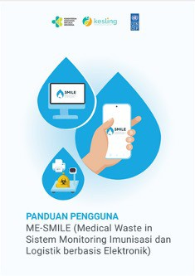
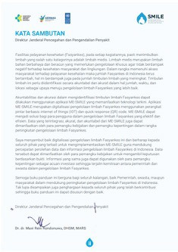
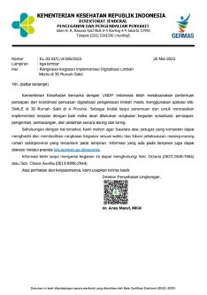
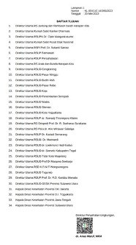
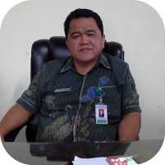
ME-SMILE Technical Guidelines for Health Facilities
Standard Operating Procedure (SoP)
Implementation
SoP is developed signed by
Dr. dr. Maxi Rein Rondonuwu, DHSM, MARS
Director General of Disease Prevention and Control
The implementation is regulated by the MoH
dr. Anas Ma’ruf, M.K.M.
Director of Environmental Health

Slide 23
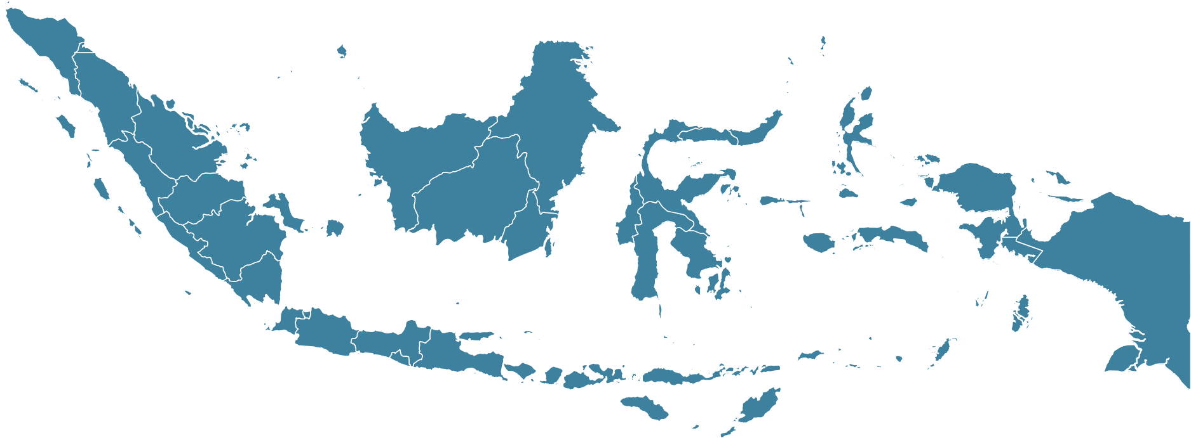
ME-SMILE Piloting and Scale-up
2022 3 health facilities in 2 Provinces
2023 33 hospitals in 4 provinces

Slide 24
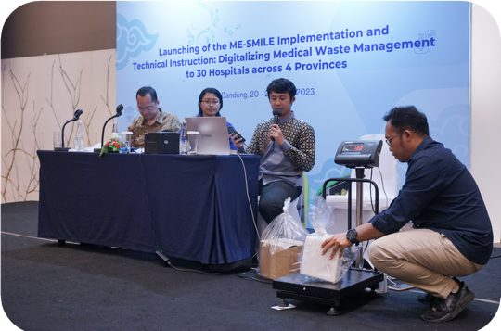
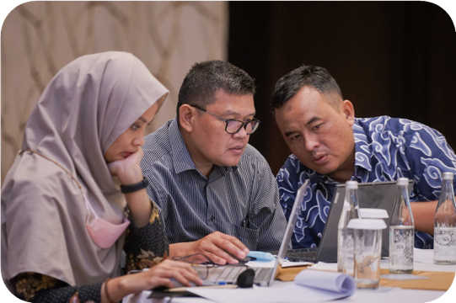
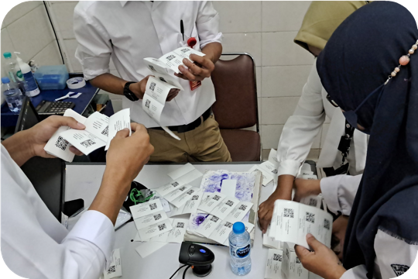
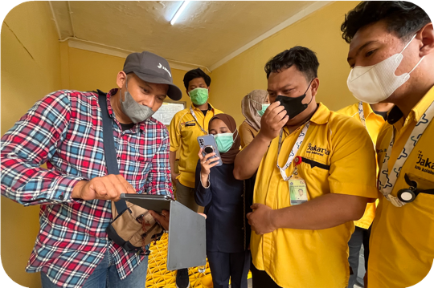
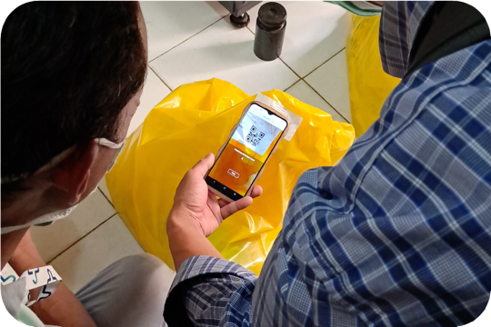
ME-SMILE Piloting and Scale-up
2022: 3 health facilities in 2 Provinces • 2023: 33 hospitals in 4 provinces

Slide 25
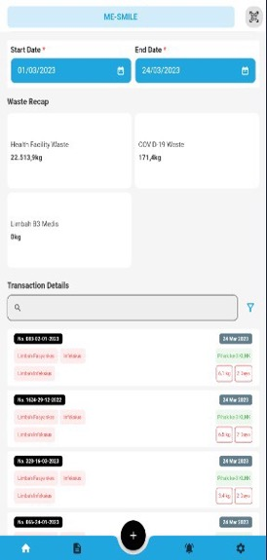
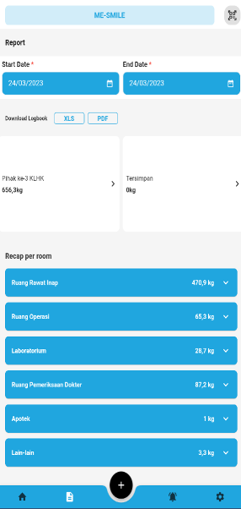
ME-SMILE Mobile Application
Scan QR code
Add data
Waste recap
Reports
Notifications
Profile

Slide 26
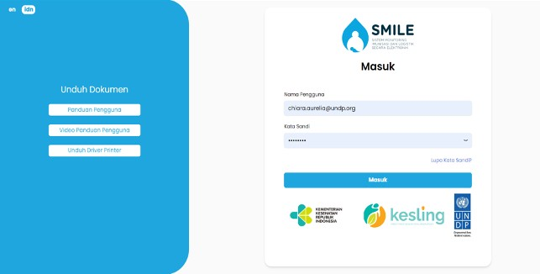
ME-SMILE Web Portal
Room/Ward List
Print label
Follow-up
Reports - Graph
Notifications
Profile

Slide 27
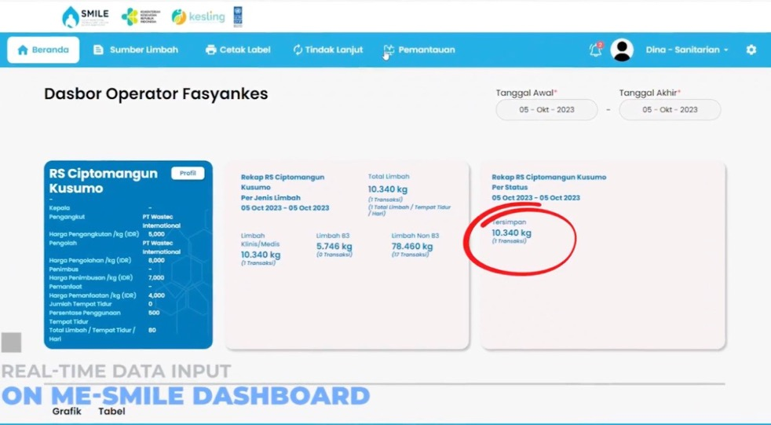
ME-SMILE Web Portal

Slide 28
ME-SMILE Corrective Measures Alert System
1 Late Waste Pick-up
2
Generated Waste > Storage Capacity
3 ^{Late Waste Treated}
4 Generated Waste > Capacity of Treatment

Slide 29
ME-SMILE Achievements in numbers
1.900 ton
Total Waste Generated
1 ton
Average of Daily Waste Generated
583.741
Total transactions in ME-SMILE
32 Hospitals &
1 Health Centre
in 18 Districts,
4 Provinces
Implement ME-SMILE (July 2023)
33
IoT scale installed in 33 Health Facilities
841
Sanitarians trained
3 Hours
Time Saving
(manual vs ME-SMILE)
Data as of 1 Oct 2023

Slide 30
ME-SMILE End to End Standard Operating Procedures
1
QR Code Labels Printing + Sticking
+ Distributing
2
Segregation
3
Moving waste to temporary storage
4
Weighing & deciding the next step
5
Hazardous waste temporary storage/ cold storage
A
6
Loading, recap of results, and
manifest filling
7
Transporting
8
Treatment
9
Disposal or Recycle
Waste is transported immediately
B
Starting from here, it is processed by a third party (Transporter)
₁₀ Loading, recap
6 7
8
9
11
12
Incineration
QR coded residue bag
Weighed
waste residues
Hazardous
waste temporary storage
of results, and manifest filling
Transporting
Landfill
Internal waste treatment using
incinerator
Starting from here, it is processed by a third party (Transporter)
C
6
Autoclaved/ Chlorinated/ Microwaved
7
QR coded
non-hazardous waste bag
8
Weighed
non-hazardous waste bag
9
Non-hazardous waste temporary storage
₁₀ Loading, recap
11
Transporting
12
Recyclers
of results, and manifest filling
Internal waste treatment using
autoclave
Starting from here, it is processed by a third party (Beneficiary Transporter)

Slide 31
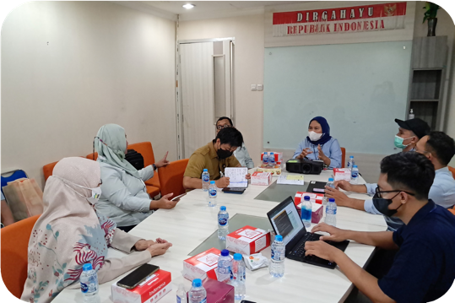
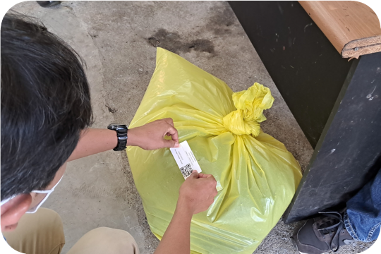
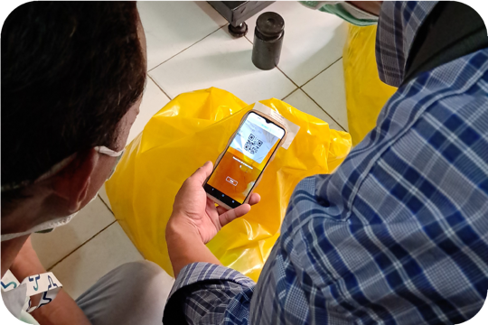
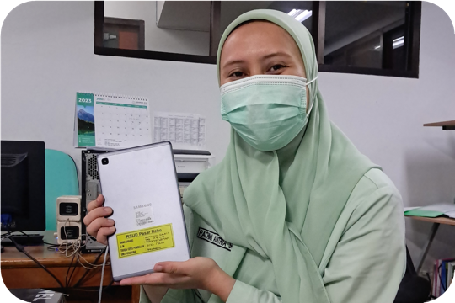
ME-SMILE Result
The initiation of ME-SMILE, 100% reporting rate and 100% are in complete report has been maintained.
The system has shortened the duration of weighing
process during waste loading in hospital from 3 to 0.5 hour, and increased the accuracy
of measuring the weighing of waste during collection and transporting.

Slide 32
ME-SMILE Benefit
Cost efficiency
Safe environment and better health
Segregated waste
(infectious waste costed more than non-infectious)
Less contamination due to segregated waste
Increased weight accuracy
QR coded scanning process:
minimize direct contact of operator to waste while weighing, loading & data input
Recycled waste for (health facility) income generating
Monitor waste location
Safe time & human resources
More control to waste

Slide 33
ME-SMILE Key Uptakes
Government Engagement
Software: ownerships of source code, open source
Field based sanitarians, transporters - involvement
Show evidence or example from UNDP (similar solution)

Slide 34
Ask Me any ME-SMILE things...
a smarter way to manage waste in health facilities

Slide 35
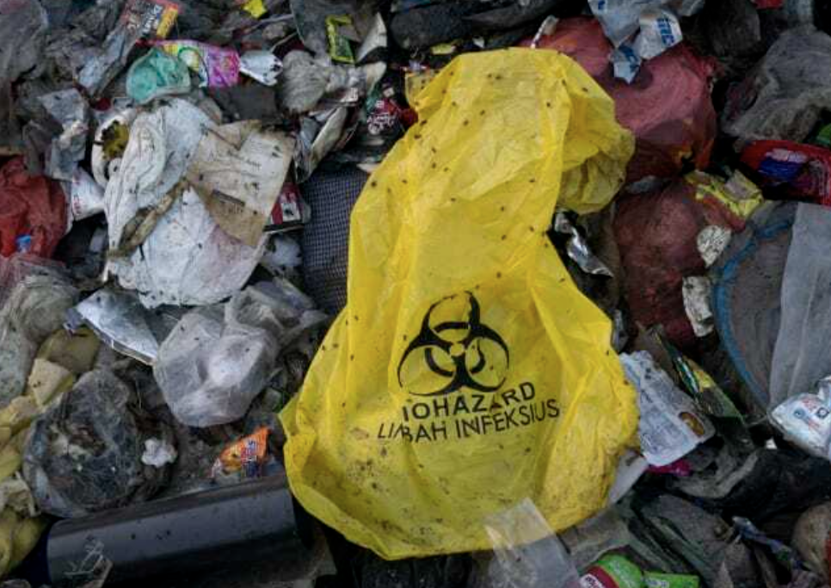
Greener and Safer Healthcare Waste equipment
What motivated UNICEF EAPRO to focus on health care waste equipment?
COVID-19 context increased the volume of waste to treat
Immunization COVID-19 workplans lacked:
Resources
Infrastructures
Tools
Budgets
Green and safe equipment
Publications from UNICEF and WHO

Slide 36
What influenced UNICEF EAPRO to green and safe?
“The ultimate aim should be use of non-burn technologies such as autoclaves”… (section 4.3.3)
“Over time, non-burn technologies cost less” … (section 4.3.3)
World Health Organization (Feb ‎2022)‎. Global analysis of healthcare waste in the context of COVID-19: status, impacts and recommendations. World Health Organization.
https://apps.who.int/iris/handle/10665/351189. Licence: CC BY-NC-SA 3.0 IGO

Slide 37
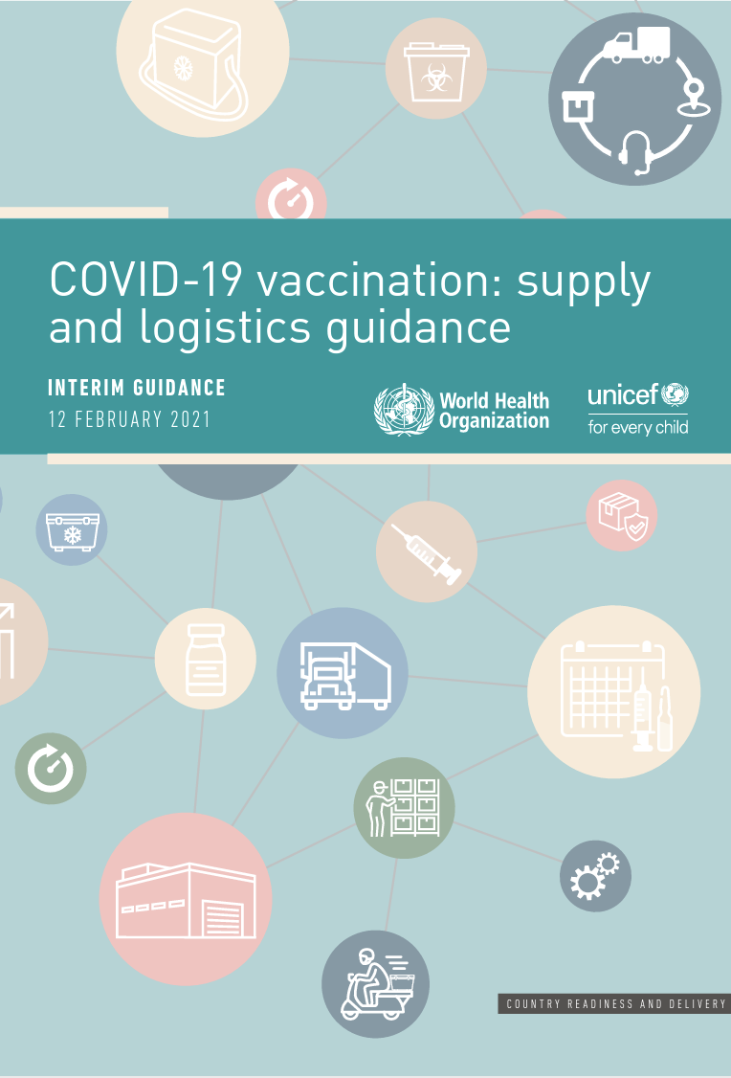
UNICEF & WHO COVID-19 vaccination:
supply and logistics guidance (February 2021)
Section 6 of the guidance:
Follow the national guidelines and codes for final disposal – if these are not available:
Preferably use best available technologies in accordance with the Stockholm Convention, such as decontamination of waste by autoclaving or similar procedures or high-temperature incineration.
World Health Organization & United Nations Children's Fund (‎UNICEF)‎. (‎2021)‎. COVID-19 vaccination: supply and logistics guidance: interim guidance, 12 February 2021. World Health Organization. https://apps.who.int/iris/handle/10665/339561. Licence: CC BY-NC-SA 3.0 IGO

Slide 38
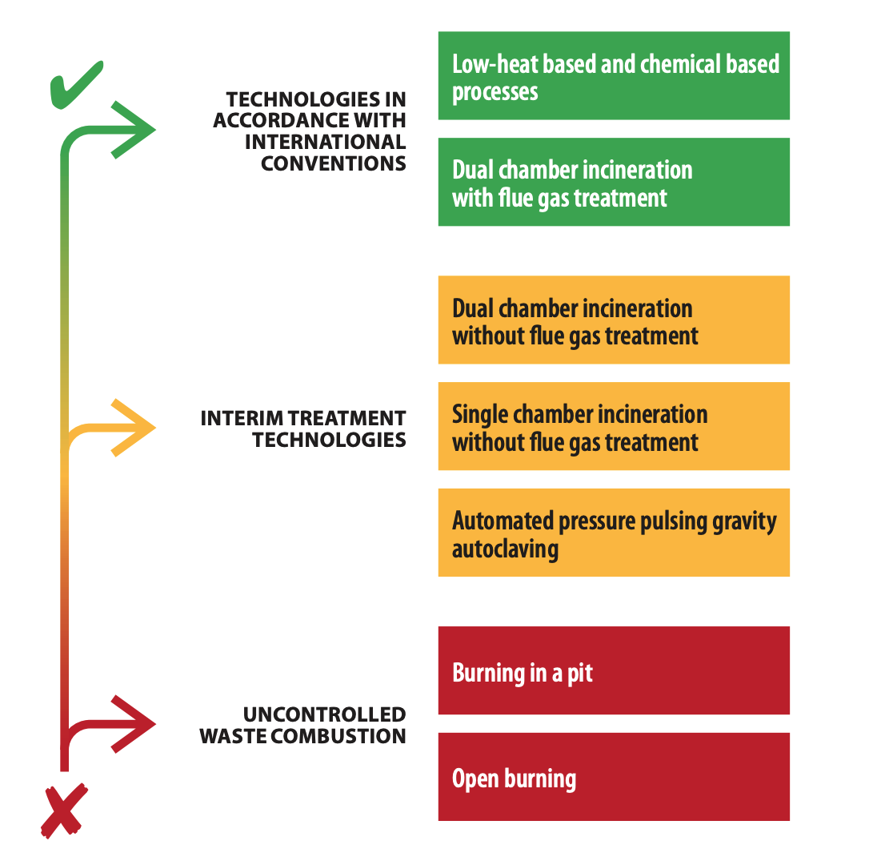
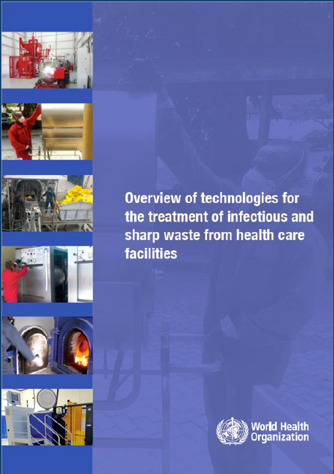
WHO Guide about infectious waste treatment (2019)
Technologies:
. Autoclave
. Microwave
. Heat-Friction
https://www.who.int/publications/i/item/9789241516228
38 | Title of Your Presentation

Slide 39
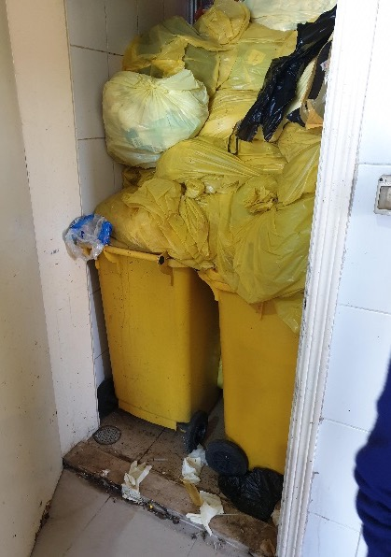
UNICEF EAPRO SOLUTION
Establish a regional LTA to help countries procured high quality, greener and safer equipment
AIMING AT SOLUTIONS THAT WOULD OFFER:
Reduction of unsafe risks to the healthcare workers during waste management operations
Reduction of exposure to dioxins and furans to the health workers, their communities and the environment
Reduction of waste volumes in health facilities; and
Bundled services, such as: installation, training, and 2-yrs warranty of HCW treatment equipment

Slide 40
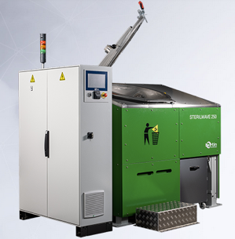
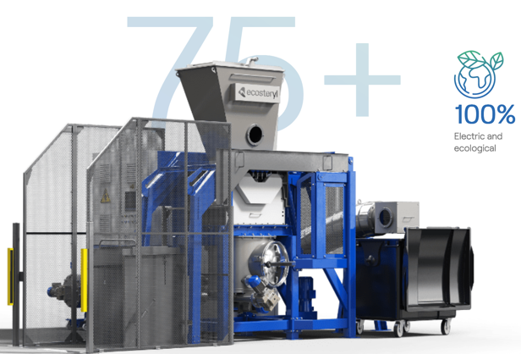
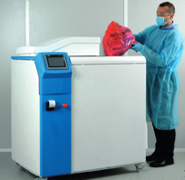
Greener and Safer Healthcare Waste equipment
April 2022 – Published RFI
22 manufacturers and suppliers responded positively
March 2023 – Published RFP
11 manufacturers responded
November 2023 – Awarded 5 LTA
RESULTS

Slide 41
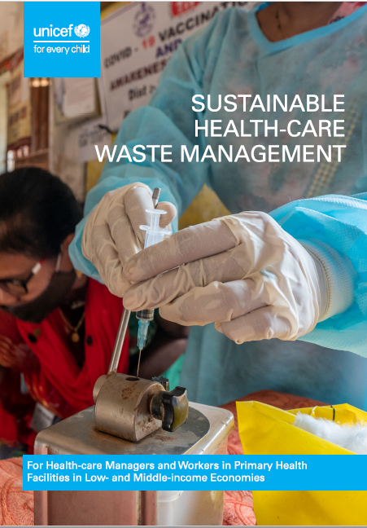
UNICEF EAPRO SUPPORT
How to choose the RIGHT technology according to the COUNTRIES’ CONTEXT
Guidance and Webinar:
A technical guide on how to choose the BEST TECHNOLOGY according to a country’ context, such as: availability of water, energy, operational economy and reduction of carbon emission
A technical guide on how to procure the products using the regional “Long-Term Agreements”
Webinar where each manufacturer will present their product and where best practices will be shared by countries

